Slide 1
Faculty and Staff Advisement Resources
John Yao Associate Director of Student Success for Academic Advisement Center for Student Success

Slide 2
Advisement Resources and Tutorials
My Advisees (for advisors)
My Advisor (for student)

Slide 3
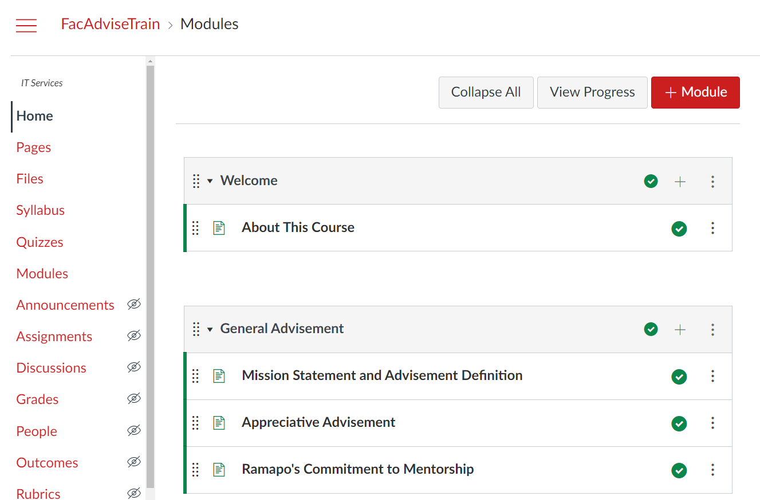
Canvas Advisement Training: How will this help you?
A comprehensive training and development resource for faculty and staff at Ramapo who provide academic advisement to students.
Always accessible to you.
New and seasoned faculty can access the course. Information provided in this course draws from all different areas of the College website and other existing resources, bringing it together in one place for advisors to come back to reference.
Developed and reviewed with the Academic Advisement Council (for faculty by faculty).

Slide 4
Areas of focus
General Advisement: Introduces the College’s approach to academic advising.
Advisement Technology: Provides information and tutorials about our three main applications that assist advisors on campus: Connect, UAchieve, and Web Self Service.
Advisement by Topic: Provides content about various topics that a student and their advisor will encounter throughout their advisement interactions at Ramapo.
Advisement Calendar: Serves as a timeline for the advisor. Each point in the timeline addresses timely information and activities for the advisor at any given point in the student's advisement cycle.
Notes:
Mike Unger

Slide 5
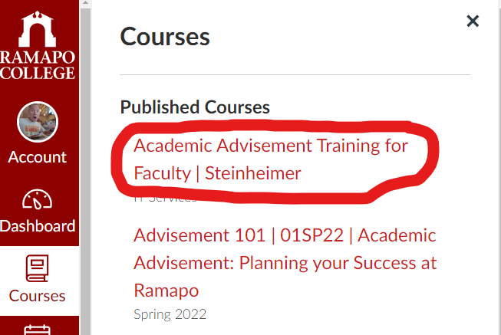
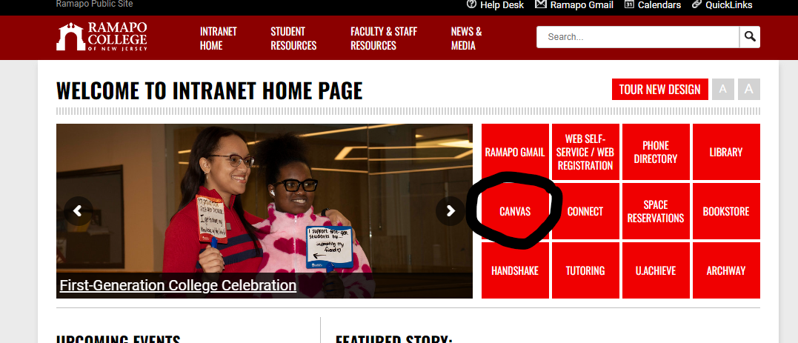
Accessing the modules
All faculty at the College were sent an invite to join the course. If you haven’t done so, please accept the invite.
Log into web.ramapo.edu and click on the link for Canvas.
Click on courses and look for Academic Advisement Training for Faculty.
https://www.ramapo.edu/connect/faculty/
Notes:
Do a walkthrough after sharing this slide.

Slide 6
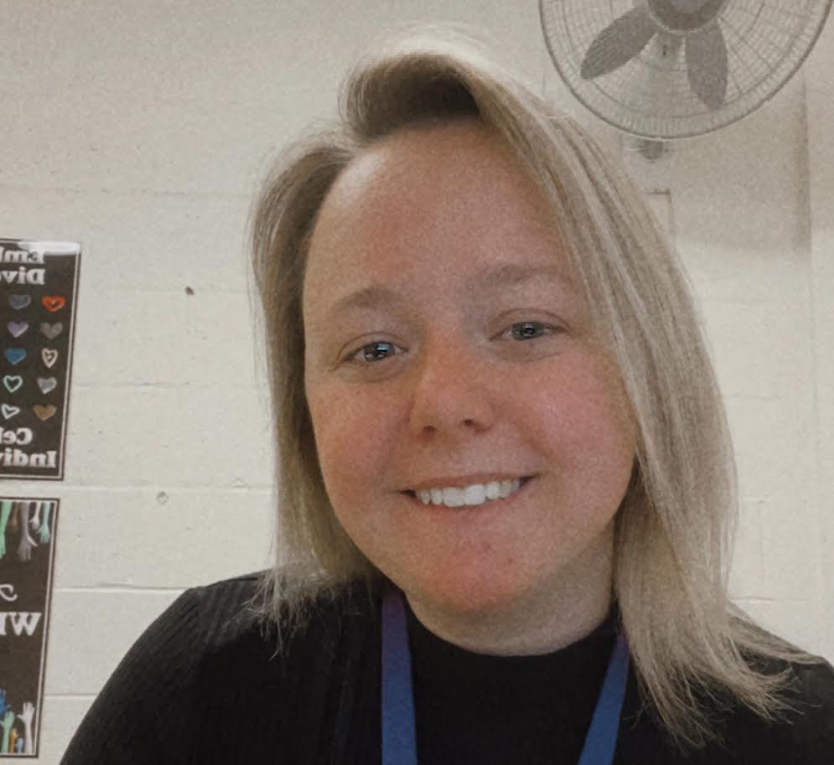
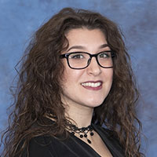
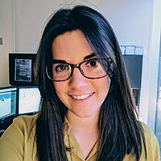
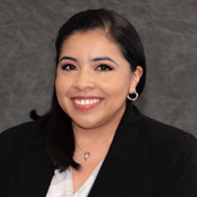
Questions?
Check in with your School Liaison
Megan Greer mgreer@ramapo.edu SSHS Liaison
Caitlyn Campbell ccampbe4@ramapo.edu TAS Liaison
Jessica Steinheimer jsteinhe@ramapo.edu ASB Liaison
Paola Guevara pguevara@ramapo.edu SCA and HGS Liaison

Slide 7
We appreciate your support as we collaborate to support all our students through comprehensive academic advisement so they can graduate in a timely manner.

