Slide 1
Using ChatGPT to Create Engaging Activities & Promote Critical Thinking
Dr. Amy Pizzulo
Ramapo College of New Jersey
Nursing Education

Slide 2
Challenges in Fostering Critical Thinking in Nursing Curriculum
Information overload
Limited clinical exposure
Cultural and ethical considerations
Fear of making mistakes

Slide 3
Application of ChatGPT in the Classroom
Spark of ideas
Unfolding case studies
Role-playing exercises
Review questions

Slide 4
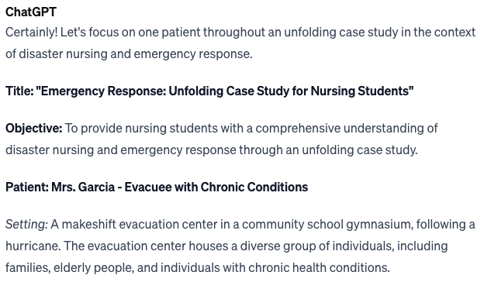
Unfolding Case Studies
“I need an unfolding case study on providing nursing care to one patient during a disaster”

Slide 5
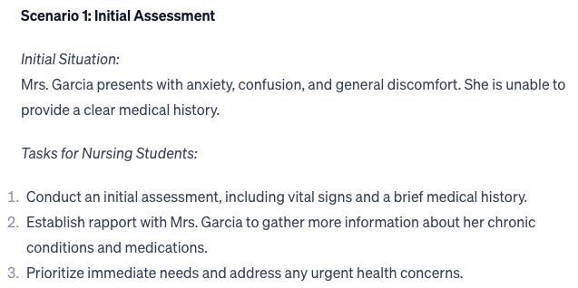
Unfolding Case Study

Slide 6
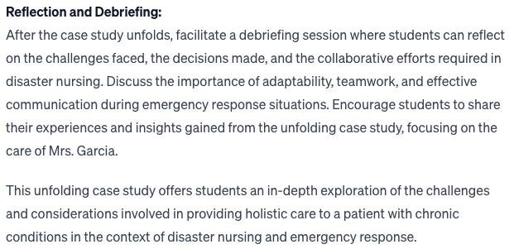
Unfolding Case Study

Slide 7
Role Playing Exercises
“I need a role-playing activity for nursing student learning mental health theories and therapies.”
ChatGPT will provide
Materials needed
Case Scenario Development
Role Assignment
Preparation
Role Play
Debriefing
Feedback
Class Discussion

Slide 8
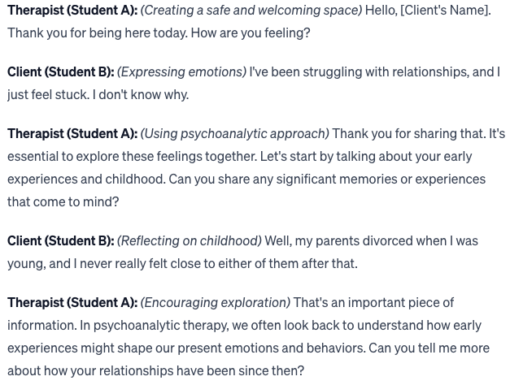
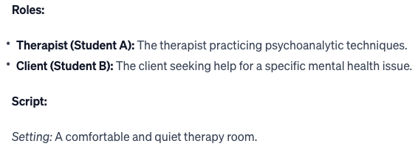
Role Playing Exercises
“Give me a script to help nursing students guess psychoanalytic therapy”

Slide 9
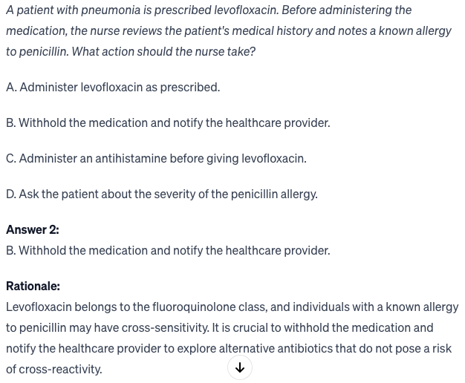
Review Questions
“Provide me with (x) NCLEX style questions with answers and rationales on the topic of nursing care for the patient with pneumonia. Ensure all questions are at the analysis level of Blooms Taxonomy”

Slide 10
Further Prompts for Review Questions
“Make question number 4 more difficult”
“Change the stem of the question to make it nursing assessment based”
“Change the third answer choice to something else”
“Give me another question on the antibiotic amoxicillin”

