Slide 1
TLTR TECHFEST DAY Using AI to generate review questions from videos, slides, and documents March 6, 2024
Anne Marie Flatekval DNP, RN, CNE, NE-BC
Associate Professor of Nursing

Slide 2
Learning Outcomes
At the end of this session the faculty will have the knowledge to be able to:
Utilize various applications to enhance student engagement in the classroom and to attain student outcomes by creating review questions from documents and videos

Slide 3
TLTR Grant Spring 2024
I have received several TLTR grants to enhance active learning in the nursing classroom
March 2020: Use of Augmented Reality Tee shirt to enhance learning in the Health Assessment Course
Fall 2021: Use of App’s in the Classroom to Increase Student Engagement
Fall 2023: Using AI Applications to Create Review Questions for Nursing Students

Slide 4
Applications
Questionwell
Kahoot
Quizizz
Twee
Students use their electronic devices to answer the questions

Slide 5
QuestionWell
Upload documents and can generate review questions
QuestionWell
Go to website
Drag files
Generate questions
Pick reading level
Then click “generate questions”
Export to platforms
(next slide)
For Kahoot is excel: convert to PDF

Slide 6
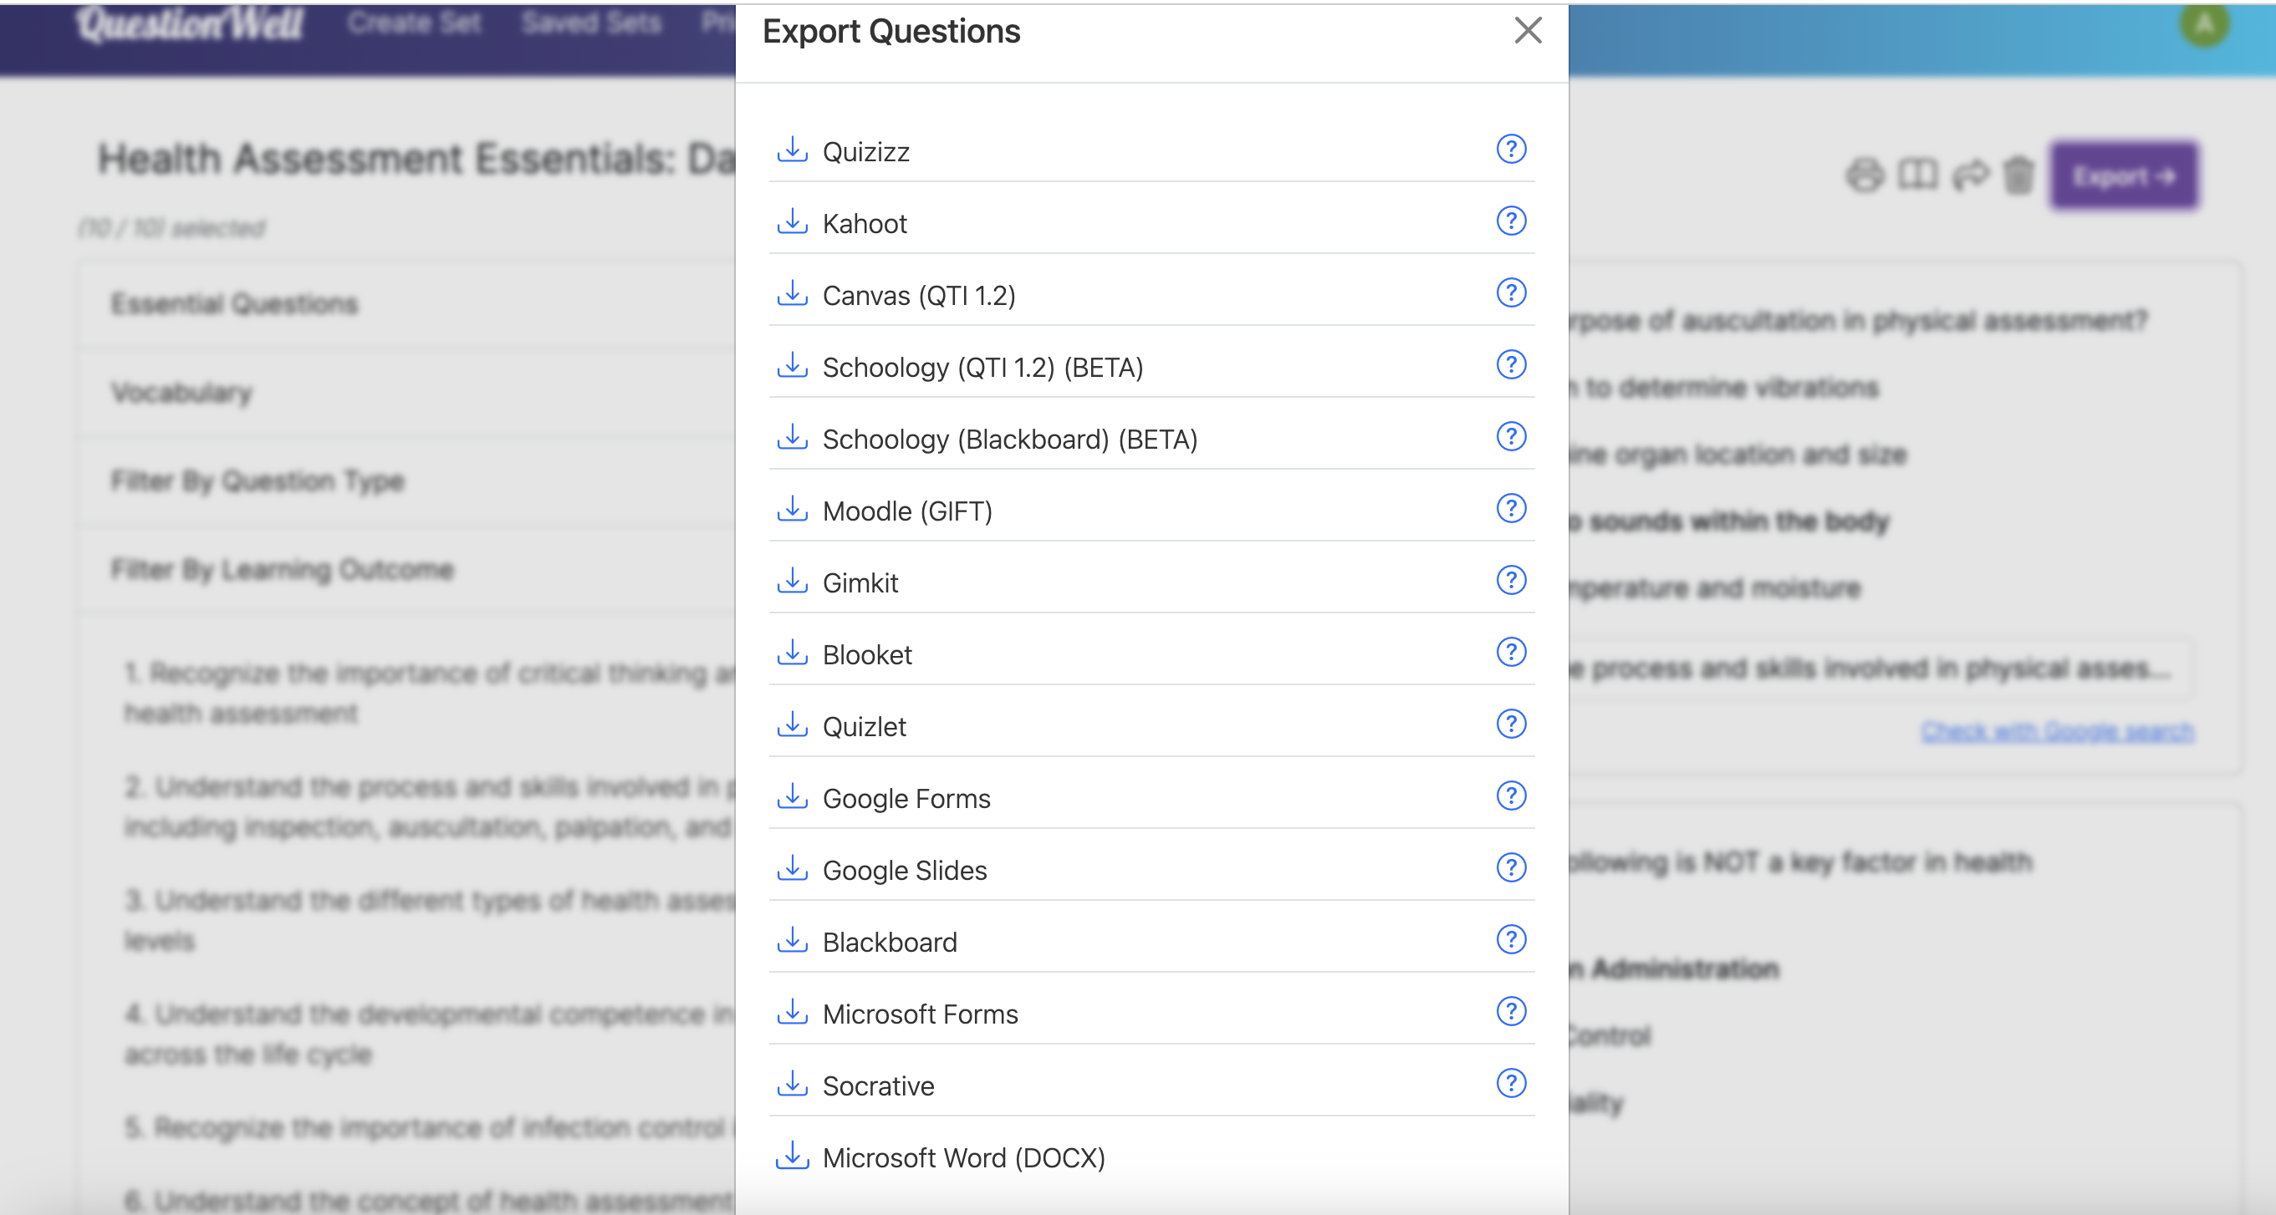

Slide 7
Kahoot
Create
Question generator using PDF file (convert Excel to PDF)
Upload to Question Generator
It generates your questions
(make sure you preview and edit questions before saving)
Then pick the type of question (multiple choice, etc.)

Slide 8
Quizizz
http://quizizz.com/
Go to sign up
Then sign up with your email
To create a game
Go to create new quiz
Create new question and follow prompts
Choose question type
For multiple choice, you can select multi-select
Choose the time to answer the questions
Go to settings and change to private and follow prompts
To play the game, go to your library and start a live quiz for in person or you can assign it with a link

Slide 9
Quizizz

Slide 10
Export to Quizizz

Slide 11
Generating from Documents

Slide 12
Publish
Review your questions, and edit
Edit settings (make private or public)
Then Publish
You can play a live game
Or get link and set it up as independent work for students

Slide 13
Twee
Upload a YouTube video or file to Twee and choose questions
Choose from menu options

Slide 14
Twee

Slide 15
Twee

Slide 16
Questions ?

Slide 17
References
Greenwood, V. & Mosca, C. (2017). Flipping the classroom without flipping out the students. Nursing Education Perspectives 38 (6). 342-343. doi: 10.1097/01.NEP.0000000000000167
Kahoot.com
McEnroe- Petitie, D. & Farris, C. (2020). Using gaming as an active teaching strategy in nursing education. Teaching and Learning in Nursing 15 (1). 61-65. doi.org/10.1016/j.teln.2019.09.002
QuestionWell.com
Quizizz.com
Twee.com

