Slide 1
Teaching AI to Managers
Nikhil Varma
Anisfield School of Business

Slide 2
Agenda
A brief description of my course
How do I introduce AI to managers?
Learning core constructs
A discussion and hands-on session in class

Slide 4
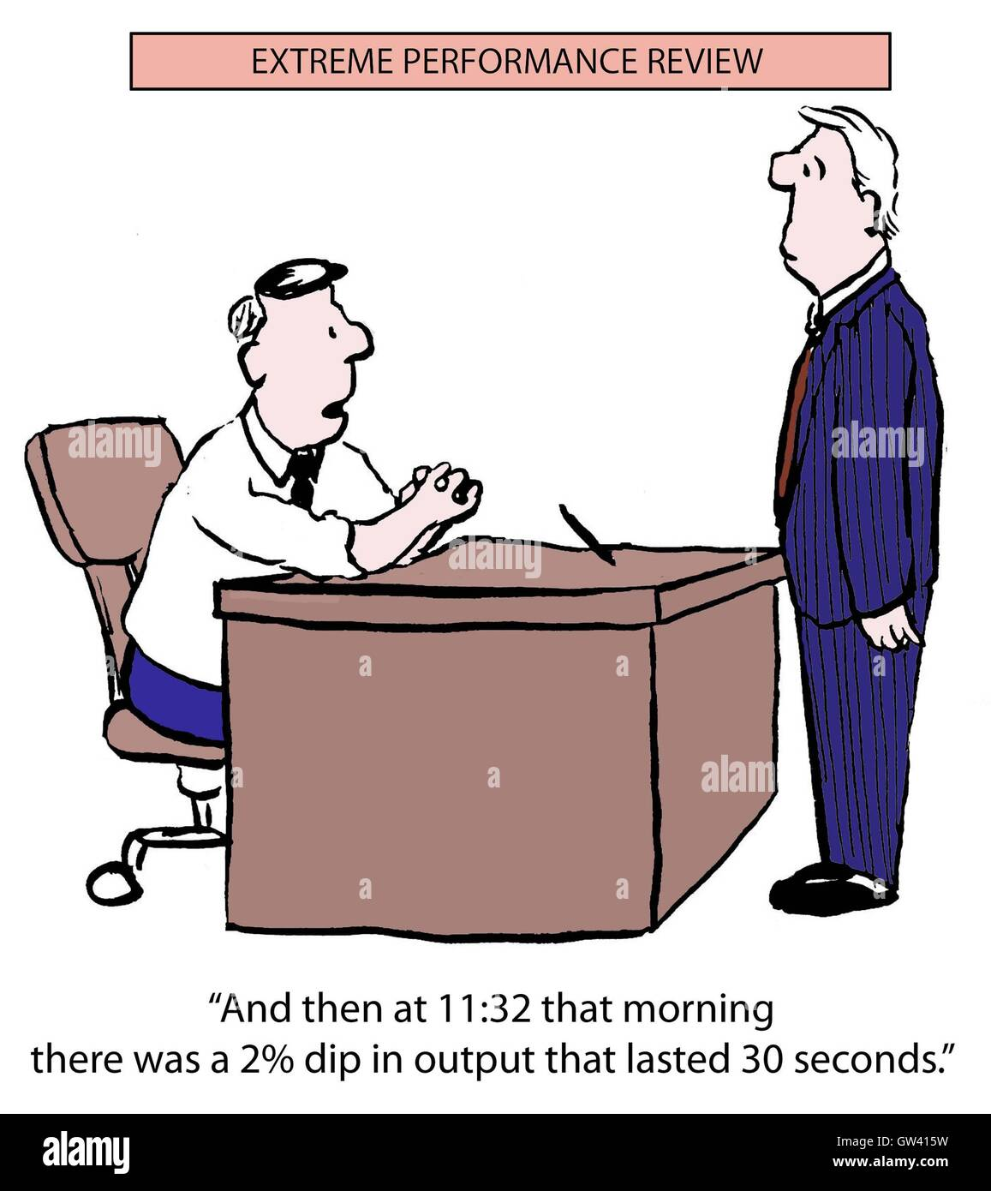

Slide 5
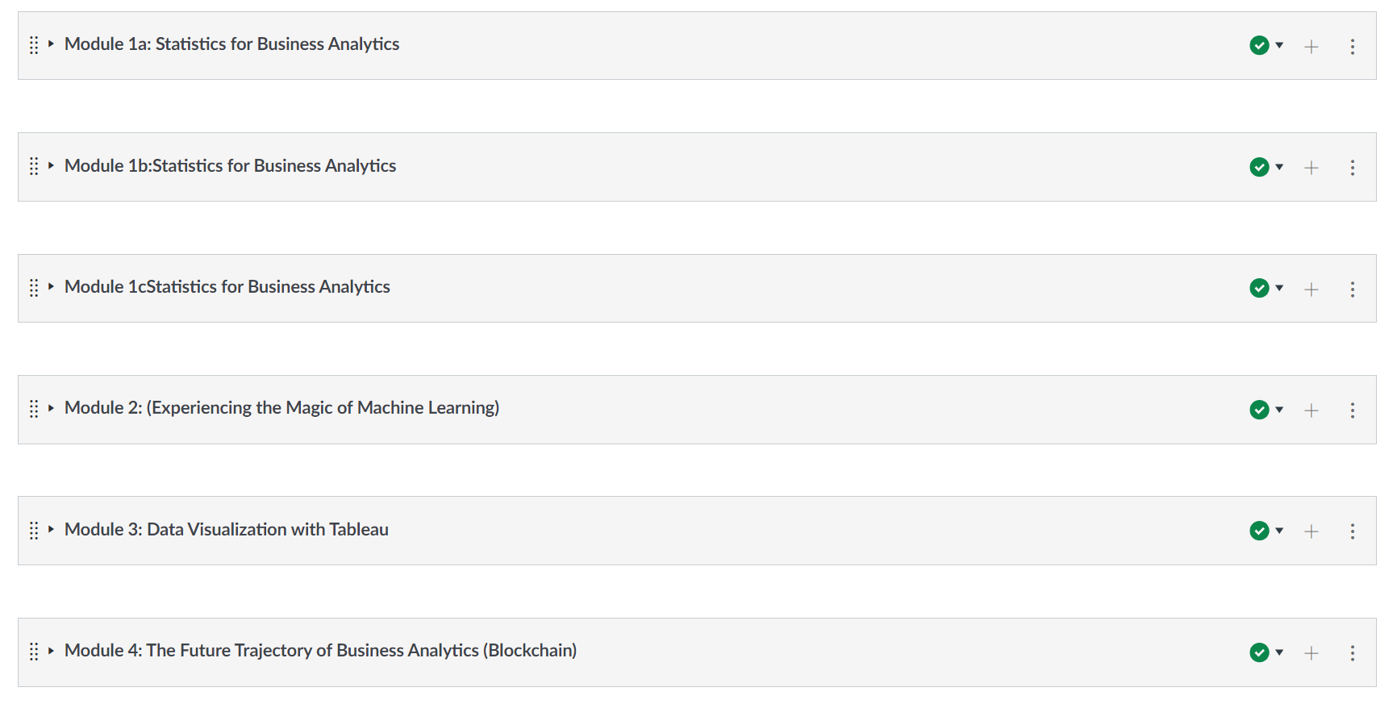
A brief introduction to my course

Slide 6
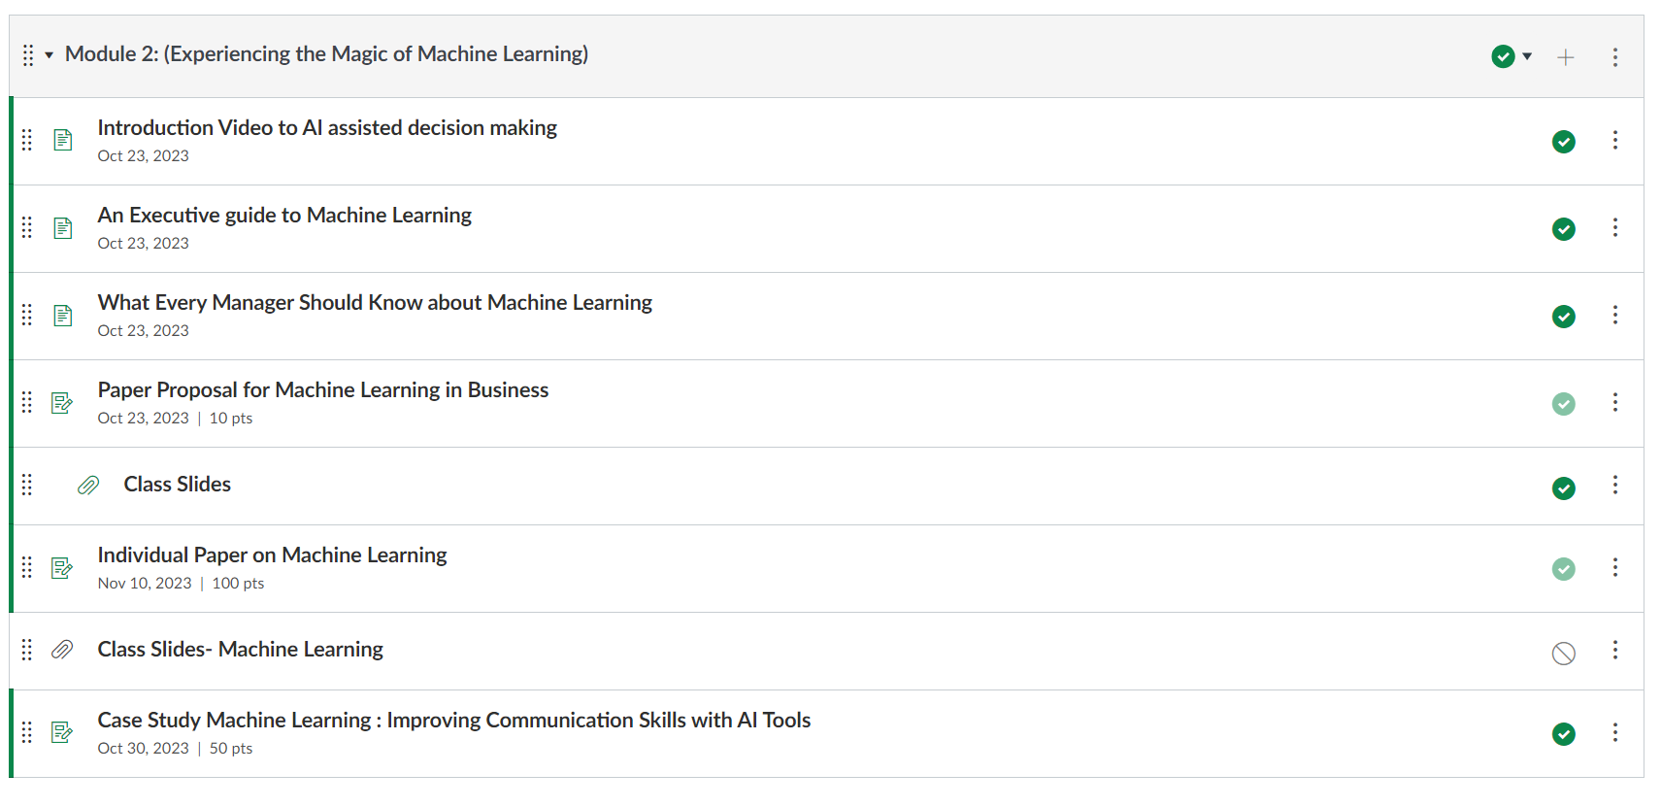
Core constructs

Slide 7
Exploratory ASSIGNMENT

Slide 8
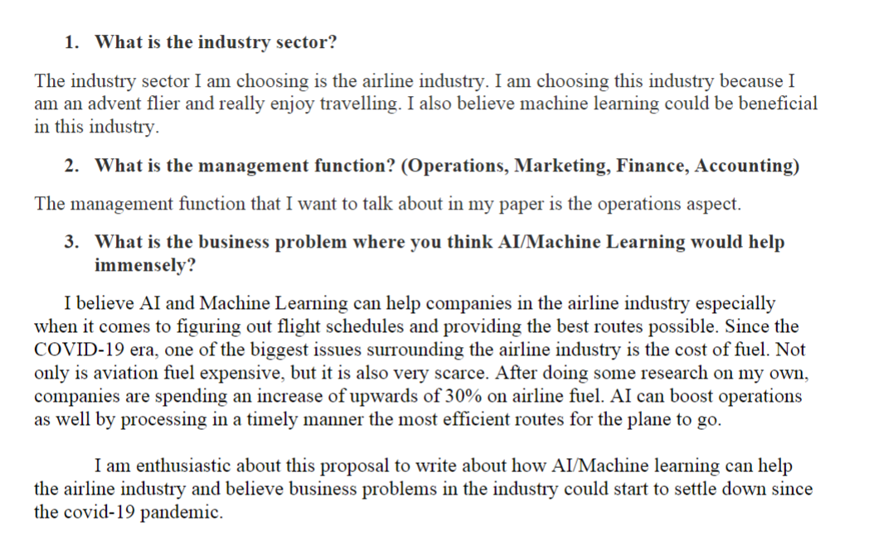

Slide 9
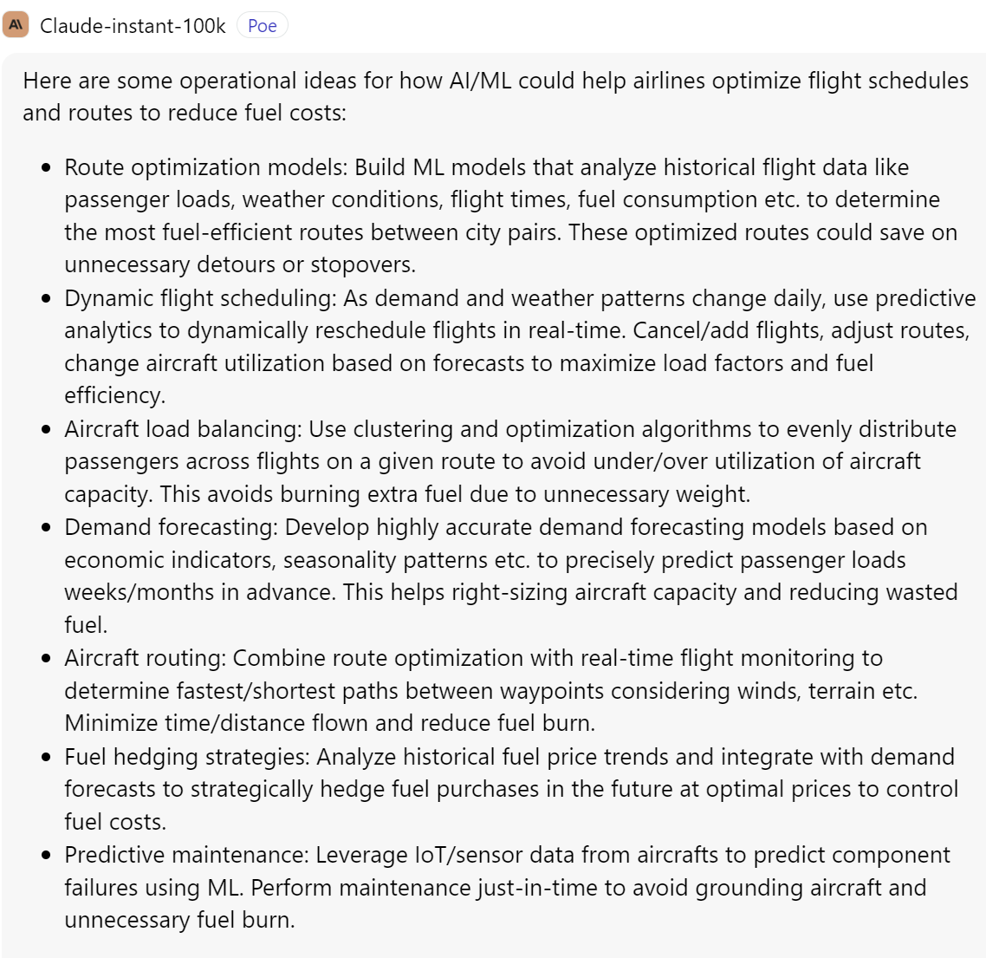
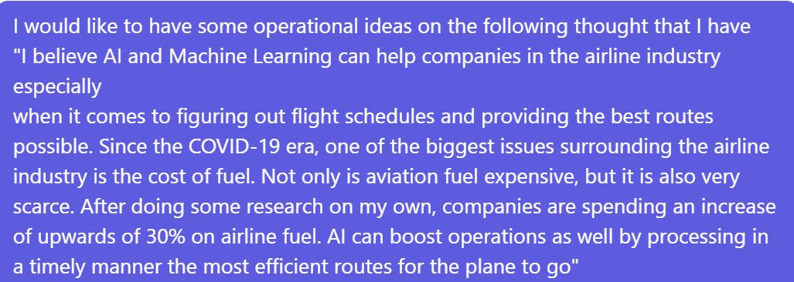
Using LLM AS A SUPPORT TOOL

Slide 10
What NEXT?
Good Enough?
REFINE
AI INPUTS
NO
YES
OPERATIONALIZE

Slide 11
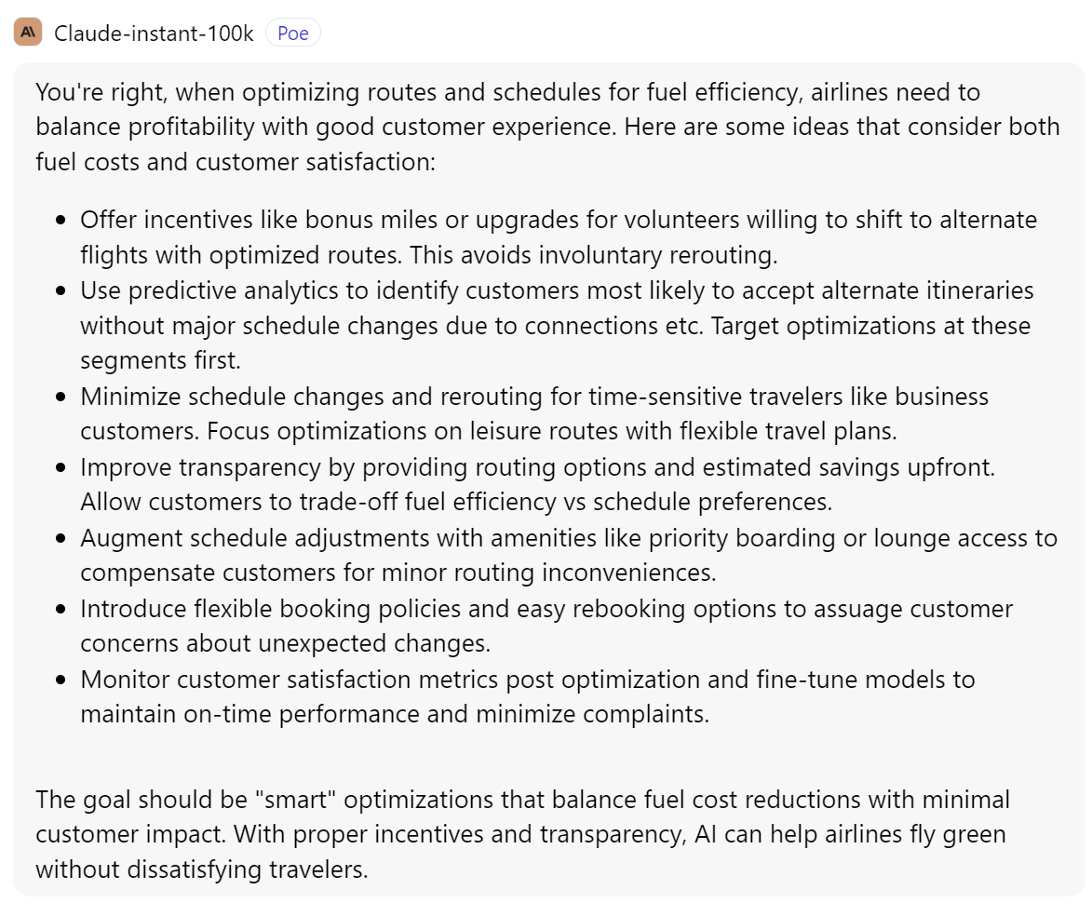
EXAMPLE REFINEMENT

Slide 12
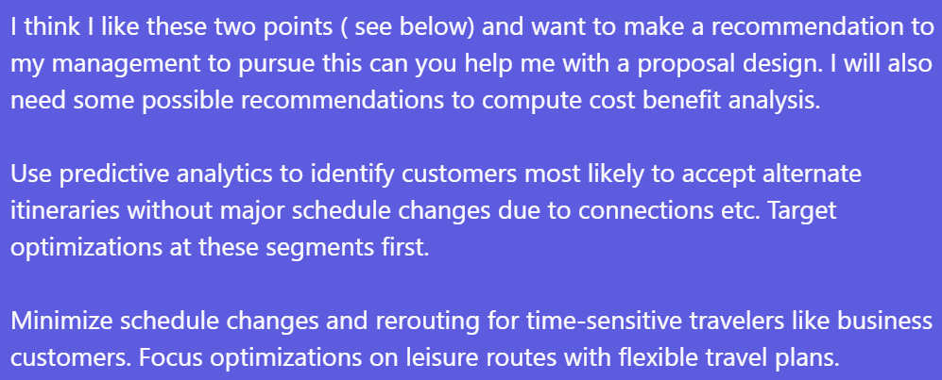
Going deeper

Slide 13
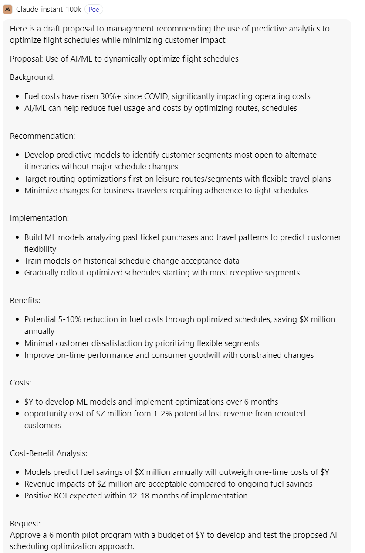

Slide 14
Each aspect is further ANALYZED UNTIL FINAL DEPLOYMENT

Slide 15
LESSONS LEARNT
AI does not replace humans
Managers need to establish a symbiotic relationship with AI
Cross validation is always required
Subject Matter Experts are required
Do not rely on AI to give a final report otherwise the earlier interaction would look something like

Slide 16
