Slide 1
Meet My Digital Assistant
How I Use Generative AI in
Teaching, Research, and Service
Fariba Nosrati | PhD, MBA, MSc, BEng
Assistant Professor of IT Management
Anisfield School of Business
March 6, 2024

Slide 2
Promoting innovative practices
By leveraging AI, educators, researchers, and administrators can embrace innovative practices to drive positive change.

Slide 3
The Future of AI in Academia
ENHANCED LEARNING EXPERIENCES WITH AI
EMPOWERING FACULTY WITH AI
Revolutionizing learning through artificial intelligence technologies.
Efficiency and innovation through advanced artificial intelligence systems

Slide 4
Enhancing Teaching Methods

Slide 5
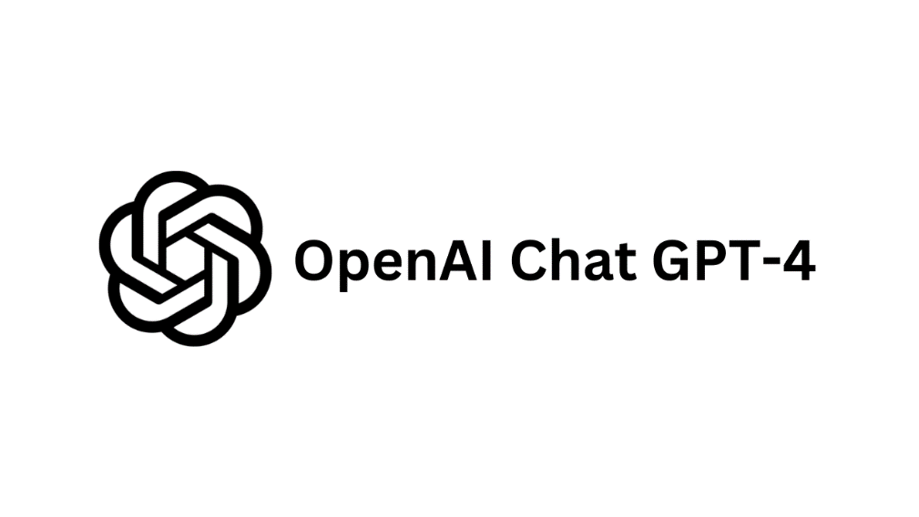
Use cases
Create templates and rubrics
Draft course outlines
Develop class activities and icebreakers
Develop assignments
Emails
Feedback
Discussions
Case studies
Applied examples
Summarize videos
Tools
Chat GPT 4 and apps (GPTs)
Grammarly (AI writing assistant)

Slide 6
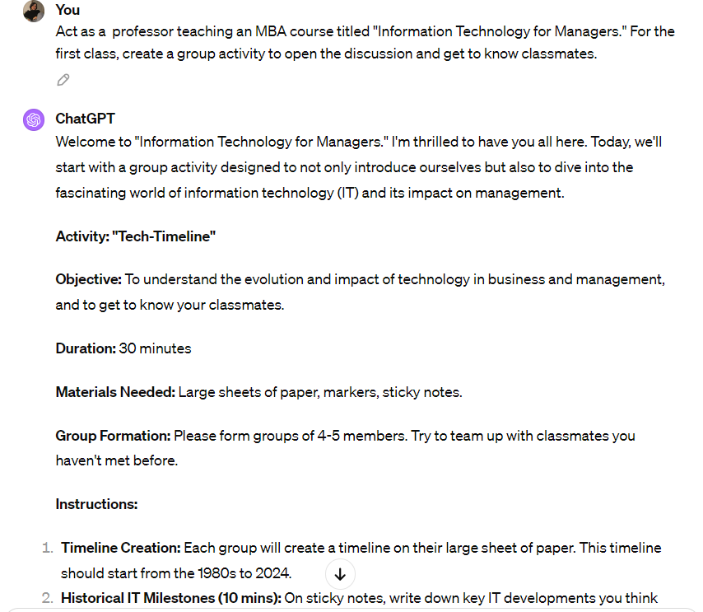
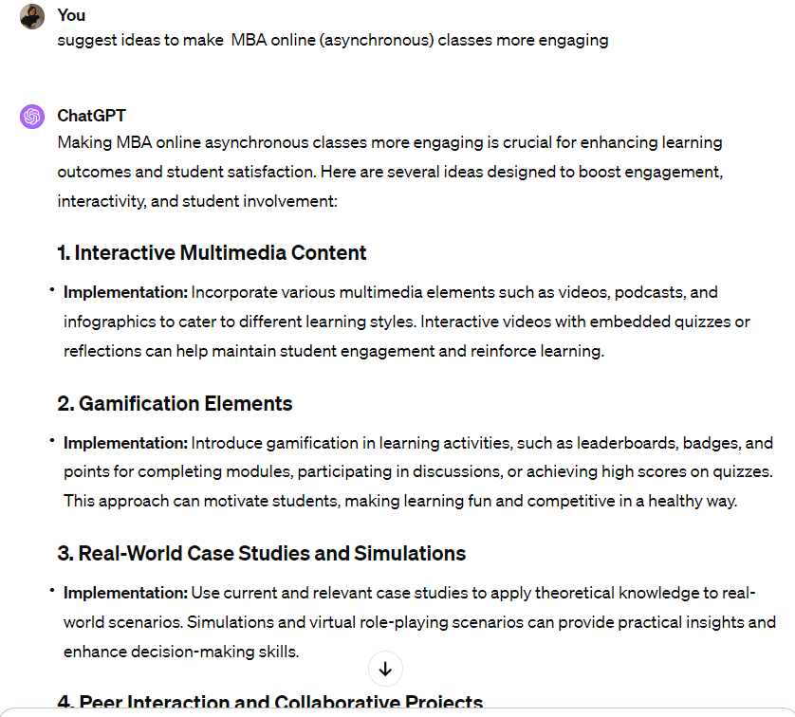
Examples
Creating icebreaker activity
Ideas to enhance class experience and engagement

Slide 7
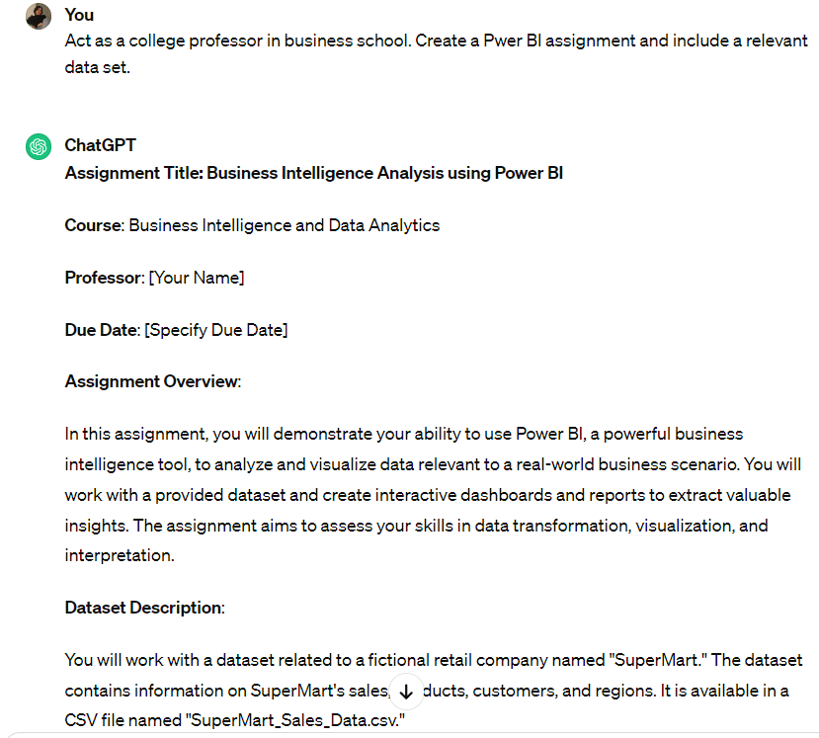
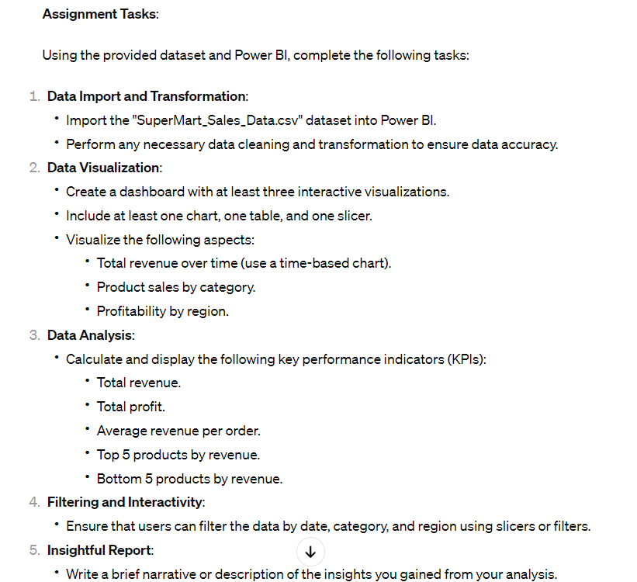
Examples
Creating assignments

Slide 8
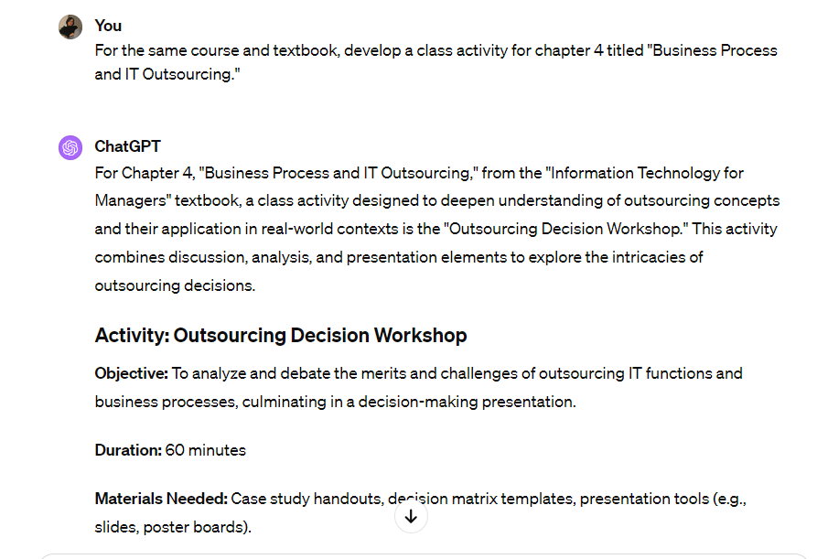
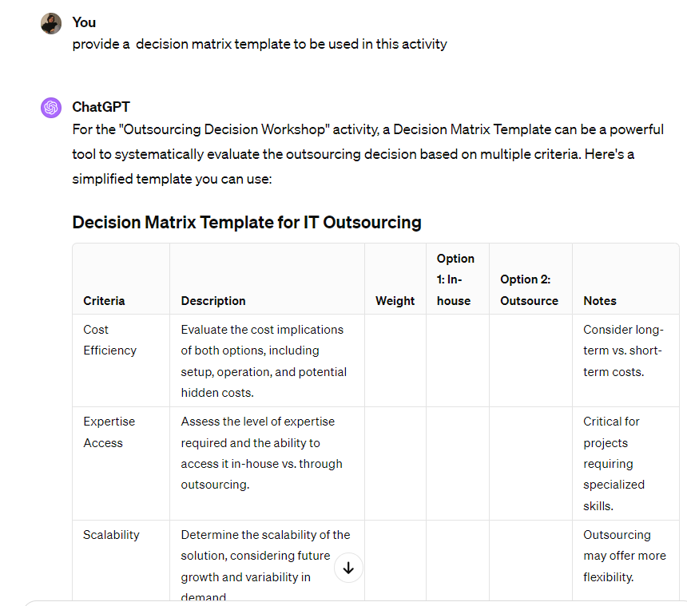
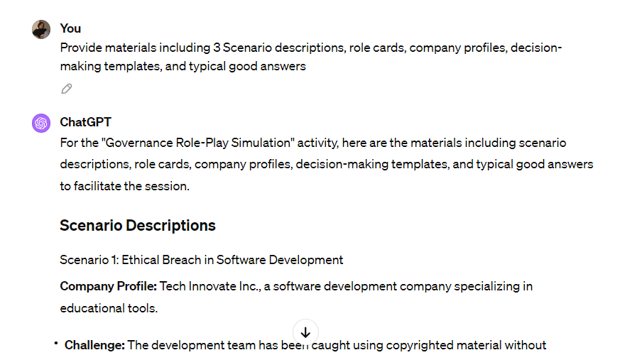
Examples
Developing class activity and related material
Creating templates

Slide 9
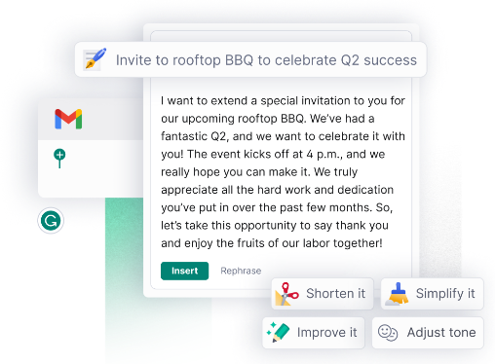
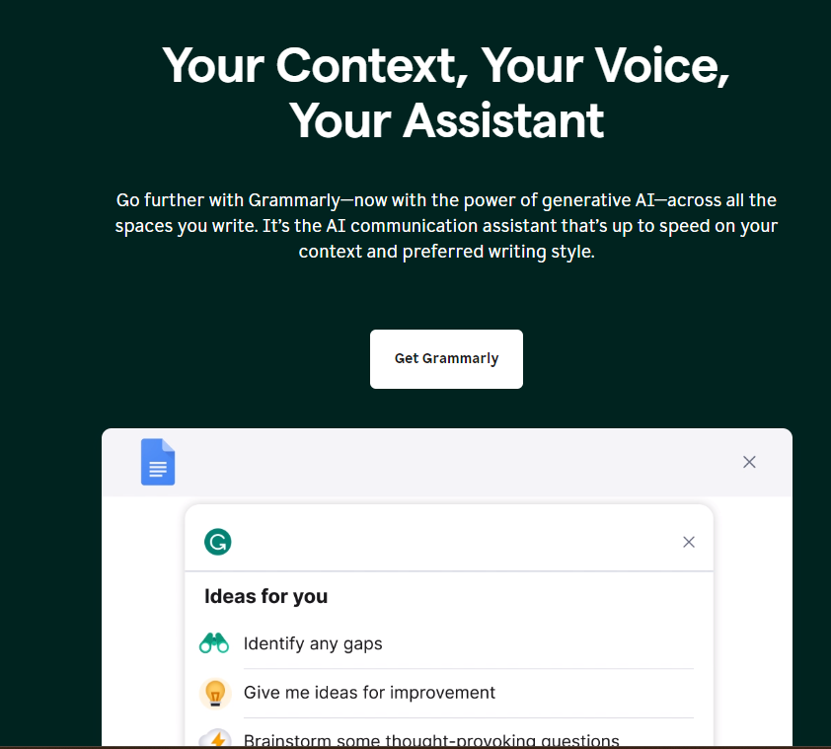
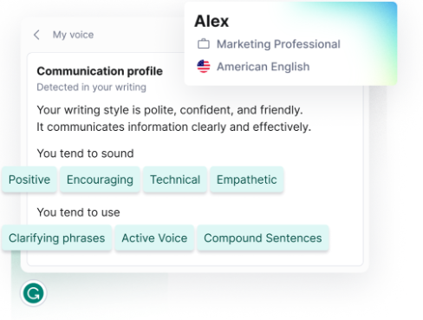
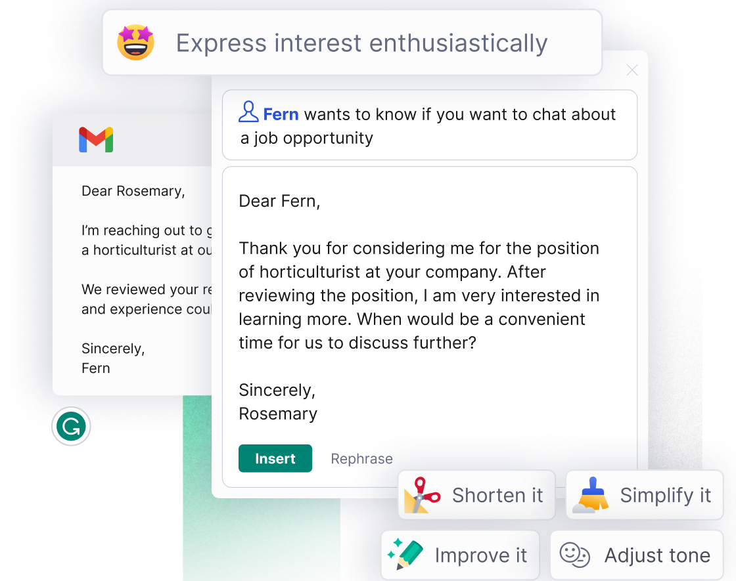
Examples
Assistance in communication, feedback, and explanation

Slide 10
Improving Research Efficiency

Slide 11
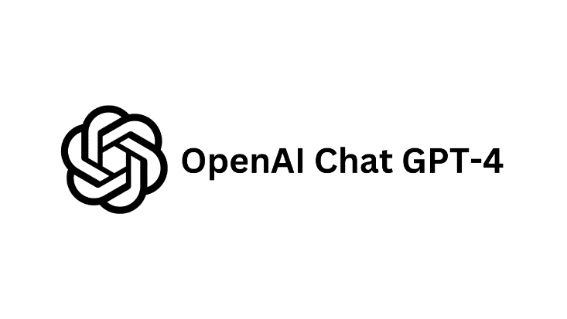
Use cases
Generating ideas, drafts, and titles
Finding resources
Summarizing information
Copy editing
Presentation templates
Tools
Elicit (analyze research papers, systematic reviews, meta-analyses, scoping reviews, rapid reviews)
Consensus(AI-powered search engine that finds and summarizes scientific research papers)
Semantic Scholar (AI-powered research tool for scientific literature)
Chat GPT 4 and apps (GPTs)
Grammarly (AI writing assistant)
Prezi AI (presentation)

Slide 12
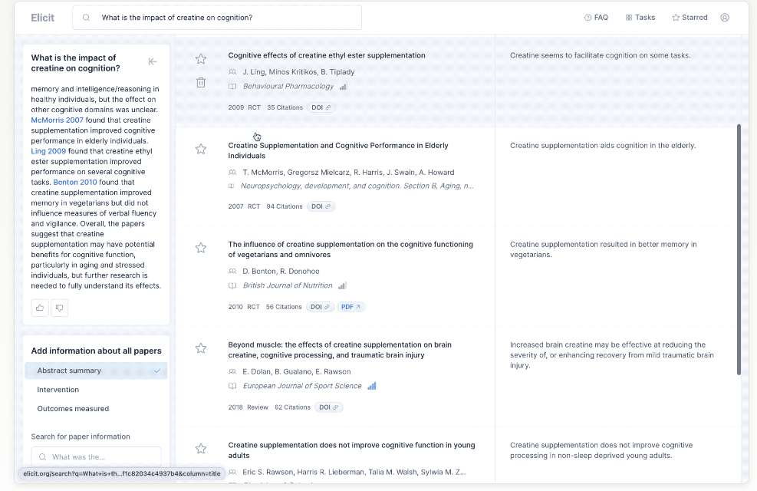
Examples
Finding and summarizing papers

Slide 13
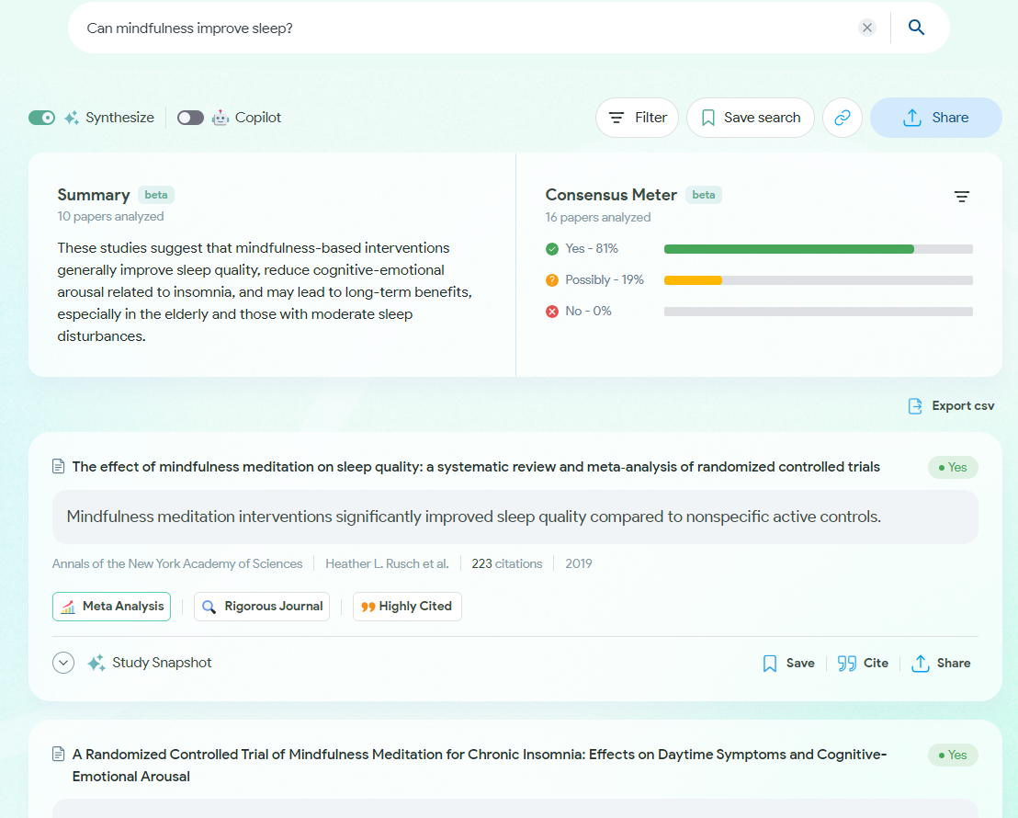
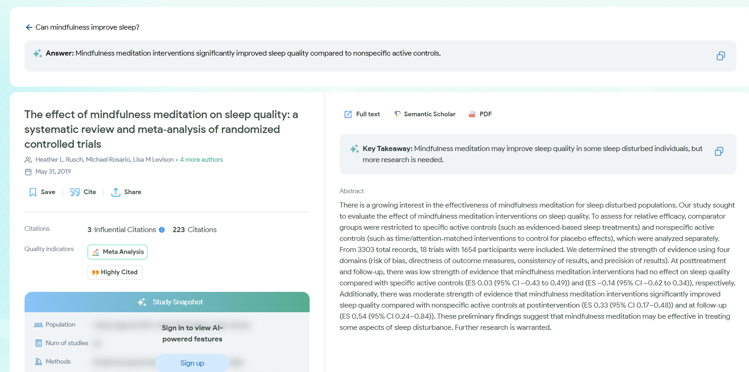
Examples
Finding and summarizing papers

Slide 14
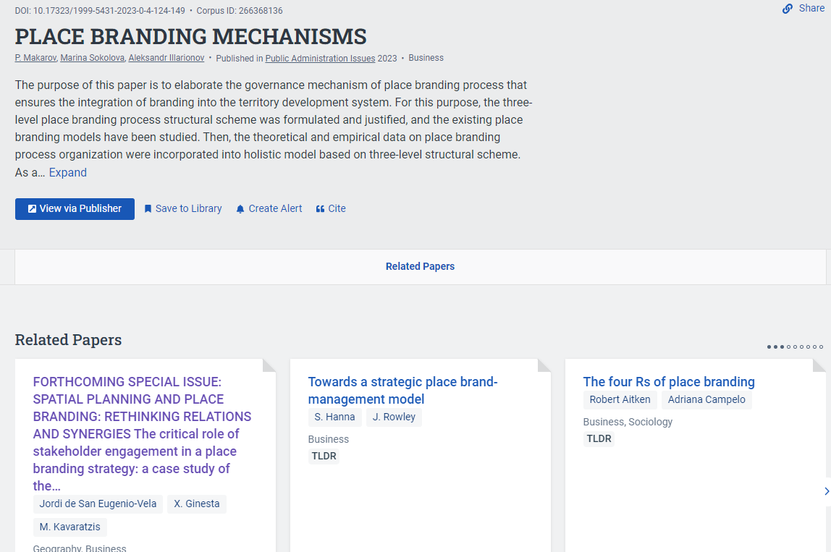
Examples
Finding and summarizing papers

Slide 15
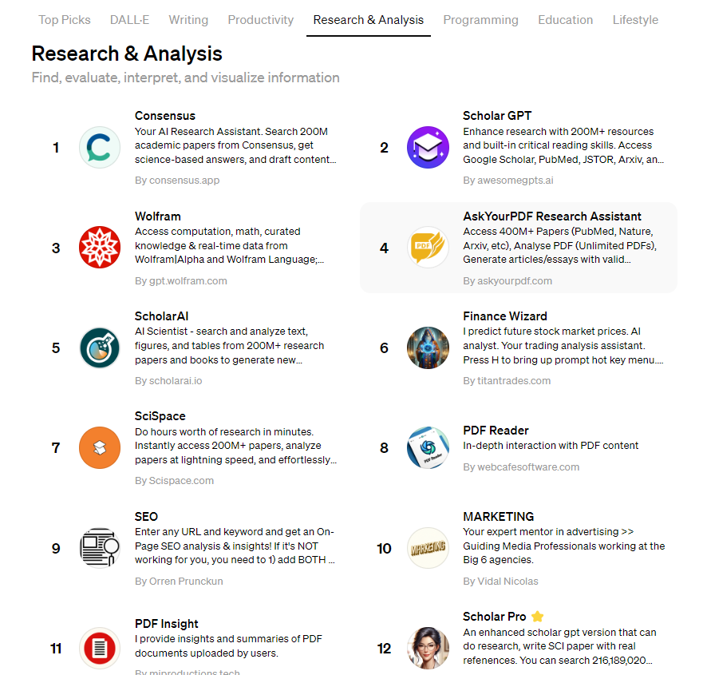
Examples

Slide 16
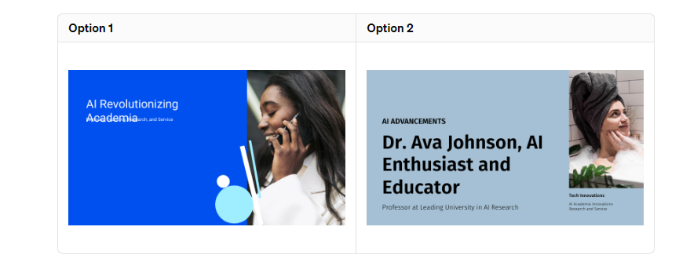
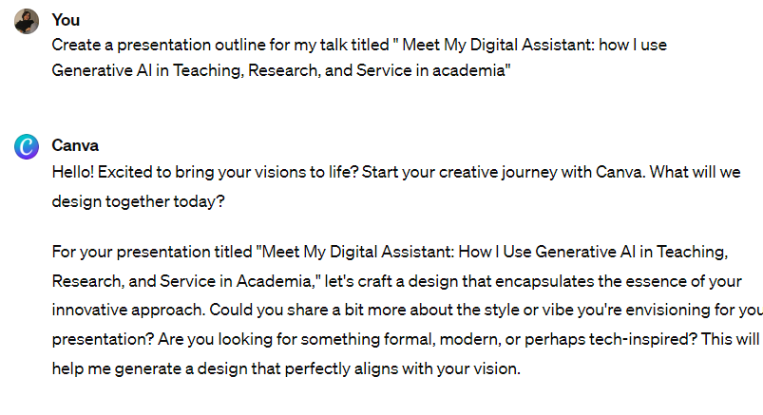
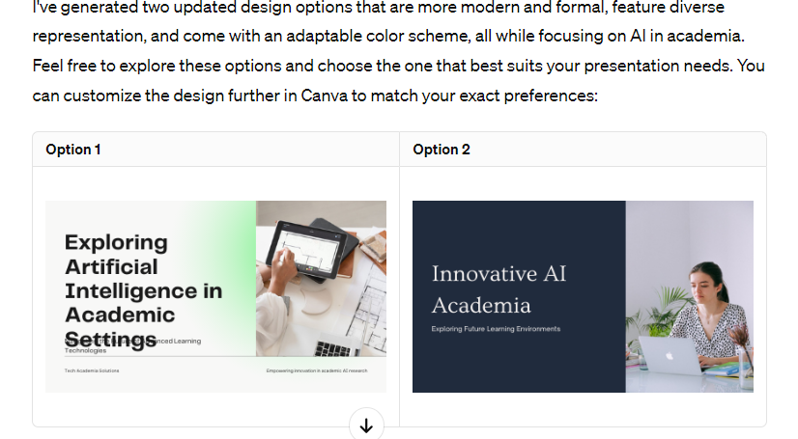
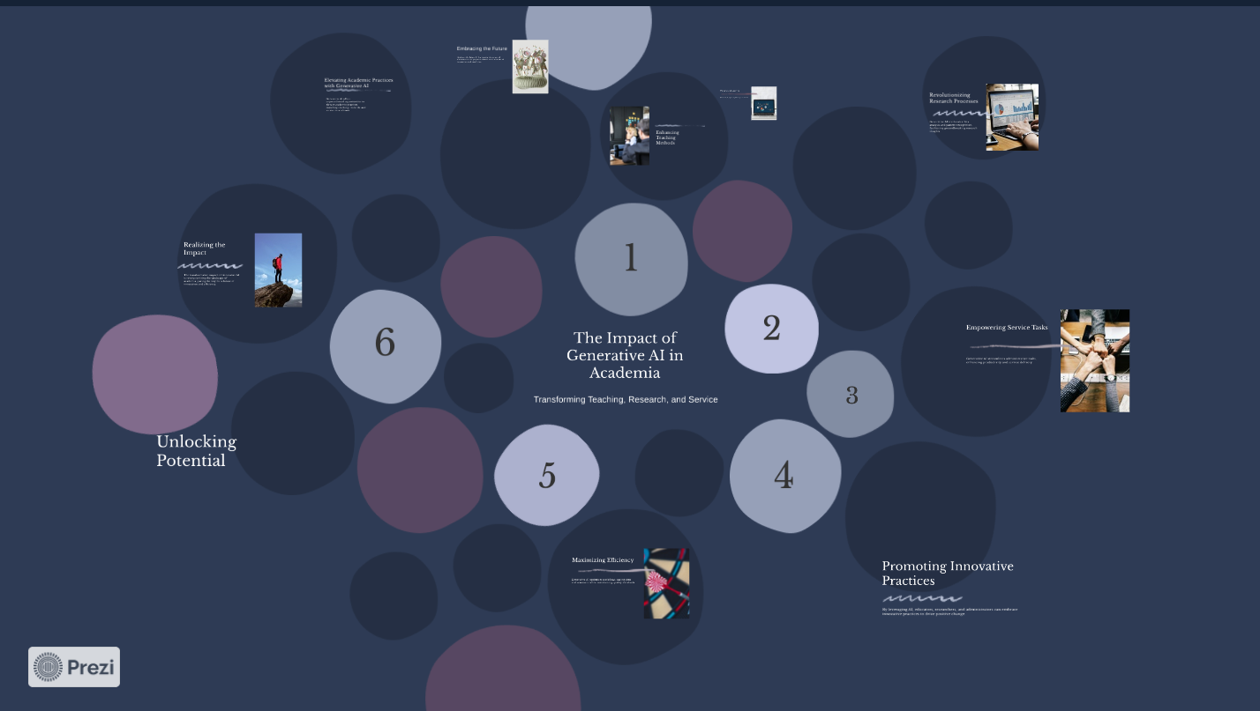
Examples
Creating presentations
https://prezi.com/view/b5b3mDdVW9w4y0OjOfYE/

Slide 17
Empowering Service Tasks
Generative AI streamlines administrative tasks, enhancing productivity and service delivery.

Slide 18
Use cases
Generating ideas & drafts
Creating templates
Finding resources
Summarizing information
Copy editing
Communications
Emails
Tools
Chat GPT 4 and apps (GPTs)
Grammarly (AI writing assistant)
Prezi AI (presentation)

Slide 19
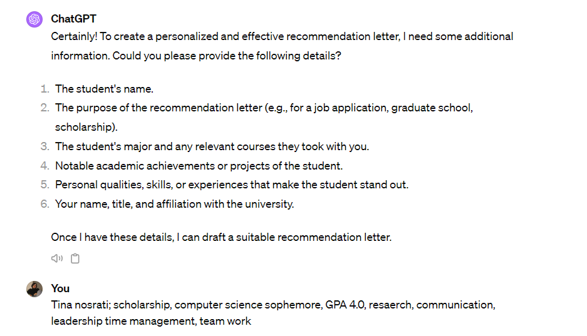
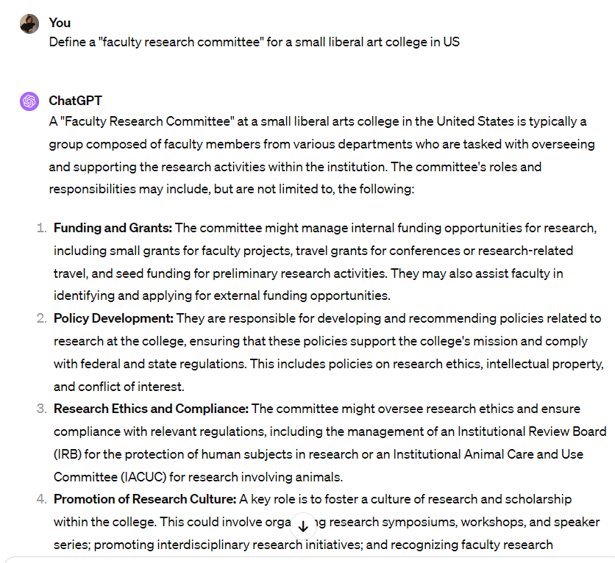
Examples
Personalized recommendation letter
Generating ideas and drafts

Slide 20
Wrap up
AI is a powerful productivity tool that can help:
Maximize efficiency
Unlock potential
Elevate academic practices
Embrace the future

Slide 21
My top use cases
Teaching
Research
Service
Creating templates and rubrics
Drafting course outlines
Developing class activities
emails
Generating ideas, drafts, and titles
Finding resources and summarizing information
Copy editing
Generating ideas & drafts
Creating templates
summarizing information
Copy editing
Communications
emails

