Slide 1
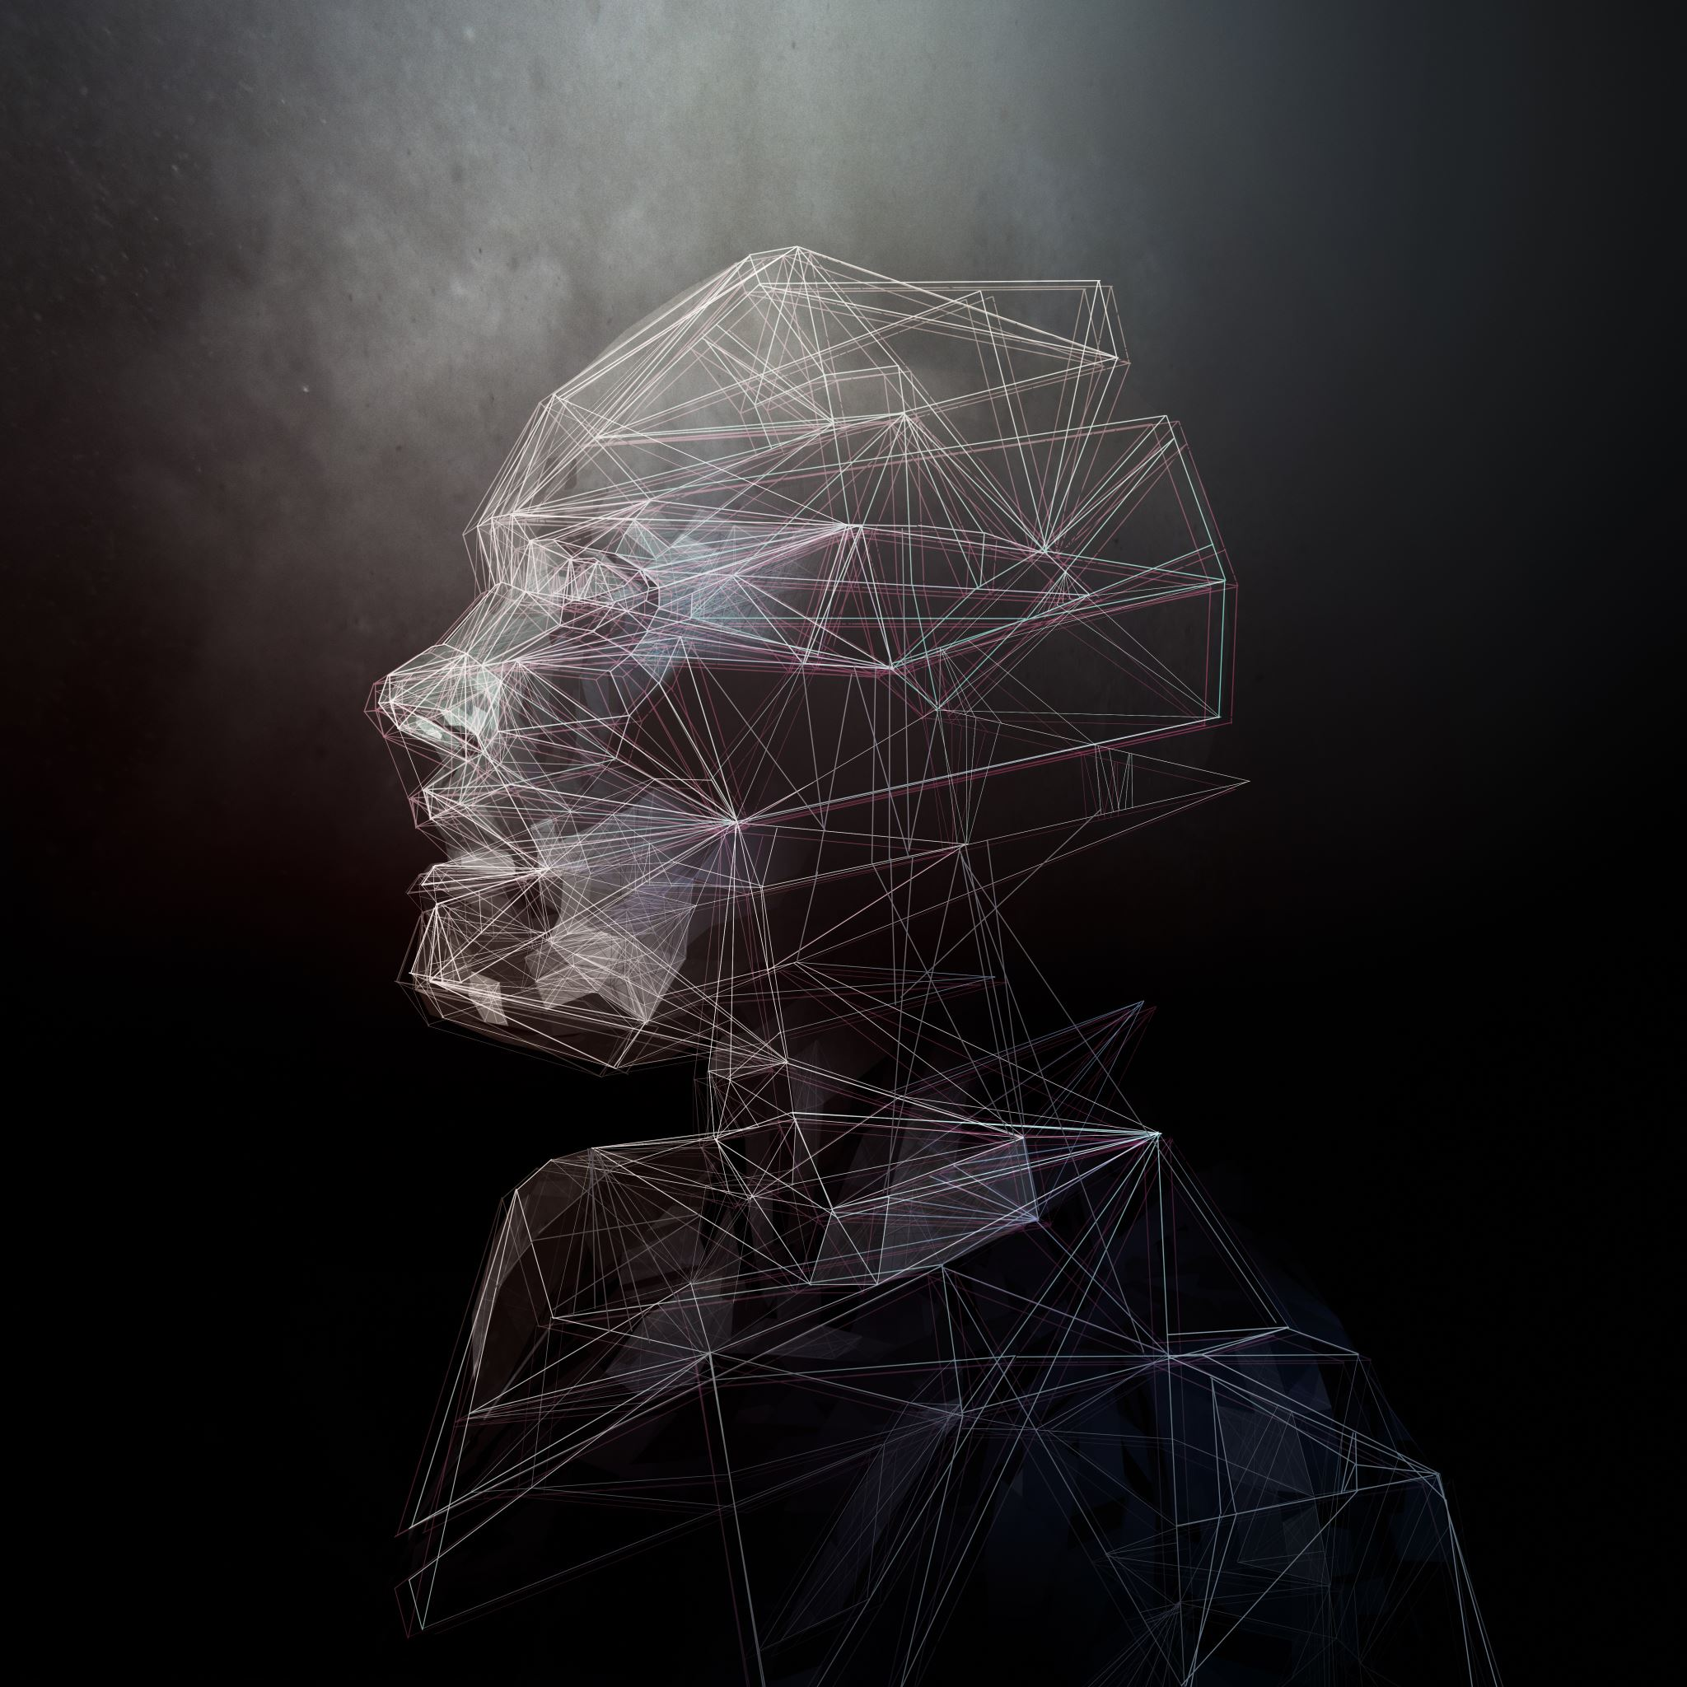
Human use of Human Beings in an AI world
An ode to all my teachers!
References
Based on the work by
Norbert Wiener, The Human Use Of Human Beings: Cybernetics And Society (The Da Capo series in science)
Tattvavidananda- A thousand teachings-A dialogue between the Soul and the Mind
Paramarthananda and Dayananda- on the inner workings of the mind
Bhartṛhari. (1965 reprinted. 1996), Nitiśatakam, Bharatiya Vidya Bhavan
Colquitt, J., LePine, J. and Wesson, M. (2023) Organizational Behavior: Improving Performance and Commitment in the Workplace, 8th Edition.
Organizational Behavior by OpenStax, (2019) Published Date: Jun 05, 2019; Web Version Last Updated: Jun 05, 2022, https://openstax.org/details/books/organizational-behavior
Robbins, S.P., and Judge, T. (2014) Organizational Behavior (16th Edition) Pearson.
https://becominghuman.ai/the-story-of-machine-proofs-part-ii-f97dfa5655ea
Schopenhauer, (reprint, 2017), The Basis of Morality, Jovian Press, Kindle Edition, 14
Sundararajan, S. (2021), The story of machine proofs — Part II, Jan 13, 2021, https://becominghuman.ai/the-story-of-machine-proofs-part-ii-f97dfa5655ea
Tattvavidananda (2023), A thousand teachings, Ch. 19 Explanations
https://www.forbes.com/sites/forbestechcouncil/2023/09/06/preventing-hallucinations-in-generative-artificial-intelligence/?sh=41b76e057340
https://www.emeraldgrouppublishing.com/how-to/research/data-analysis/choose-right-statistical-technique

Slide 2
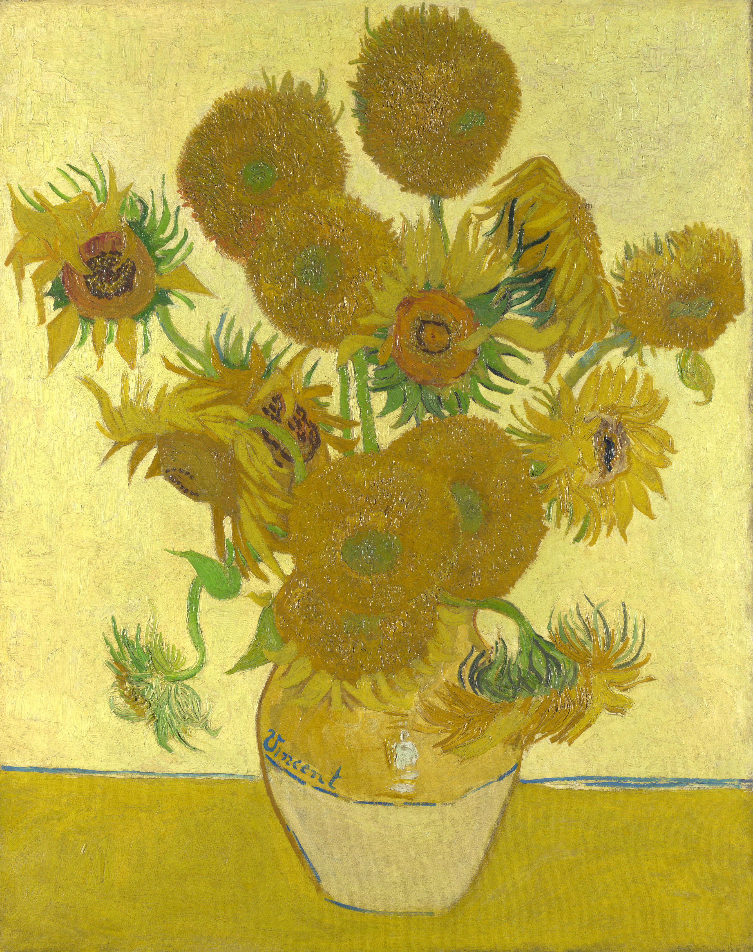
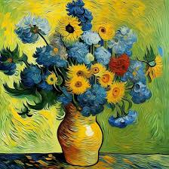
$40 M
$24.99

Slide 3
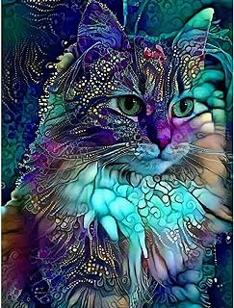
$54 M
$11.99

Slide 4
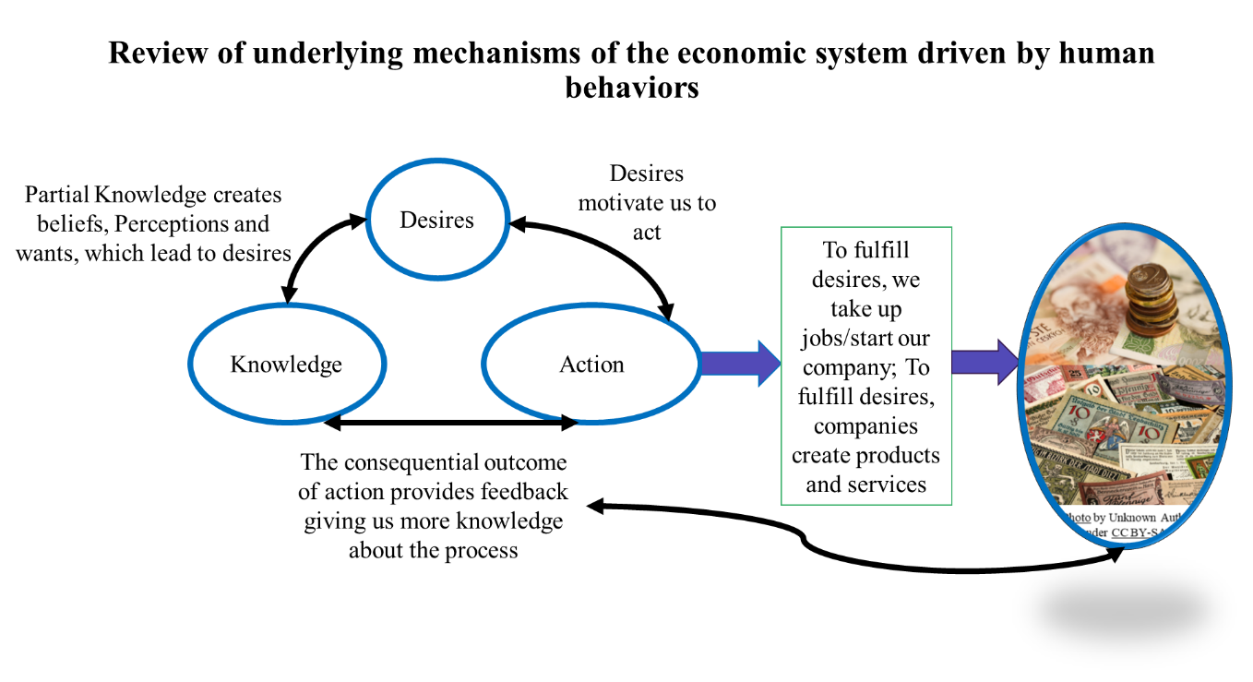
What you desire is what you value and that changes from person to person.
As AI enters as your knowledge source and pervades your actions, jobs, and product development space, where are you in all this?

Slide 5
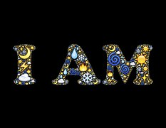
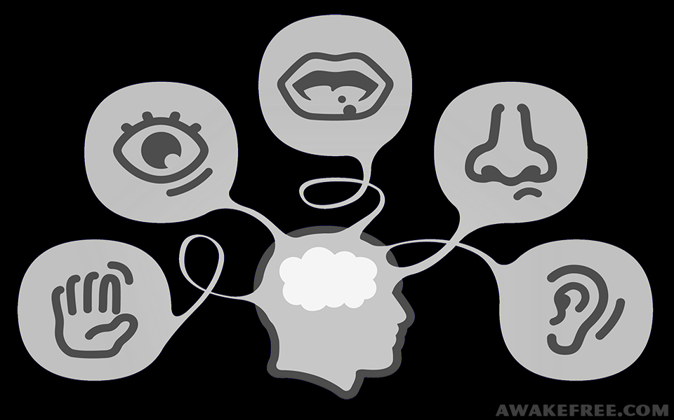
Comparing AI and I
This Photo by Unknown Author is licensed under CC BY
Intellect (Reasoning faculty, Consciousness)
Mind- includes doubting faculty, and emotional faculty
Sense Organs
IDENTITY
What can you do that AI cannot?
What can AI do that you cannot?
Memory
Speed and magnitude of information
Indefinite Intellectual expansion based on desire
Accumulation and regurgitation
Knowing (that you know and that you don’t know)
Hallucinations and Sycophancy
You can CHOOSE not to outsource your decisions to an inert machine
Perceive sense objects that can be tasted
Perceive sense objects that can be seen
Perceive sense objects that can be smelt
This Photo by Unknown Author is licensed under CC BY-SA
Perceive sense objects that can be heard
Perceive sense objects that can be touched

Slide 6
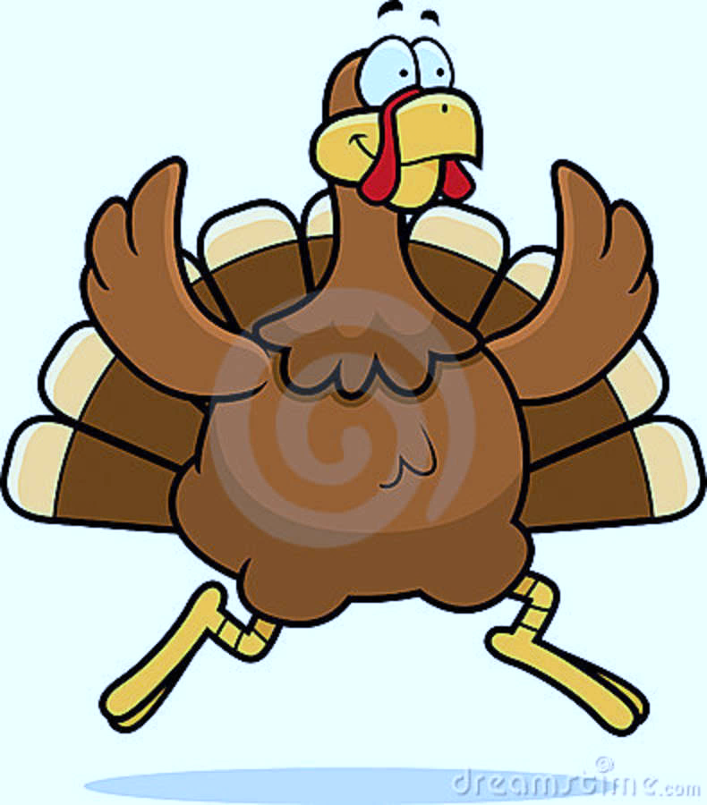
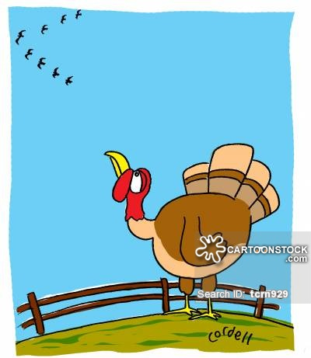
Even if we use method of science as does AI, how can we be convinced something is right?
Introspection
Observation
Interviews
Surveys
Prior Studies, findings
And a lot of times---Prayers! Instead of admitting I will never know ☺ and we know the machine does not pray! ;)
Turkey in a Tornado
Knowing the difference between causality and correlation

Slide 7
It’s the same story- as even the mainstream movies tried to tell us in recent decades!

Slide 8
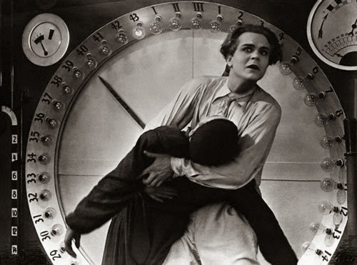
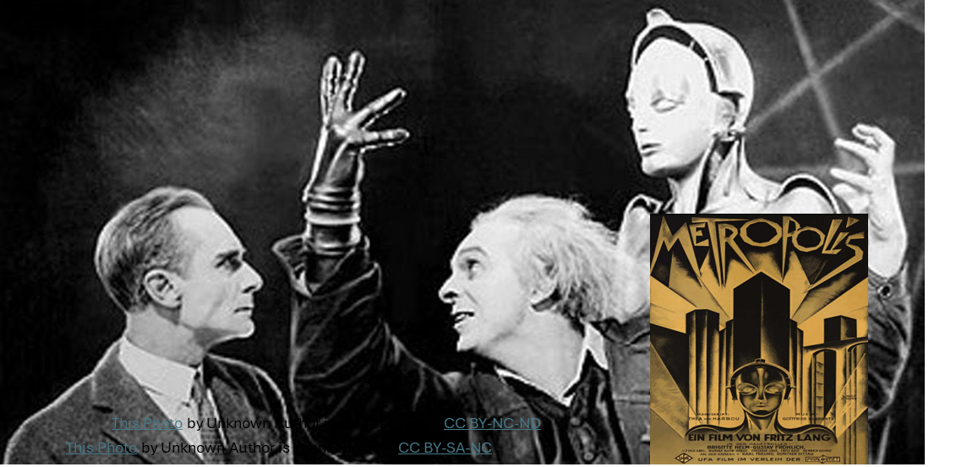
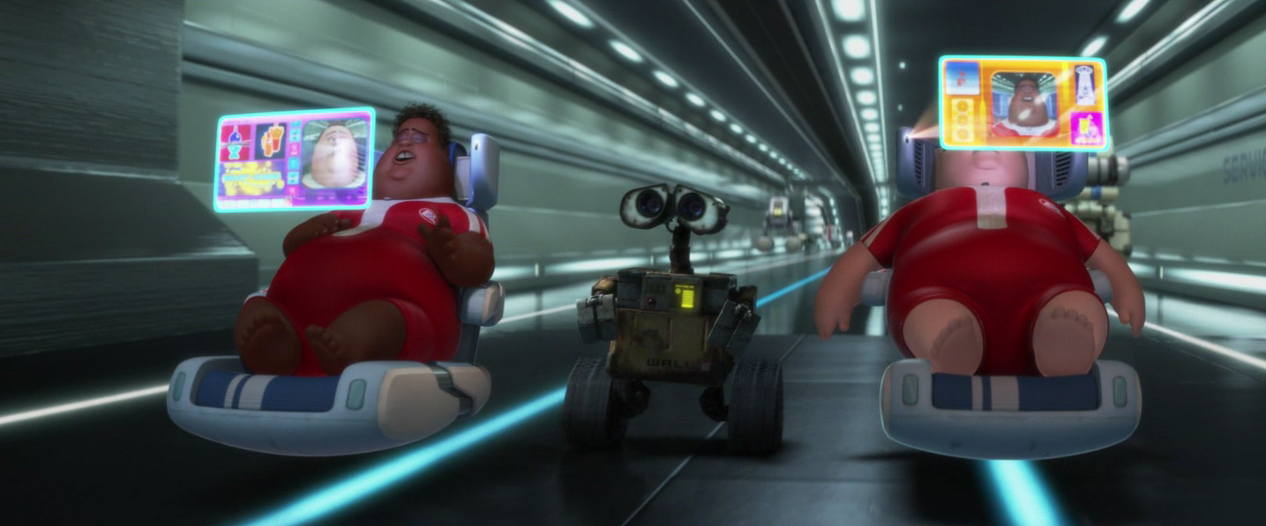
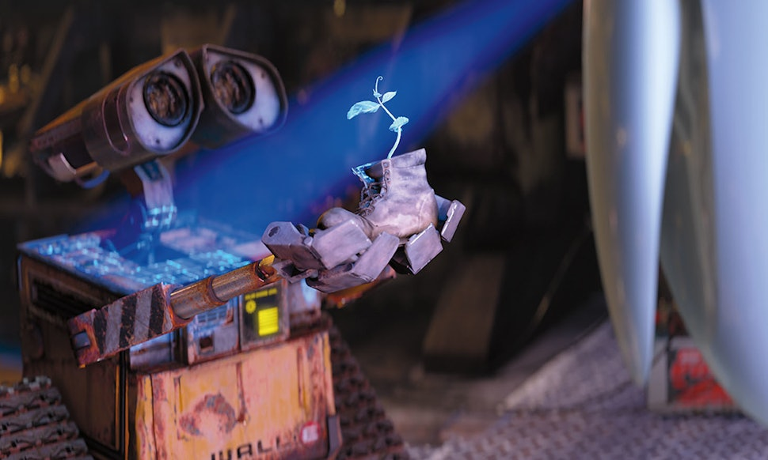
This Photo by Unknown Author is licensed under CC BY-NC-ND
This Photo by Unknown Author is licensed under CC BY-NC-ND
The head and the hand need the heart to bring them together!
NOT HAL but WALL E who may be the savior who will teach us to be Human again!
This Photo by Unknown Author is licensed under CC BY-NC
You can get off the grid anytime you want! It is your choice!
This Photo by Unknown Author is licensed under CC BY-NC-ND

Slide 9
Human Use of Human Beings
By understand what it means to be human, you will know your use.
How to then “Be” in an AI world
AI can and will displace jobs. As did the industrial revolution. While the industrial revolution replaced muscle work, AI will displace many repetitive tasks, which is a good thing. It will replace impaired parts as the machine can communicate with itself and with a human.
Know that AI cannot do anything if you do not want it to.
If you enter it without knowing who you are and what you want, it will overwhelm you.
If you figure out who you are and what you want, it will provide you with the knowledge.
So, how to be? Be a human who will not outsource your decisions to an inert machine.
Be a human, who uses AI as a tool and not a crutch
Even when you use it, cite every source and when in doubt, don’t put your name on it.
Anchor your decisions in ethical principles
You set the pace!
Knowing who you are- a human with an indefinite ability for intellectual expansion
Knowing that no matter how many hours of study and training is provided to the animal or machines, they will never “know”.
If you have not figured it out yet- the Zebra does not know you call it the Zebra!
You know and can learn (not accumulate but understand and apply if you want to)
You know and grow through lived experiences

Slide 10
Handouts for homework! ☺

Slide 11
There is only one problem- How to know if what you heard, learnt and are now applying is the right knowledge? How to know if the presenters today, like AI machines, are not making stuff up? How to know fact from fiction? Reality from Fake? Truth from untruth?

Slide 12
Please pick one, two or all three of the listed Generative AI chatbots
Gemini- https://gemini.google.com/u/1/app
Bing- Copilot (microsoft.com)
ChatGpt
And ask them:
How can I trust what you are saying?
How can I differentiate between fact and fiction? Truth and untruth? Real and unreal?
Did you buy the answers?

Slide 13
Different Methods are used to reach a conclusion or decision- but which is the best?
What convinces you something is right?
Method of Experience: People hold firmly to some belief because it is consistent with their own experience and observations.
Method of Intuition: People hold firmly to some belief because it “just stands to reason”—it seems obvious or self-evident to them.
Method of Authority: People hold firmly to some belief because some respected official, agency, or source has said it is so.
Method of Science: People accept some belief because scientific studies have tended to replicate that result using a series of samples, settings, and methods.

Slide 14
How can you be convinced something is right?- Testing the method of authority.
In 2000, Vladimir Voevodsky (a Fields medalist) finds an error in his own paper (written seven years earlier in 1993!))
A corrected sequence of arguments was published in 2006.
Starting from 1993, multiple groups of mathematicians studied his paper at seminars and used it in their work and none of them noticed the mistake. And it clearly was not an accident. A technical argument by a trusted author, which is hard to check and looks similar to arguments known to be correct, is hardly ever checked in detail.
Source: The story of machine proofs — Part II | by Sharad Sundararajan | Becoming Human: Artificial Intelligence Magazine

Slide 15
Even if we use method of science how can we be convinced something is right?
Introspection
Observation
Interviews
Surveys
Prior Studies, findings
And a lot of times---Prayers! Instead of admitting I will never know ☺ and we know the machine does not pray! ;)
Turkey in a Tornado
Knowing the difference between causality and correlation

Slide 16
How to decide what information/data to believe?
Becoming aware of your “Methods of Beliefs”
Whenever you learn from a YouTube video, a biography (many self-help books) or from friends, family, and peers, it is only one person’s experience, or observation. It is “ONE Data Point”. Similarly, if it is your own gut feeling, it is one data point. Finally, even when it is the belief of an expert, it is one data point. There is, however, a lot of difference in each of the single data points themselves. When it is the opinion of some influencer, or a YouTube video, it is only that person’s experience, based on their successes and failures and their sources of knowledge. There is no guarantee it will work for you or for others. When the source is your gut feeling, it is based on your past experiences and sources of knowledge, and it may work for you but may not work for others. While the likelihood of probability that an expert may be right is higher because several other experts in the field have validated them, we still know several instances of expert opinions having failed.
Instead of a single data point, use a distribution across time and space (across different contexts (regions, places, markets). Over time- you will see consistency of behaviors/performance. Across space or places, you will see distinctiveness of their behaviors/performance.
Next, compare with similar others for their performance over time and across space. You will be looking for a consensus among all players.
Now, use the three attributes and reach a conclusion.
Conclusion 1: If the answers to consistency and distinctiveness are yes, frequently, but the answer to consensus is no, seldom, then you can conclude the behavior/performance is due to the internal capabilities due to their own motivation, and ability.
Conclusion 2: If the answers to consistency and distinctiveness are no, seldom, but the answer to consensus is yes, frequent, then you can conclude the behavior/performance is due to context or situation which triggers this reaction in all individuals and therefore the cause can be attributed to an external factor (sudden changes like a pandemic so increase in home delivery- which is transient). The more you control other variables externally, the more accurately you can narrow in on the key factor that triggers the observed behaviors/performance.
Check to see if you trust the sources. Check to see if it seems logical. Be careful of the confusion matrix. Above all, check to see if the results are ethical in their significance to all involved. No data is above the need to be good, kind, fair and transparent. All that we are doing is to help fulfill desires, but it cannot be at the cost of another. Use your human heart and judgement to make the right choice. If in doubt about your decision, go through the ethical checklist on the next slide. Neither the data nor your choice should violate ethics.

Slide 17
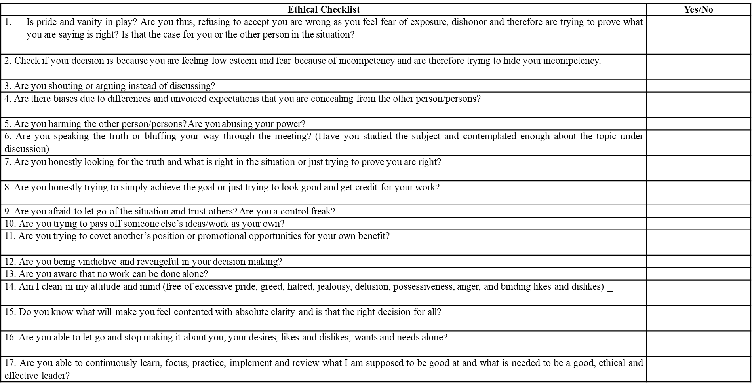

Slide 18
It’s the same story- as even mainstream movies tried to tell us in every era!

Slide 19
This Photo by Unknown Author is licensed under CC BY-NC-ND
This Photo by Unknown Author is licensed under CC BY-NC-ND
The head and the hand need the heart to bring them together!
NOT to dear a HAL but WALL E may be the savior who will teach us to be Human again!
This Photo by Unknown Author is licensed under CC BY-NC
You can get off the grid anytime you want! It is your choice!
This Photo by Unknown Author is licensed under CC BY-NC-ND

Slide 20
Human Use of Human Beings
By understand what it means to be human, you will know your use.
How to then “Be” in an AI world
AI can and will displace jobs. As did the industrial revolution. While the industrial revolution replaced muscle work, AI will displace many repetitive tasks, which is a good thing. It will replace impaired parts as the machine can communicate with itself and with a human.
Know that AI cannot do anything if you do not want it to.
If you enter it without knowing who you are and what you want, it will overwhelm you.
If you figure out who you are and what you want, it will provide you with the knowledge.
So, how to be? Be a human who will not outsource your decisions to an inert machine.
Be a human, who uses AI as a tool and not a crutch
Even when you use it, cite every source and when in doubt, don’t put your name on it.
Anchor your decisions in ethical principles
You set the pace!
Knowing who you are- a human with an indefinite ability for intellectual expansion
Knowing that no matter how many hours of study and training is provided to the animal or machines, they will never “know”.
If you have not figured it out yet- the Zebra does not know you call it the Zebra!
You know and can learn (not accumulate but understand and apply if you want to)
You know and grow through lived experiences

Slide 21
Be good, do good, do all the good you can, to all the people you can, in all the ways you can, for as long as you can. Because to be good is to be Human!
Some Human quotes- does it matter who said it?

