Slide 1
Experimenting with AI for Historical Writing
Cathy Moran Hajo, Ramapo college TECHFEST, March 6, 2024

Slide 2
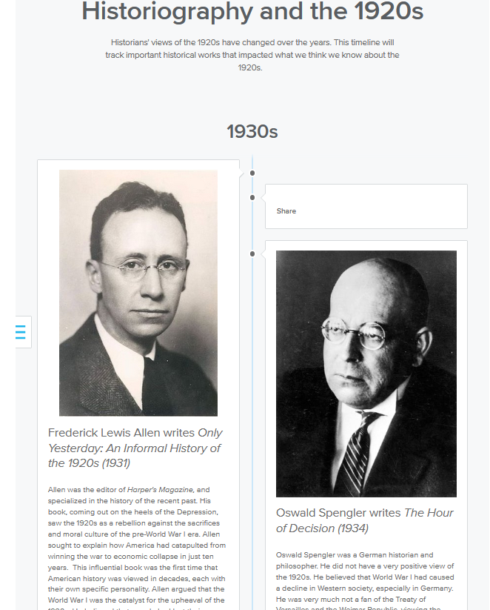
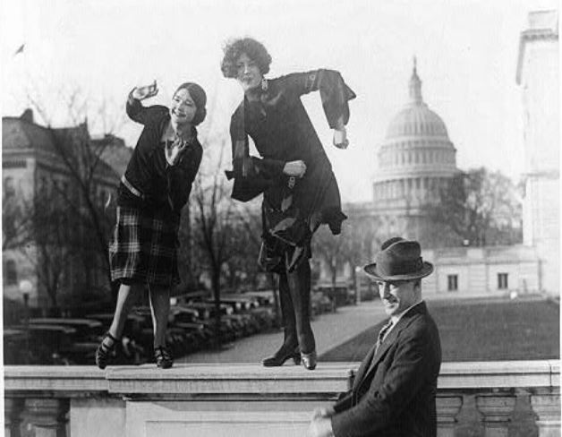
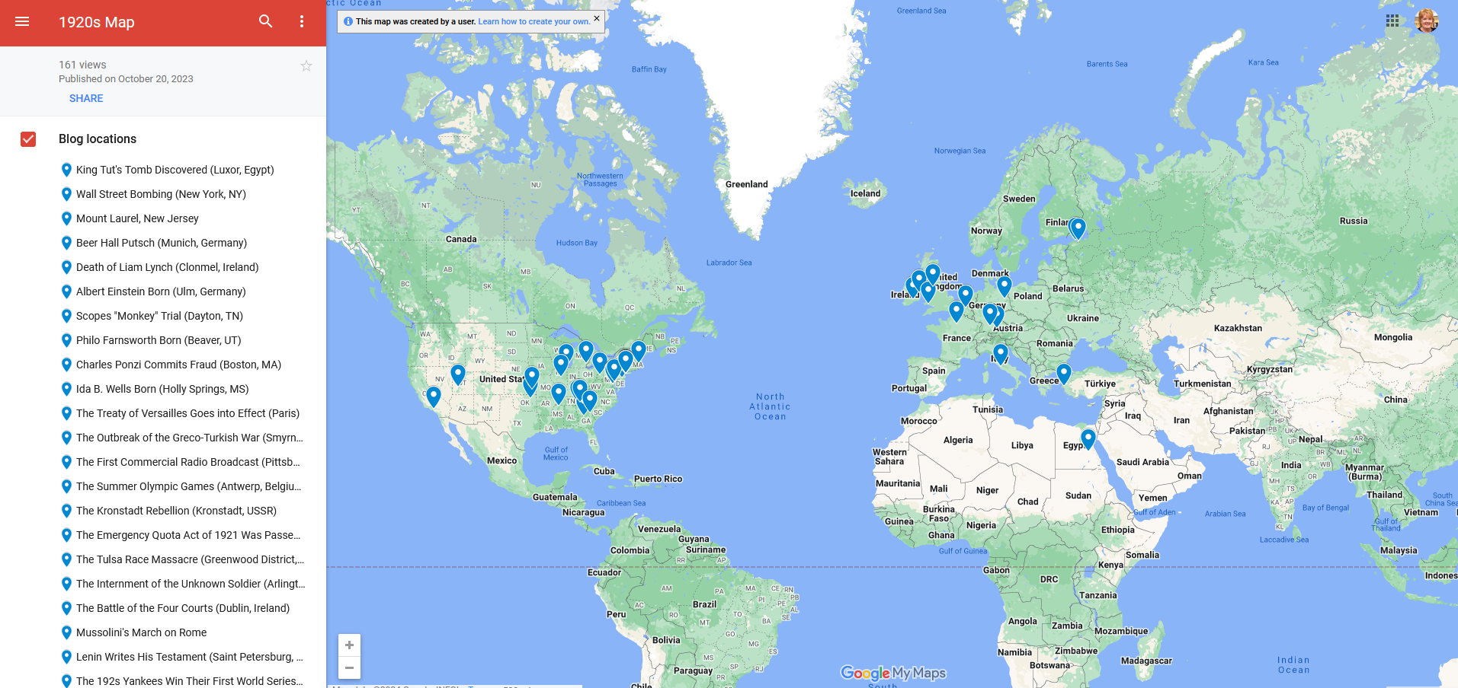
Discovering digital history
200-level History course
Students write two blog posts about a historic event from the 1920s, integrating digital tools like timelines and maps, embed video and audio, and using digitized primary source resources.
Also look at the ways that historians use digital tools.
New assignments this year to investigate and explore best practices for using AI for research and writing.

Slide 3
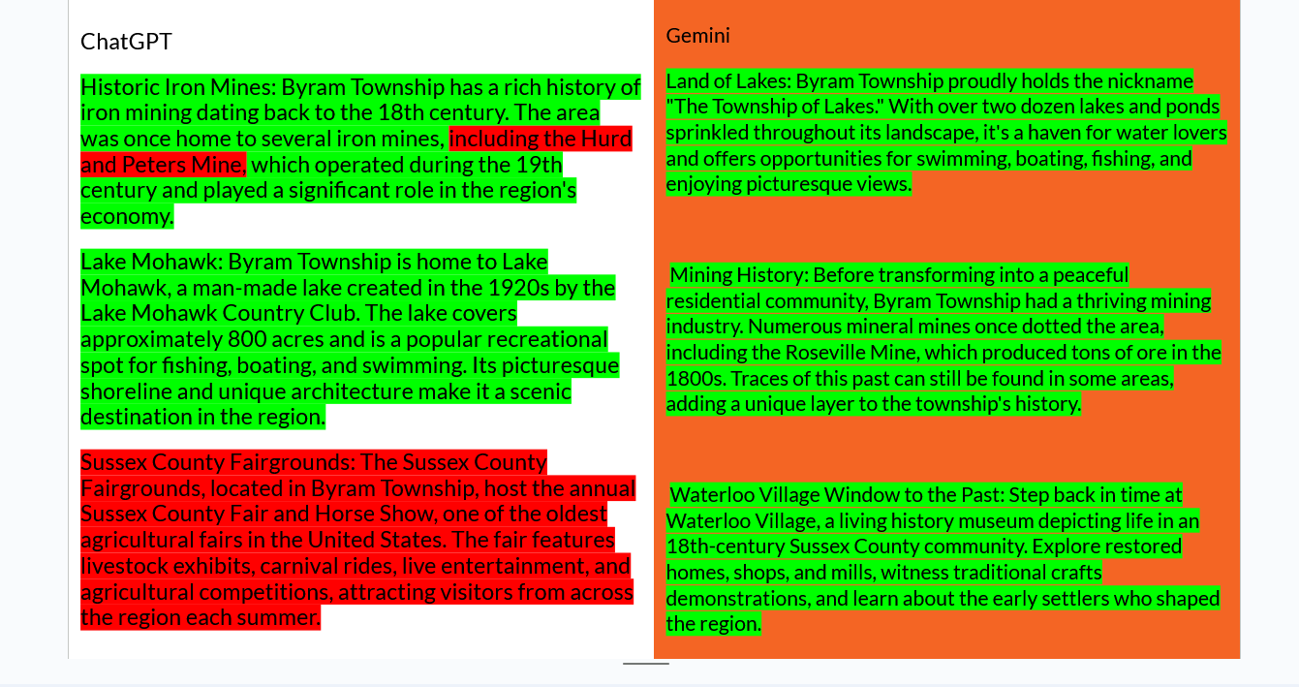
Investigating AI
In-Class assignment, based on the workshop we did last year.
Three questions that you know something about
A general knowledge, pop-culture, or well-known event
A less well-known local event that might have less on the web.
A scholarly question that you might have researched for a previous paper or essay.
Compare at least two AI tools and report on the quality of their work.

Slide 4
Takeways
Healthy suspicion of accuracy of AI
Impressed by its ability to organize information
Concern about sources it uses.

Slide 5
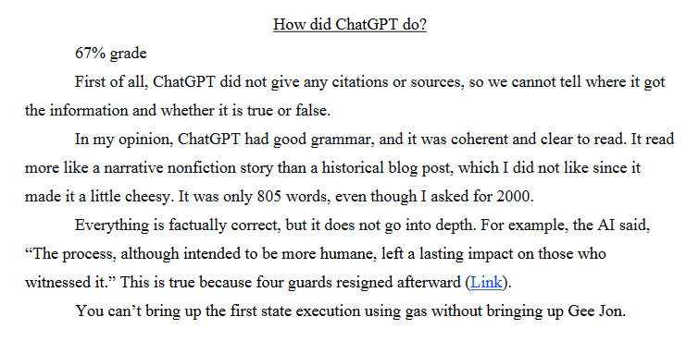
AI as a tool for drafting historical writing
Prompt: Draft a 2000 word college level blog post about the [insert your event]. It should provide a general overview of the event, a detailed breakdown of what happened, and a section that contextualizes its importance to the 1920s. It will be part of a website about the 1920s.
Use two different AI tools, fact-check the essays, marking inaccuracies or stylistic issues.
Grade the AI-generated essay based on the rubric in class.
You can use this as the first draft of your midterm post, but need to make it your own.

Slide 6
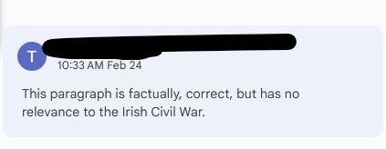
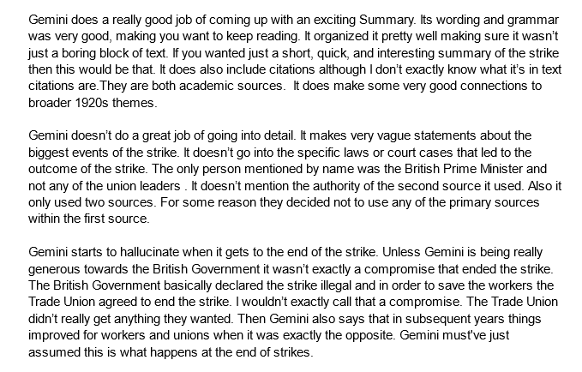
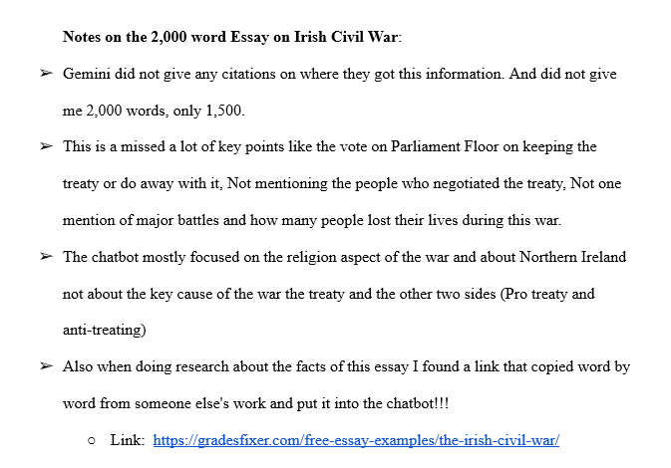
British General Strike of 1926
Familiarized students with rubric and critiquing writing.
Positive takeaways included using it for organization help, found it generally well-written.
Negative takeaways included plagiarism, errors, incapable of generating word count, weak citations.

Slide 7
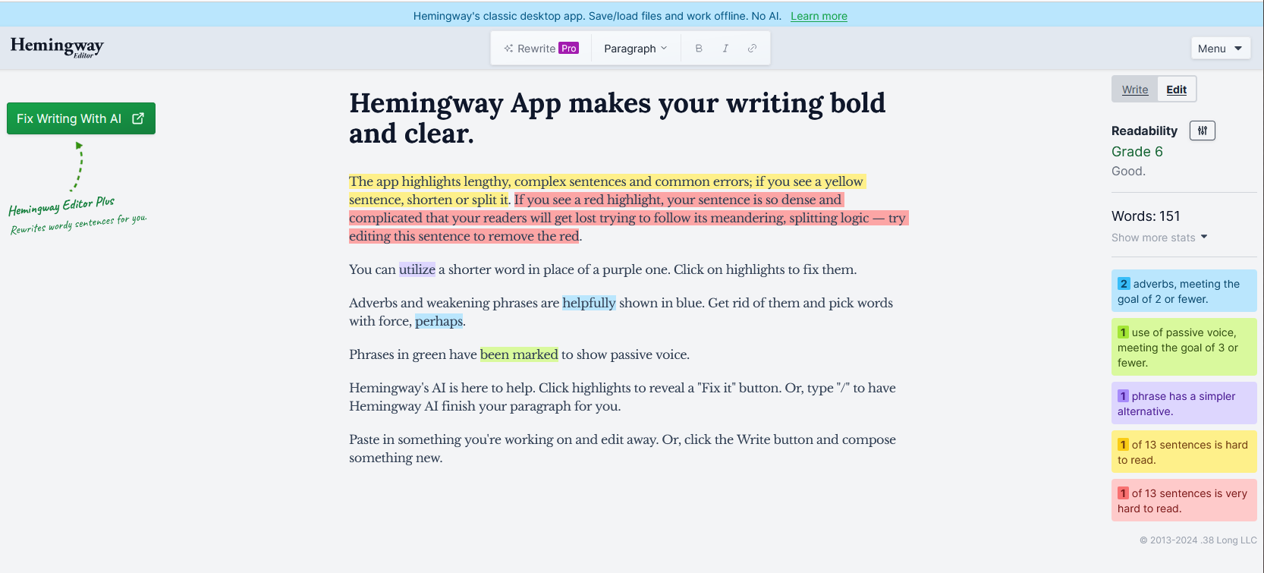
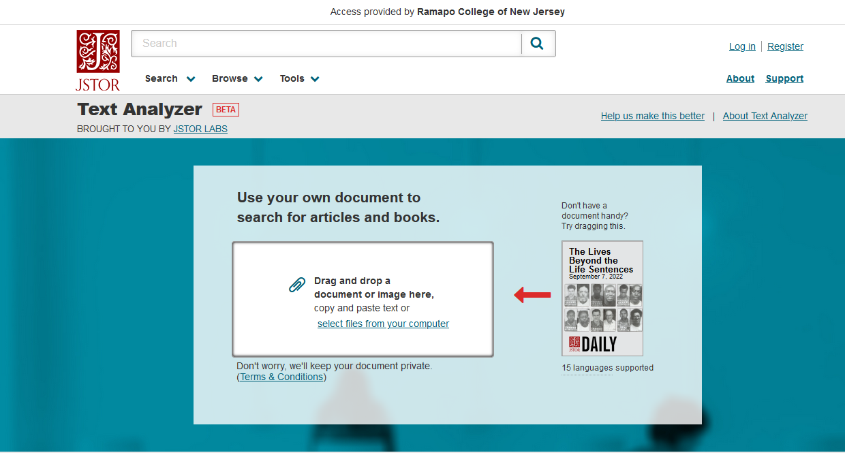
AI as a Tool for Editing Historical Writing
Students will prepare draft essays, critique them using the rubric, and then use AI to improve them.
Grammar and Style: Use AI editors to check reading levels, look for and correct common grammar problems.
Finding Scholarly Sources: Use JSTOR Text Analyzer, a tool that lets you upload your draft work and then uses AI to seek scholarly articles related to your topic.
Report on your findings. Did the tools help you edit your writing and locate new quality sources?

Slide 8
My Goals
Improve the level of writing in the class
Stress the importance of editing their work and thinking about the process of writing.
Stress the importance of fact checking
Understand what AI can do for you and what you might not want it to do.
Understand the strengths and weaknesses of different AI tools

