Slide 1
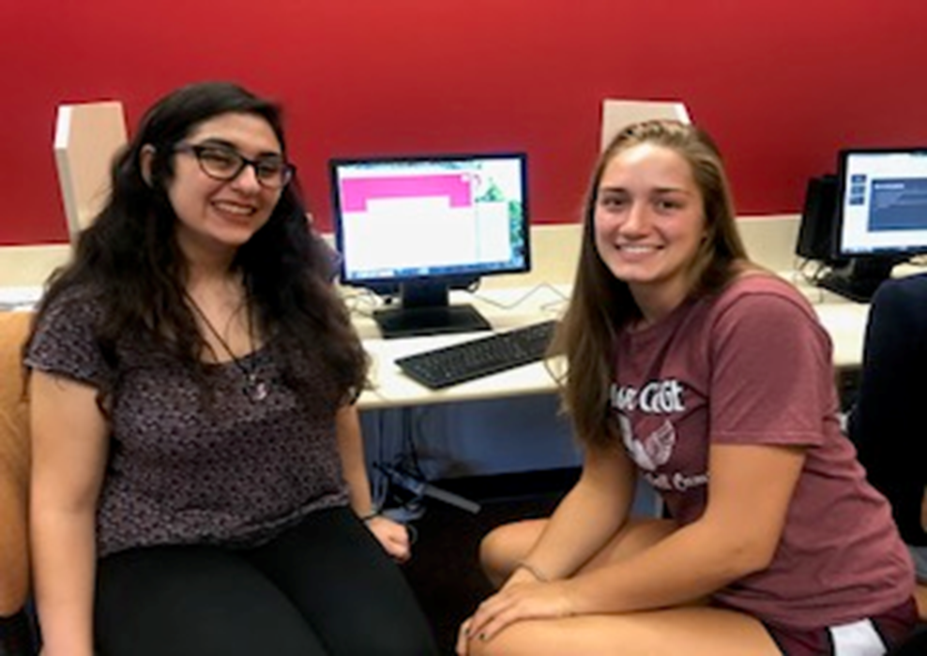
New Faculty Orientation, 2021 Center for Reading and Writing

Slide 2
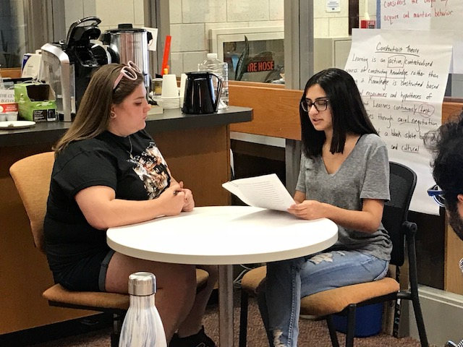
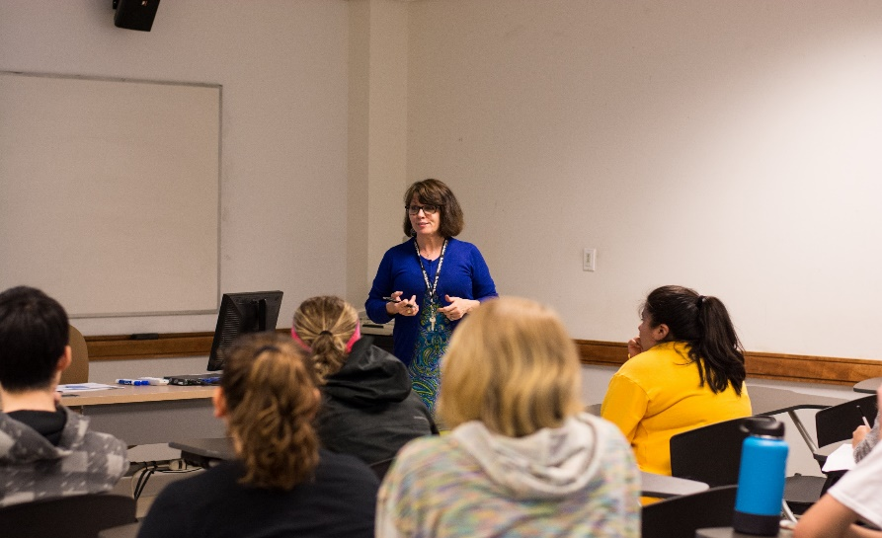
CRW Services
Many faculty require students to use CRW services and provide credit for it.
Writing & reading sessions
Student workshops
Road show presentations
Critical Reading & Writing Program
Class-time writing workshop support, peer consultants
Class-time workshops, professional staff
Faculty workshops (FRC)
Serving Students on All Academic Levels

Slide 3
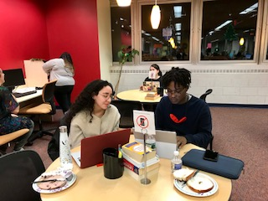
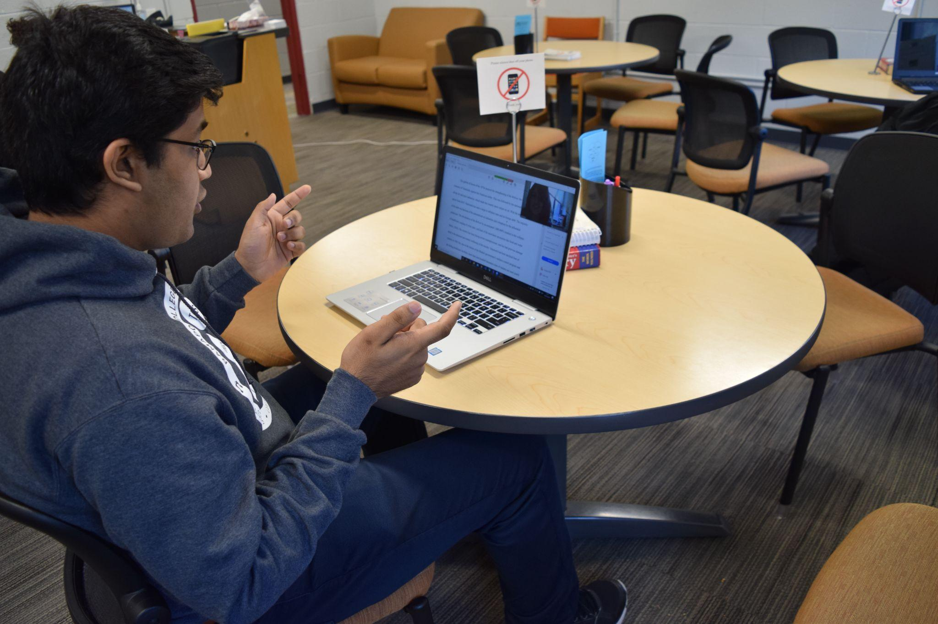
Writing & Reading Sessions
In-person & on Webex
Thesis
Organization
Evidence
Sentence clarity
MLA, APA, Chicago/Turabian
Active reading
Annotating
Questioning
Critical thinking

Slide 4
Appointments, Walk-Ins, & Referrals
Students make in-person and virtual appointments on Connect.
Instructions can be found on the CRW website.
Faculty can refer students to the CRW through the Connect system.
Walk-in sessions are available on Wednesdays from 10-5. Appointments are not necessary.
Students can make appointments or walk-in up until the day before a paper is due. We do not work with students on the due date.

Slide 5
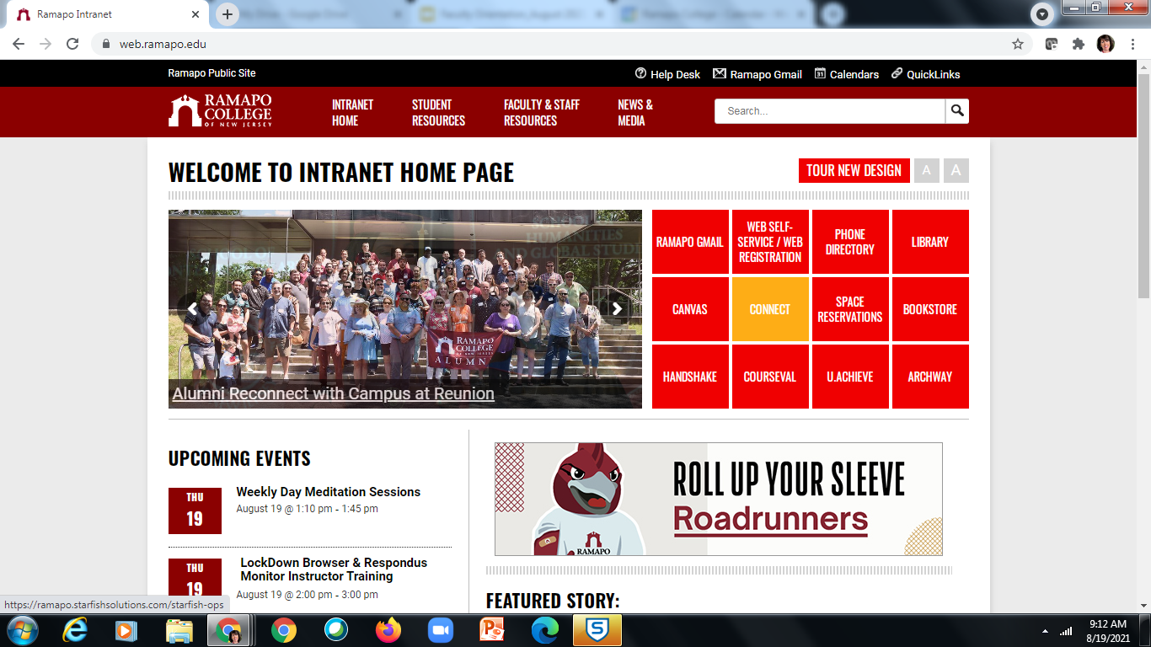
Connect

Slide 6
Student Workshops
Study Skills
Developing an Argument & Thesis
MLA, APA, & Chicago documentation styles
Annotating & Outlining a Text
Avoiding Plagiarism
Reading for the Research Paper
Critical Reading Strategies
Improving Sentences: Avoiding Fragments, Run-ons, & Comma Splices
Email Professionalism
Evaluating Source Credibility
Time Management

Slide 7
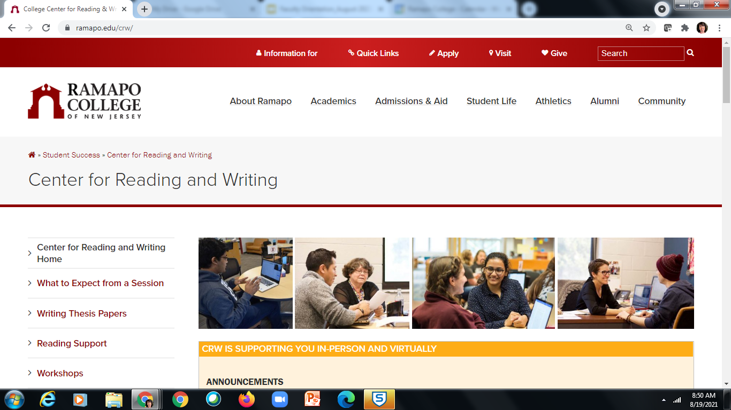
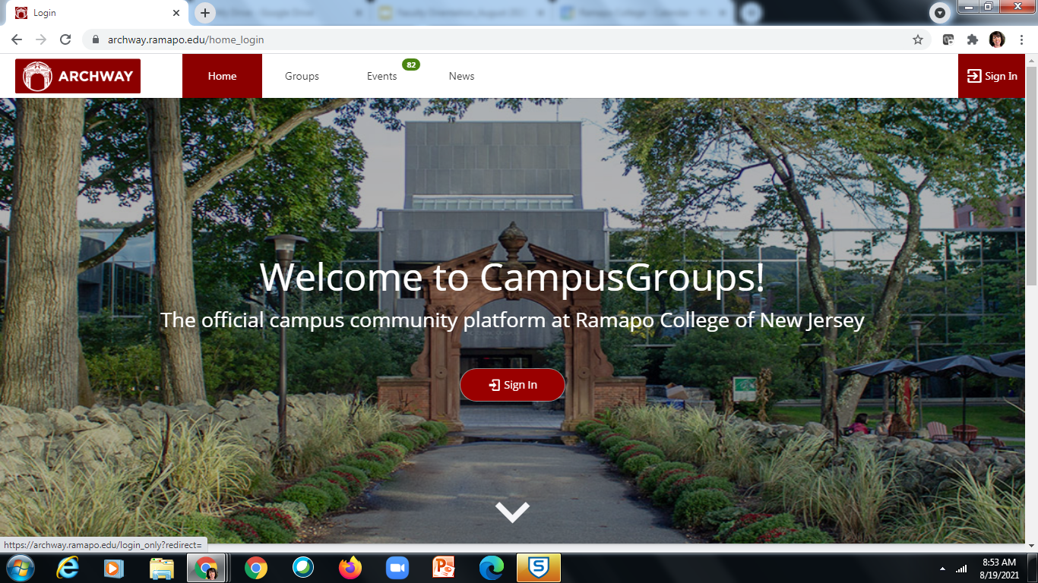
Workshop Registration
CRW website or Archway (app)

Slide 8
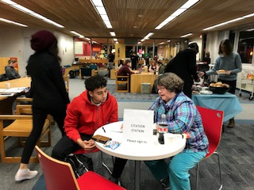
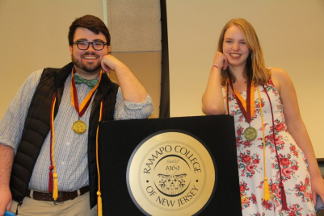
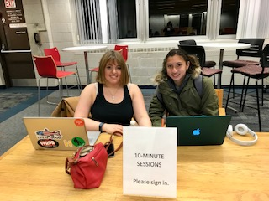
Consultants: Professional and Peer
Professional Consultants
Professional staff who teach Critical Reading & Writing courses
ESL Specialist/Adjunct Professor
Peer Consultants
Academically strong upper-level students
15-20 per academic year
The Center solicits faculty recommendations for consultants and hires students from all majors. Please refer your strong readers and writers to us!

Slide 9
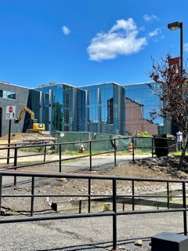
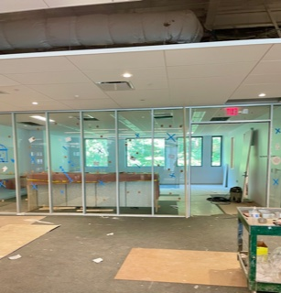
Location and Hours
Location:
New Learning Commons, 4th fl.
Hours:
Mon.-Thurs. 10-5 (in-person);
5-9 (virtual)
Fri. 10-2 (in-person); 2- 5 (virtual)
Virtual appointments available on weekends.

Slide 10
Staff
The Center reports to Dean Susan Hangen, School of Humanities & Global Studies (HGS)
Coordinator of Program and Faculty Outreach: Priscilla Tovey-Van Aulen (ptovey@ramapo.edu)
Developmental Writing Specialist: Ramon Reyes (rreyes@ramapo.edu)
Reading Specialist: Susan Auger (sauger@ramapo.edu)
ESL Professional Consultant/Adjunct Professor: Peg Hartog (phartog@ramapo.edu)
Faculty Liaison: Dr. Todd Barnes, School of HGS

Slide 11
Questions?

