Slide 1
Start Here
Orientation to New Faculty
Ramapo College of New Jersey

Slide 2
Fast Facts about Ramapo
Ramapo College of New Jersey
Founded: 1969
Students: 6,110
Average class size: 23
Just under 50% of our students live on campus
Five colleges/schools; convening groups (not departments) housed within each college/school
Primarily undergraduate, but there are 9 graduate programs

Slide 3
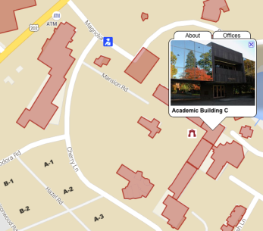
Public Safety
Location: C-102
Go here to get your ID card
Go here for parking passes
Campus Public Safety Emergency: (201) 684-6666
Non-Emergency Calls: (201) 684-7432 (201) 684-7433

Slide 4
Technology Problems?
Just dial 201.684.7777
Tech Support Help Desk
They are not always the answer to your problem, but they will connect you to the right person!

Slide 5
Academic Calendar
http://www.ramapo.edu/academic-calendars/
Important Dates:
First Day of Classes
Labor Day (college closed)
Add/Drop Ends
Last Day to give a “W” Grade
Thanksgiving Break (college closed)
Spring Break (college closed)
Reading Day (no classes)
Final Day to Give an “I”
Final Exams
Note: classes held, offices closed on certain days!

Slide 6
Meeting Schedule
Visit the following link to the Faculty Meeting Calendar:
https://www.ramapo.edu/fa/calendar/
-Faculty Assembly
-Unit Council Meetings
-AFT Union Meetings
-Major/Minor Convening Group Meetings

Slide 7
Finishing Up the Semester
Course Evaluations:
electronic versions
Final Exam Schedule:
http://www.ramapo.edu/web-resources/exams/

Slide 8
Questions?
Contact your convener!
Contact your Unit secretary!
Contact me!

