Slide 1
New York’s Farm to School Program Origins, Goals, and Lessons Learned
Kristy Apostolides, Regional Farm to School Coordinator, Cornell Cooperative Extension/Harvest NY

Slide 2
Who is in the room?
Students
Faculty
Administration (school or government)
Food Service Professionals
Farmers/producers/growers
Other (please state)
Notes:
State wide services linking university learning to local communities. Operate in collaboration with local county extension offices.

Slide 3
Harvest New York is an innovative Cornell Cooperative Extension team that focuses on development projects in the farm and food industries in all of New York State. There are five project areas:
Local Food Distribution and Marketing
Urban Agriculture
Urban Gardens
Farm-Based Beverages
Emerging Crops
Notes:
State wide services linking university learning to local communities. Operate in collaboration with local county extension offices.

Slide 4
Program Goals
Develop resources, trainings, technical assistance to support supply chain partners
Farm to School Regional Coordinator Program Activities
Provide boots on the ground support directly to supply chain partners.
Provide statewide support via resource development, training, and technical assistance to supply chain partners.
Strengthen the campus-to-community connection by identifying and developing opportunities for applied Farm to school research.
Provide direct support in procuring NYS food products
Notes:
Goals of Farm to School Program – more NY food in schools

Slide 5
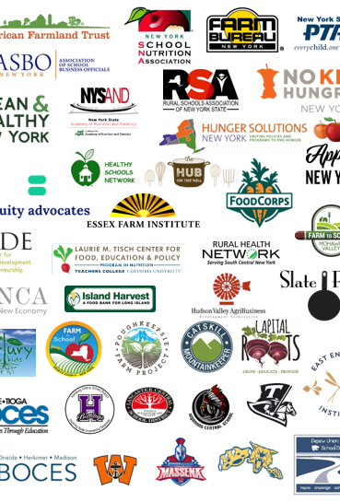
New York Grown Food for New York Kids Coalition
Over 150 organizations and individuals advocating for Farm to School policy with the legislature and administration in New York since September 2017
Notes:
Couldn’t have done work without advocacy organization, American Farmland Trust
And a reminder about the initiative we coordinate, FINYS

Slide 6
Farm to School in New York
2001
NYS Creates Farm to School program
2015
Farm to School Grants Program launched
2017
AFT/FINYS forms New York Grown Food for New York Kids Coalition
2018
2020
2021/2022
No Kid Hungry Initiative launches Farm to School Incentive
2019
Evaluation of program after Year 1
Growing Opportunity report
Evaluation of program after Year 2
Growing Reseilience report
Advocacy to expand Incentive program
Notes:
Samantha
And a reminder about the initiative we coordinate, FINYS

Slide 7
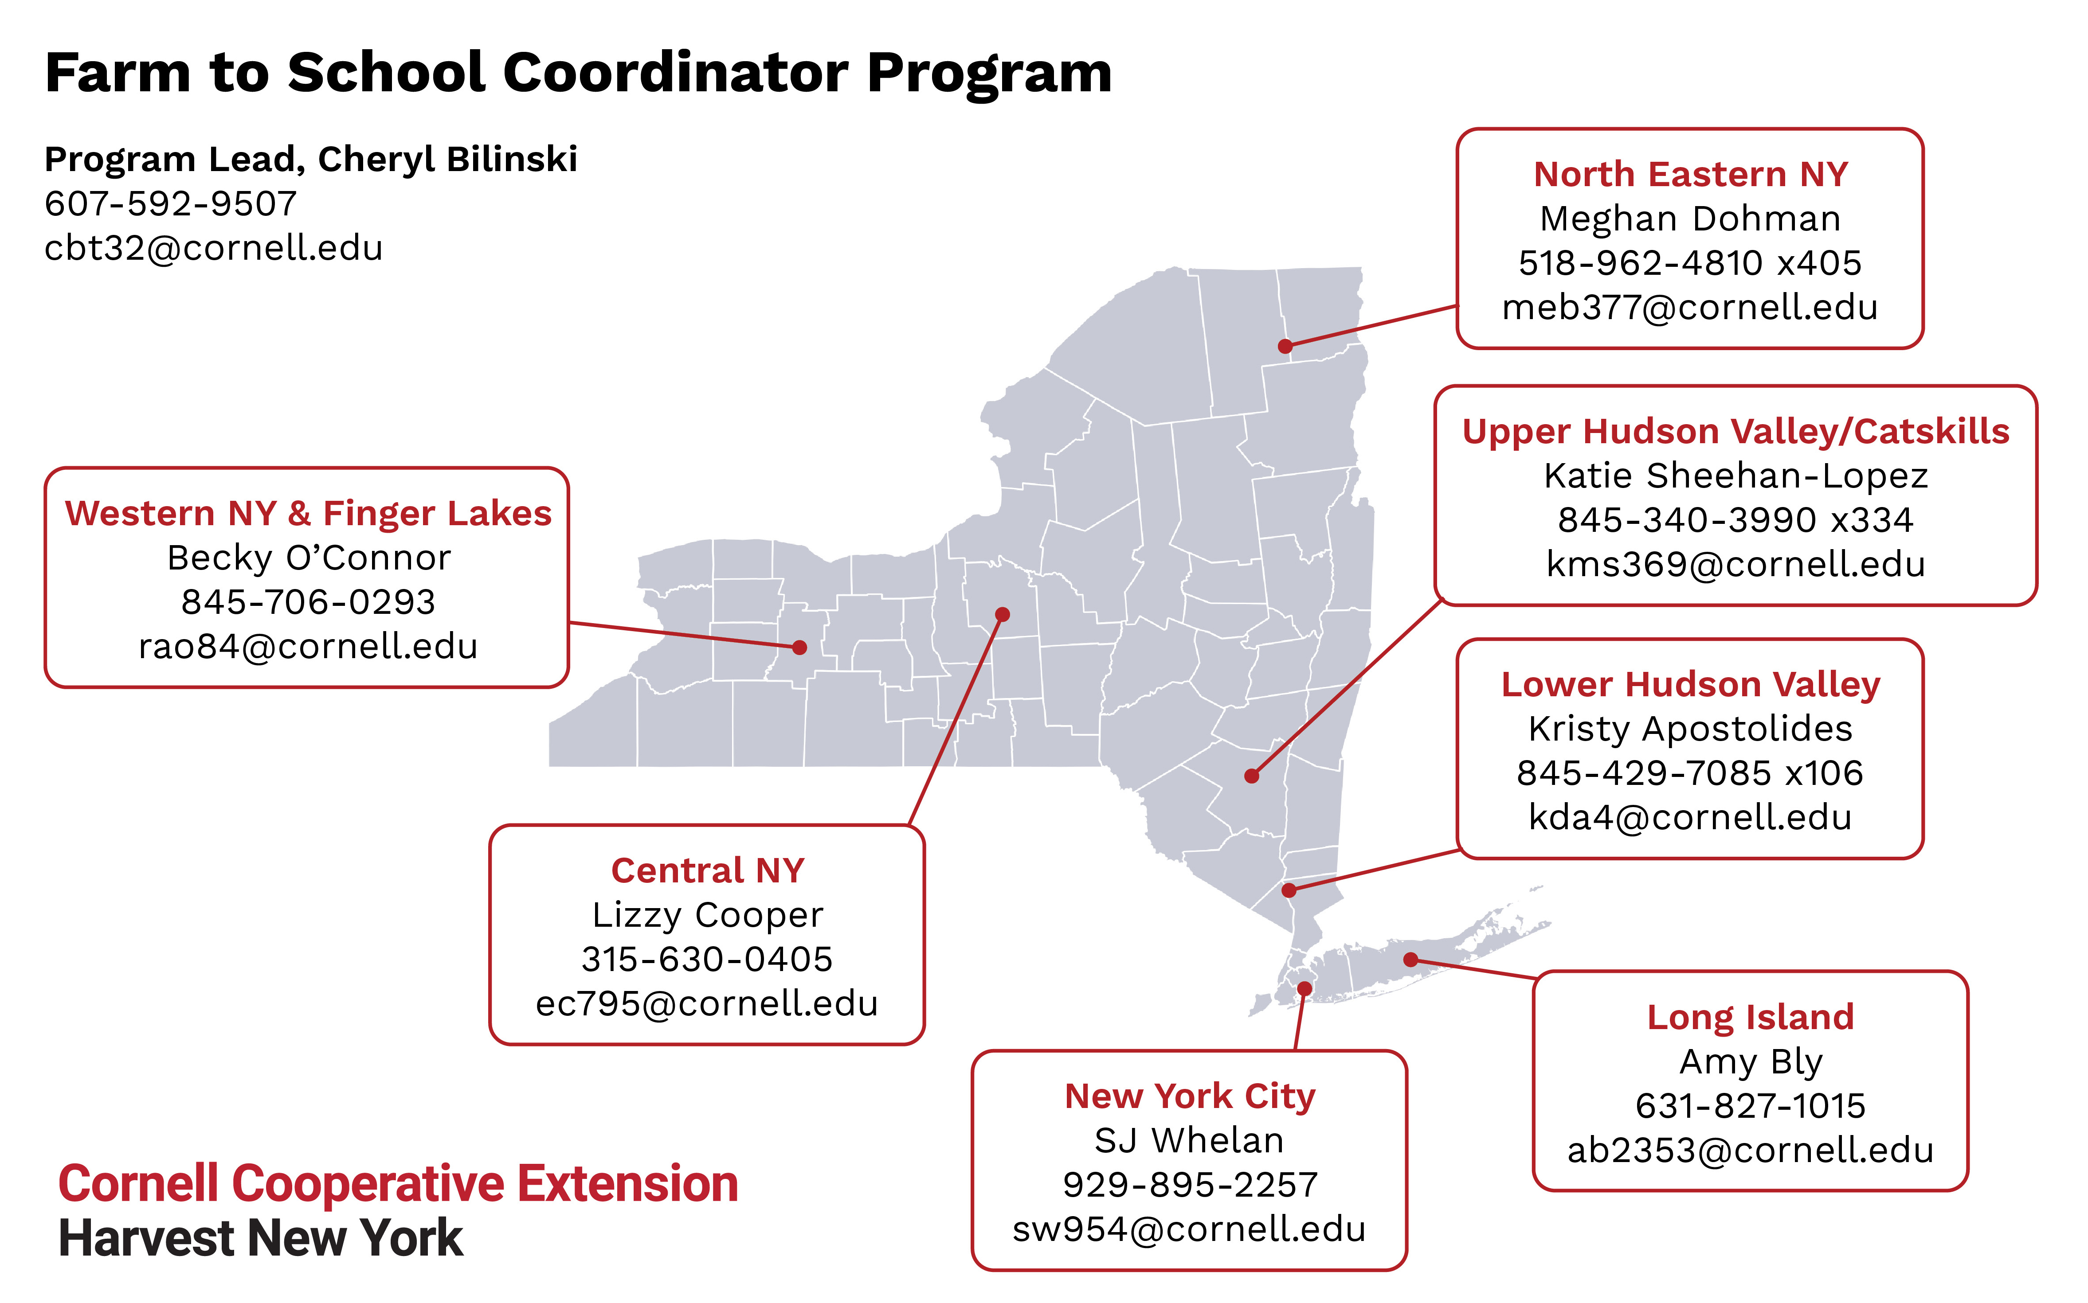

Slide 8
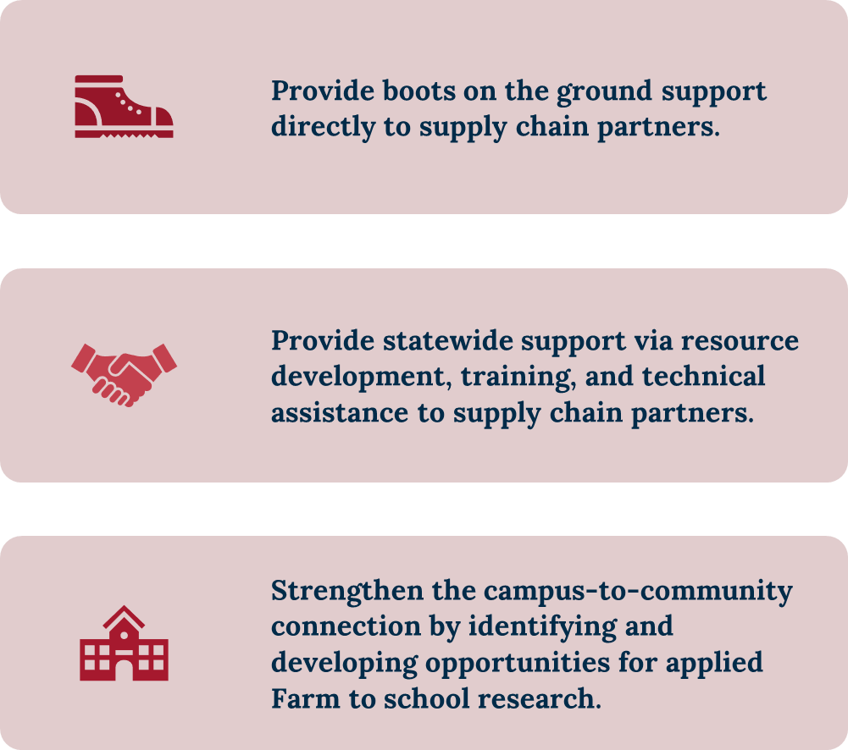
Farm to School Regional Coordinator Program Scope of Work

Slide 9
The 3C’s of Farm to School
In the Classroom
Ag in the Classroom
Harvest of the Month/Jersey Tastes
In the Cafeteria
Local procurement
In the Community
Farm Tours
“In order for Farm to School to take root, the value must be experienced by a diversity of players in a school and communicated to the extended school community…this work cannot be done in isolation.” -VT Feed

Slide 10
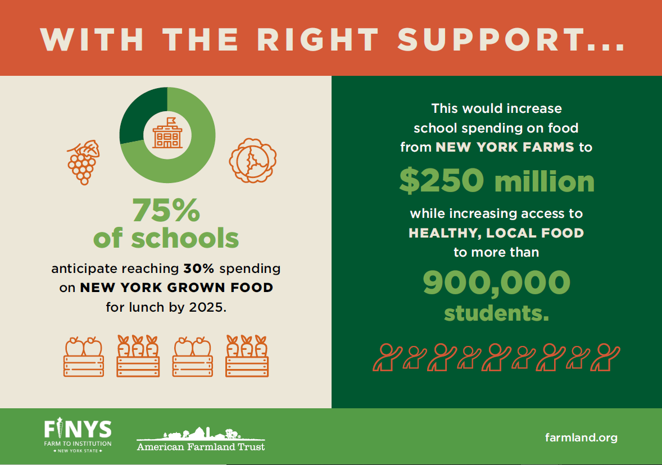
Notes:
Looking ahead, we did projections both years asking schools when they might reach 30% with the right support, and projecting impact on kids, farmers and the economy

Slide 11
This could generate nearly $360 million in total economic impact
statewide while only costing the state of New York $103 million.
If 75% of schools spend 30% of breakfast costs on New York grown food, this would mean over $78 million in annual spending on food from New York farms with over $112 million in total yearly statewide economic impact.
Incentivizing schools to purchase more New York grown food to serve to students at breakfast and lunch could unlock roughly half a billion dollars in statewide economic impact.​
Notes:
Total projected impact of the program from that outcome—and return on investment from the state. Can see how this makes a compelling case to continue!
A return on investment of $3.50 in economic activity for every taxpayer dollar spent.

Slide 12
Local Foods for Schools
Funds must be spent on minimally processed products…produce is a great fit!
Special emphasis is placed on supporting small businesses and/or socially disadvantaged
Purchases expected to begin Spring 2023

Slide 13
Opportunity
546 Districts
384 in Local Food for Schools Program
77 in Bergen, Sussex and Passaic Cos.
$4.9 million to increase schools’ purchase of nutritious, local foods for school meal programs

Slide 14
Important Definitions
School Food Authority (SFA) - The governing body responsible for the administration of meal programs at schools. SFAs may serve one or several school districts, or individual schools and are managed by a food service director.
New York Food Product - Whole foods or minimally processed items grown, harvested, or produced in New York State (NYS); or a processed product comprising over 51% agricultural raw materials grown, harvested, or produced in NYS, by weight or volume.
Minimally Processed Food Item – Food items that retain their original characteristics, including: raw agricultural products and those that are chopped, cut, sliced, diced or shucked. Does not apply to any products that have been cooked, heated, canned or that have any additives or fillers
Notes:
Mikaela: if we say NY Grown food, or local or locally sourced, we mean NYFP, if we say school, we mean SFA
A school food authority is an entity authorized by the gov’t to administer child nutrition programs. CN programs are….
SFAs are not always synonymous with the school district they serve
White Milk is minimally processed chocolate milk is not

Slide 15
30% New York State Initiative
Chapter 56 of the Laws of 2022 provides school food authorities (SFAs) with increased State reimbursement for the purchase of New York State (NYS) food products for school lunch programs.

Slide 16
How the 30% Initiative Works
School Food Authorities (SFA) that spend at least 30% of lunch food costs on New York State Food Products from farmers, growers, producers, or processors quadruple their per-lunch-meal reimbursement from the state, increasing it from 6 cents to 25 cents during the following year.
To qualify SFAs MUST take part in the National School Lunch Program.
September - June
Program Year
Schools submit applications
August
Application audits
July
Next September-June
Successful schools receive additional $$
Notes:
Samantha
And a reminder about the initiative we coordinate, FINYS

Slide 17
30% Initiative Documentation
What is a NY Food?
A food item that is grown, harvested, or produced in NYS
A food item processed inside or outside NYS comprising over 51% agricultural raw materials grown, harvested, or produced in NYS, by weight or volume.
Documentation:
Include farm name and address on invoice
For distributors, include NY in invoice and a letter with all farms of origin
Processed products, Product Formulation Statement

Slide 18
SFAs Qualifying for 30% NYS Initiative Program

Slide 19
Definition Challenges
NY FOOD PRODUCT- Items grown, harvested, or produced in New York State (NYS); or a processed product comprising over 51% agricultural raw materials grown, harvested, or produced in NYS, by weight or volume.
LOCAL – can be any geographic designation motivated by different goals:
Supporting local economies (i.e county is local)
Getting better quality food into schools (i.e region is local)
Supporting sustainable food growing methods (i.e state to cut down on food miles and support diversified farming systems)
GEOGRAPHIC PREFERENCE – application of this rule is confusing
Notes:
Nyfp: There is some confusion in the state regarding legacy “local” promotional programs – i.e. those that are just processed in the state using ingredients from elsewhere are often thought to be eligible products when they are not.
Local: Challenges with farms located on state borders – local might have a different (and more geographically logical) definition, but not eligible for 30%
GP: can define local as a border or radius, but needs to not be too limiting. Also can only apply to unprocessed or minimally processed products. Awards are made based on a point allocation that creates a lower final bid price that can mean a legal awards, but the bid price is paid without the points price removed.

Slide 20
Supply Side Challenges
Complicated bid process not familiar to local farms
Product availability may not meet supply needs:
Type of product (whole food items)
Volume of product too small or too great
Without purchasing NY milk, 30% has been unobtainable
Favorable pricing at other markets (retail, wholesale)
Notes:
Type of product: there are not many processors in local areas

Slide 21
School Side Challenges
Procurement is complicated
Additional work to procure NY product either using small/micro purchases or formal bids
Often working with multiple vendors
Seasonality of product needs to be a consideration
Processed products are predominately featured NYFPs
Schools not equipped with staffing knowledge or facilities to scratch cook
Cost
Local food is often more expensive
Justifying spending school food dollars on local products that can purchase with entitlement funds
Pathways
Both a challenge and an opportunity, there are many different ways that SFAs have achieved 30%
Notes:
Processed prods: (NY Milk removed from calculation)

Slide 22
Tracking & Paperwork
Supply chain
Product formulation statements
NY Grown & Certified
SFA
Production statements
Milk tracking
Vendor velocity reports
NY State Audit
Notes:
Products need to be individually certified either through the NY Grown and Certified program or filling out a product formulation statement showing origin percentage of ingredients.

Slide 23
Meeting in the middle
Food supply needs to be there at the time that school kitchens and staff have the equipment and knowledge to handle product
This means work is needed on both ends at the same time:
Schools:
Cooking skills and recipes
Familiarity with locally available product
Equipment
Tracking support
Farms
Processing
Distribution
Bid response
Notes:
More IQF products
More pre-cooked or par-cooked items
Help organizing distribution routes or getting distributors to carry products
Training for farms to successfully respond to bids

Slide 24
Support for schools vs farms
What kind of support does each group need?
Education training for sustainability and by-in: involvement from teachers, admin and food service
Food service might need training in how to handle fresh product, seasonality
Educators might want to build it into curriculum to reinforce students trying new things – if they grow it they will eat it. If they learn about dairy will try milk, if they learn about an orchard will try concord grapes, if they meet the farmer, they will try their food
Importance of regional coordinators to manage supply chain
For the product to get to the school doors, distribution, production, processing needs coordination
Farms need to supply more than one school for profitability
Coordinating bids and products that appear on bids
Distributors need help/encouragement to carry new products, often before the see the demand from schools (chicken/egg)
Processors need guidance in school market – what will sell?

Slide 25
Coordinators & Farm to School grants (facilities end)
From district to regional coordinators

Slide 26
Many pathways to 30% (and role of dairy)
Strategic Use of Entitlement Funds
7 SFAs reduced their use of USDA beef in order to purchase more local beef. SFAs 3 SFAs 9 SFAs 4 SFAs
3reduced their use of USDA cheese to increase use of local cheese.
9reduced their use of multiple commodities to purchase more local foods
4 reduced their use of just one USDA food to purchase more local foods

Slide 27
Pathway to the 30%
Determine baseline
Find and incorporate NYFPs
Bid and buy strategically
Track and document as you go
Calculate 30% expenditure
Notes:
Have an excel calculator to estimate dollar amount
Can look through one month’s worth of purchases to estimate how much more would need to purchase (often when consider milk and apples, schools are already purchasing between 18-20% local product)
Take a look at product that you want to buy and figure out how to procure them
Make sure tracking happens throughout the year….did you separate breakfast from lunch milk? Some people only serve chocolate at lunch to make it a bit easier.

Slide 28
Pathway to the 30%
Find and incorporate NYFPs
30% NY Database
Product substitutions (milk, diary, applesauce, grape juice)
Incorporate high cost items as a featured item
Notes:
To successfully incorporate local product, you might need to make a few changes.
more planning of purchases to accommodate seasonally available products
Changes to how things are bid – using the available tools: small and micro-purchases, geographic preference
Working as a team with other districts to meet minimums and keep costs down
It is necessary to look at your purchase practices and make changes in order to incorporate local products.
You can balance the higher cost of local products with the entitlement products with smart planning. We will talk about some of these techniques.
Remember the reimbursement might cover any extra costs incurred

Slide 29
Pathway to the 30%
Bid and buy strategically
Alter what/how you buy with entitlement funds
Blend commodity foods with NY foods
Use entitlement funds for products not available in NY (bananas)
Front- and back-load menus with NYS items
NY apples, beets, cabbage, onions, potatoes available year round! Some like carrots and winter squash you can find through March.
September
October
May
June
Broccoli
November
Spinach
Spinach
Broccoli
Cauliflower
Cucumbers
Summer Squash
Lettuce
Peppers
Lettuce
Lettuce
Summer Squash
Summer Squash
Cauliflower
Lettuce
Cauliflower
Cucumbers
Tomatoes
Collard Greens
Kale
Broccoli
December-April
Commodity purchase:
PILOT
DoD Fresh Vegetables
USDA Foods
Notes:
To successfully incorporate local product, you might need to make a few changes.
more planning of purchases to accommodate seasonally available products
Changes to how things are bid – using the available tools: small and micro-purchases, geographic preference
Working as a team with other districts to meet minimums and keep costs down
It is necessary to look at your purchase practices and make changes in order to incorporate local products.
You can balance the higher cost of local products with the entitlement products with smart planning. We will talk about some of these techniques.
Remember the reimbursement might cover any extra costs incurred

Slide 30
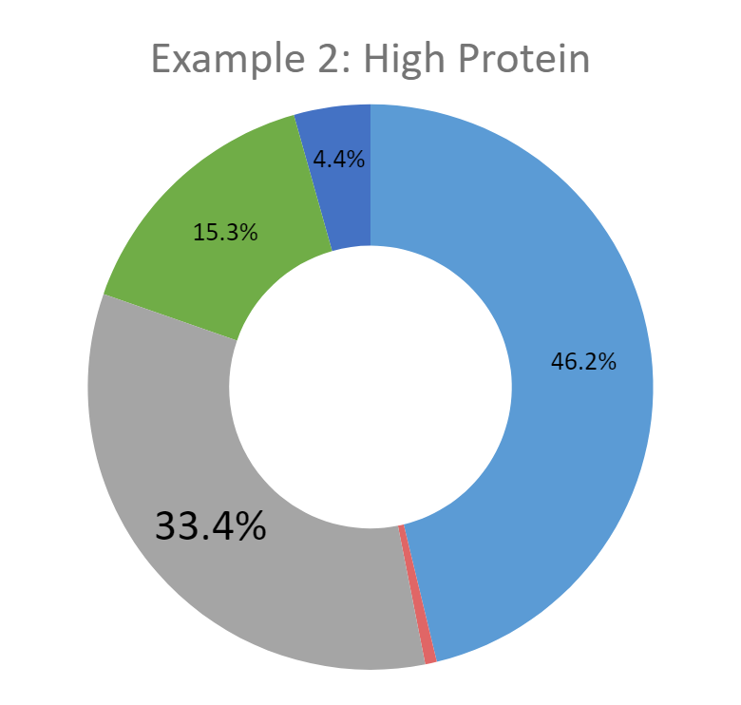
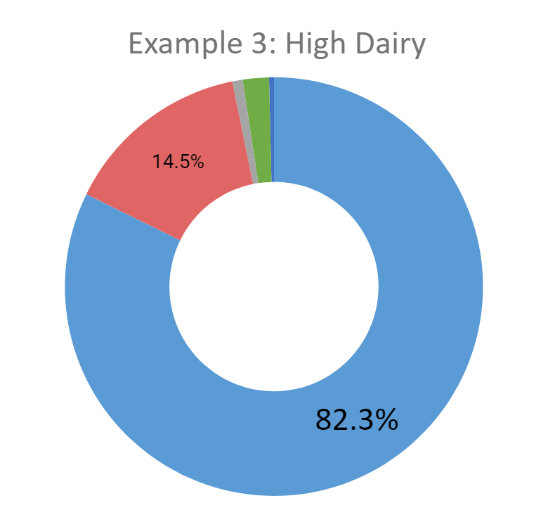
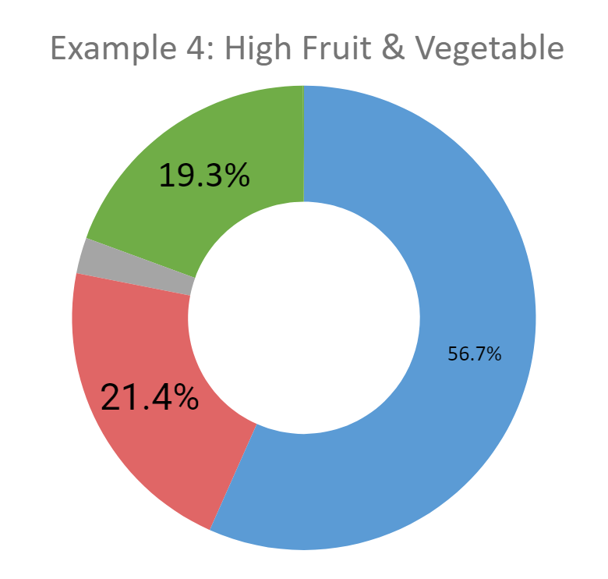
Multiple Ways to get there
Dairy | Fruit | Vegetables | Protein | Other Item | Grains
Notes:
This slide present four unique pathways individual SFAs took to achieve the 30%.
There is no one size fits all approach
Dairy is the blue potion of the wheel, which illustrates the previous point about the importance of dairy.
There is no one size fits all approach, it depends on your district, your menu, what you have access to

Slide 31
Overview of NY Purchases
CATEGORY | TOTAL SPENT | RANGE OF NY PURCHASE PERCENT | MOST PURCHASED ITEM IN CATEGORY
DAIRY | $2,877,275 | 25.3%-82.3% | Milk
FRUIT | $1,020,919 | 0.0%-30.9% | Grape Juice
PROTEIN | $492,720 | 0.0%-33.4% | Hot dogs
VEGETABLES | $456,922 | 1.4%-30.6% | Leafy Greens
GRAIN | $52,636 | 0.0%-2.3% | Pita Chips
OTHER ITEMS | $121,537 | 0.0%-15.0% | Egg rolls
Notes:
Katie
This is an overview of total 30% purchases, broken down by product category,
We want to illustrate the dramatic range of purchases by category, and indirectly, the multiple pathways.
You can get to 30% without all 5 components
Some SFAs spent as much as 80% of their total NYSFP expenditures on dairy, but some, less than 30%
This range is repeated in all categories:
Fruit from 0 to 30% of all NY food
Vegetables from about 1%-30%
Small amount of grains (up to 2%)

Slide 32
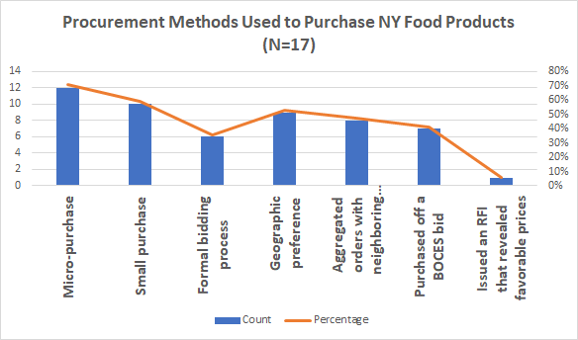
Procurement Methods
71% of SFAs used micro purchase
59% used small purchase
51% used geographic preference
47% aggregated orders with neighboring SFAs
Notes:
Katie
We asked Food Service Directors that achieved the 30% which procurement methods were used to purchase NY Food Products.
Most used micropurchases-31% of FSDs said it was the most helpful tool to achieving the 30%.
Almost all used more than one of these tools

Slide 33
Average Profile of a Successful SFA
Bidding through a BOCES
Self Operated
Supported by a F2S Coordinator (either regionally or at the school or district level)
Received NY Milk
Notes:
Although there were many ways to get there, these were common elements in the majority of schools that successfully achieved purchasing at least 30% NYFP for their NSLP.

Slide 34
AFT’s Farm to School Research
Growing Opportunity
Rollout of Farm to School Incentive
Barriers to purchasing local items
Key to success
Growing Resilience
300 School Food Authorities surveyed in July 2020
54% response rate
Findings generalizable statewide to a reasonable degree
Photo by Josh Baldo
Notes:
As some of you may know, in 2020 American Farmland Trust released its Growing Opportunity report, which looked at the launch of the incentive, what barriers schools were facing purchasing New York items, and what factors helped schools be successful. This research raised more questions for us, so we conducted follow up research this past summer and published our Growing Resilience report in December. We surveyed 300 school food authorities from across the state and had a 54% response rate, and analysis of our sample showed our findings are generalizable statewide to a reasonable degree.

Slide 35
Program Evaluation
What impacts is this program having?
What key barriers are schools facing?
What policy changes are needed to continue growing farm to school in New York?
Notes:
Challenges with farms located on state borders – local might have a different (and more geographically logical) definition, but not eligible for 30%
With Geo Preference also causes confusion, but GP allows you to define local so can be state border (reminder only with non or minially processed items)

Slide 36
After two Years, Students had increased access to nutritious New York products while growing new markets
Fruit
Vegetables
Fluid Milk
Processed Products
87%
54%
51%
42%
Other Dairy
Animal Protein
Honey/Maple Syrup
32%
22%
4%
Notes:
A few of the outcomes we found:
Year one and two, reported increases in purchases of fruit, vegetables, and milk were in the top three. There was a higher increase in vegetable purchases this year than last year. Also seeing more processed products purchases as more products become available/adopted. As a refresher, processed products mean products where processor is buying at least 51% of raw ingredients from New York farmers. These are serious new markets created for farmers. The jump from 3% to 42% indicates intense market growth that is worth celebrating. Frequently cited products included grape juice, French fries, and apple sauce.

Slide 37
Cost remains the #1 Barrier to Purchasing Local Food
Notes:
In both years of our research, we found that cost was the #1 barrier to purchasing local food. Selection and availability of items offered by vendors rose from #3 to #2. Rounding out the top 5, we see that NY suppliers are not least cost bidders. Schools face budget limitations, and they have a lack of time to collect documentation

Slide 38
1.
2.
3.
4.
5.
6.
7.
8.
9.
10.
Lack of time to collect documentation
Lack of staff time to prep New York grown food
Current vendors sell little or no New York grown food
Suppliers of New York grown food are not least cost bidders
I wouldn’t know where to start [purchasing from New York farms]
Budget limitations
NY producers aren't bidding
There aren’t enough shelf stable local products in the winter
Cost of New York grown food too high
Vendors can’t provide documentation to affirm sourcing
*
Barriers
to Program Participation
*
Notes:
When asked to rate these barriers in context of participating in the 30% Initiative, we see that both cost-related issues fell significantly, with cost of NYFP dropping from #1 to #9.
Documentation jumped from #5 to #1,
lack of staff time #2, current vendors sell little/no still in top 5, as is suppliers not least cost bidders.
Rounding out our top 10, we see that [the rest]
New York city also identified the barriers marked with asterisks, and also said that New York grown food often did not meet their specifications, quality standards, or food safety certification requirements, and that the school’s payment system was also likely incompatible with farmer vendors.

Slide 39
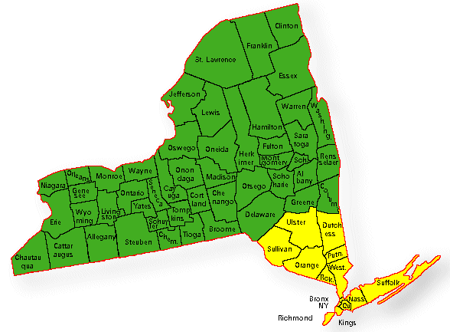
Which Schools Buy Local?
Upstate schools were statistically more likely to report buying New York grown food than downstate schools (p=0.002)
Trend of Non-Urban schools more likely to report buying New York grown food than Urban schools (p=0.088)
Upstate NY
Downstate NY
Notes:
In addition to tackling the question of milk access, we also need to understand and address potential inequities in access to local foods for school districts in urban areas. In our research, We found that upstate schools, defined as all counties above Ulster, Dutchess and Sullivan were more likely to report buying NY food than downstate schools.

Slide 40
Implications for Equitable Access
Upstate and non-urban schools have disproportionately higher percentages of white students. (p <0.001)
Downstate and urban schools have disproportionately higher percentages of Black and Hispanic students. (p<0.001)
Upstate NY
Downstate NY
Notes:
This, of course, has implications for who has access to New York grown food, as upstate and non-urban schools have disproportionately higher percentages of white students, and downstate and urban schools disproportionately higher percentages of black and Hispanic students.
We did collect data from the 5 largest public school districts—NYC, Albany, Syracuse, Rochester and Buffalo—and with the exception of Albany, all were buying NY grown food and serving it to their students. Since these schools serve 80-85% of the students in these urban areas, this means most of those kids are still getting access to NY grown food at school, but more research is needed to better understand the needs of urban districts and who has access to NY grown food and who doesn’t in NY cities.

Slide 41
The Road Ahead
Update 30% program to include all school meals, with an additional 11 cent reimbursement per breakfast meal
Increase funding for Farm to School Grants program
Grow Regional Farm to School Coordinator network
Change procurement law to better support local food purchases
Notes:
Challenges with farms located on state borders – local might have a different (and more geographically logical) definition, but not eligible for 30%
With Geo Preference also causes confusion, but GP allows you to define local so can be state border (reminder only with non or minially processed items)

Slide 42
Lessons Learned
Farm to School Incentives and Grants Programs go hand in hand to support New York schools in buying local. Farm to School Coordinators are Key
Review State Procurement Laws Regulations and remove barriers they may create to buying local
Identify and address supply chain gaps

Slide 43
Lessons Learned
Consider adapting New York’s incentive program for New Jersey’s unique needs
30%? Review where schools are at and design a percentage threshold that is challenging, yet achievable
Create definitions for which purchases should qualify and communicate them up front
Create documentation and tracking guidelines that ensure program integrity yet are not too burdensome and communicate them up front
Incentivize purchase at all school meals, rather than just lunch
Incentivize* participation by FSMCs
Notes:
Although the FSMCs are usually national or sometimes international corporations utilizing a business model that has lowered pricing on raw agricultural products to the point where it no longer meets the cost of production, so I don’t think they should be rewarded for squeezing their suppliers. I don’t know what a good way to encourage them would be, except that when money can’t or shouldn’t incentivize, often organizing and amassing support is. So getting enough schools to write this requirement into their bid for contracts might be crucial and even maybe regulating this requirement.

Slide 44
Thank you! Questions?
Kristy Apostolides
Regional Farm to School Coordinator
Harvest NY, Cornell Cooperative Extension
kda4@cornell.edu

