Slide 1
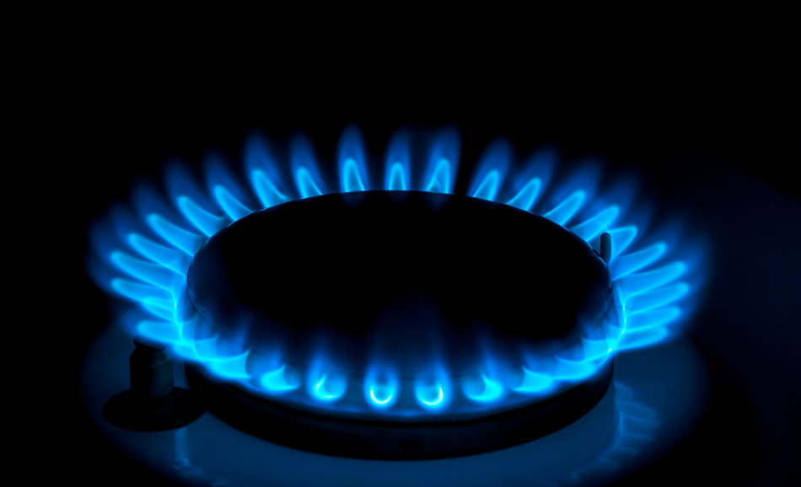
Natural gas
Justin Yan

Slide 2
What is natural gas?
Natural gas is a fossil fuel originated from the remains of plants and animals.
Natural gas contains many compounds including methane, which is the largest component.
Natural gas is generally used as a fuel source, and is also used to make other materials.
Russia is a leading exporter of natural gas.

Slide 3
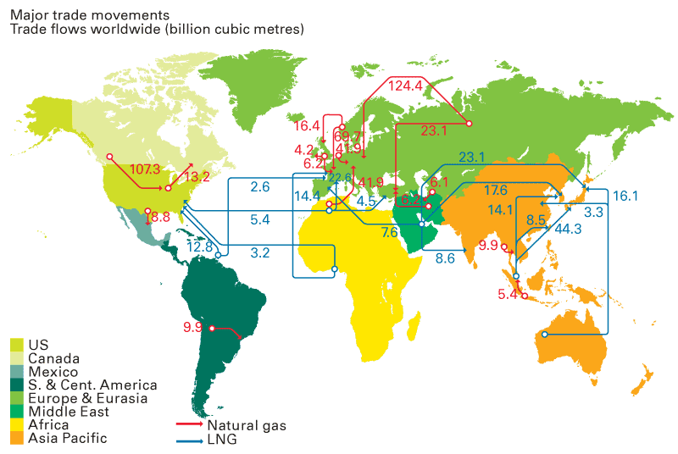
Where it is produced?
Outside of the US, the countries that produces natural gas includes Russia, Qatar, Iran, Canada, and China.

Slide 4
Map Flows
Distribution of natural gas

Slide 5
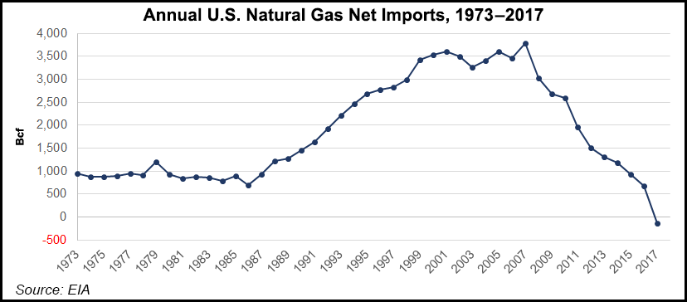
Imports to the United States
U.S. imports of natural gas had been declining since 2007 since the U.S. is a producer of natural gas.

Slide 6
Gazprom
China National Petroleum (CNPC)
Royal Dutch Shell
BP

Slide 7
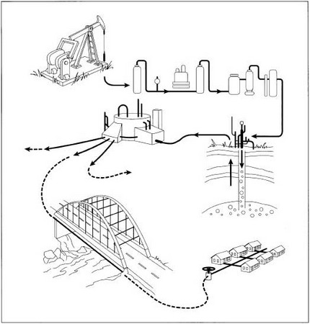
Production Process
1. Extraction
Many wells require a pump to allow gas to flow to the surface.
When the raw gas reaches the surface, it is separated from any oil that may be present and piped to a nearby central gas processing plant.
2. Processing
During processing, many materials such as dirt is removed to prevent contamination, and corrosion.
The processing of natural gas makes it cleaner and burn hotter to the point the gas is considered to be “upgraded”.

Slide 8
3. Transporting
The processed gas received its odor with Mercaptan, and piped to a compressor station to increase pressure.
The gas is transported to several major underground pipelines.
When it reaches is final destination, the gas is injected back to the ground for storage.
4. Distribution
If needed, the gas is transported through pipelines to cities at pressures up to 1000 psi so the gas can be used.
If piped to houses and businesses, the pressure is reduced to 0.25 psi.

Slide 9
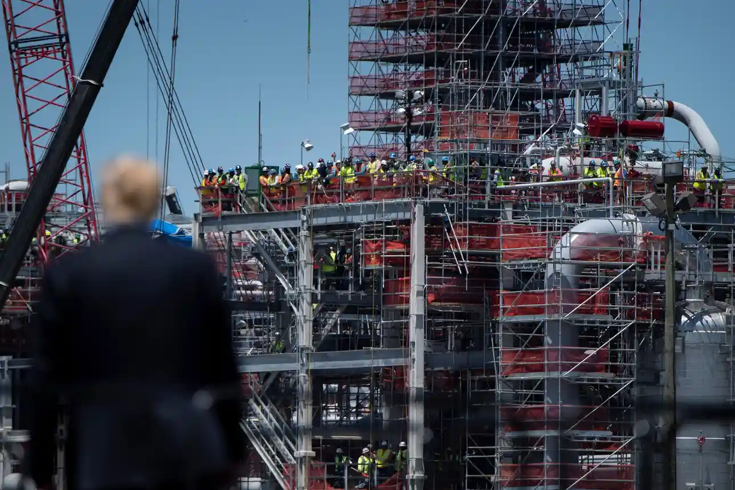
Hindering natural gas flows
Due to environmental concerns, many nations including the EU ended support for fossil fuels.
Phase-out of natural gas and other usage of fossil fuels by 2050.
Can affect transportation.
Push-back from the gas industry over job losses and the effects from the economy

Slide 10
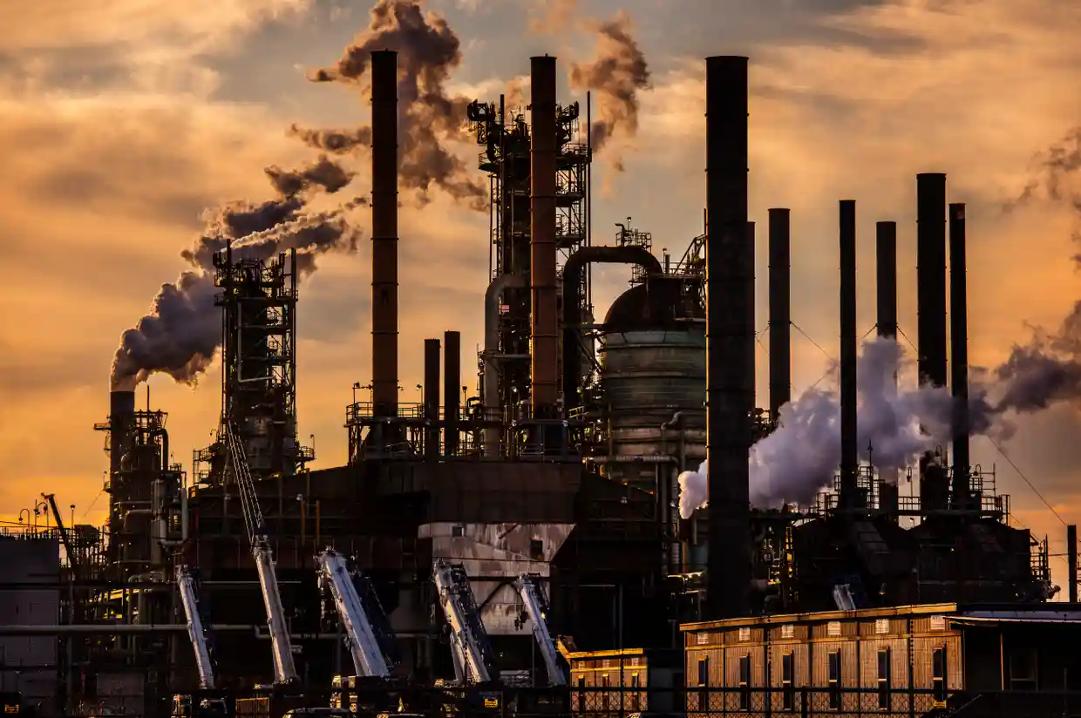
Enabling Natural gas flows
Natural gas is usually pushed by the gas industry for being an alternative to other fossil fuels, and necessary for the economy, and clients needing gas fireplaces.

Slide 11
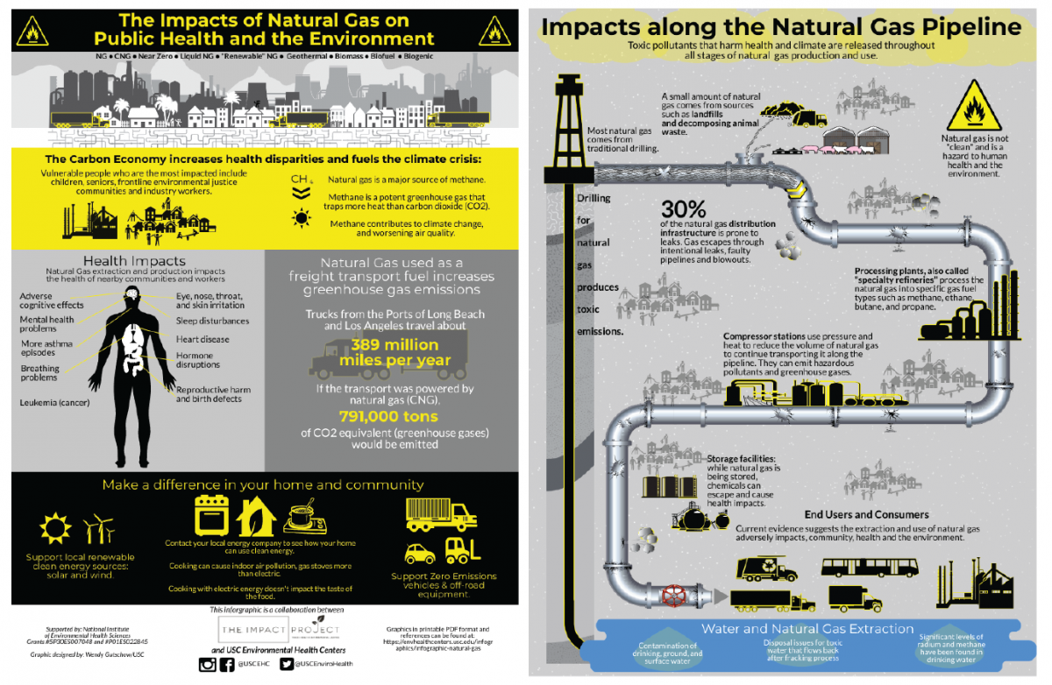
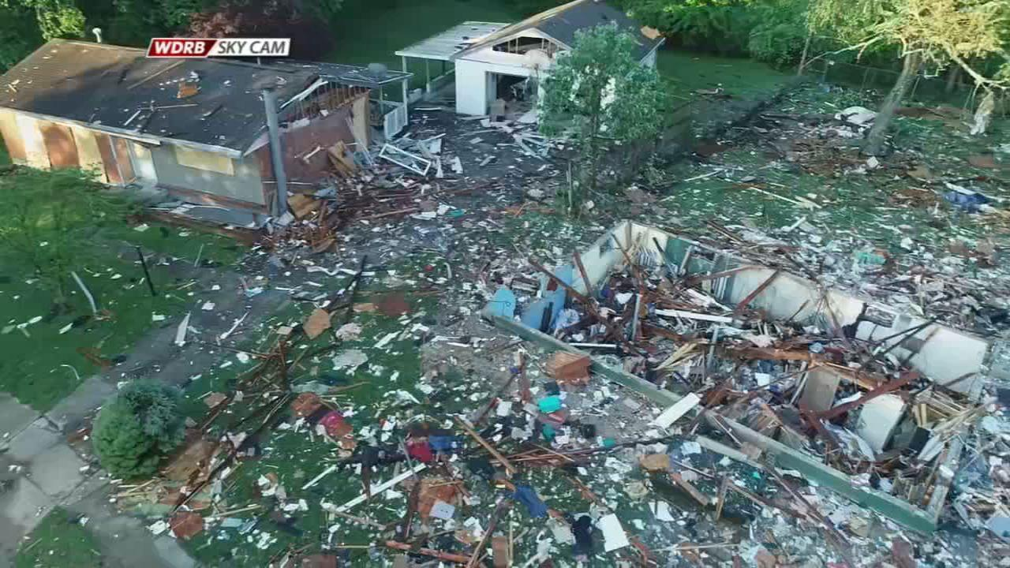
Controversy
Lack of strong health and safety measures affecting many workers.
Since natural gas is a fossil fuel, it contributes to global warming such as pollution, especially when it comes to fracking.
Land allocated can bring harmful pollutants to streams.
Natural gas pipelines are susceptible to gas leaks, which can explode destroying houses, potentially displacing people such as a house explosion in Jeffersonville, Indiana

Slide 12
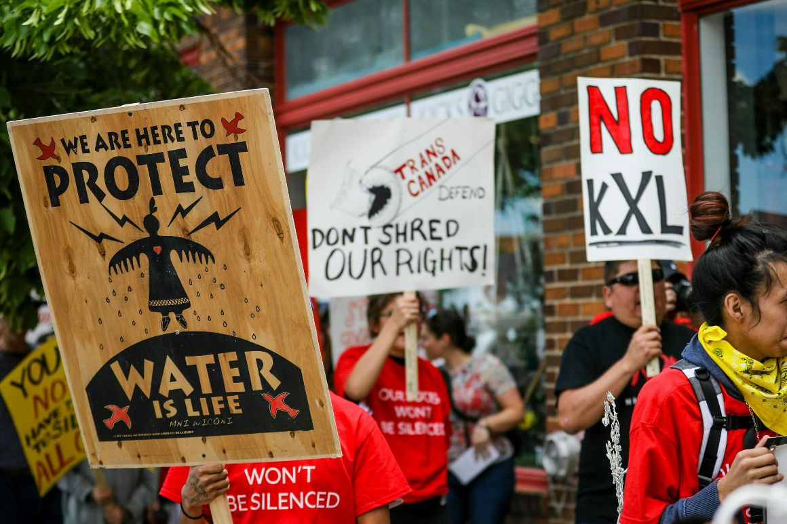
Protests and campaigns
There are many social movements, protests, and campaigns throughout US, and Canada against natural gas under fear of displacement due to construction of Keystone XL and Dakota Access pipelines.

Slide 13
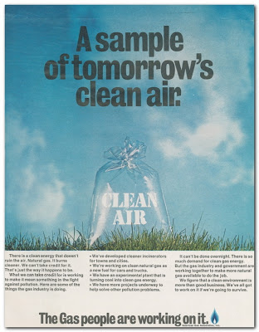
Advertising
The desires for natural gas has increased due to demand consumption growth for exports and industrial use.
Natural gas was advertised within the social status is seen as an alternative clean energy source that can reduce economic losses from pollution from coal and petroleum.

Slide 14
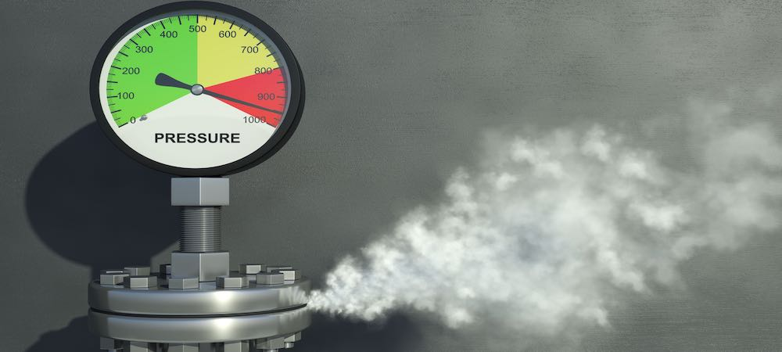
Commodity fetishism
There is knowledge on the problems with natural gas.
The problem involves gas leaks since it does not pose a immediate threat to safety.
The average consumer was unaware about a gas leak unless they notice a physical signs or symptoms.
Consumers may need to research where natural gas is produced or where it came from though they might not care if they know about it.
Even if they know about natural gas, it is hard for the consumer to rely heavily on natural gas for heating and cooking.

Slide 15
Taking Action
To tackle natural gas and fracking, consumers can contact entities at a federal, state, or local level to make a big impact on natural gas.
Contacting political entities at a federal or state level can motivate to take action on natural gas with strong wars due to concerns on the impact on the environment, and other controversies and dangers.
One way to take action on a local level is to push for small-scale ideas with representatives to limit fracking.
An action I will take based on the above is to push for ideas at a local level first before going forward to state and federal levels to take action on natural gas. Specifically, I would push for measures to limit fracking in busy cities.
Though there may be a possibility of fracking operations moving elsewhere.

Slide 16
Link to in-class reading
Anderson “International Studies” Chapter 18. ”Global Climate Change”
About greenhouse gasses
Natural gas is a fossil fuel which produces a greenhouse gas known as carbon dioxide, which contributes to climate change
When doing this project, this reading explains why climate change is a major issue in today’s world
The big picture
How can we tackle natural gas and fracking in order to combat climate change?

Slide 17
Sources
2019. “Natural Gas Leak Sparked Massive Home Explosion in Jeffersonville, Police Say.” WDRB, May 22. Accessed April 16, 2021. https://www.wdrb.com/news/natural-gas-leak-sparked-massive-home-explosion-in-jeffersonville-police-say/article_9e52b16a-7c18-11e9-8b5f-e350101abe7c.html.
2020. “Revealed: How the Gas Industry Is Waging War against Climate Action.” The Guardian. Guardian News and Media, August 20. Accessed April 16, 2021. https://www.theguardian.com/environment/2020/aug/20/gas-industry-waging-war-against-climate-action.
Anderson et. all, 2007. International Studies: An Interdiscplinary Approach to Global Issues. Routledge.
Baron, Richard Laurence. 1970. “A Natgas Ad from Life Magazine – the Issue with Jane FONDA on the Cover...,” January 1. Accessed April 16, 2021. http://signalwriter.blogspot.com/2011/10/natgas-ad-from-life-magazine-issue-with.html.
Bradley, David. 2018. “For First Time Since 1958, U.S. Became Net Natural Gas Exporter Last Year, FERC Says.” Natural Gas Intelligence, April 19. Accessed April 13, 2021. https://www.naturalgasintel.com/for-first-time-since-1958-u-s-became-net-natural-gas-exporter-last-year-ferc-says/.
Carpenter, J. William. 2020. “The Top Natural Gas Companies in the World.” Investopedia. Investopedia, August 28. Accessed April 13, 2021. https://www.investopedia.com/articles/markets/030116/worlds-top-10-natural-gas-companies-xom-ogzpy.asp.
D'Antonio, Isabelle. 2019. “House Explosions Are Rare but Have Had a Deadly Toll across the Country.” Journal. Courier Journal, May 23. Accessed April 16, 2021. https://www.courier-journal.com/story/news/local/indiana/2019/05/23/jefferonsville-indiana-home-explosion-how-common-are-gas-explosions/3734516002/.
“Environmental Impacts of Natural Gas.” Union of Concerned Scientists. Accessed April 16, 2021. https://www.ucsusa.org/resources/environmental-impacts-natural-gas.

Slide 18
Sources
Euractiv, Kira Taylor for. 2021. “'Gas Is over': EU Bank CHIEF Signals Phaseout of Fossil FUEL FINANCE,” January 21. Accessed April 16, 2021. https://www.climatechangenews.com/2021/01/21/gas-eib-president-signals-complete-phase-unabated-fossil-fuels/.
“Leak Detection Services in Phoenix.” Day Night. Accessed April 16, 2021. https://www.stampedeplumbing.com/gas-leak/.
Lefebvre, Ben, and Eric Wolff. 2020. “Major Pipelines Take Hit, but Oil Networks Keep Growing.” POLITICO. POLITICO, July 20. Accessed April 16, 2021. https://www.politico.com/news/2020/07/20/oil-networks-pipelines-374440.
https://link.springer.com/chapter/10.1007/978-3-319-59734-8_4
Lucas, Dave. 2020. “Blockades across Canada to Protest Pipeline | Pictures.” Reuters. Thomson Reuters, February 26. Accessed April 16, 2021. https://www.reuters.com/news/picture/blockades-across-canada-to-protest-pipel-idUSRTS31YE3.
Mall, Amy. 2016. “More Reports of Unsafe Work Conditions in the Oil and Gas Industry, This Time for Hispanic Workers.” NRDC, December 15. Accessed April 16, 2021. https://www.nrdc.org/experts/amy-mall/more-reports-unsafe-work-conditions-oil-and-gas-industry-time-hispanic-workers.
“Natural Gas.” How Products Are Made. Accessed April 16, 2021. http://www.madehow.com/Volume-6/Natural-Gas.html.
“Natural Gas Reserves by Country.” Worldometer. Accessed April 13, 2021. https://www.worldometers.info/gas/gas-reserves-by-country/.
https://www.researchgate.net/figure/Major-trade-movements-in-natural-gas-Source-BP-Statistical-Review-2009_fig2_284027212
“Signs and Symptoms of a Gas Leak.” Medical News Today. MediLexicon International. Accessed April 16, 2021. https://www.medicalnewstoday.com/articles/321277#physical-symptoms.

Slide 19
Sources
“USC Environmental Health Centers.” NEW INFOGRAPHIC: The Impacts of Natural Gas on Public Health and the Environment - USC Environmental Health Centers. Accessed April 16, 2021. https://envhealthcenters.usc.edu/2020/05/infographic-natural-gas-public-health.html.
“U.S. Energy Information Administration - EIA - Independent Statistics and Analysis.” Growing industrial consumption and exports support future U.S. natural gas market growth - Today in Energy - U.S. Energy Information Administration (EIA). Accessed April 16, 2021. https://www.eia.gov/todayinenergy/detail.php?id=46757.
“U.S. Energy Information Administration - EIA - Independent Statistics and Analysis.” Natural gas explained - U.S. Energy Information Administration (EIA). Accessed April 13, 2021. https://www.eia.gov/energyexplained/natural-gas/.
“Why Are Natural Gas Leaks a Problem?” Environmental Defense Fund. Accessed April 16, 2021. https://www.edf.org/climate/methanemaps/leaks-problem.
Zissu, Alexandra. 2019. “How to Tackle Fracking in Your Community.” NRDC, June 7. Accessed April 16, 2019. https://www.nrdc.org/stories/how-tackle-fracking-your-community.

