Slide 1
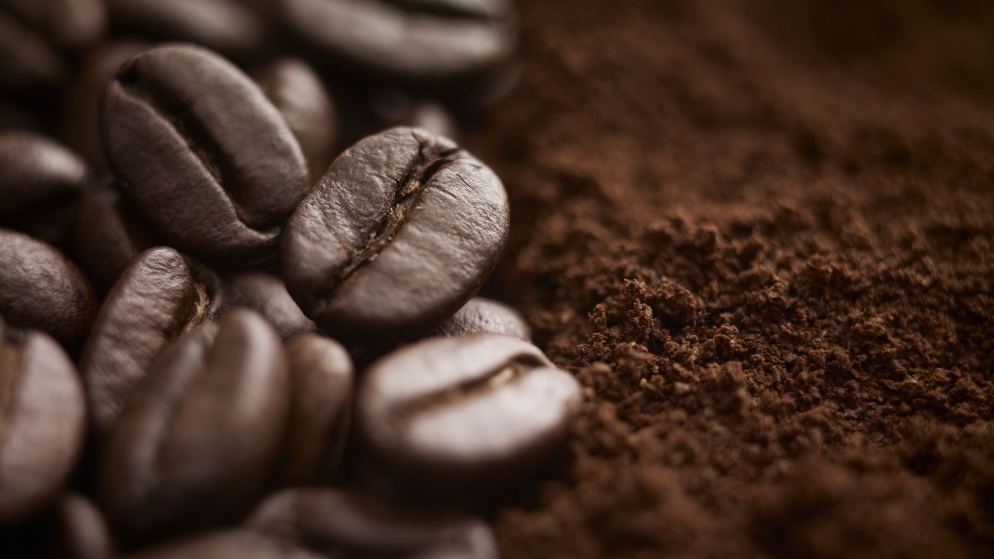
Coffee
Evan Westcott

Slide 2
What it is
Coffee is a caffeinated beverage brewed from the beans of the coffee plant
65% of American adults drink coffee every day
Coffee is the second most frequently consumed beverage
Hawaii and California are the only US states that can produce coffee, so the US relies on imports

Slide 3
Companies
Keurig Dr Pepper
Nestle
Starbucks

Slide 4
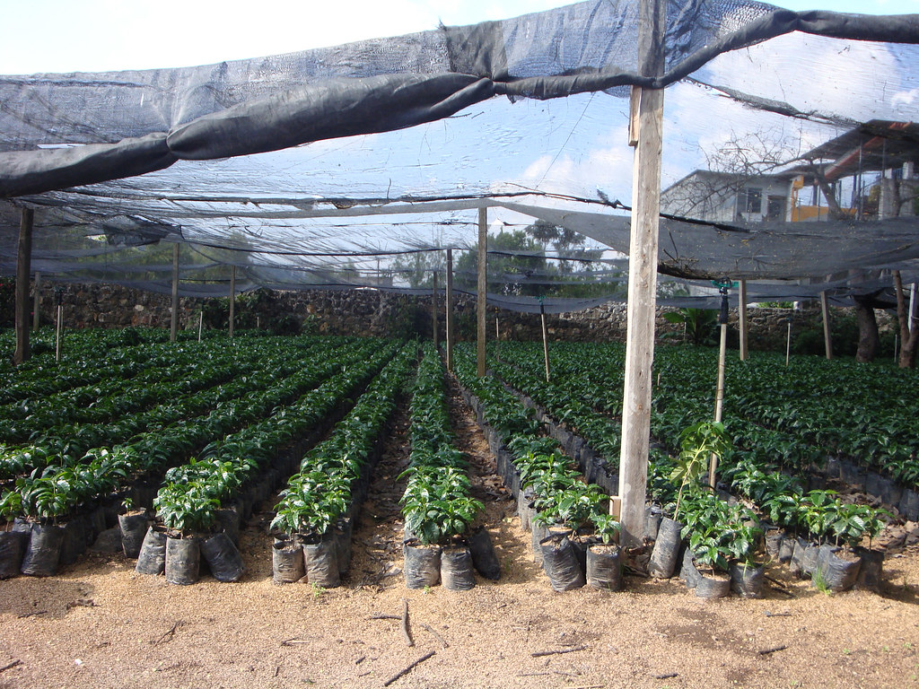
Production Process
Coffee trees are planted and cared for until they begin producing fruit
Fruit is Picked by workers
Fruits and seeds separated
Beans are dried, cleaned and milled for export
Beans are imported
Tested and tasted for quality
Blended for flavor
Roasted
Packaged for consumer
This Photo by Unknown Author is licensed under CC BY-NC-ND

Slide 6
Where its produced

Slide 7
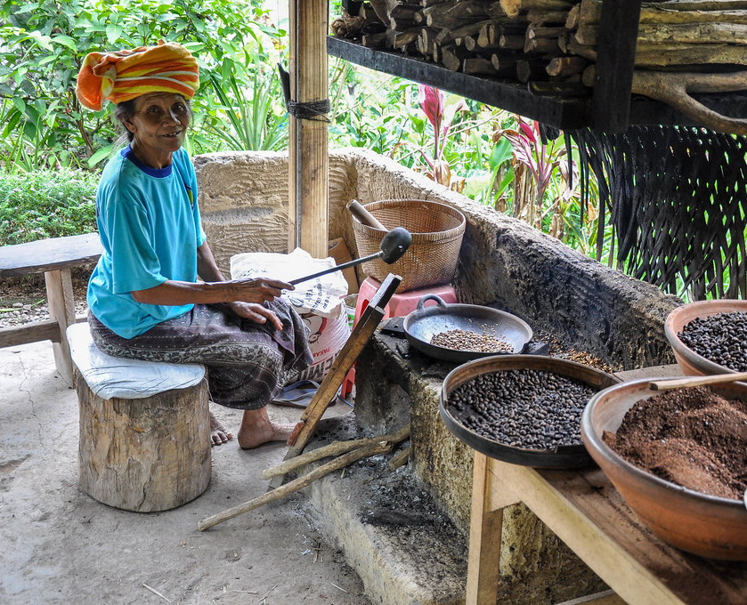
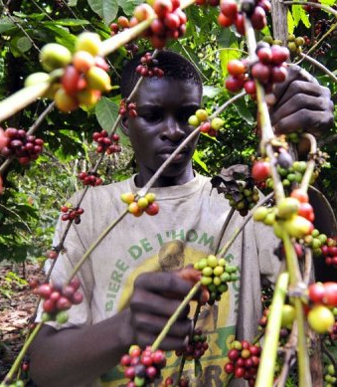
Workers
In Brazil there are roughly 8 million workers in the coffee industry
Exploitation results in poor laborer’s being forced into slave like conditions
Brazil employs labor inspectors to police these practices, but it is not enough to protect everyone
Even coffee plantations selling to large corporations like Starbucks have been found to produce beans through slave or child labor
This Photo by Unknown Author is licensed under CC BY
This Photo by Unknown Author is licensed under CC BY-NC-ND

Slide 8
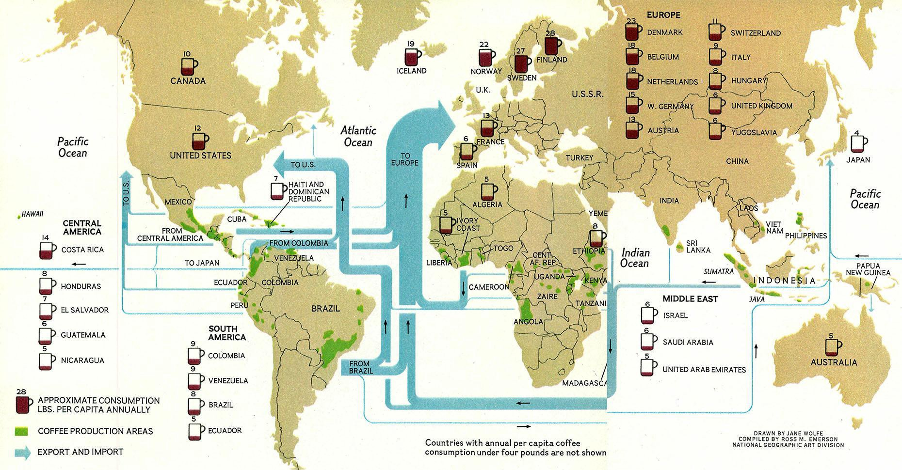
Flow of Coffee

Slide 9
US imports (billions of $)

Slide 10
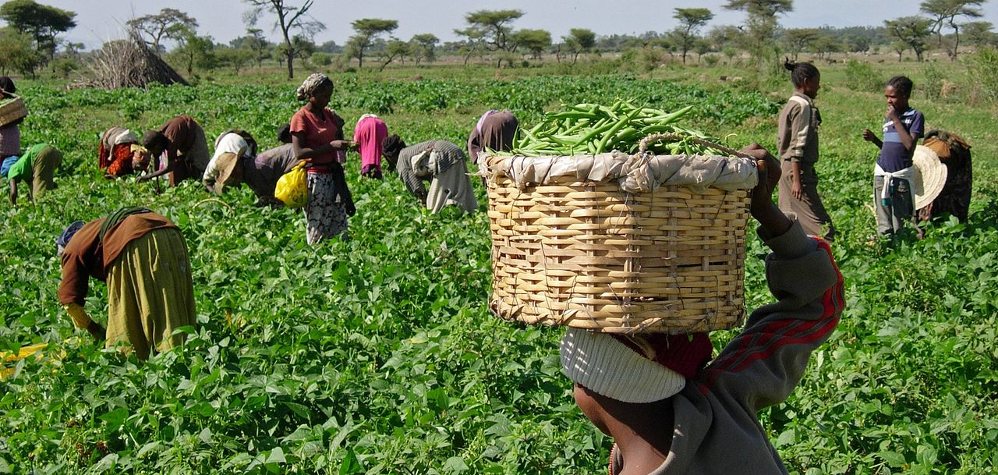
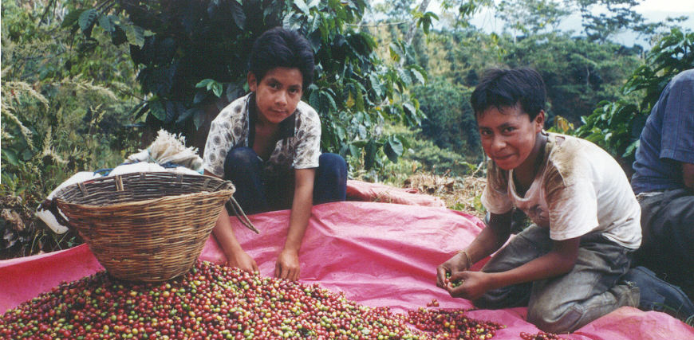
Controversy
Slavery practices are difficult to police
Unfair pay and poor living conditions
Environmental Injustice
Areas that grow coffee are impacted greatly by global warming, while areas with the highest emissions drink coffee
As climate changes, coffee plantations are at risk of a disruption to the crop
FairTrade certification has helped bring awareness, but the industry still produces coffee on the backs of underpaid workers
This Photo by Unknown Author is licensed under CC BY-SA
This Photo by Unknown Author is licensed under CC BY-NC-ND

Slide 11
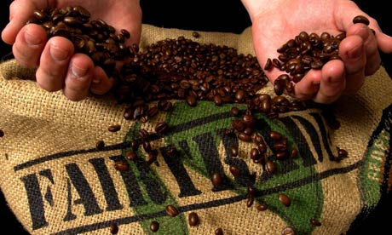
Commodity Fetishism
Coffee is frequently labeled as Fair Trade and slave free
The coffee industry tries to hide the reality of low-income coffee labor
Searching about coffee practices results in fair trade articles and companies boasting about their responsible practices
In 2018 it was found Starbucks was using beans from farms with slave practices(unintentionally)
This highlights the need for proper policing
This Photo by Unknown Author is licensed under CC BY-NC-ND

Slide 12
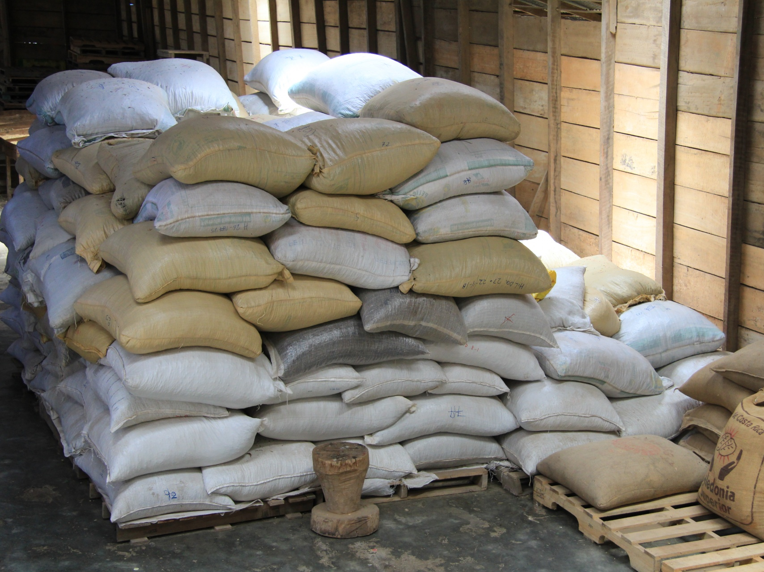
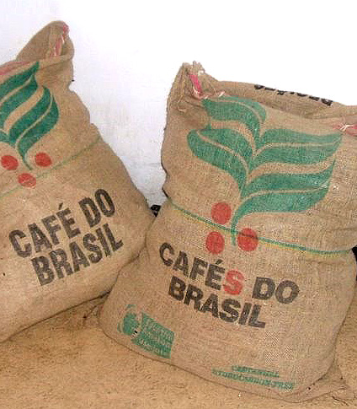
Hindering of Imports
Until recently coffee has been traded with little to no resistance
There are no tariffs on coffee
Coffee producers and sellers have recently (2016) discussed choosing other regions to import from due to the prevalence of slave labor in Brazil
This is putting pressure on Brazil to comply with fair certification practices
This Photo by Unknown Author is licensed under CC BY-SA

Slide 13
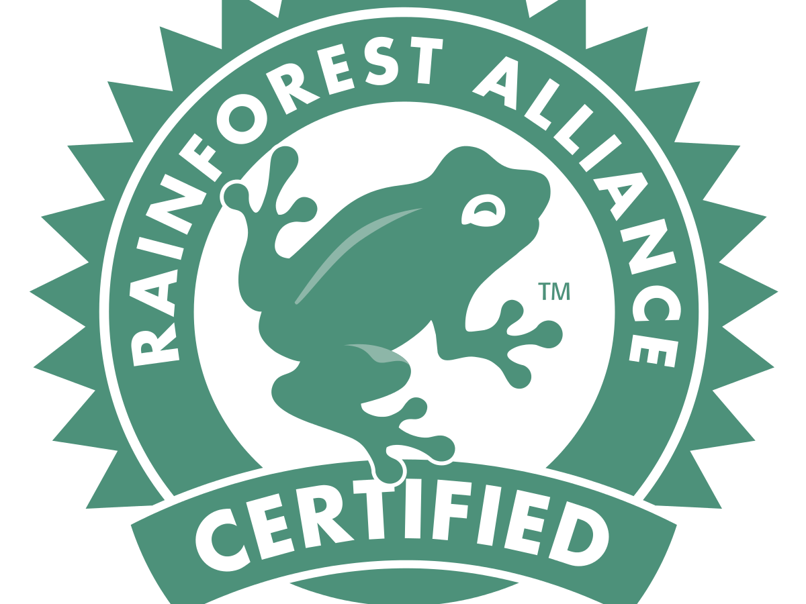
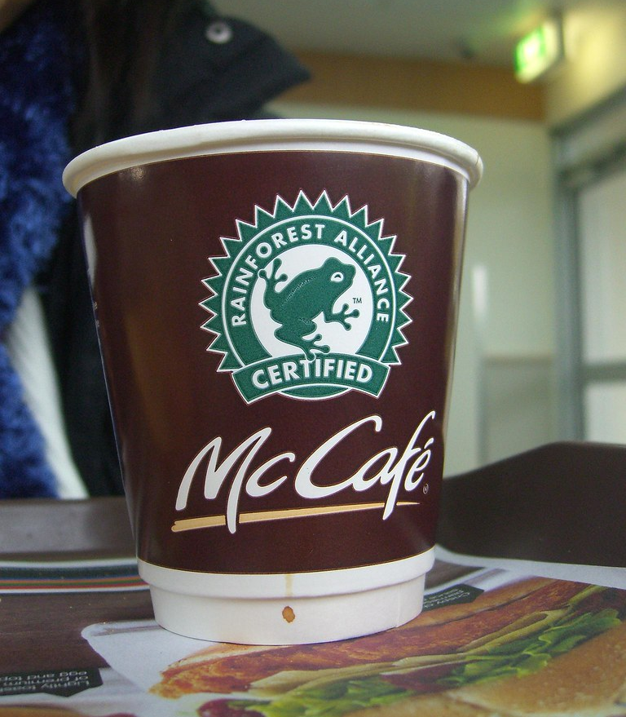
Take Action
Support The Rainforest Alliance, a global non-profit that certifies farms as slave-free
Spread the word and raise awareness, the more funding they have the more they can investigate farms
The Sustainable Coffee Challenge
Formed by many high profile coffee companies, including starbucks
Goal is for all coffee to be produced through sustainable practices
This Photo by Unknown Author is licensed under CC BY-SA
This Photo by Unknown Author is licensed under CC BY-SA

Slide 14
Sources:
Collins, M. (2021, March 14). 90 coffee statistics you should Know: 2021 INFOGRAPHICS: PERFECTBREW. Retrieved April 27, 2021, from https://www.perfectbrew.com/blog/coffee-statistics-infographic/
Conway, J., & 26, N. (2020, November 26). U.S. coffee imports by country of origin 2019. Retrieved April 27, 2021, from https://www.statista.com/statistics/194261/us-coffee-imports-by-top-10-countries-of-origin-2009/
Maps, V. (2018, October 02). Consumption, production, export, and import of coffee around the world (1981). Retrieved April 27, 2021, from https://vividmaps.medium.com/consumption-production-export-and-import-of-coffee-around-the-world-1981-7959e4eb6af3
National coffee Association. (n.d.). Retrieved April 27, 2021, from https://www.ncausa.org/Newsroom/NCA-releases-Atlas-of-American-Coffee
Streefkerk, M. (2019, October 27). Five coffee organizations you can donate to. Retrieved April 27, 2021, from https://www.baristamagazine.com/five-coffee-organizations-you-can-donate-to/
Teixeira, F. (2019, December 12). Picked by slaves: COFFEE crisis brews in Brazil. Retrieved April 27, 2021, from https://www.reuters.com/article/us-brazil-coffee-slavery/picked-by-slaves-coffee-crisis-brews-in-brazil-idUSKBN1YG13E

