Slide 1
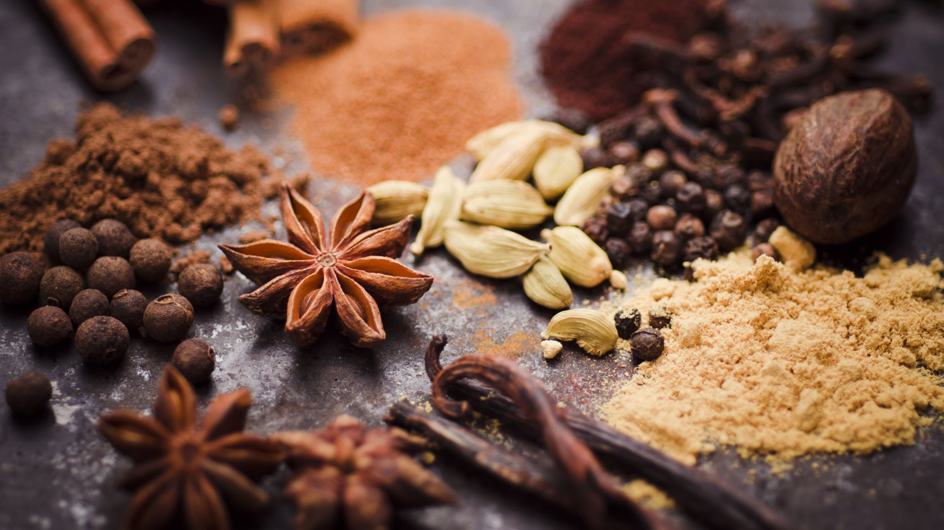
Cinnamon
Kenny Vilorio

Slide 2
What is Cinnamon?
Cinnamon is a spice that comes from the bark of species of Cinnamomum genus of evergreen trees.
It can be used as both a “quill” and in powered form for flavoring foods.
It can be used for essential oils & supplements
Rich source of nutrients.
Medical researchers have suggested that its compounds have antioxidant, anti-diabetic and anti-microbial properties that may offer protection against cardiovascular disease, cancer, and HIV.

Slide 3
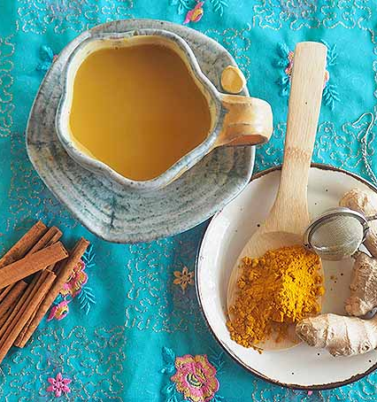
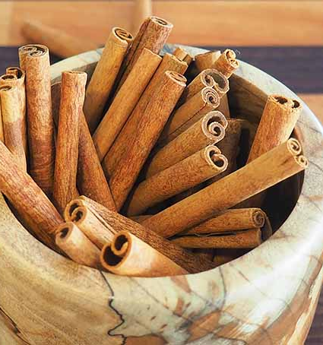
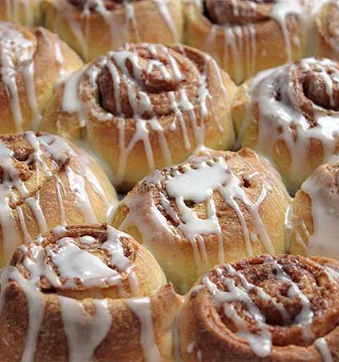
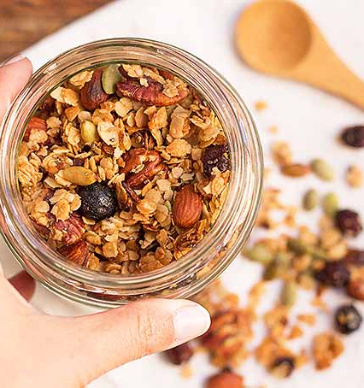
Usage of Cinnamon
Cinnamon quills add flavor to drinks, such as Chai tea
Cereal
Muffins

Slide 4
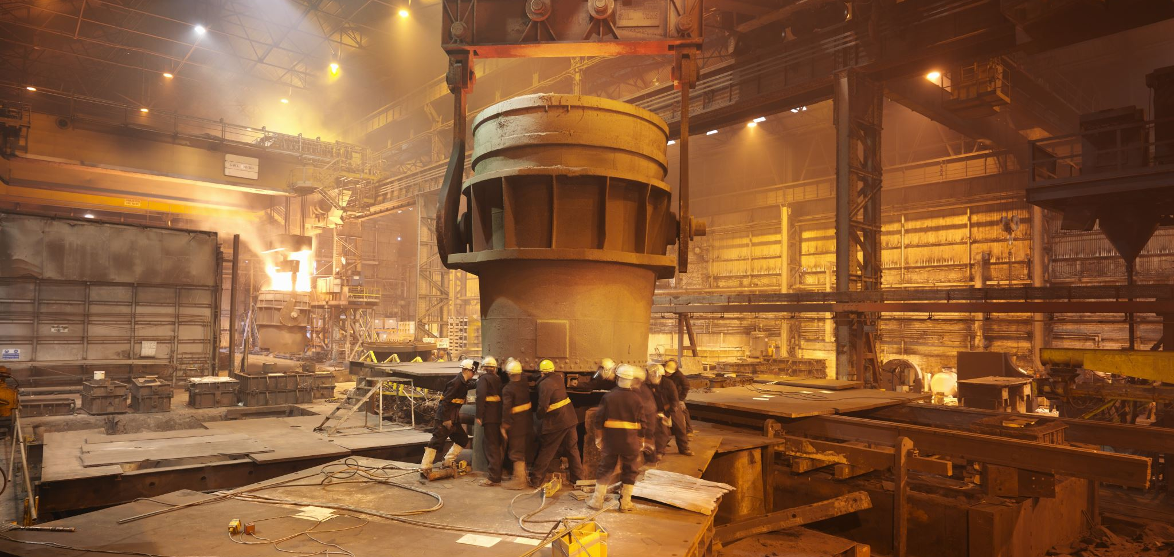
Production Process
1. Cinnamon bark is stripped off from the bark by workers and ship them into factories
It’s not a fruit, and it is harvested during any time of the year.
The entire process is labor intensive.
Sees two to three harvests annually.
It must be scarped into thin layers and laid under the sun to dry
Process
Once they become quills, they are packaged and transported into factories by the “peelers”.

Slide 5
(Cont.)
It will be sent to a warehouse and then transported
For non-quills, the leaves and branches are transported to cinnamon to oil refineries where they can be made into cinnamon leaf oil/and or bark oil cinnamon.
At an oil refinery, the farmers would use the remaining leaves to create the oil.

Slide 6
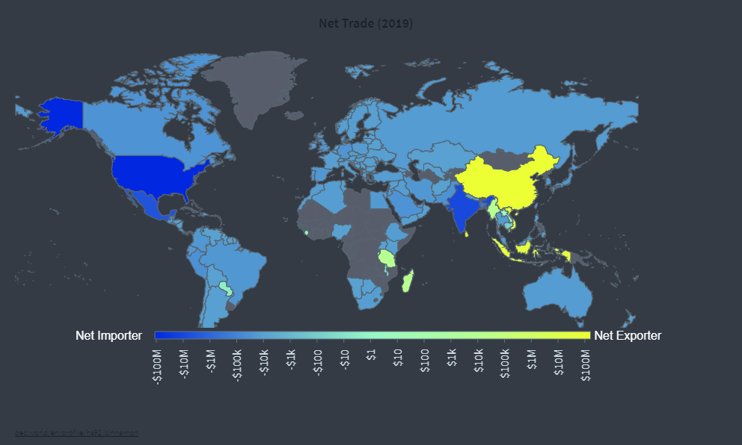
Where is it produced?
Cinnamon is native to Sri Lanka
Most of the Cinnamon in the world is exported from most of Asia, such as Sri Lanka, Myanmar, and Indonesia, et cetera.
Sri Lanka is the largest exporter of cinnamon and Indonesia is the largest producer

Slide 7
(Cont.)
The Asia-pacific accounts for producing most of the world's cinnamon.
Indonesia alone accounts nearly 40% of the total.
In 2019-20 Indonesia was the leading producer of cinnamon, followed by countries China, Vietnam, and Sri Lanka.
Sri Lanka oversees Ceylon cinnamon concentrated along the coastal belt from Kaluthatara to Mathara in the capital of Colombo
One of its main ports of export is situated the capital city.
They are sold internationally and the byproducts from the factories and into the ports where they can be sent to countries in Europe

Slide 8
Cinnamon & Herbs: The challenges
The international spice trade had taken a downturn in 2020
On demand, consumers are buying more and more shelf stable food
Not just Cinnamon, but other herbs and spices

Slide 9
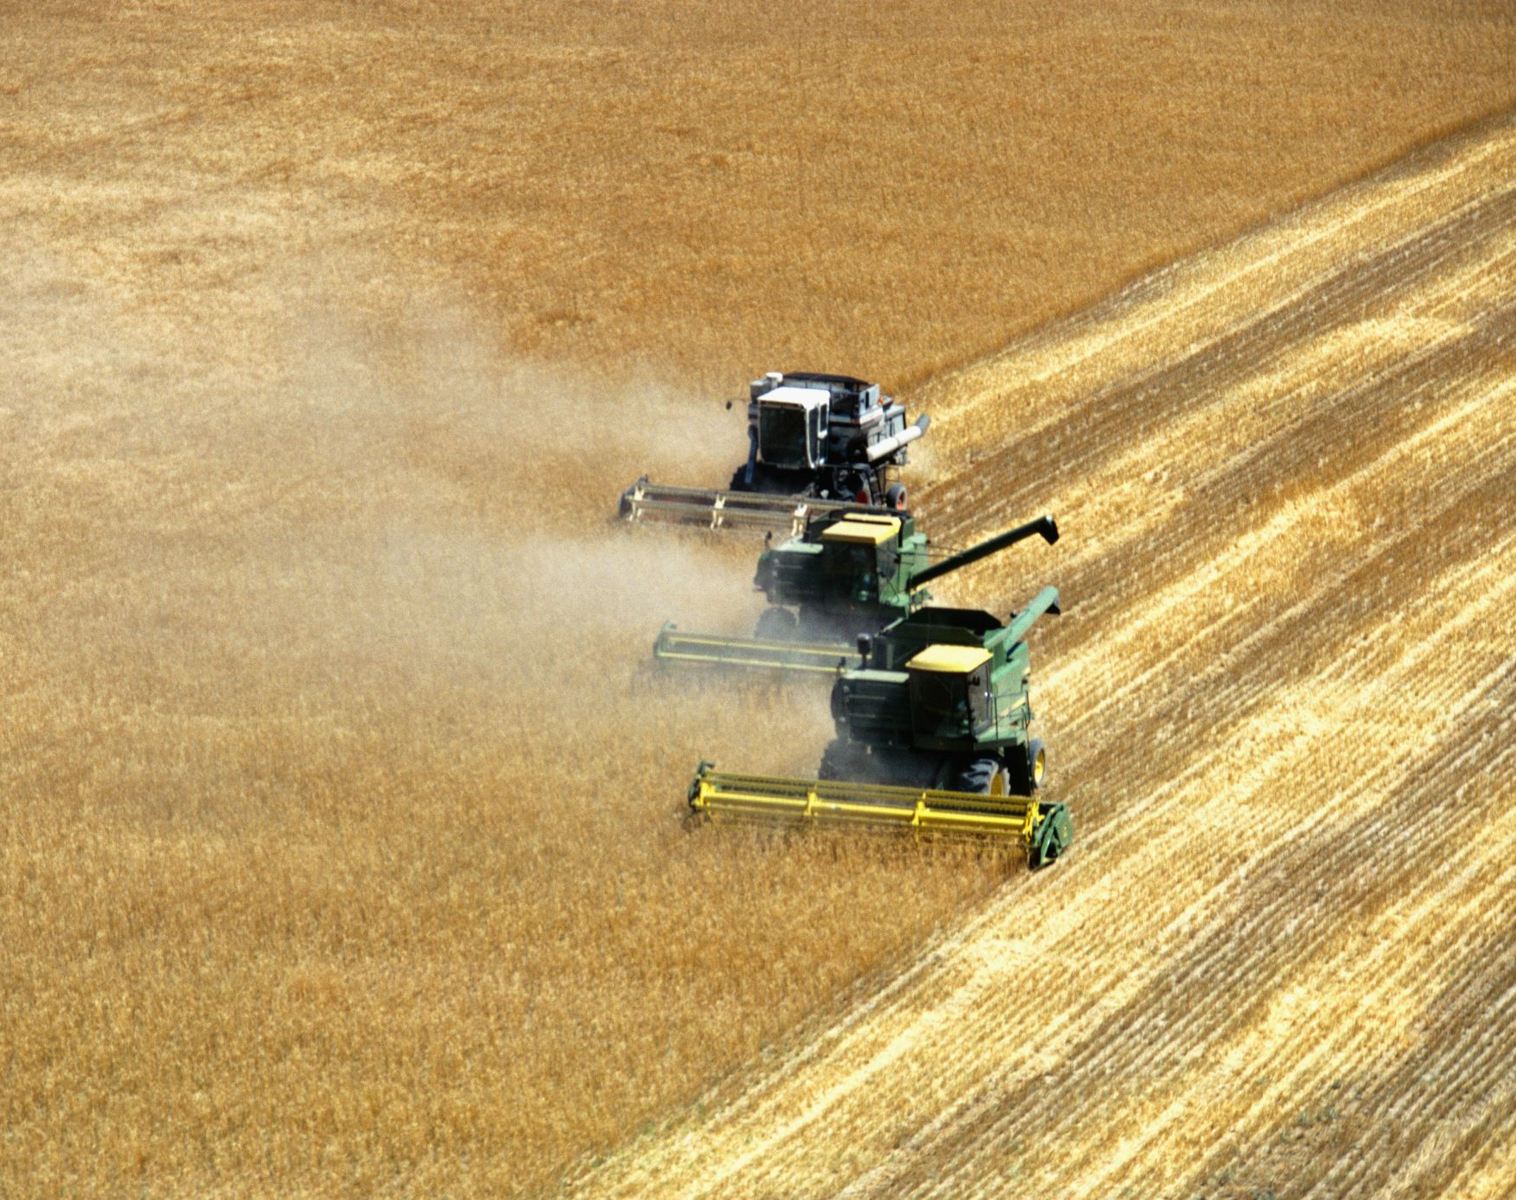
But…
You can participate with your local authorities and NGOS
There are specific projects you can work with in protecting farmers conditions
Consider through collaboration
For example, Nedspice-Farmers Partership Programme invites them for long term paternetship
Through training, helping farms in charge if this type of work

Slide 10
Sources
https://www.britannica.com/plant/cinnamon
https://www.huffpost.com/entry/cinnamon-comes-from_n_4963435
Cinnamon Market - Growth, Trends, COVID-19 Impact, and Forecasts (2021 - 2026) (mordorintelligence.com)
https://www.globenewswire.com/news-release/2020/11/23/2131871/0/en/cinnamon-bark-market-forecast-to-2027-covid-19-impact-and-global-analysis-by-product-type-and-end-use.html
https://www.medicalnewstoday.com/articles/266069#benefits
https://oec.world/en/profile/hs92/cinnamon

