Slide 1
My Commodity:
- The US on its own produces approximately 0.008 million metric tons of bananas annually, so they heavily rely on bananas from countries in order to meet high demands for the fruit.
- Fun Fact: Bananas outsell oranges and apples combines in the US.
- These other countries (Top 5), include Ecuador, Philippines, Costa Rica, Honduras and Columbia. They account for over 90% of US imports of bananas.
- In 2019, Ecuador was the leading exporter of bananas to the US, shipping about 3.3 billion US dollars, or 10.3 billion pounds worth of them .
- Data from 2010 shows that these countries collectively shipped 3.9mmt of bananas to the US.
Bananas
Caroline Tuite

Slide 2
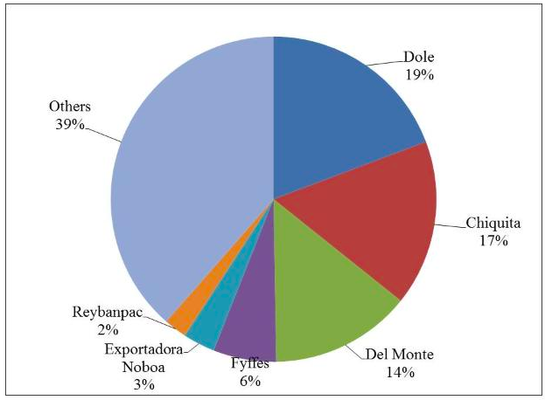
Corporations:
Dole is one of the biggest companies in the banana industry.
This company is vertically integrated; own/contract plantations to farm, utilize sea transport and ripening facilities, and control their own distribution networks. Allows them great market power in selling bananas.
The US cannot grow bananas to the scale of these tropical regions, so whereas these three companies headquarters are all in the US, they have control of the plantations they utilize in Central America. They can maintain profit and power, but eliminate certain risks of production.
Dole has 36,000 workers and their headquarters is in Westlake Village, California. 74,300 employees elsewhere.
Distribution of fresh banana imports, 2010–2019.
FAOSTAT (Food and Agriculture Organization of the United Nations)

Slide 3
Production Process
Bananas are harvested throughout the year with plants at various stages of their growth. It takes twelve to thirteen weeks from the time the banana stem appears to the time they are harvested
Harvesting takes place six times a week on their plantations and is done by three workers a time. Each banana bunch requires about nine and a half gallons of water a day. A well designed drainage system is important.
During early growth, workers cut the tips of the banana ‘fingers’ so that the bananas grow outward and thus, bigger in size. Bags are placed in between the chunks of banana to avoid bruising or things like insects contamination.
Plants must be secured with rope because they can get to be 65-100 lbs.
Crop protection specialists are on-call to assist when any threats of disease from insects comes up. They also help in dispersing chemicals across fields.
Bananas are harvested while green so that they are ripe when they are sold, Dole packs the bananas and ships them in a plastic material that helps this process. The entire process from when the bananas are harvested to when they end up in the box is only 2/3 hours.
Dole mentions their packaging is mostly recycled material from their production processes.
Click here to watch video

Slide 4
Map Flow Across Boarders: Costa Rica, Ecuador, and Philippines are the top producers and exporters of bananas. The biggest importer from these countries is the United States.
United States
Philippines
Costa Rica
Ecuador

Slide 5
What enables these flows?
The development of railroads and technological advances in refrigerated maritime transport consequently enable bananas to become the most traded fruit in the world. Refrigeration advancements continue to improve, including humidity and air composition of shipments.
The introduction of the Cavendish banana after the Panama disease
The bananas are sterile and cannot grow from seeds, making them free from variety or chance. This can also be a hindrance though because the bananas are vulnerable and if one plant is affected with disease they are all in danger.
An innovation to prevent bruising and correct ripening uses ethylene which can trigger the ripening process in a timely manner.

Slide 6
What Hinders these Flows?
The banana industry consumes more agrochemicals than any other industry in the world besides cotton, and this is harmful environmentally. There is pressure put on them to do the right thing.
To keep prices low on bananas, companies are constantly trying to relocate in search of cheaper labor and weaker legislation in production and trade laws. Labor is often sub-contracted to other regions in an attempt to reduce responsibility for wages and working conditions.
Banana production utilizes massive amounts of water, and with climate change becoming an increasing problem, Dole has had to innovate and introduce plans to use less to help the environment.
Dole is always trying to find new land for their plantations, when soil from one plantation is rendered unusable to grow, they go to another spot and commit massive amounts of deforestation. This is done over and over again.

Slide 7
Violence and Inequality
The main people suffering in the banana industry are the plantation workers who work up to 14 hours a day in poor conditions.
Dole has great political power in Central American governments when they first started the plantations there, and they used this to their advantage. They receive large amounts of land at cheap costs, pay low export taxes, and immunity from local labor and environmental laws.
Wages: Unionized banana workers have the ability to make $10 a day as well as $10 more in extra benefits; non-union banana workers make $3 a day, with zero benefits.
The banana industry is one of the 3 big multinationals with the lowest number of trade unions today.
Few regulations governing banana trade so Dole can sell as many bananas as they choose at a low price to maximize profits in the long run.
In a recent investigation, Human Rights Watch discovered that Ecuadorian children as young as eight years old are working on banana plantations in poor conditions, and adult workers fear firing if they try to exercise their right to organize.
Unequal distribution of land: many farmers remain landless and are forced to settle wherever any opportunity of land comes up as the most fertile land is controlled by large corporations

Slide 8
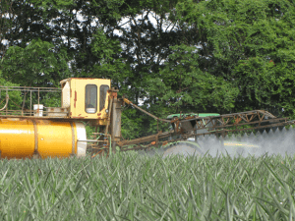
Violence/ Inequality in Production
Surrounding Environment:
Deforestation has recently resulted in the near-extinction of 18 tree species. Increased plant and animal diversity loss.
Marshes in these lowlands of Central America are constantly drained because bananas cannot be submerged in water. This causes a lowering of the overall water table which negatively affects surrounding areas water supply
The harsh chemicals and pesticides used to grow and harvest bananas ruins the soil, and runs in local water supply and negatively disrupted downstream ecosystems.
Intensive Agricultural has devastated non-protected forests, including the animals and plant diversity that resides there.

Slide 9
Campaigns and Protests
June 2, 2019 Protestors set fire to about 30 shipping containers from Dole plantations. This was done in an attack against U.S. power in Central America, something that has been a long-standing issue for them.
Banana Link is an organization that works for fair production and trade in bananas and pineapples based on environmental, social, and economic sustainability. They are always coming out with campaigns against unfair practices and conditions. Because of their popularity, they have a big voice with the banana industry
They have : raised wages for workers in Ecuador, work to produce Fairtrade bananas, give voices to plantation workers, spread awareness of social and environmental impacts of banana production, and created a strong union organization of banana workers.
The U.S. Labor Education in the Americas Project (USLEAP) advocates fora global economy in which workers are treated fairly, paid a living wage, and respected by corporations and governments. They have organized many campaigns to encourage Dole to produce fairly.

Slide 10
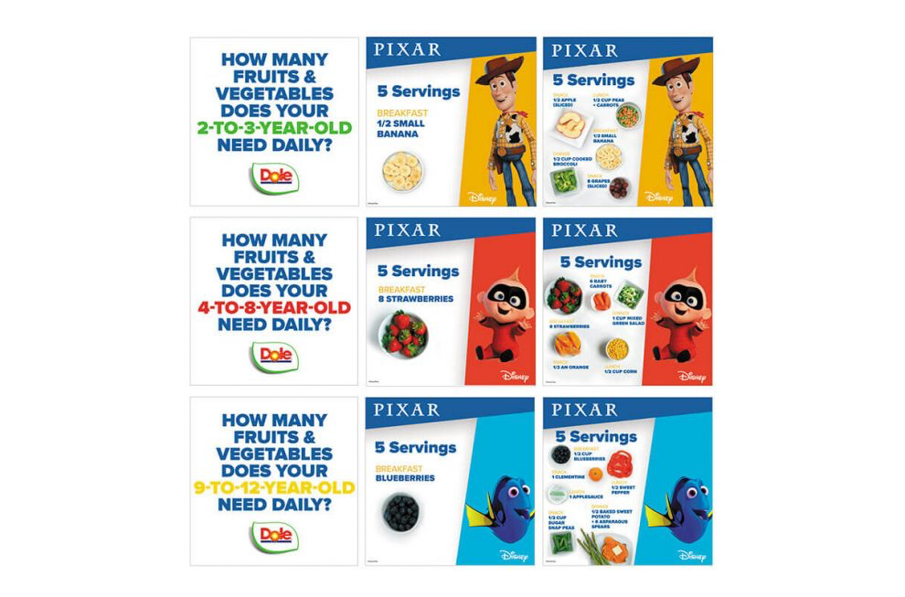
Advertising:
Bananas are the most popular fruit in the world, there is not really a need to advertise. Dole specifically advertises their company with labels of freshness and health.
In June of 2020, they had an advertisement for children using Pixar characters.
Looking at Dole’s website, they advertise bananas for their health qualities.

Slide 11
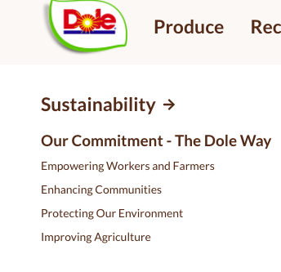
Commodity Fetishism:
They market as fresh and sustainable, but hide the fact that they are exploiting workers.
On their website you can find countless videos portraying dole as an ethical company that cares about their workers, their product quality, and the environment.
The website Banana Link gives loads of information on the unjust practices in the banana industry, this is a valuable source in learning the truth of the industry.

Slide 12
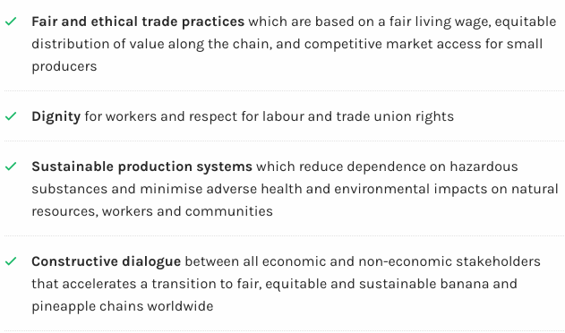
Strategy for Consumers:
As consumers, our voice is in our money. If an industry is partaking in unethical or unhealthy practices, the way we can help is by not supporting them in an attempt that they will listen and change their practices accordingly.
Supporting Banana Link in their effort to make the banana industry ethical ! This can be through donating, sharing their blog, and reading their newsletter.
One of the most important things to do is spread awareness.
I posted to my social media’s a link to the newsletter and encouraged people to learn about the problems of the banana industry.

Slide 13
Sources:
https://www.worldatlas.com/articles/where-do-america-s-bananas-come-from.html
https://edis.ifas.ufl.edu/fe901
https://corporatefinanceinstitute.com/resources/knowledge/strategy/vertical-integration/
https://members.tripod.com/foro_emaus/BanPlantsCA.htm
https://laborrights.org/industries/bananas#:~:text=Nearly%20all%20bananas%20consumed%20in,accelerating%20race%20to%20the%20bottom.
https://community.plu.edu/~bananas/economic/home.html
https://www.youtube.com/watch?v=_l7sak6Vlq8
https://www.reuters.com/article/us-honduras-protests/dole-fruit-trucks-burned-in-honduras-as-protests-spread-idUSKCN1T40IQ

Slide 14
Sources Cont.
https://theconversation.com/the-quest-to-save-the-banana-from-extinction-112256
http://www.fao.org/3/y5102e/y5102e07.htm
https://www.dole.com/en/produce/fruits/bananas

