Slide 1
Avocados
Matt Rohrman

Slide 2
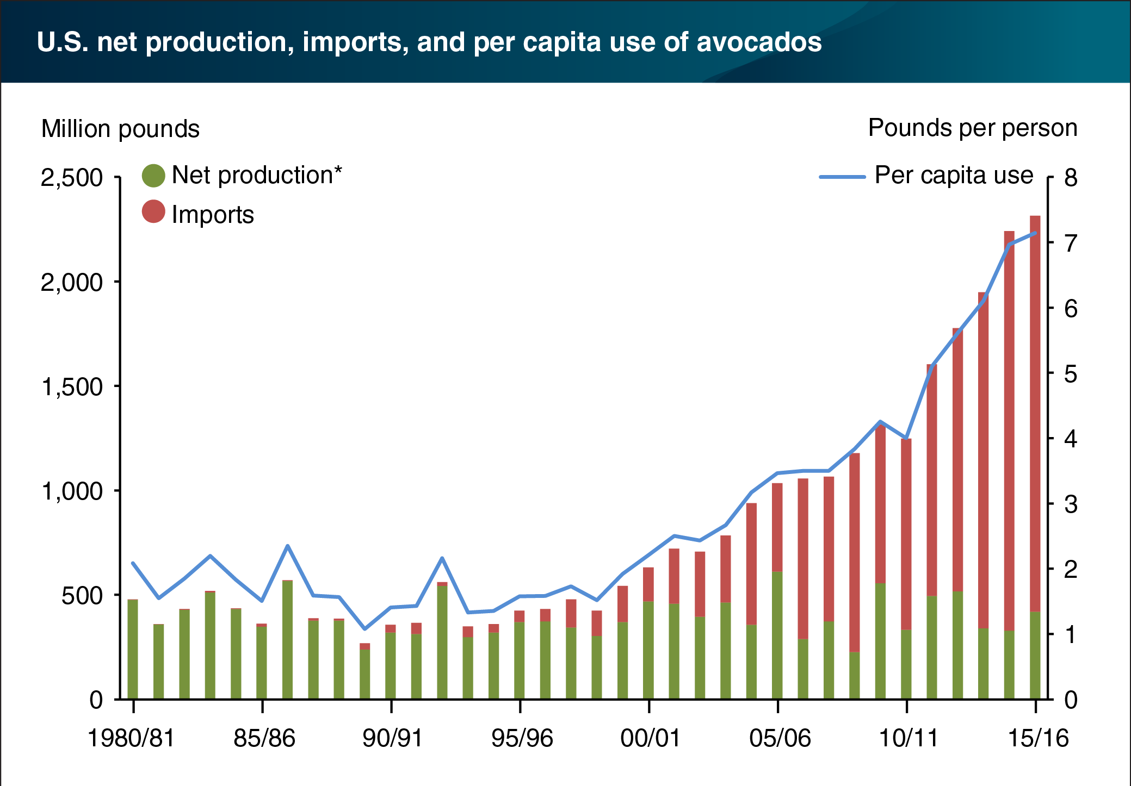
US Imports of Avocados
19% of global consumption
Growing demand
89% of avocado imports come from Mexico
$2.6 billion worth of avocado imports (2017)
About 2.3 billion pounds

Slide 3
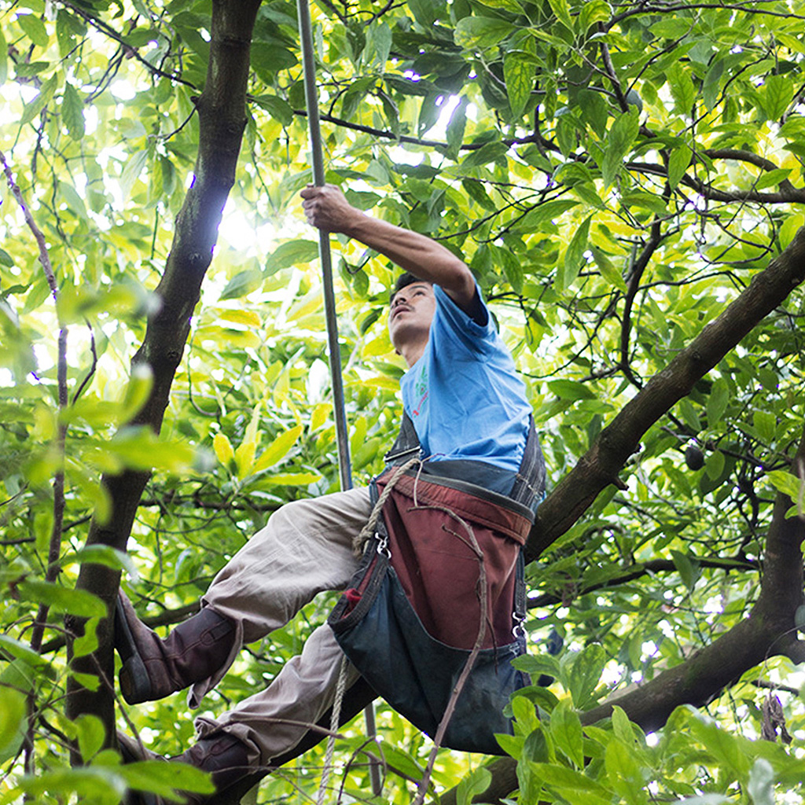
Production Process
Mix between Criollo and Patron plant = Haas avocado
3-5 years
Up to 750 pounds/year
Pick fruits with a pole, avoids bruising
Quality check technology

Slide 4
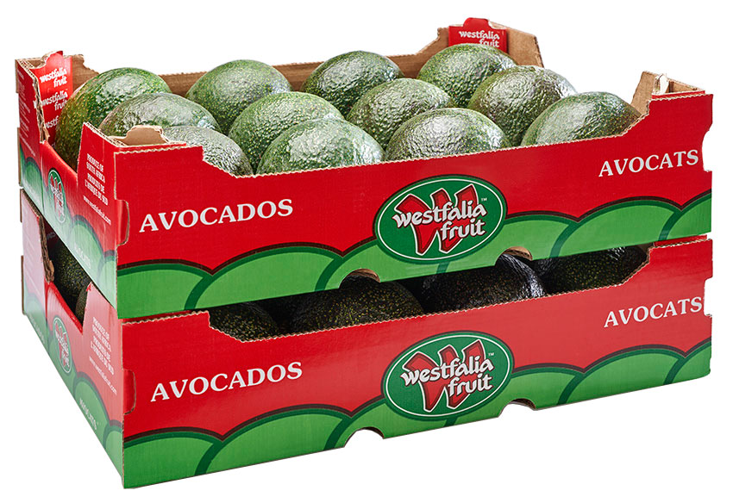
Transportation Across the US Border
Various protocols/regulations to cross into the US
Insect proof containers
Orchard Certification
Trace back labeling
Port of arrival inspection
Sanitation

Slide 5
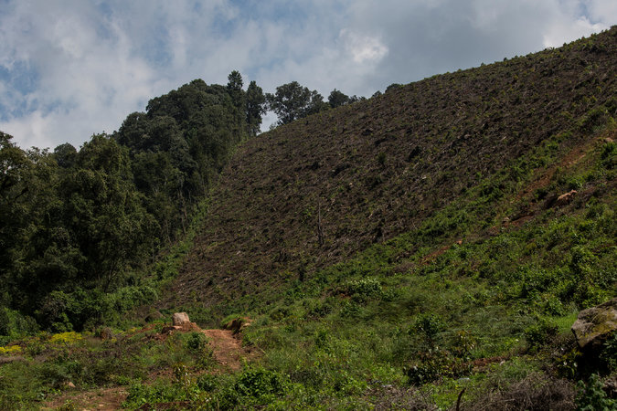
Environmental Impact
Growing demand, high profit commodity in Mexico
Deforestation
Avocado trees require a huge amount of water
Tons of pesticides

Slide 6
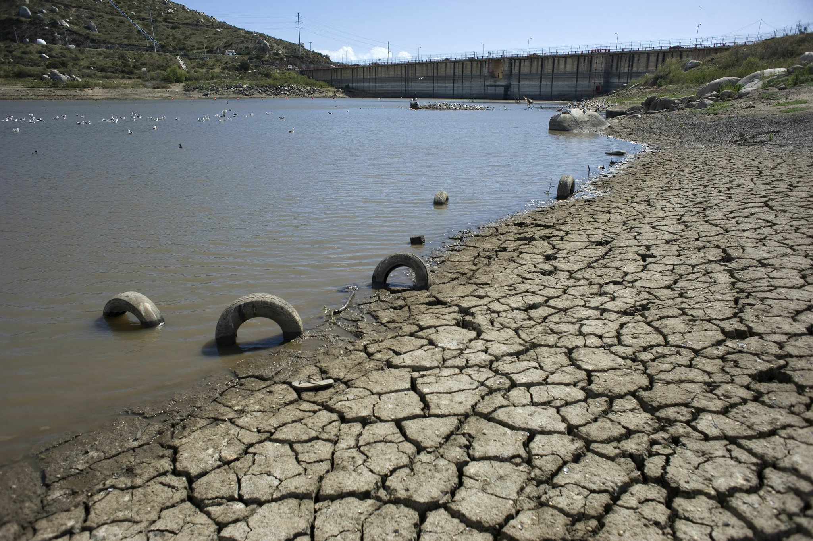
The National Human Rights Institute
Private Businesses
About 80% of drinkable water (Agribusiness)
Shortages
Raising Awareness

Slide 7
Sources
https://www.federalregister.gov/documents/2016/05/27/2016-12586/mexican-hass-avocado-import-program
https://cl.boell.org/es/2018/08/06/socio-environmental-impact-avocado-industry-petorca-province
https://www.ers.usda.gov/data-products/charts-of-note/charts-of-note/?topicId=14849#:~:text=To%20support%20year%2Dround%20demand%2C%20the%20United%20States%20imports%20avocados,are%20lower%20during%20the%20summer.
https://avocadosfrommexico.com/about/

