Slide 1
Indian Steel
By: Alex Rochlitz

Slide 2
The Importance of Steel and Iron Production in India
World’s 2nd largest producer of steel in 2019
Finished Steel production reached 100 metric tons in 2020
Between April and November 2020 India’s cumulative production of crude steel was 62.01 MT
In the same time frame its production of finished steel was 55.68 MT
Export and import of finished steel stood at 7.70 MT and 2.70 MT, respectively, between April November 2020
In 2017, iron and steel was India’s 7th largest export
According to the Ministry of Steel the sector contributes around 2% of the country's GDP
Employs around 25 lakh (2.5 million) people in steel/allied sectors

Slide 3
Where in India is Steel Produced
Most of India's steel produced in 2019 came from the regions of Odisha (18.5K tons) and Jharkhand (16.5K tons)
Both of these regions are located in Eastern India
These two regions alone made up 33% of India’s national steel production (106.5K tons) in 2019
The northern and western regions of India do not produce as much, but still account for a large amount of the national steel production

Slide 4
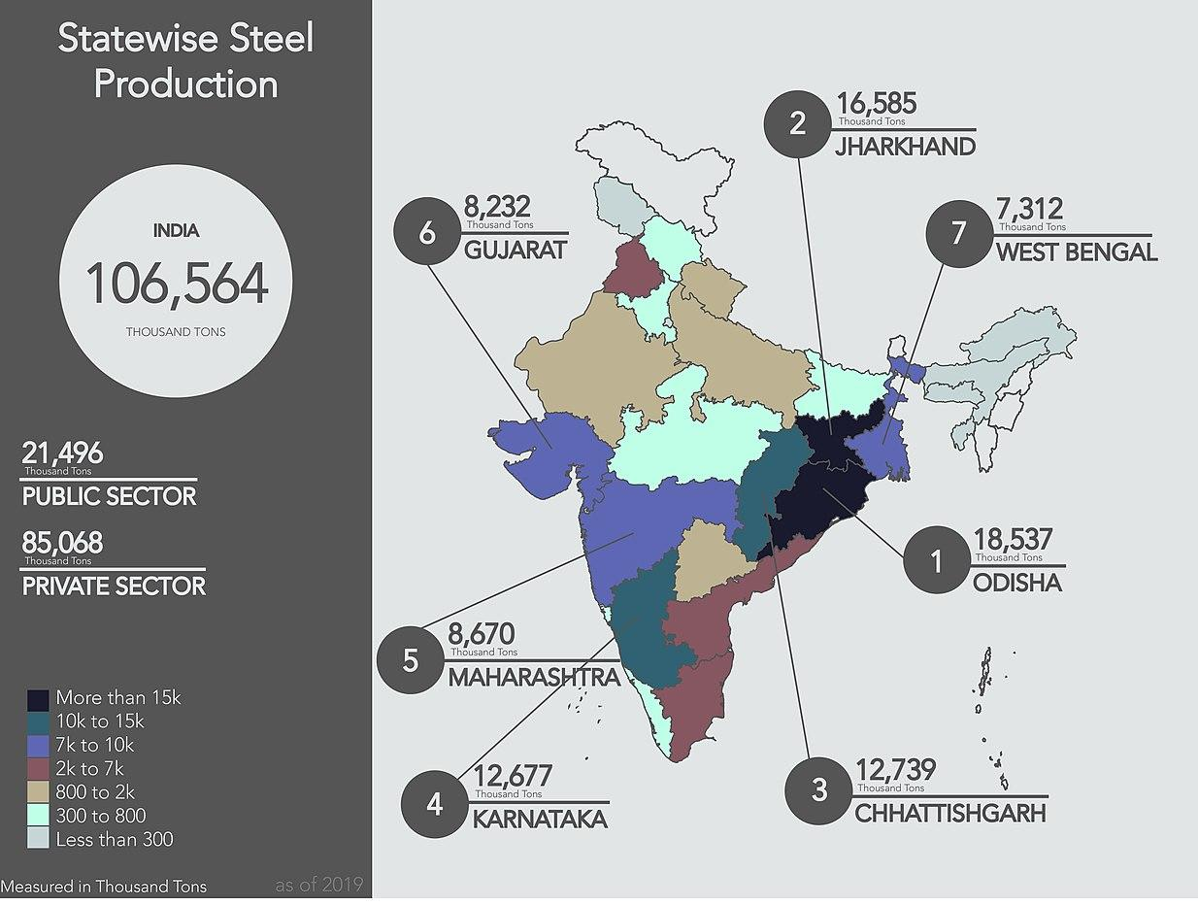

Slide 5
Indian Steel Exports to the United States
2018: US imported USD 29.5 billion worth of steel total
India's steel export to the U.S. in 2018 declined by 49% to USD 372 million
This only accounts for approx. 1.26% of the U.S.’s steel imports in 2018
The main reason for the decline was former President Trump’s new tariffs

Slide 6
Major Corporations in Indian Steel Production
SAIL (Steel Authority of India Limited)
Based in New Delhi, founded in 1954
Owned and operated by the Indian Government
Operates 9 of the 18 biggest steel plants in the country
JSW Steel Ltd.
Based in Mumbai, founded in 1982
Second largest steel company in India, one of the country’s fastest growing corps.
Operates another 3 of the 18 biggest steel plants
Jindal Steel and Power
Based in Hisar
Tata Steel
Based in Jamshedpur, founded in 1907
Rashtriya Ispat Nigam
Based in Visakhapatnam, founded in 1982

Slide 7
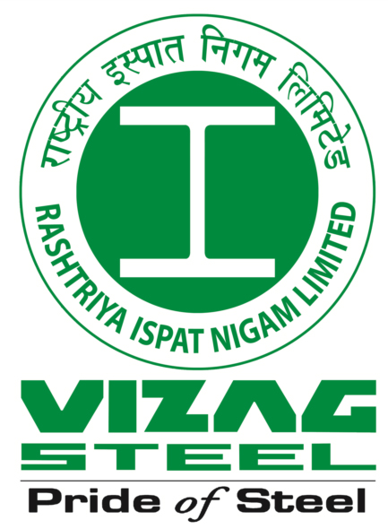

Slide 8
The Production Process of Steel
Basic oxygen furnace: This method has seen an increase in the share of steel manufactured since financial year 2014
Converts pig (crude) iron into steel by blowing air through the molten pig iron
This lowers the carbon content of the alloy (3.8-4.7%) to a lower number (0.05-3.8%), transforming it into steel
This is how Tata Steel produced all of its steel last fiscal year (2020)
Electric arc furnace: not as widely used in India
High current electric arcs are used to melt steel scrap into liquid steel of a specified chemical composition and temperature
More environmentally sustainable than the basic oxygen method
Induction furnace: Like EAF this method is electric and uses a high voltage electrical source to transfer energy via induction
Faster than EAF
Popular in India since late 1980s
Mostly used to make stainless steel

Slide 9
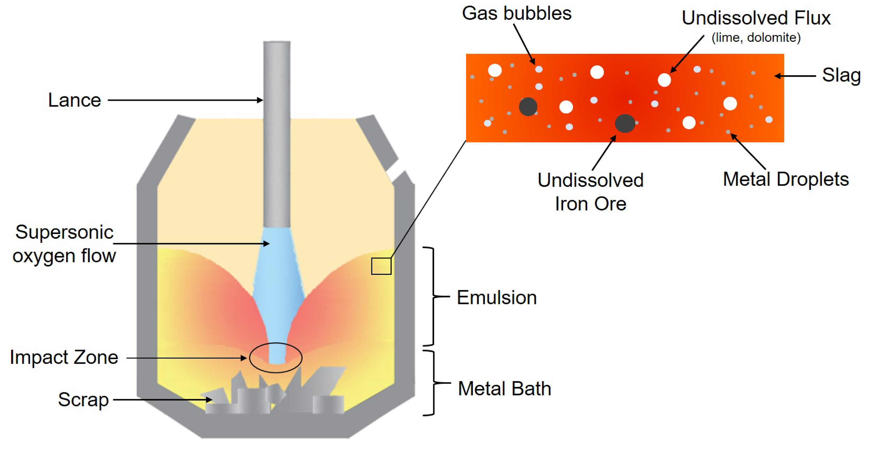
Basic Oxygen Furnace

Slide 10
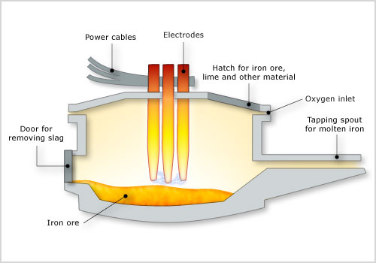
Electric Arc Furnace

Slide 11
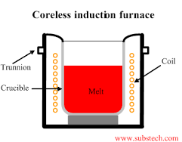
Induction Furnace

Slide 12
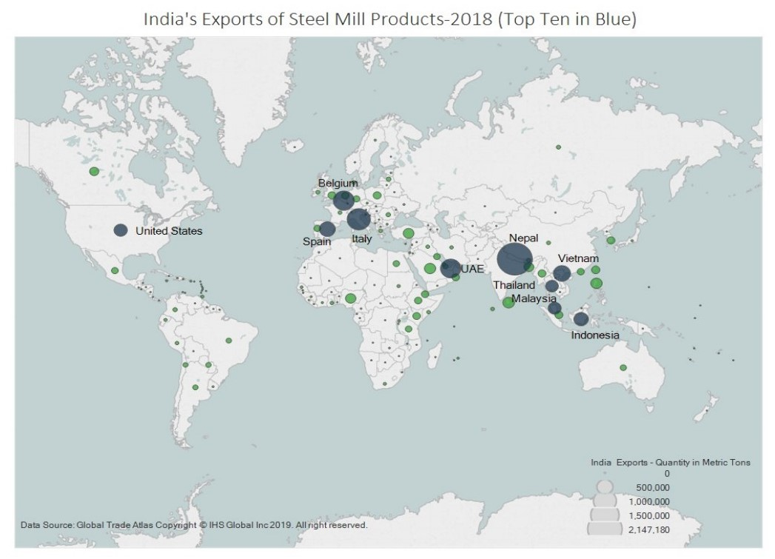

Slide 13
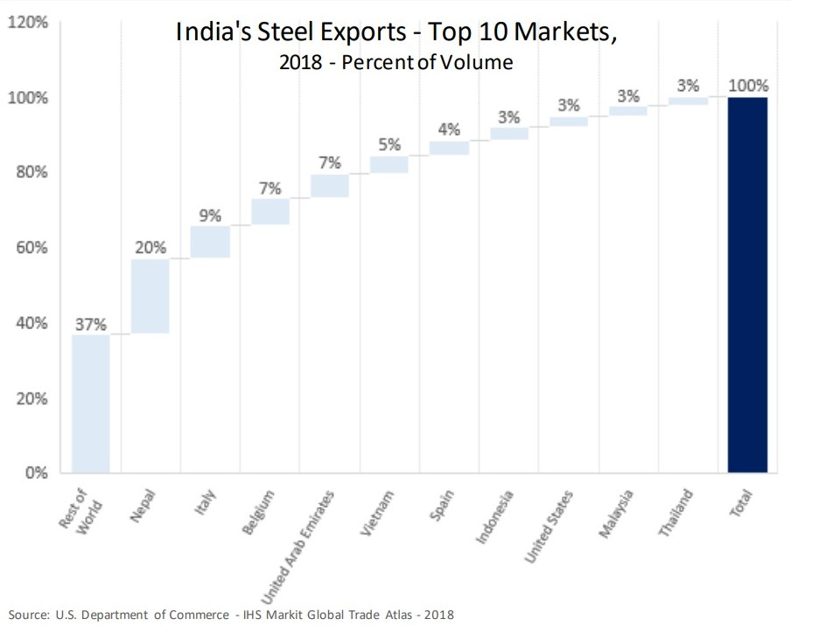

Slide 14
Common Uses for Steel
Construction of buildings, bridges, railroads
metal roofing, steel beams, safety barriers for roads
Used in vehicle production
Cars, trucks, trains, bicycles
Industrial needs
Cranes, drills, rollers, machines
Healthcare uses
Scalpels, hip replacements, surgical pins
Used to make everyday household items
Paperclips, scissors, radiators, appliances, sporting equipment, etc.

Slide 15
Advantages to Using Steel
World’s most widely used metallic construction material
combination of competitive price and high performance
Doesn’t give off any emissions that can damage human health
Buildings with steel frames offer good safety, high comfort, satisfactory sound insulation
Very long-lasting material
Can be used advantageously where high hygiene standards are required
Can cope with extreme environments
corrosive liquids, high heat/pressure
All steel can be recycled and reused
Steel’s magnetic properties mean that steel products can be dismantled easily and sorted for recycling or reuse

Slide 16
Social Issues With Indian Steel Production
Building even one steel mill can require the company to receive approval from hundreds of land owners
Many of these landowners are farmers
Often these plans meet stiff resistance from said farmers who don’t want to give up their land for the construction of yet another steel mill
Tribes have also shown fierce opposition in the past
This threatened two of the largest steel producers in the world back in 2009 when they couldn’t acquire desired land due to resistance from local tribes
There are also environmental concerns over the steady expansion of the Indian steel market in a country with massive amounts of pollution and carbon emissions

Slide 17
Commodity Fetishism
The National Center for Biotechnology Information held a study on morbidity of workers in Indian steel mills
The study was conducted in a single steel mill in India
Overall prevalence of morbidities among the workers was 60%
Lumbago (musculoskeletal pain) - Group A: 18.78%, Group B: 49.73%
Occupational dermatitis (skin disorder) - Group A: 33.33%, Group B: 19.79%
The results of this study show that many workers in steel mills go through very tough work which can leave them with serious health problems

Slide 18
Sources
https://www.ibef.org/industry/steel.aspx#:~:text=India%20was%20the%20world's%20second,ore%20and%20cost%2Deffective%20labour.
https://en.wikipedia.org/wiki/List_of_exports_of_India
https://en.wikipedia.org/wiki/Iron_and_steel_industry_in_India
https://www.worldsteel.org/steel-by-topic/statistics/steel-data-viewer/MCSP_crude_steel_monthly/CHN/IND/DEU
https://steel.gov.in/make-india
https://economictimes.indiatimes.com/news/economy/foreign-trade/major-decline-in-indias-steel-export-to-us-increase-in-aluminum-report/articleshow/68883316.cms?from=mdr
https://en.wikipedia.org/wiki/Basic_oxygen_steelmaking
https://www.statista.com/statistics/714301/india-production-volume-of-crude-steel/
https://www.industryweek.com/the-economy/article/21936082/the-rapid-rise-of-indias-steel-industry

Slide 19
Sources Cont.
https://www.wsj.com/articles/SB10001424052748703697004574495511978316746
https://legacy.trade.gov/steel/countries/pdfs/exports-India.pdf
https://www.ncbi.nlm.nih.gov/pmc/articles/PMC4292197/
https://www.jernkontoret.se/en/the-steel-industry/production-utilisation-recycling/end-products-of-steel/
https://www.ncbi.nlm.nih.gov/pmc/articles/PMC4292197/

