Slide 1
Gold
By Maya Pyrzanowski

Slide 2
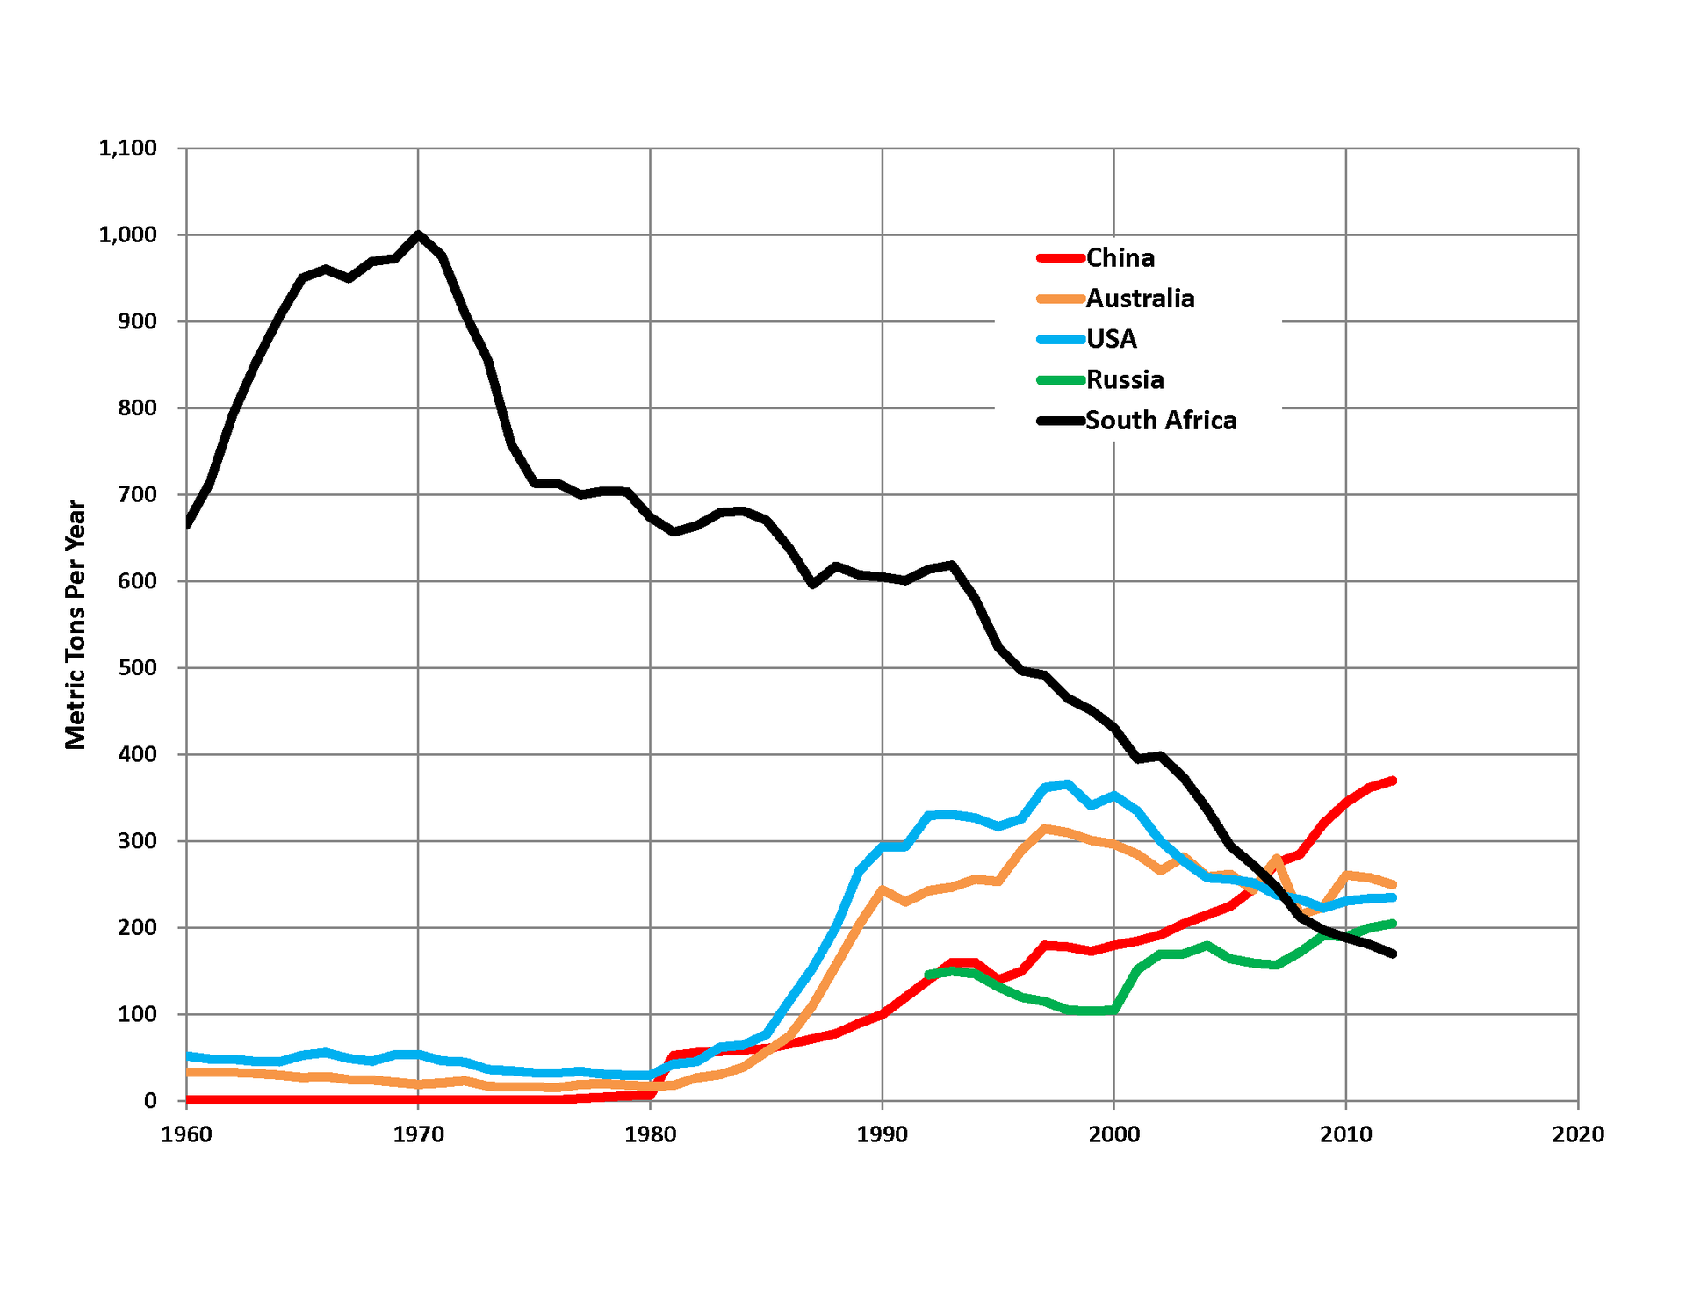
Where is the gold being mined?
China is the leading country in gold production, producing about 11% of total gold production.

Slide 3
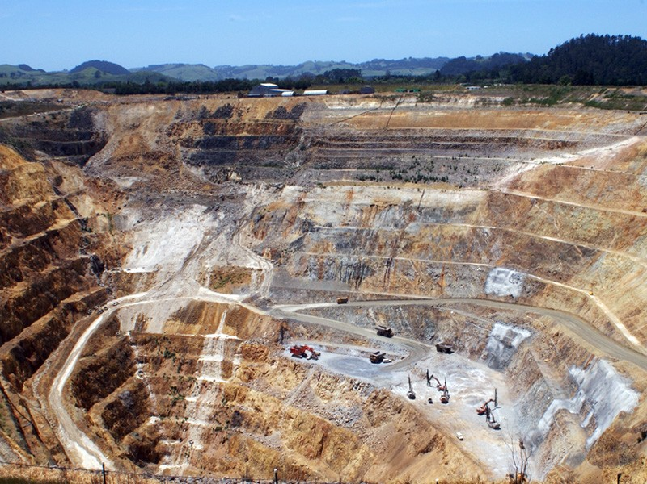
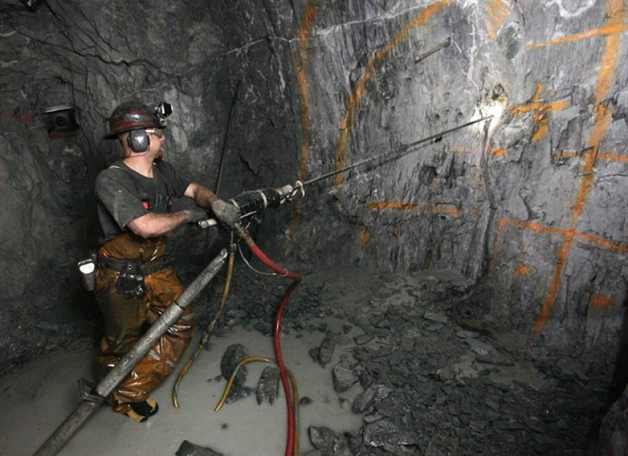
Production Process
Determine gold mining locations
Ore samples are taken
Mining
Breaking down the ores
Shipped out to be refined
Open-pit mining
Breaking down the ores:
The ores are processed by both gravity separation and cyanide solution
Underground mining

Slide 4
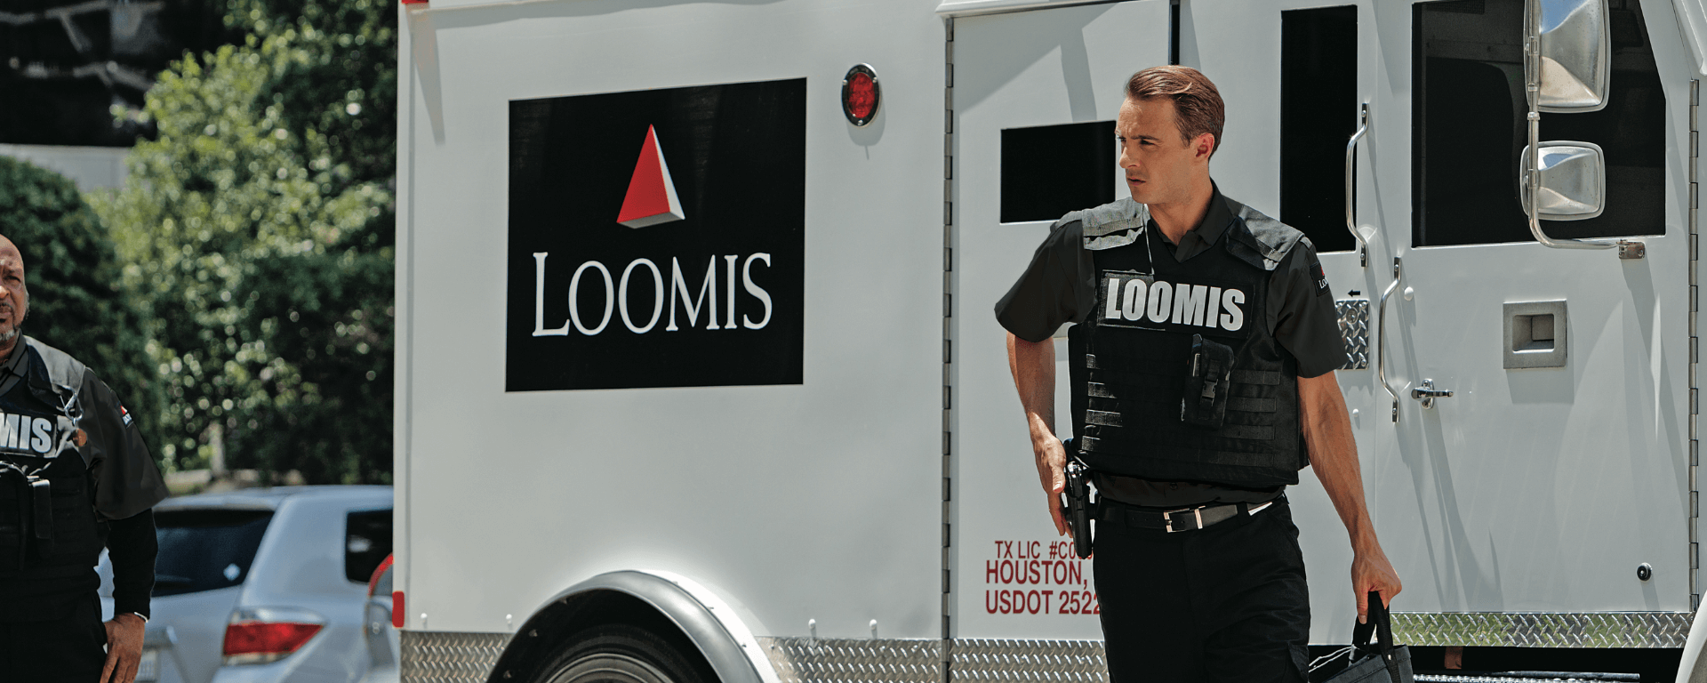
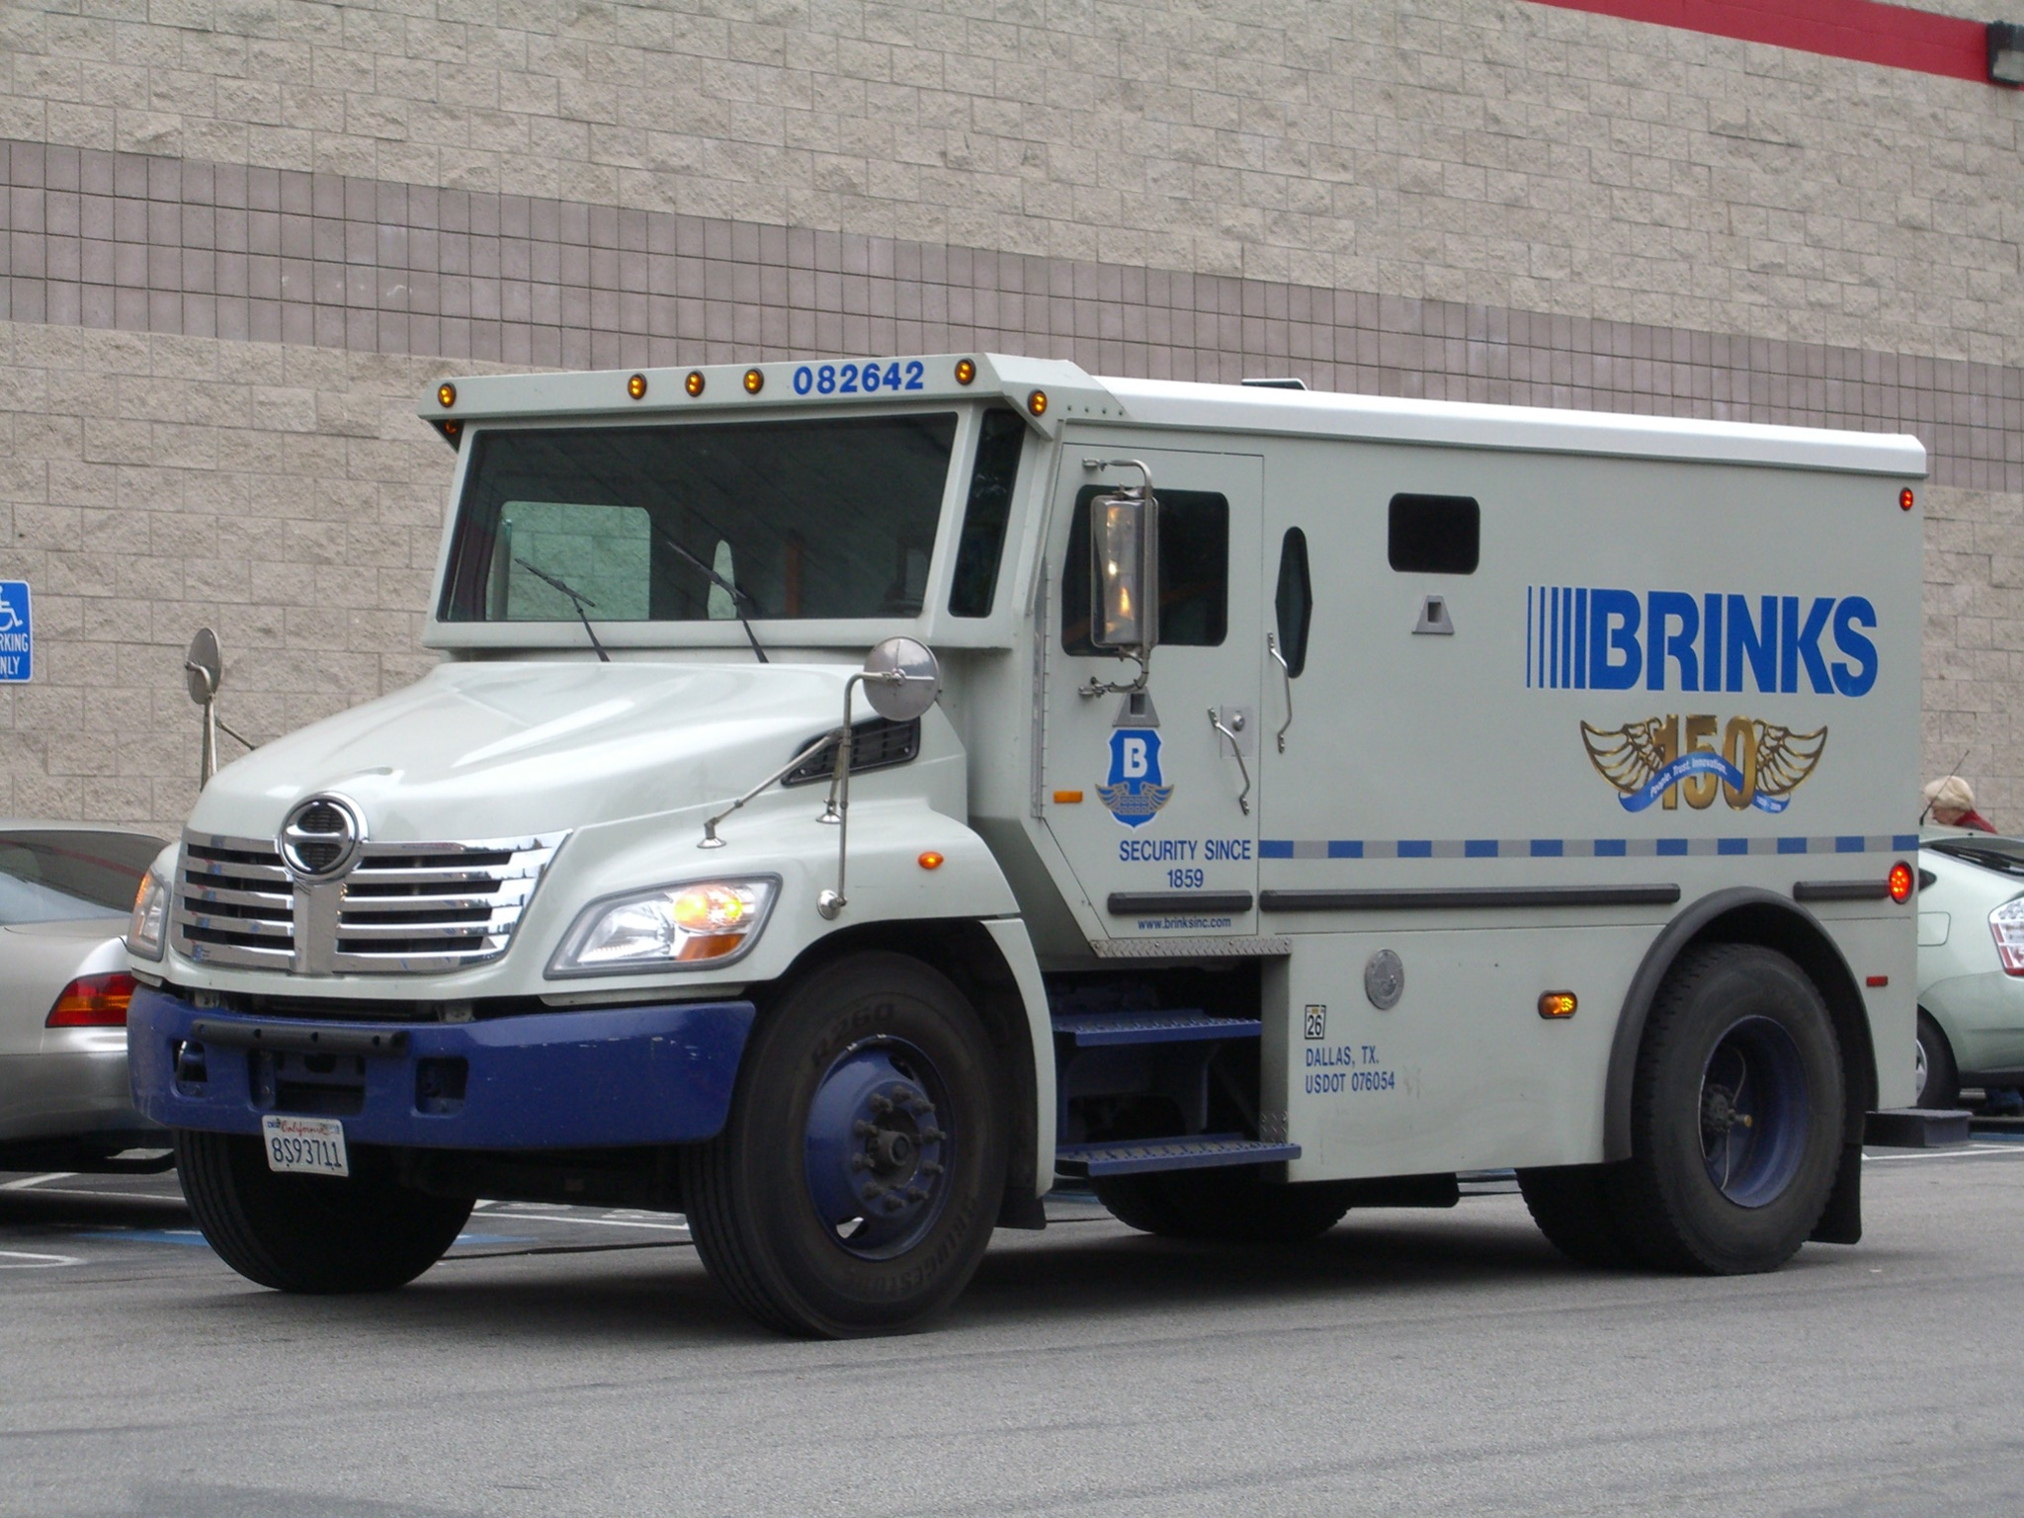
How is the gold imported?
Packages less than $100,000 are transported through FedEx or UPS.
Must be insured by third-party company, such as AIB Express
‘Double-boxed’ packaging
VATs, tariffs & duties
Packages that are greater than $100,000 in value are transported by either Loomis or Brinks, which are armored car companies.
Must have commercial invoice if it’s being internationally shipped
Must be picked up from storefront, office or bank

Slide 5
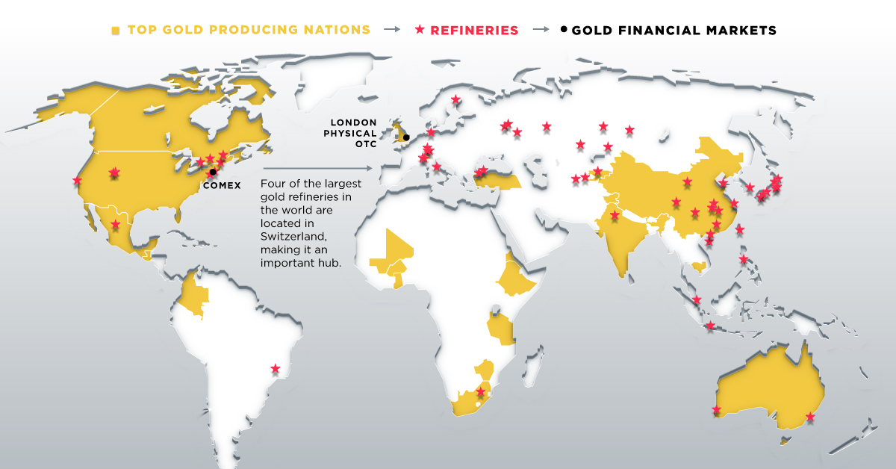

Slide 6
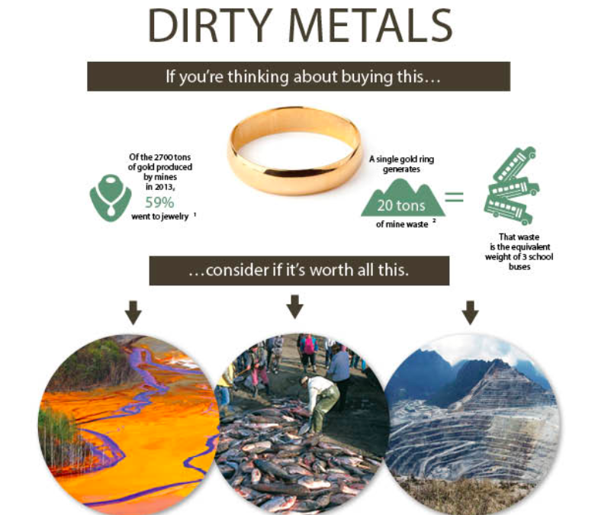
Commodity Fetishism
Gold is usually seen as a symbol of wealth or religion. It is also used for industrial and investment purposes.
There is information accessible to consumers to learn more about the harmful effects of gold, but you have to be looking for it.
Gold is not an everyday commodity but consumers are constantly looking for that pretty piece of jewelry to gift someone or gift themselves.
A ring produces about 20 tons of waste, which majority of consumers don’t realize.

Slide 7
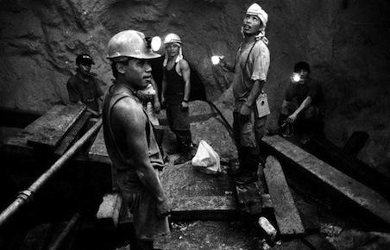
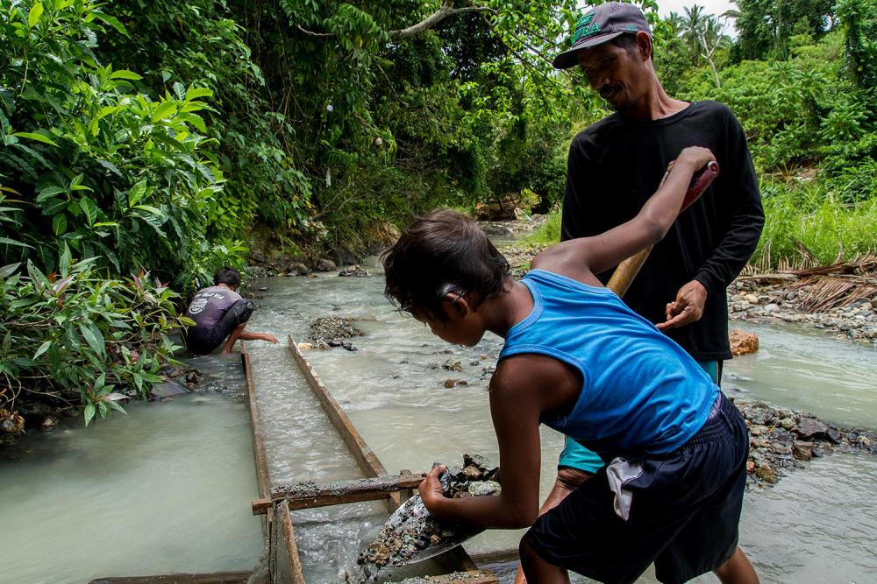
Controversy
Poisoned waters
Child labor
Solid waste
Indigenous peoples’ land taken and destroyed
Gender bias towards men
Long term disabilities, such as tuberculosis, bronchitis and lung cancer
Extreme heat
Lifespan is generally lower if you are a gold miner
The down side to gold mining

Slide 8
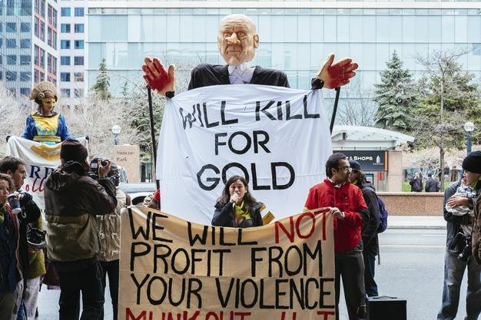
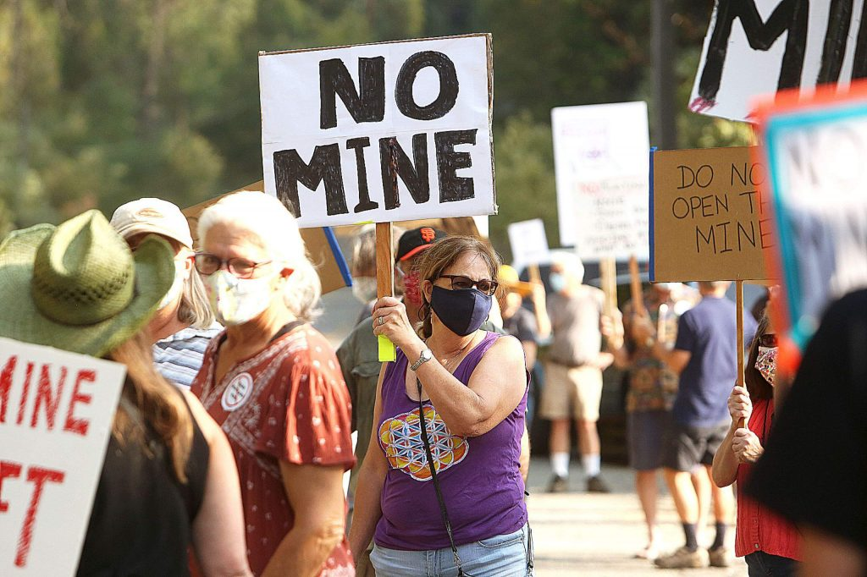
Protests
Protest against reopening Idaho-Maryland mine, 2020
10 years of protests against Barrick Gold in Toronto, 2016
There are thousands of protests that occur in different countries against gold mining and the harmful effects it has on the environment.

Slide 9
China: industrial, investment & jewelry
In China, some banks sell gold coins over the counter
United States: industrial, investment & jewelry
Status in different countries:
India: jewelry, religion, marriage

Slide 10
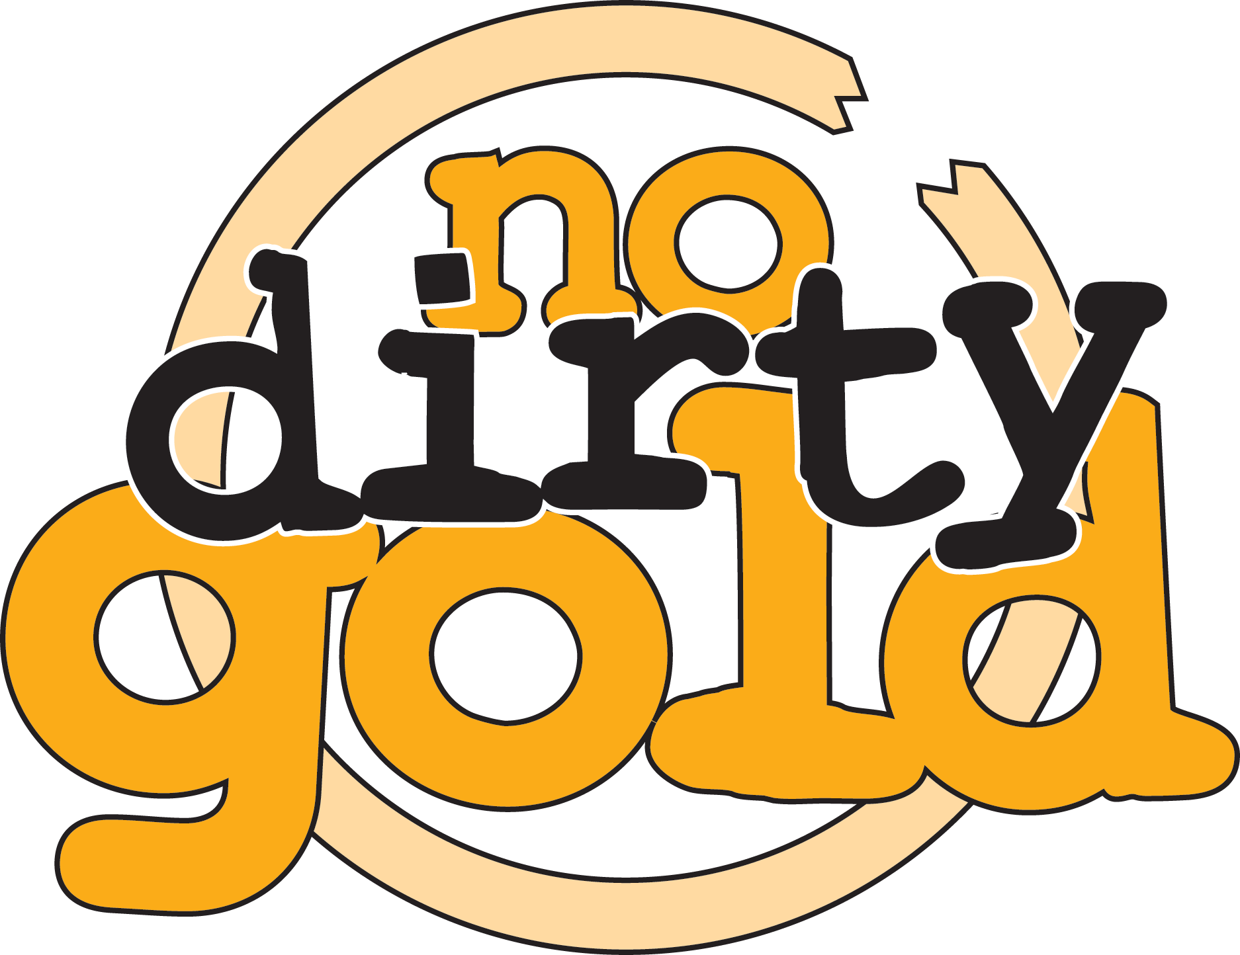
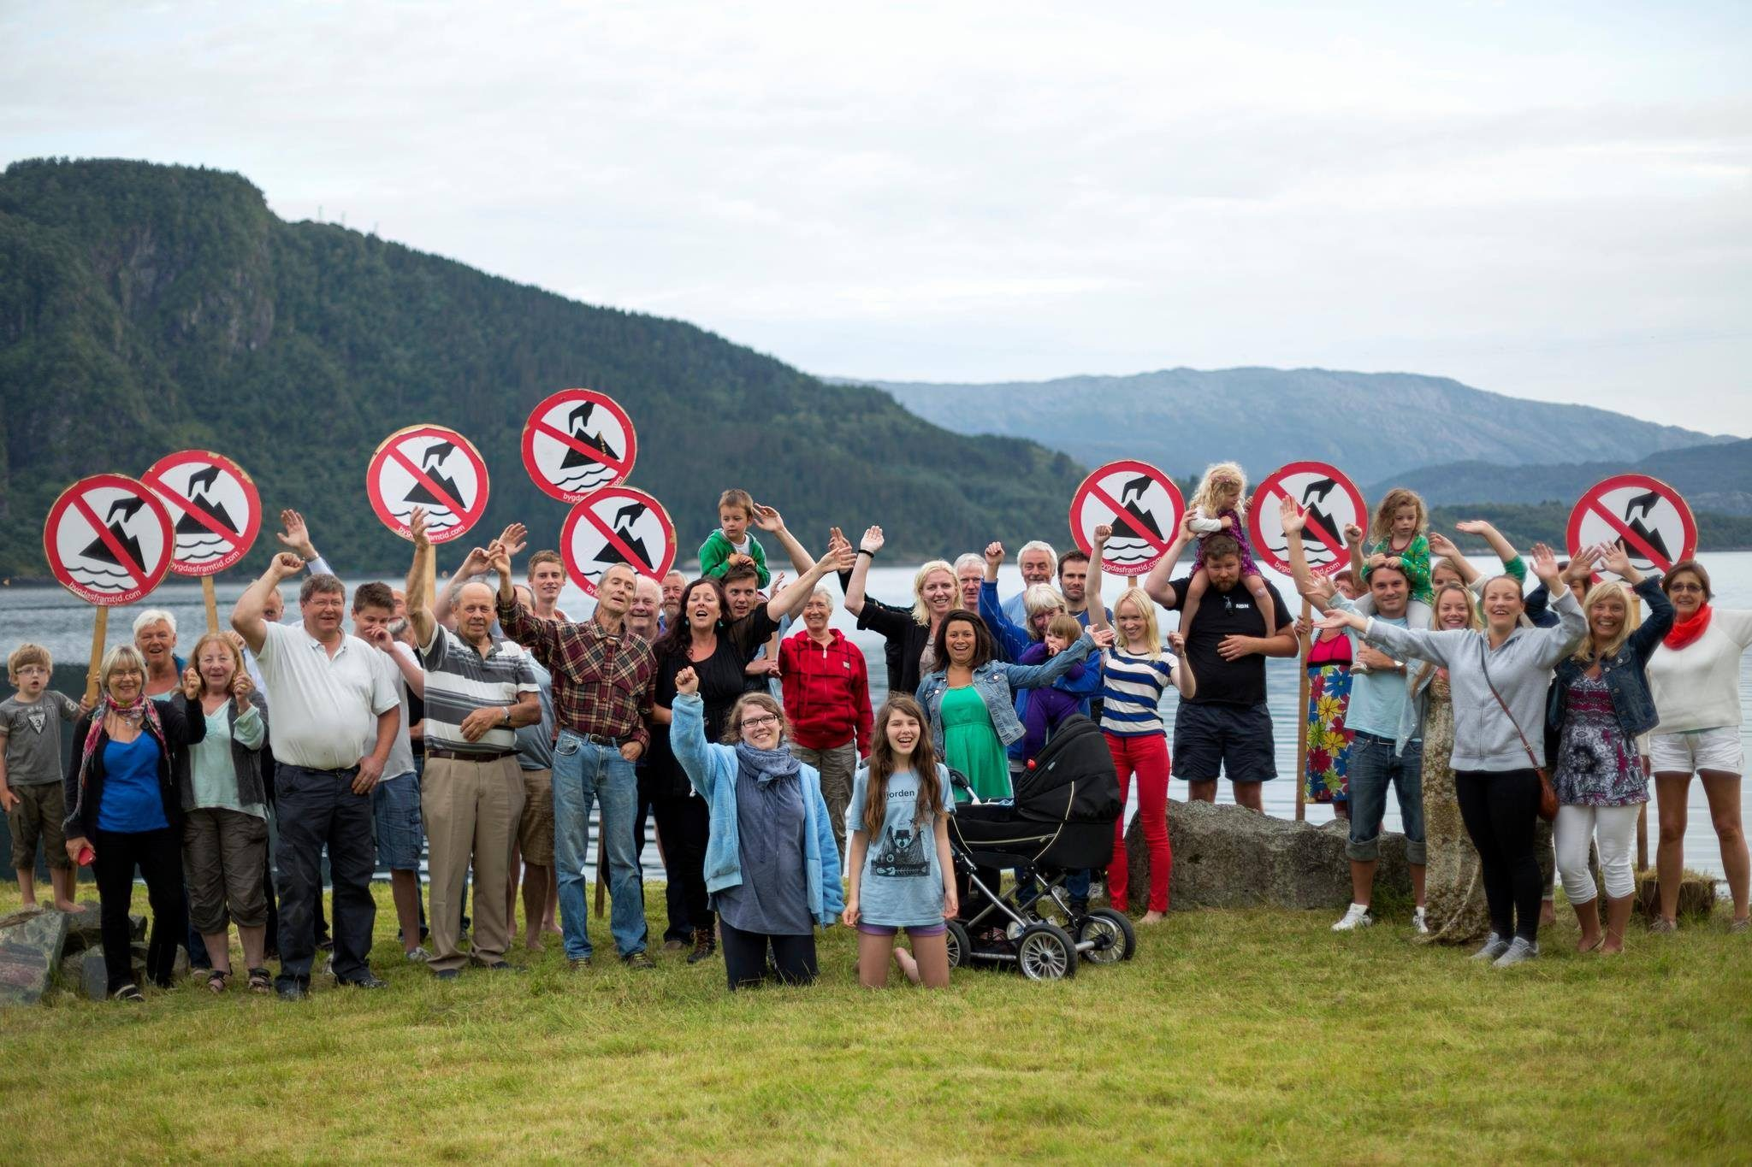
Taking Action
Earthworks is a nonprofit organization that is dedicated to protecting the environment and its materials. They stand for clean air, water and land, and healthy communities, and corporate accountability.
One of their campaigns is called “No Dirty Gold.” It's an international campaign whose goal is to ensure that gold mining operations respect human rights and their environment. They try to educate consumers, retailers and manufacturers about how much of an impact gold mining has on the environment. Most consumers don’t know where the gold is coming from and how it is produced.
Go to:
https://www.earthworks.org/donate/ to donate and fight for environmental justice

Slide 11
Sources
https://www.gold.org
https://www.gold.org/about-gold/gold-demand/sectors-of-demand
https://www.macrotrends.net/stocks/charts/NEM/newmont/revenue
https://www.cnbc.com/2011/09/01/how-the-gold-business-operates.html
https://www.generalkinematics.com/blog/gold-mining-processing-everything-need-know/
https://www.earthworks.org/campaigns/no-dirty-gold/impacts/
https://www.business-humanrights.org/en/latest-news/turkey-thousands-protest-at-gold-mine-owned-by-canadian-company/
https://www.streetdirectory.com/travel_guide/61267/jewelry/jewelry___the_symbol_of_status_and_wealth.html
https://fr.swpcayman.com/media/commentary/shipping-gold-into-other-countries-how-does-it-work
https://www.cnbc.com/2011/09/01/how-the-gold-business-operates.html
https://www.earthworks.org/campaigns/no-dirty-gold/

