Slide 1
Socks!
Matthew Pluzsik

Slide 2
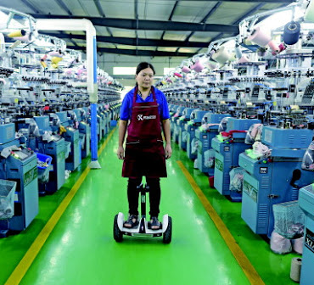
Place
Datang, Zhuji
“Sock City”
40% of World’s socks!

Slide 3
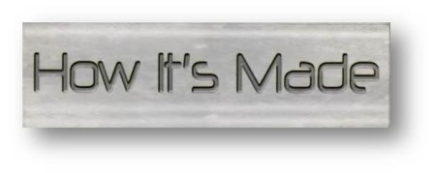
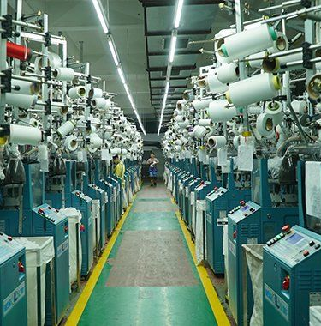
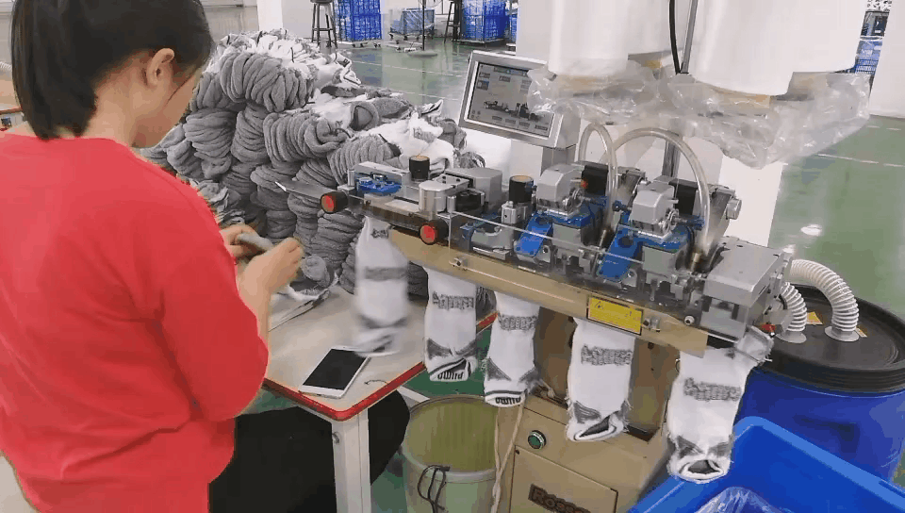
A single machine can make around 380 pairs of adult socks a day.
Sock machines like these make the process efficient.
The toe opening is sewn by another machine.

Slide 4
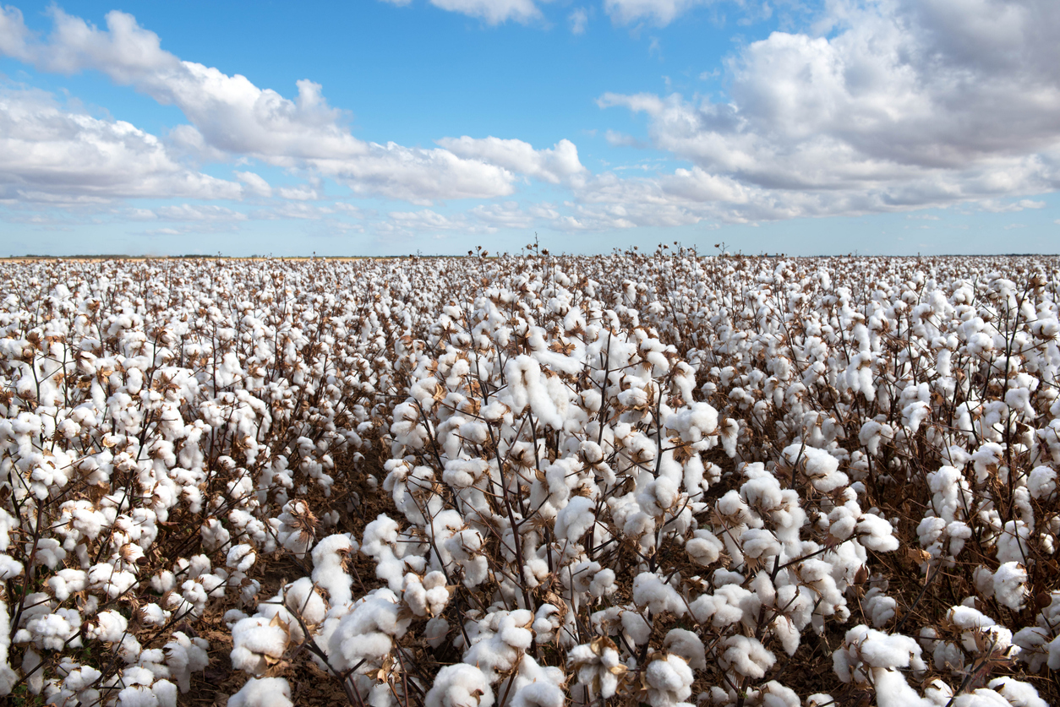
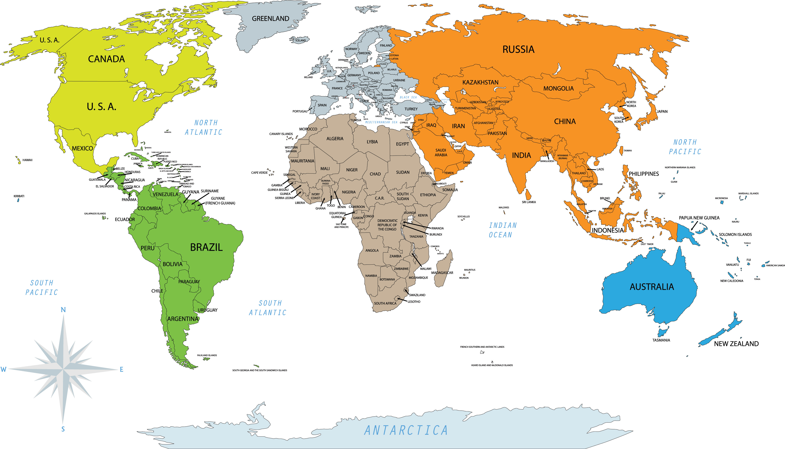
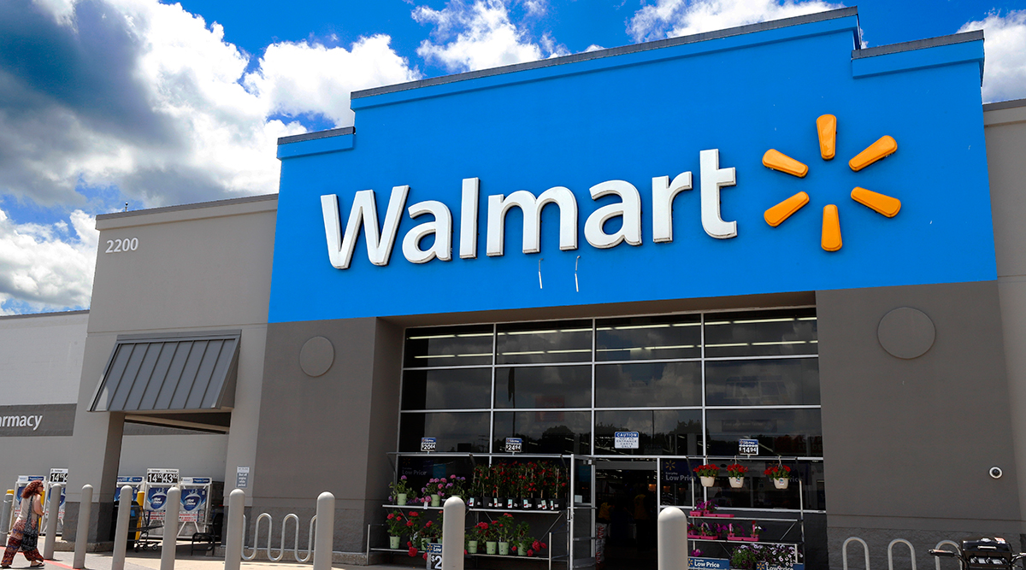
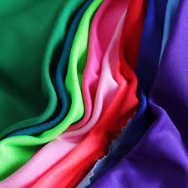
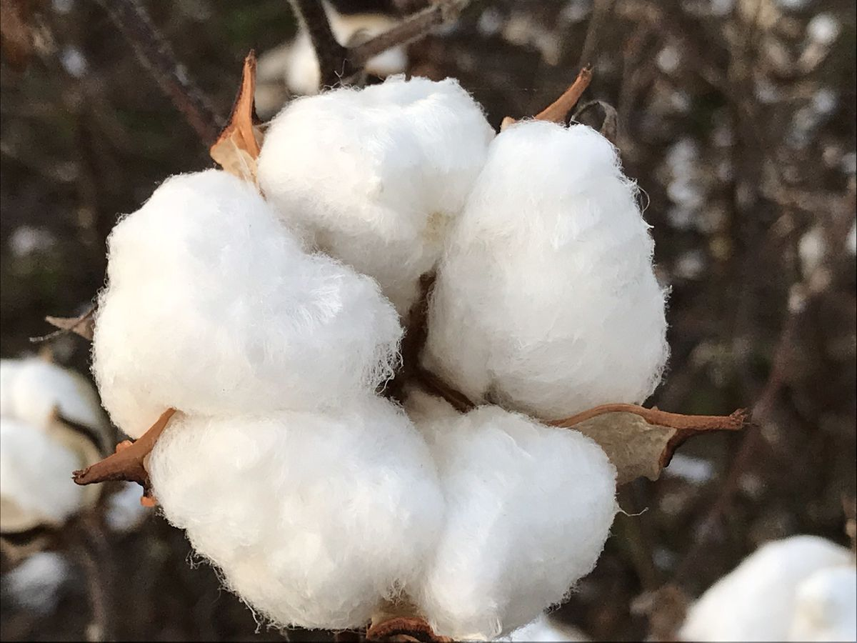
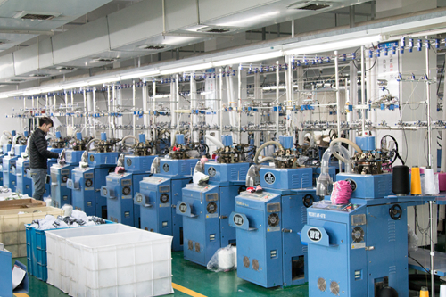
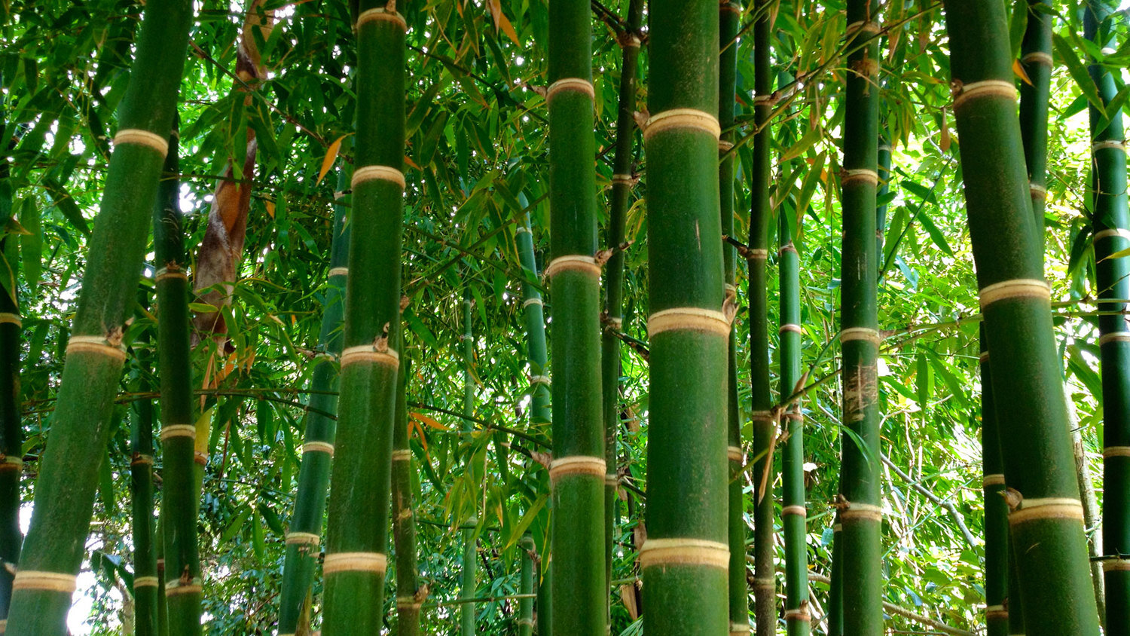
The Map: Global Trade
36% of EU sock imports come from China
58% of US sock imports come from China
Datang factory

Slide 5
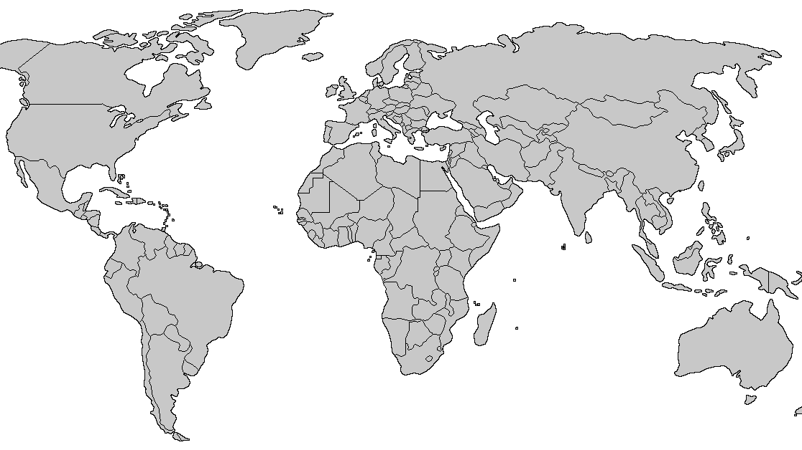
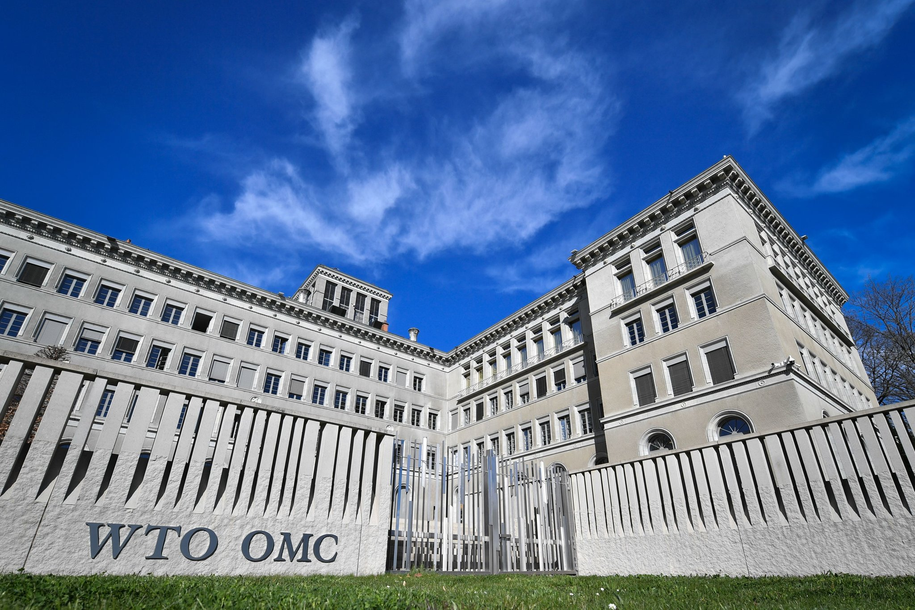
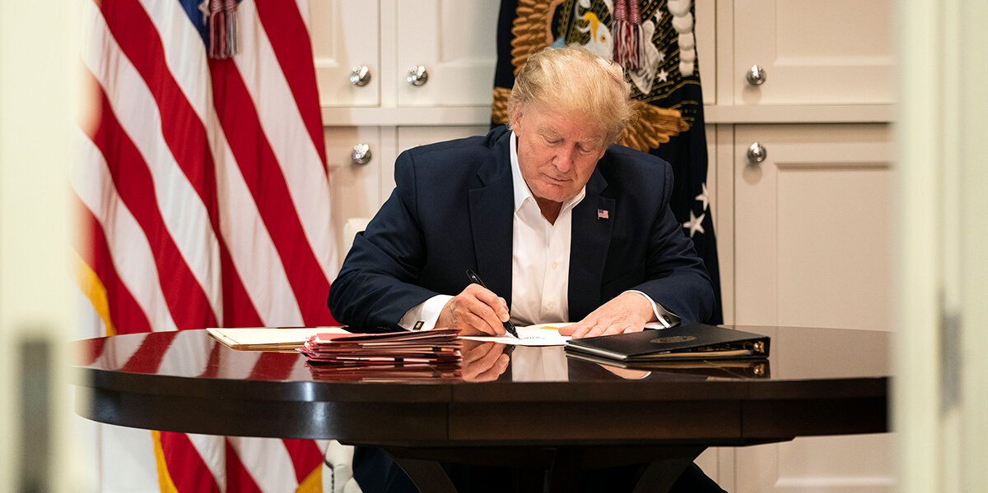
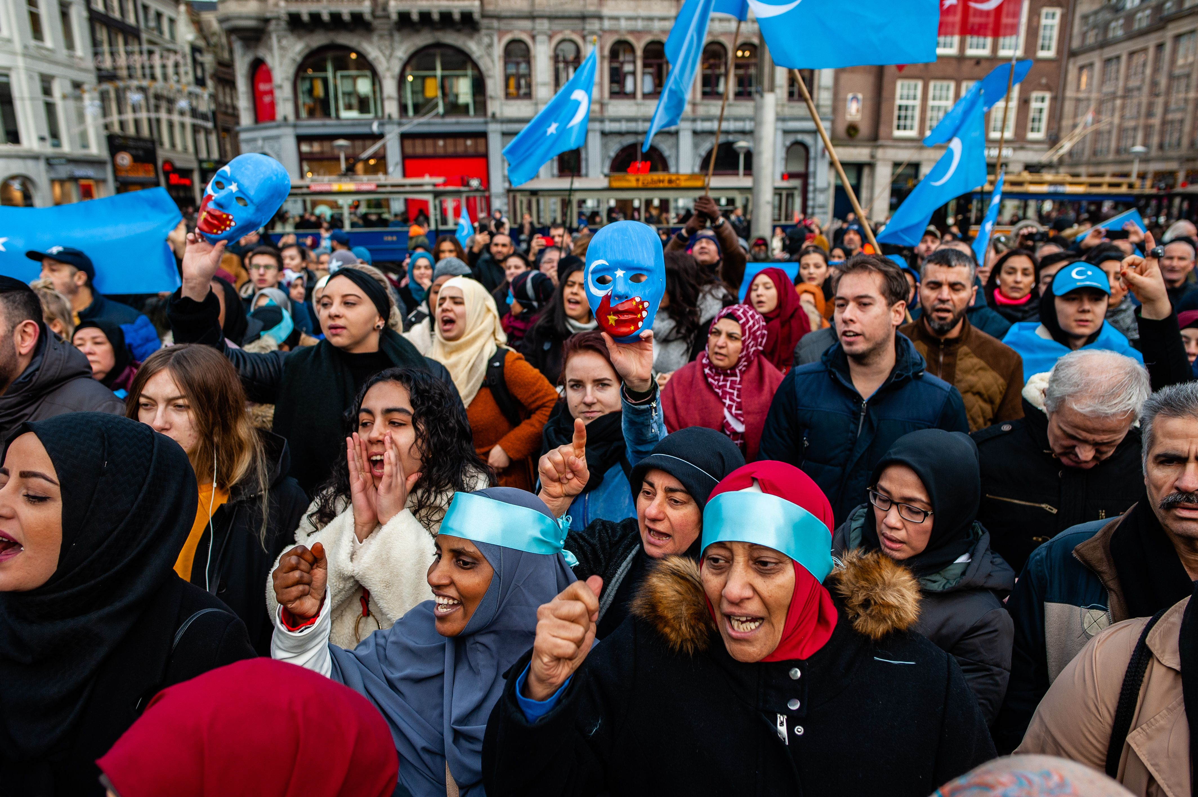
The Map: Flow Hinderance
WTO - Switzerland
Datang factory
“Trade War” 2018-Present
Uighur forced labor

Slide 6
Safe – sock strategy
Boodywear.com
Support free trade / eco – friendly creators
Write to Congress about Uighur refugees
Research, research, research!

