Slide 1
Tennis Balls
By Joshua Pereira

Slide 2
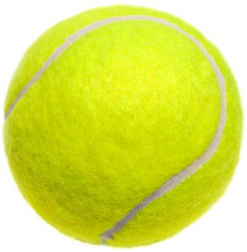
What is a Tennis Ball
Tennis Balls are made from a pressurized rubber core that is covered by bright yellow felt
They are an essential part of tennis, and not many
people realize how many tennis balls are used yearly

Slide 3
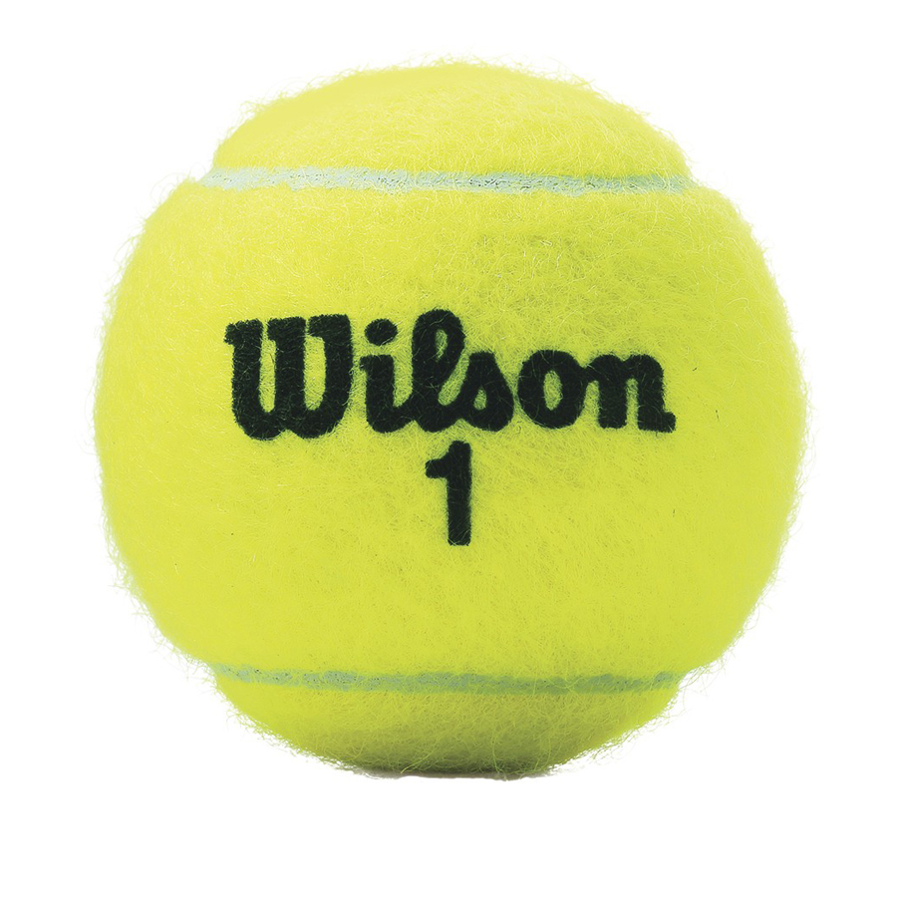
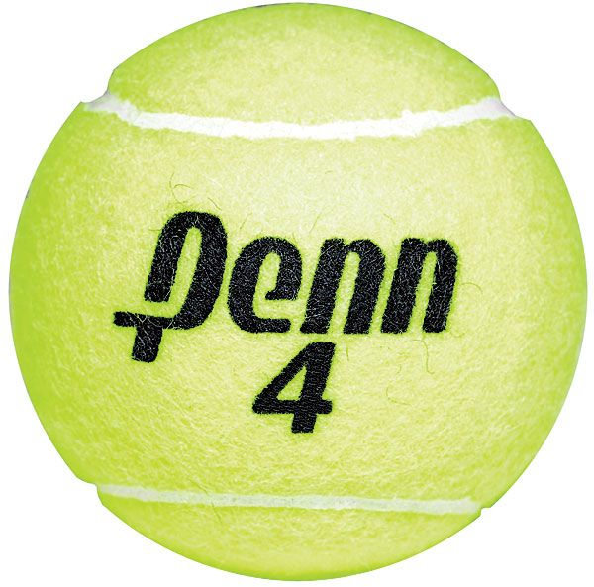
Big Corporations
Wilson Sporting Goods Penn Dunlop Sport

Slide 4
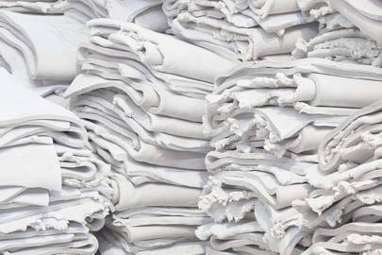
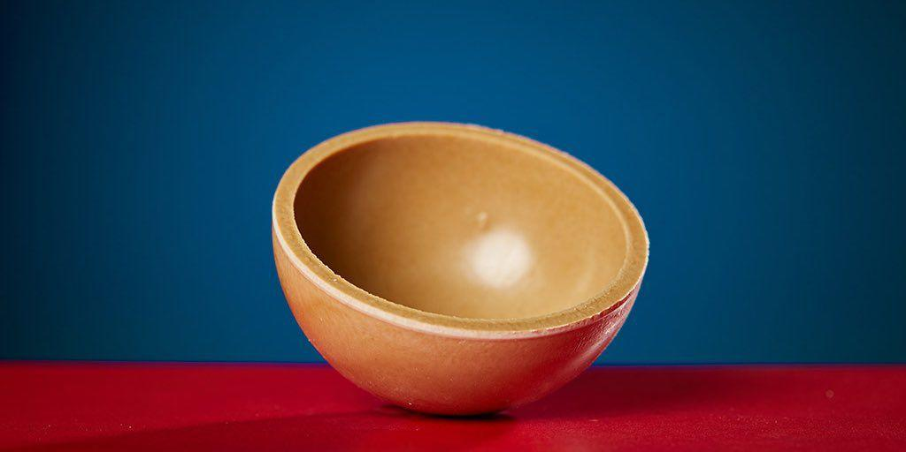
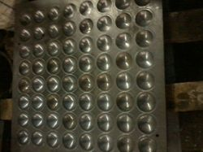
Production Process
1. Crushing
this is where the materials that make up the core are crushed together in a mill
those items are mainly rubber and some clay
2. Compression
The rubber from the mill is taken and put into molds to make the halves of the core, and are compressed for 90 seconds
3. Sheeting
From step 2 the molds are taken and formed into a sheet to cooldown. Afterwards they are cut to make the halves
Benedict Rosgrove

Slide 5
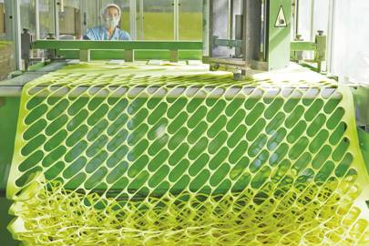
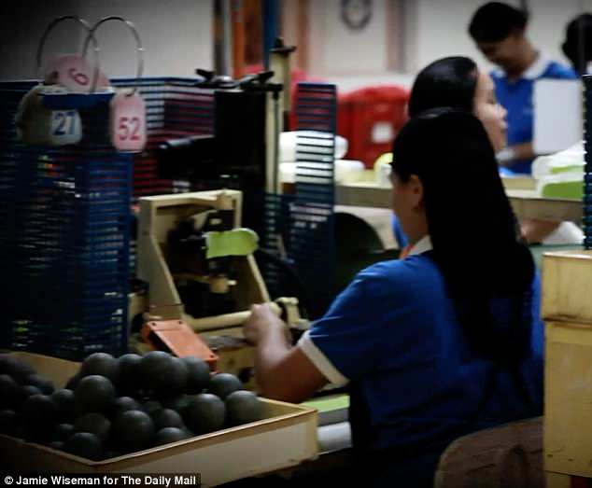
4.Buffing
This is where the ball is made, the two halves are put together to form the whole sphere with an adhesive material to keep them together
5.Felting
This is the last part where felt is added to the tennis ball. A sheet of felt is taken and put through a machine to take out unnecessary parts. Then the felt is applied manually

Slide 6
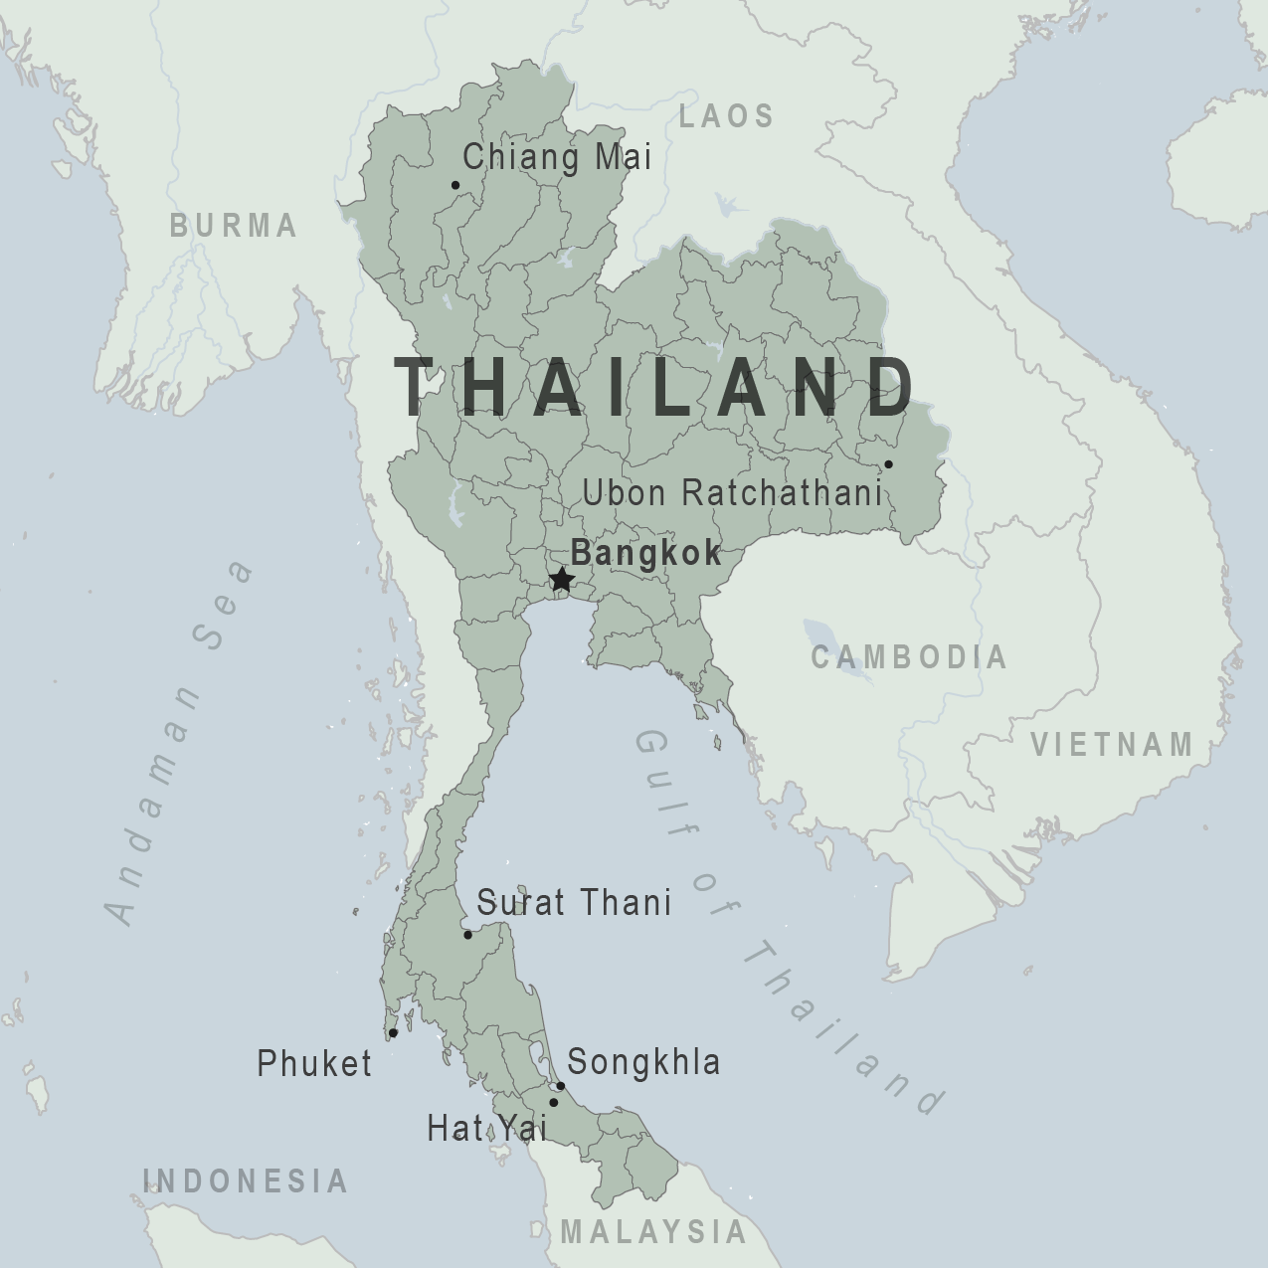
Where are they made?
Wilson Tennis balls are produced in a factory in Thailand. This is done primarily as a good amount of the rubber they use is sourced from there

Slide 7
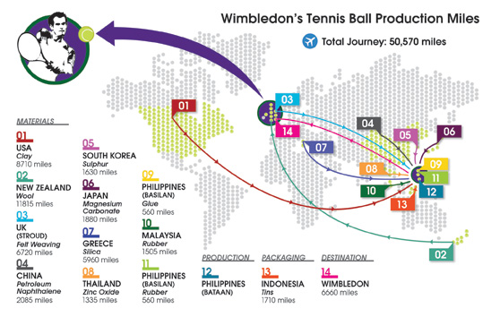
Map Flows
Something to note here on this map in particular is that it shows the distance each material travels. That is done in order to emphasize the abnormal distance that these materials travel for production
Another interesting to note is that all the rubber needed for this doesn’t come from Thailand alone, where the factory is based. This is done in an attempt to limit the strain on rubber trees in Thailand

Slide 8
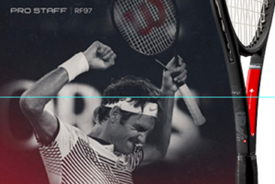
Advertising
Advertising is a very important part in any business, and Wilson does a very good job in that department as well
A large amount of their sales comes from advertisements of popular tennis players.
Some of the most notable players who are endorsed by Wilson are Roger Federer and Serena Williams. By appearing in commercials as well as using their equipment Wilson are able to show the appeal of their products

Slide 9
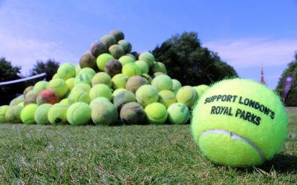
Controversies or Issues in Production
There have been no ethical controversies surrounding the workers in the factory, or in the process of sourcing their materials
However, a different issue is present and that is an environmental problem. Millions of tennis balls are disposed of yearly and sent to a landfill. The US open alone uses around 70,000 tennis balls in the span of the two week tournament

Slide 10
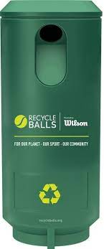
Social Movements
At the moment there are a few social movements in the works to help combat these issues
One of the more prominent movements is called Recycle Balls, who have partnered with Wilson
Another is Project Green Ball who take used tennis balls and tries to repurpose the materials
Wilson themselves have taken the initiative to make a more sustainable packaging as well in order to reduce plastic waste by introducing a new line called Triniti

Slide 11
Commodity Fetishism
While researching about Wilson, I found that a lot of information easily accessible. This makes a lot of sense considering they have allowed multiple journalist, like those from the New York Times for example come in and film their production process
On Wilson’s website they have issued a statement regarding California Transparency Supply Chains Act
What it is says is that Wilson aren’t taking advantage of their employees and are going about their production and distribution properly

Slide 12
What can you do?
As stated earlier, you can take part in reducing tennis ball waste by recycling tennis balls through any of the programs you find online.
My recommendation is to use Recycle Balls as the balls get repressurized and right back into the hands of those who aren’t able to afford them
This can be done by going to https://recycleballs.org/ and following the instructions there. In some cases, there are courts and facilities with recycle ball bins on site, and it is as simple as dropping the balls off there

Slide 13
References
https://www.nytimes.com/2016/09/04/sports/tennis/wilson-tennis-balls-made.html#:~:text=A%20Wilson%20Tennis%20Ball%20is%20Made&text=Raw%20rubber%20from%20Thailand%2C%20Vietnam,in%20that%20distinct%20fluorescent%20felt.
https://numerical.co.in/numerons/collection/589456a91429f7bc222cf873
https://www.reliableplant.com/view/29428/tennis-balls-manufactured
https://www.wired.co.uk/article/tennis-ball-factory
https://resource.co/article/new-balls-please-what-happens-300-million-tennis-balls-discarded-every-year-11371
https://www.amersports.com/2019/09/wilson-launches-sustainable-tennis-ball-triniti/
https://www.wilson.com/en-us/california-transparency
https://www.wbs.ac.uk/news/the-50-000-mile-journey-of-wimbledon-s-tennis-balls/
https://www.amersports.com/2018/10/wilson-teams-up-with-recycleballs-to-recycle-20-million-tennis-balls-over-next-three-years/
https://www.wilson.com/en-us/tennis/balls/premium/triniti-tennis-balls-3-ball-sleeve

