Slide 1
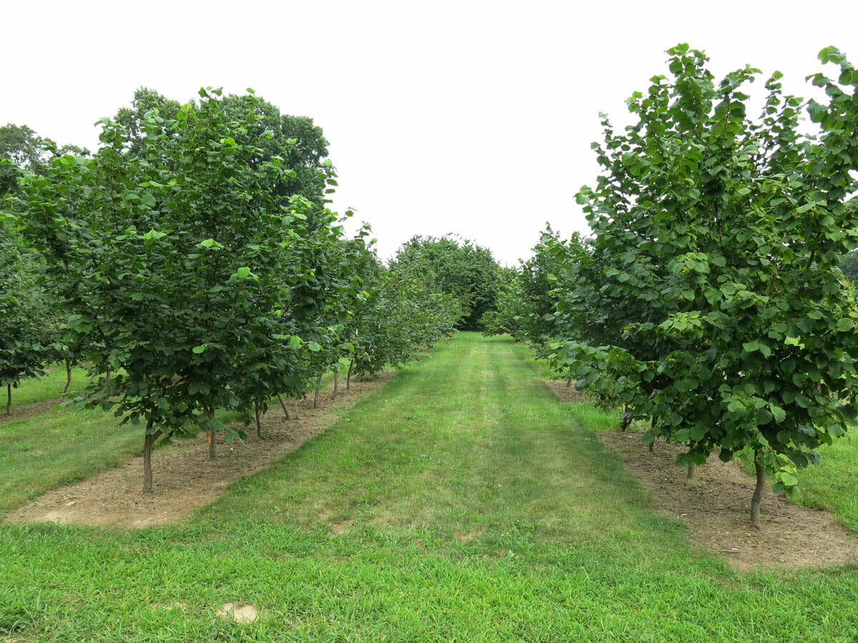
Hazelnuts
Presented by Gabriel Luyun

Slide 2
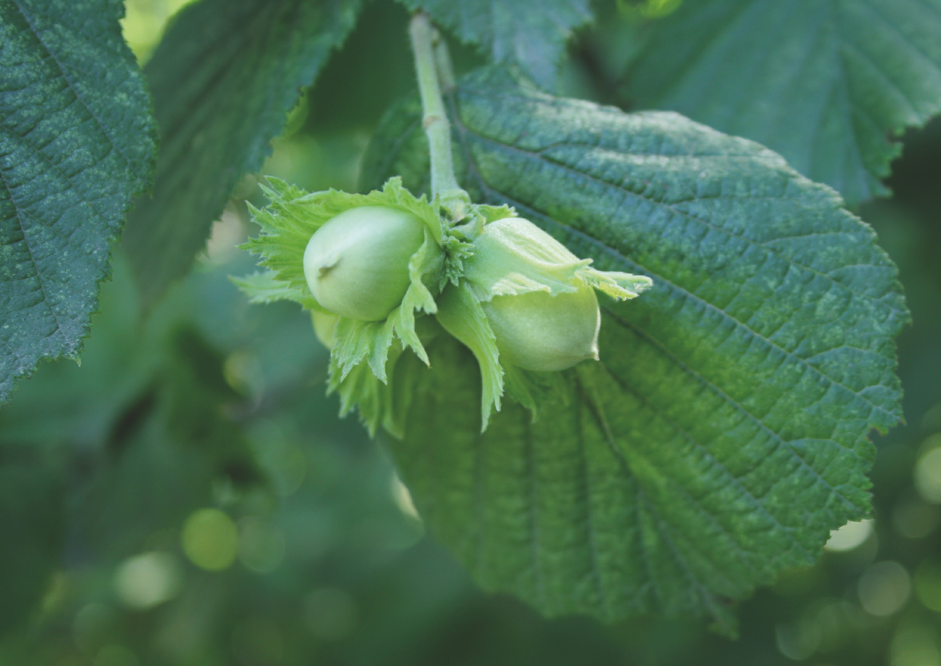
What are Hazelnuts?
Fruit of hazel trees
Known as cobnuts or filberts in Europe
Widely used for desserts

Slide 3
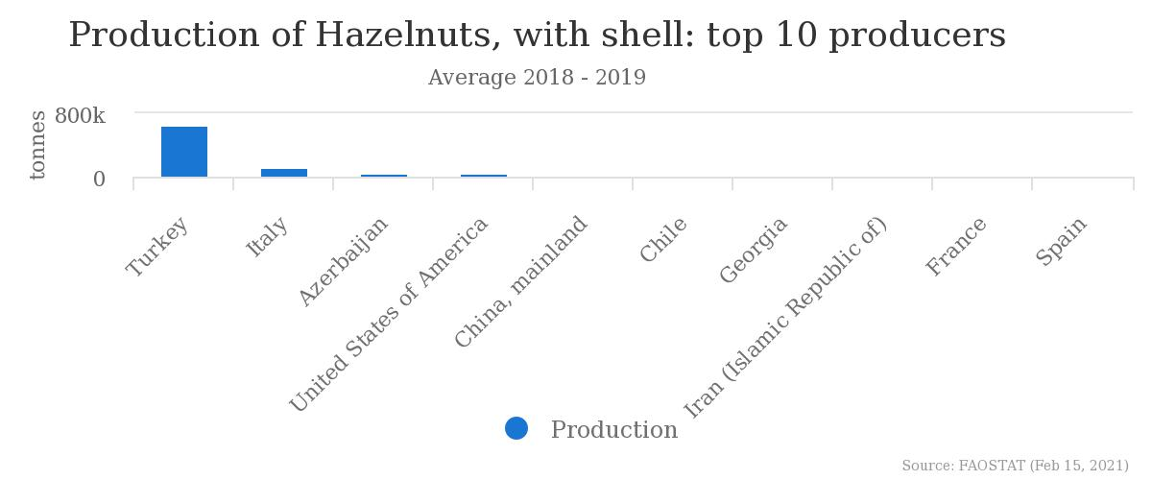
Where are Hazelnuts Produced?
Turkey produces two-thirds (645,523 tonnes) of the world’s hazelnut supply according to the UN FAO estimates

Slide 4
Hazelnut Processing Steps
1
2
3
Harvesting
De-husking
Inspecting and Cleaning
6
5
4
Drying
Packaging & Shipping
Cracking

Slide 5
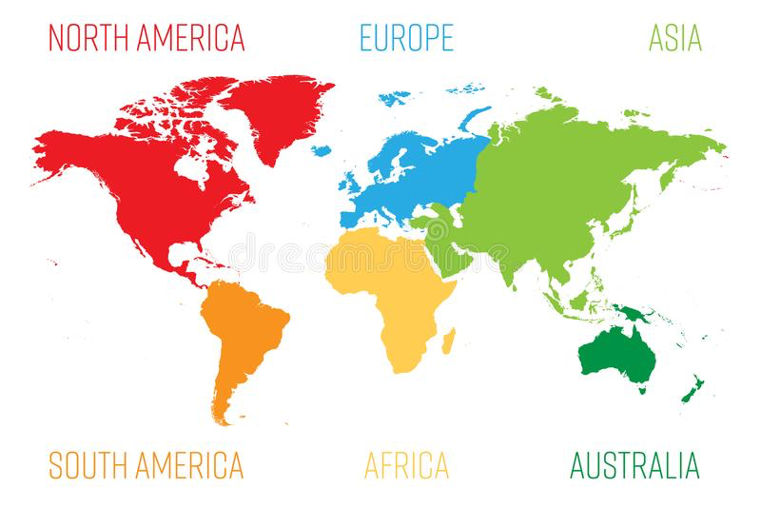
Hazelnut Export Distribution Flow Map
Total exports: 159,439-185,147
(August 2020-April 2021)

Slide 6
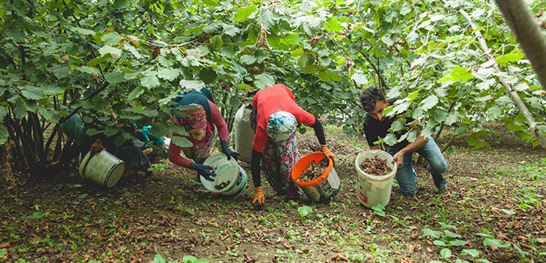
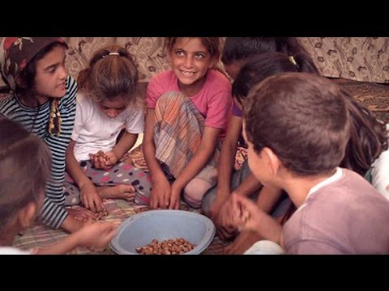
Hazelnut Trade Controversies
Labor exploitation
Juvenile employment (Elementary-age students)
10-12 hour workday, 7 days per week
Use of undocumented migrants
Many have no work permits
No labor protections
Low wages ($13 a day)
10% paid to labor agency for
transport costs

Slide 7
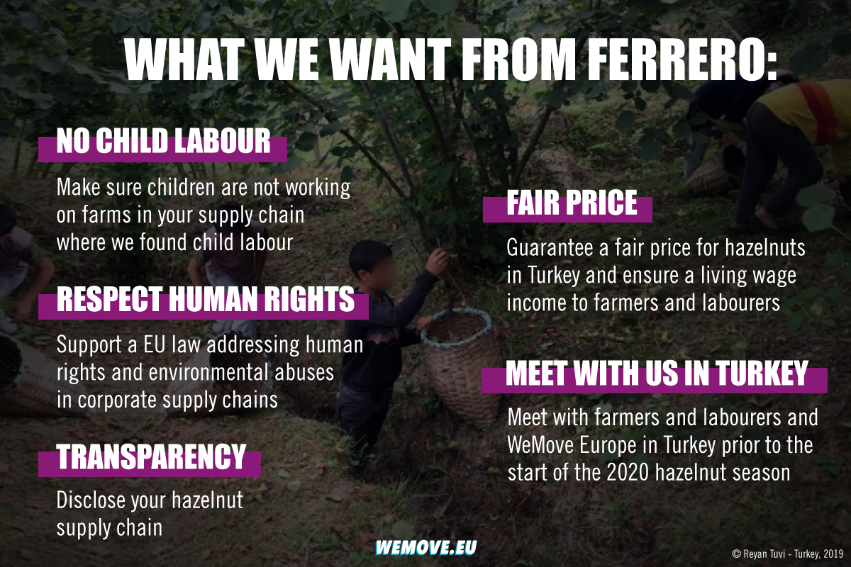
Campaigns against Child Labor
WeMove EU Petition
Ferrero - ILO collaboration
$4 million investment to encourage children to leave the hazelnut industry for school

Slide 8
Campaigns against Child Labor
Ferrero - SourceMap Traceability Plan
Implement 100% hazelnut traceability by 2020
SourceMap’s state-of-the-art technology
Tracks Ferrero’s hazelnuts (block chain)
Progress stalled by pandemic
Turkish government initiatives
Inspect farms bi/tri-annually for children
Online system tracking the names of child workers

Slide 9
Ending Child Labor
Educate yourselves
Learn about the plight of Migrant workers
Use the Internet, books, and other forms
of media and communication
E.g: BBC Hazelnut article:
https://www.bbc.com/news/stories-49741675
Sign petitions/ write letters / protest
against child labor in Turkey
E.g: WeMove Petition
https://act.wemove.eu/campaigns/ferrero-child-labour-uk

Slide 10
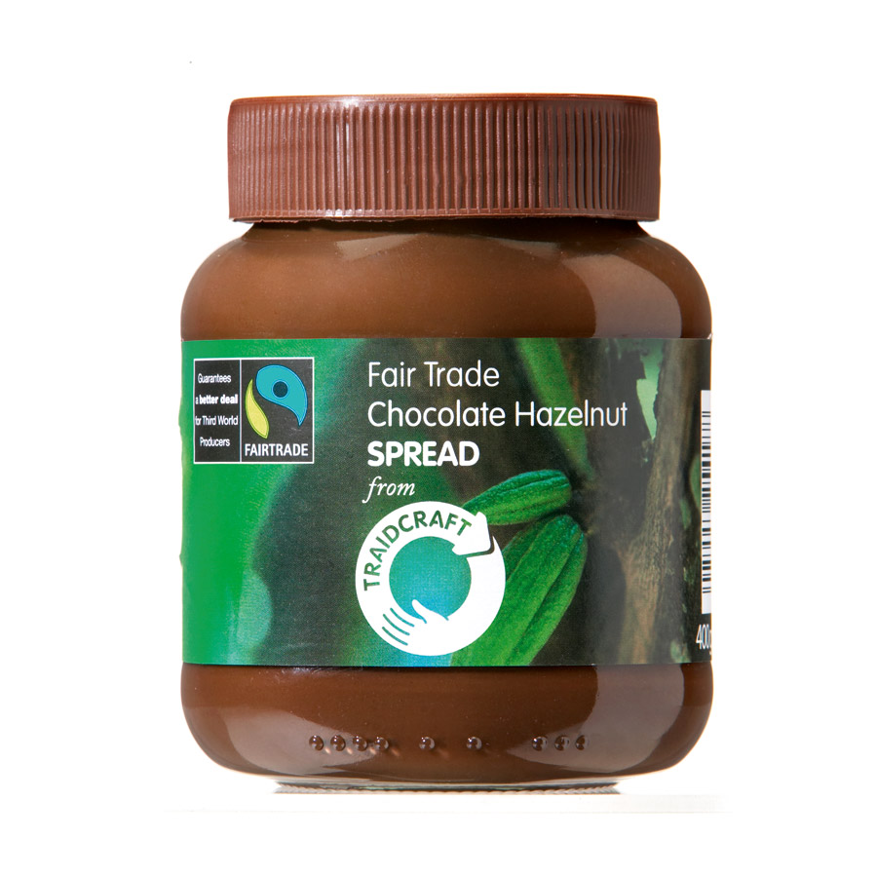
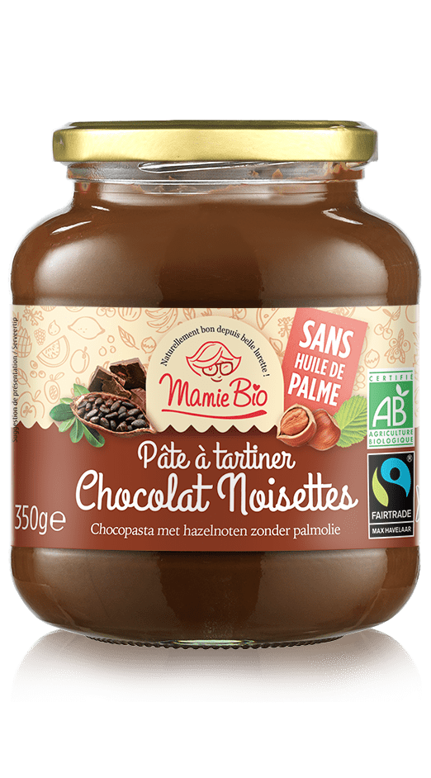
Ferrero North America Contacts
E-mail: see https://www.ferreronorthamerica.com/contact-US-residents
Phone Number: 1-800-688-3552; Monday – Friday 8am-10pm EST, except major holidays.
3. Buy more hazelnut and hazelnut-based products
with fair trade seals
4. Consider donating to NGOs supporting the needs of children
in Turkey
I.e: Humanium’s Turkey branch:
https://www.humanium.org/en/turkey/

Slide 11
Sources
https://www.cips.org/supply-management/news/2021/february/ferrero-draws-up-supply-chain-hazelnut-charter/
https://www.bbc.com/news/stories-49741675
https://act.wemove.eu/campaigns/ferrero-child-labor
https://www.ferreronorthamerica.com/contact-US-residents
https://www.humanium.org/en/turkey/
http://justfunfacts.com/interesting-facts-about-hazelnuts/
http://www.fao.org/faostat/en/#data/QC/visualize
https://www.nutfruit.org/files/tech/1575274087_Technical_Information_Kit_Hazelnuts.pdf
https://www.confectioneryproduction.com/news/32570/ferrero-donates-4-million-for-venture-tackling-child-labour-in-turkish-hazelnut-market/

