Slide 1
Platinum in Jewelry
By: Youssef Khalil

Slide 2
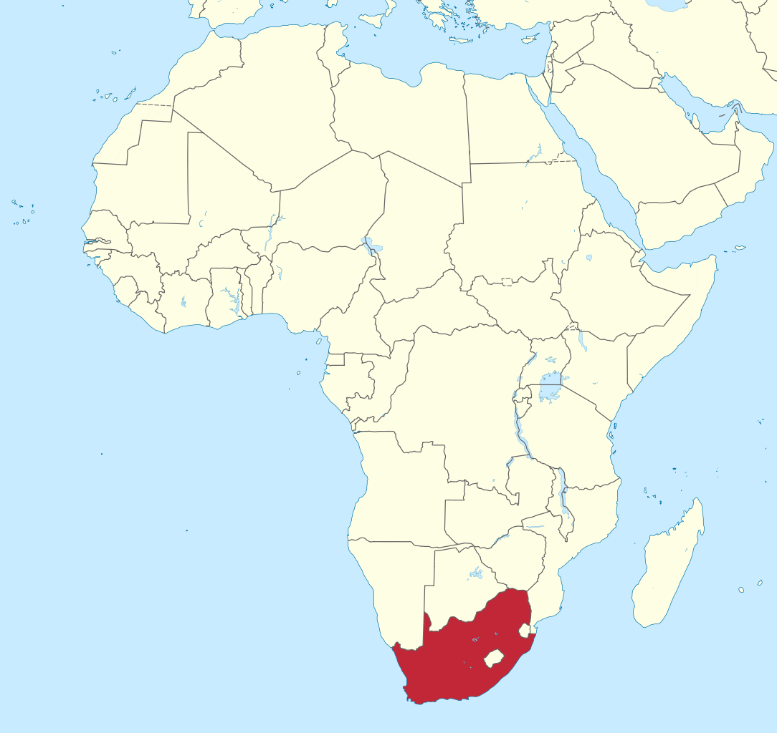
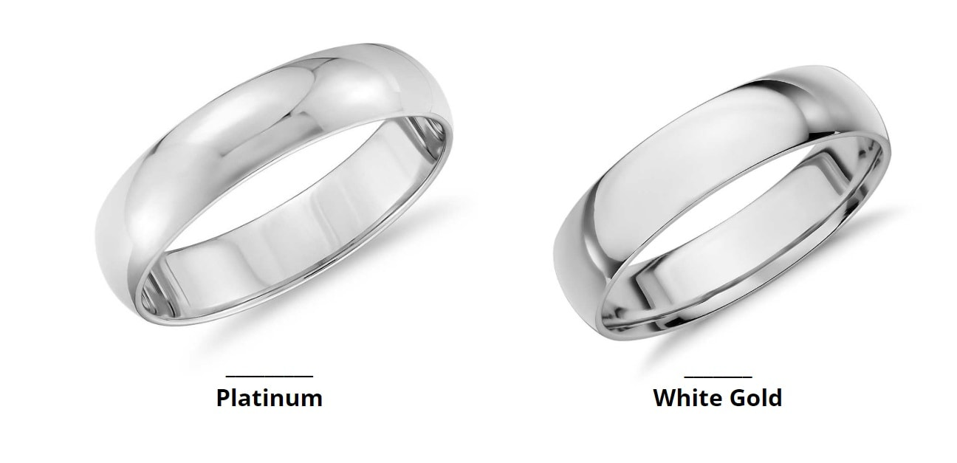
Where
Platinum is mainly mined and exported from South Africa making up about 80% of production. Following South Africa, Russia and Canada make up the rest of the platinum production. The jewelry itself is mostly made in Europe. Switzerland is the leading producer of quality platinum jewelry.

Slide 3
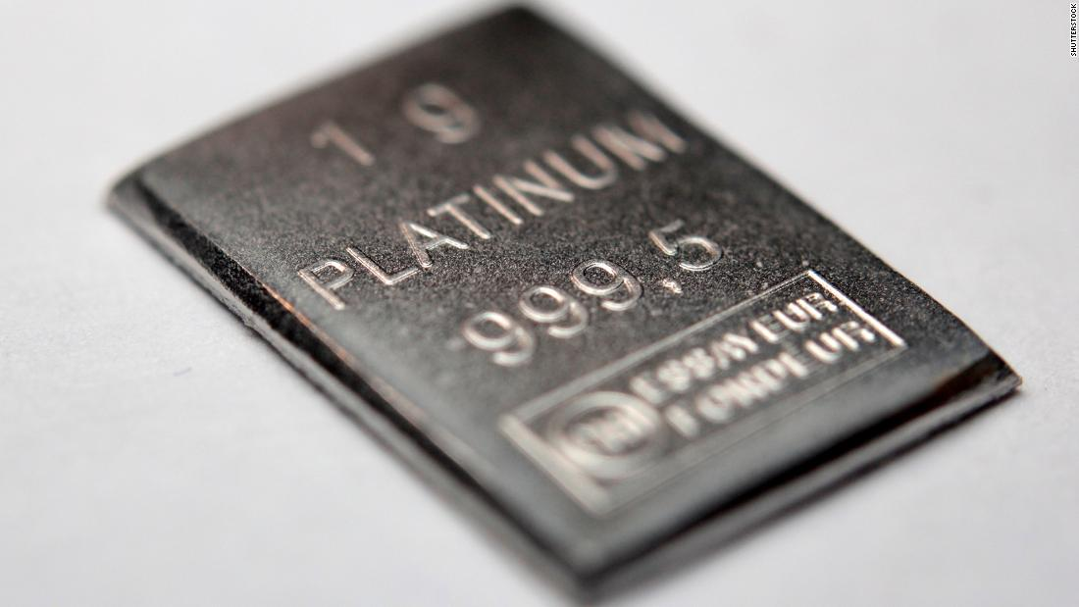
How much is imported to the United States
In 2018, America imported 58.5 metric tons of platinum. When it comes to jewelry alone in 2016 the US imported 169 kg, which was up 63% from the previous year.

Slide 4
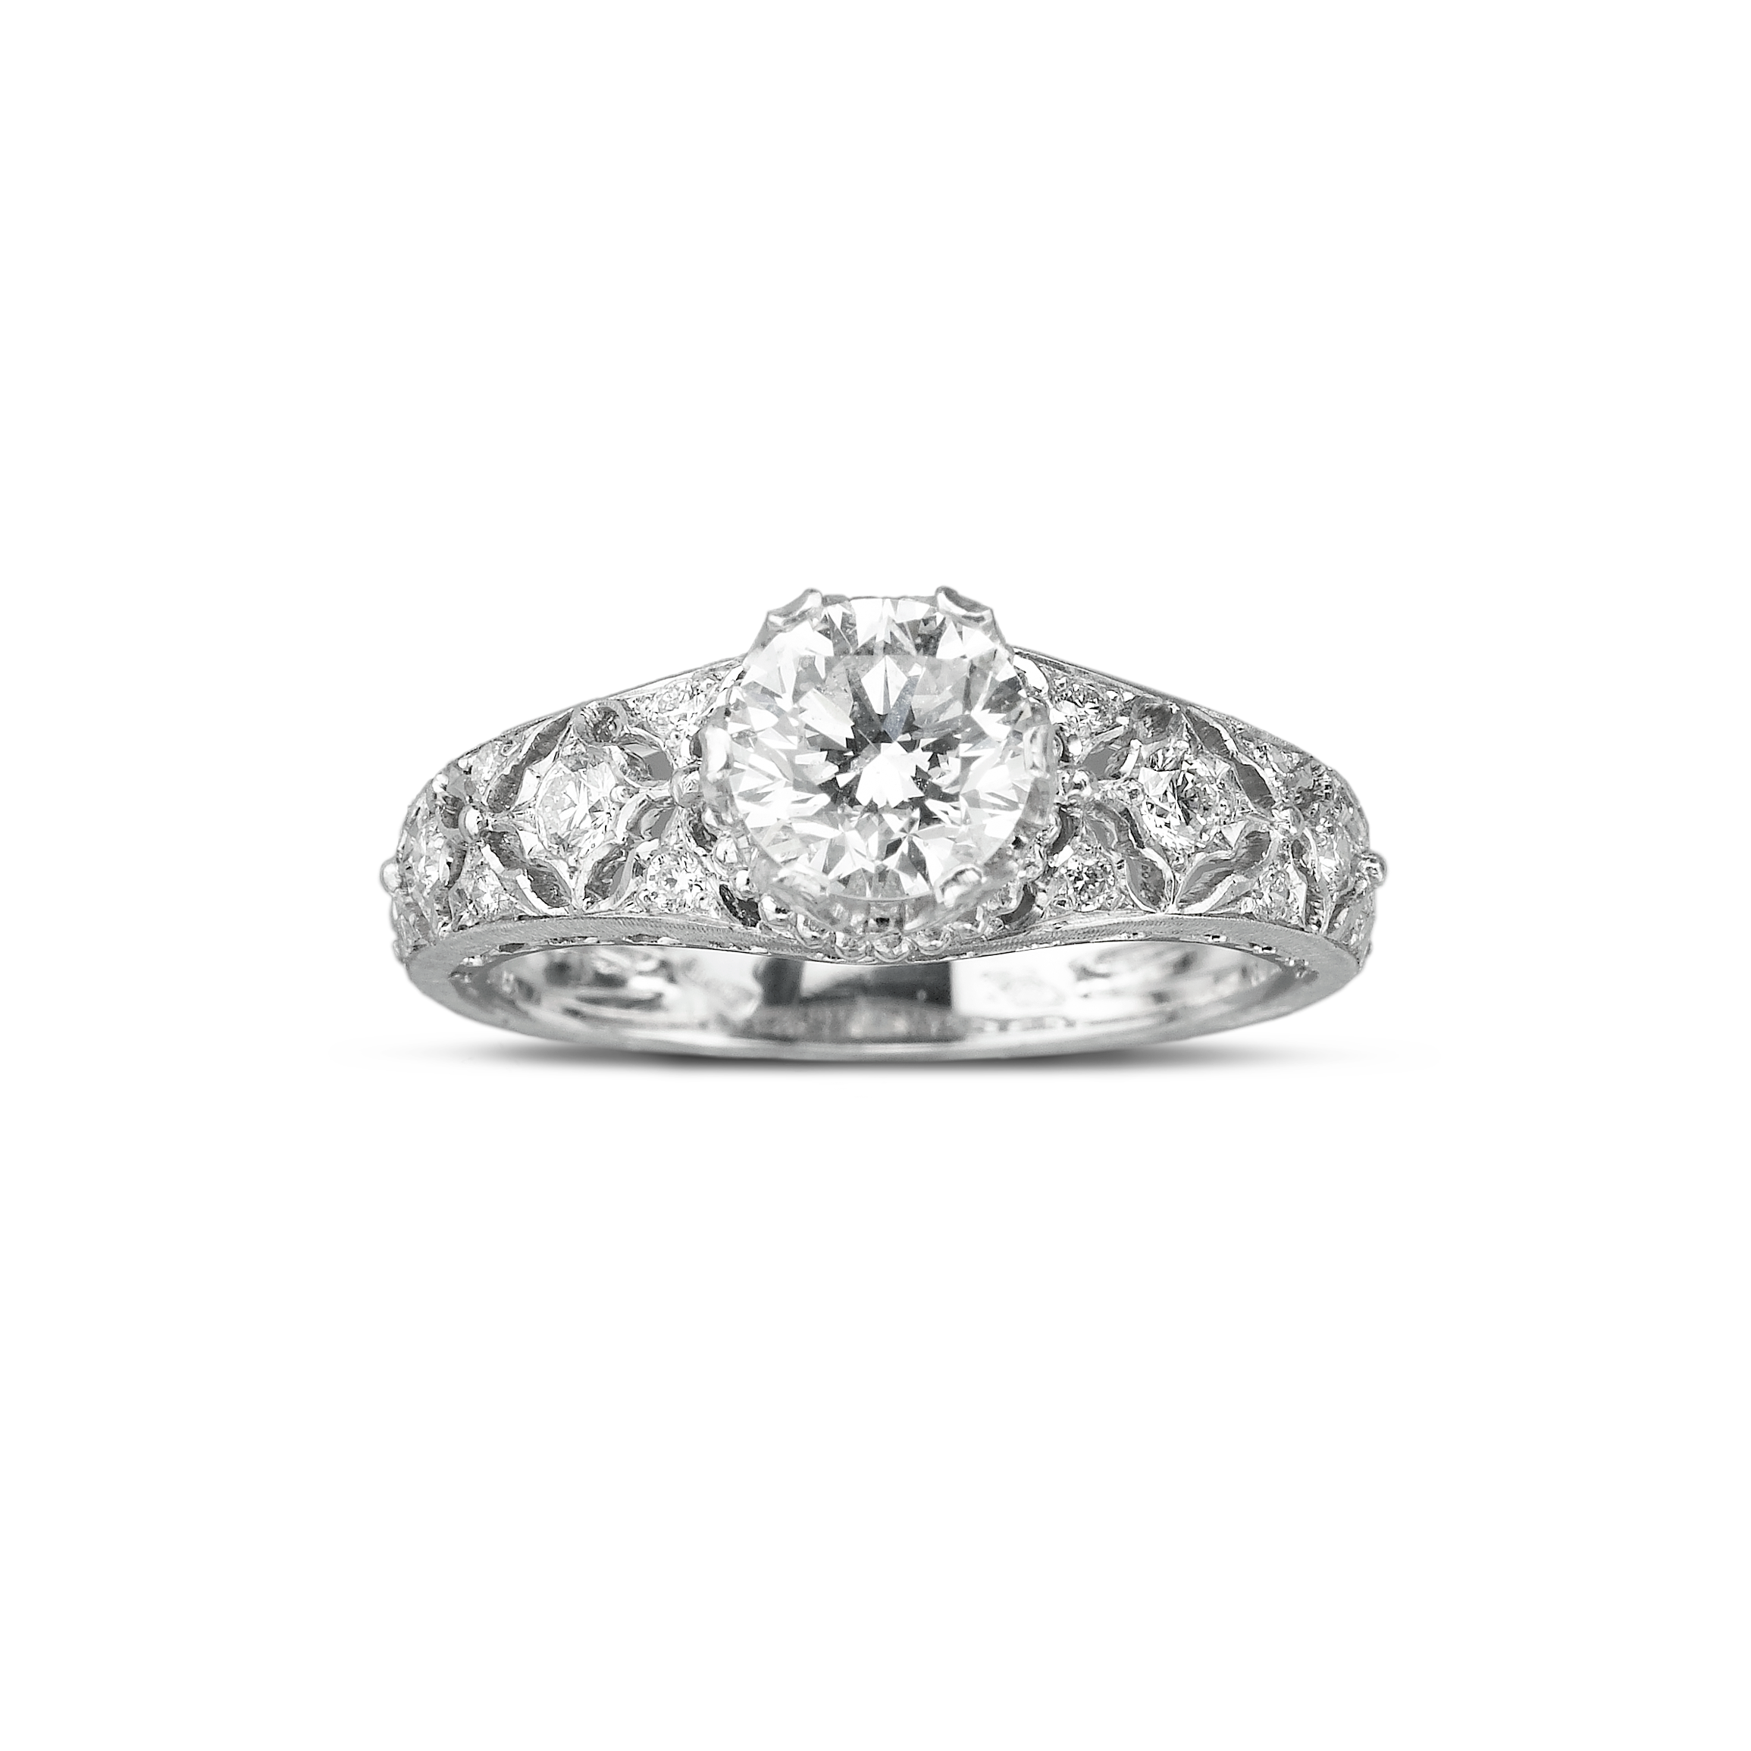
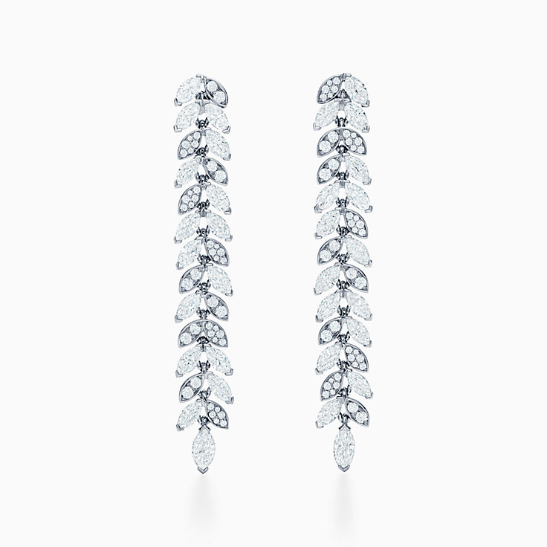
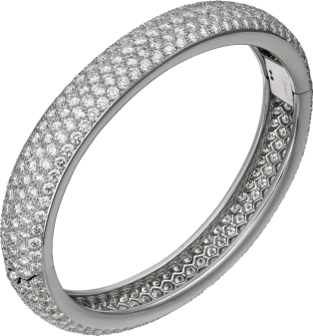
Manufacturing/Distribution
30% of the world’s platinum goes towards jewelry. Most jewelry companies sell platinum jewelry. The leading distributors and manufacturers would be Tiffany and Co., Cartier, and Buccellati. They are the best in term of quality of the jewelry. The headquarters of each, respectively, is New York City, Paris, and Milan. The images below are pieces of the respective companies.

Slide 5
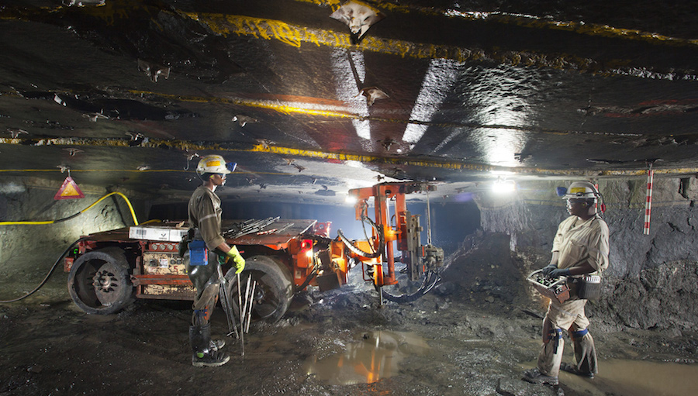
Mining
Platinum is usually mined for deep underground. Miners drill cracks into the rock and pack it with explosives, blasting the rock into smaller pieces. These pieces are then sent up to the surface to be processed.

Slide 6
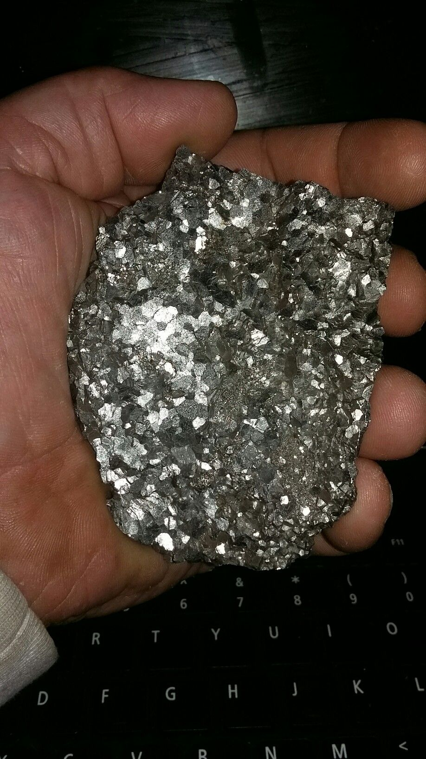
Processing
The processing of platinum is extremely costly and time consuming. It can take from eight weeks to six months to process a batch of ore, and it can take up to 12 tons of ore to produce a single troy ounce of platinum. The broken pieces of rock are then crushed up into powder and passed through chemicals to separate the platinum from other metals and rock. The platinum is put through further separation processes to ensure purity. Then it is processes into solid platinum ingot.

Slide 7
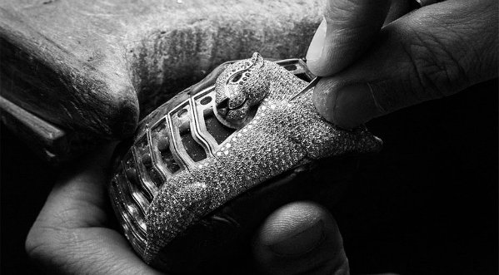
Cartier
After the platinum is made into ingot it is then sent of to Paris for the jewelry to be made. They were the first company to start using platinum in jewelry and hand make most of their pieces.

Slide 8
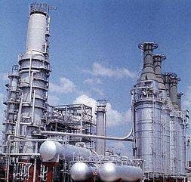
Problems with Production
The biggest issue with production of platinum is the environmental toll it has on the environment. It creates a large amount of rock waste and tailings, consumes a large sum of electricity and water, and worst of all it releases large quantities of CO2 into the atmosphere. Exact numbers are 98% of the ores found becomes tailing, it consumes 175 GJ/kg of PGM and 400m³/kg of PGM, and 40t of CO2/kg of PGM. The working conditions are also not ideal for the miners safety and health. Also large corporations try to coarse people who live in certain areas using violence to take their land to turn into mines.

Slide 9
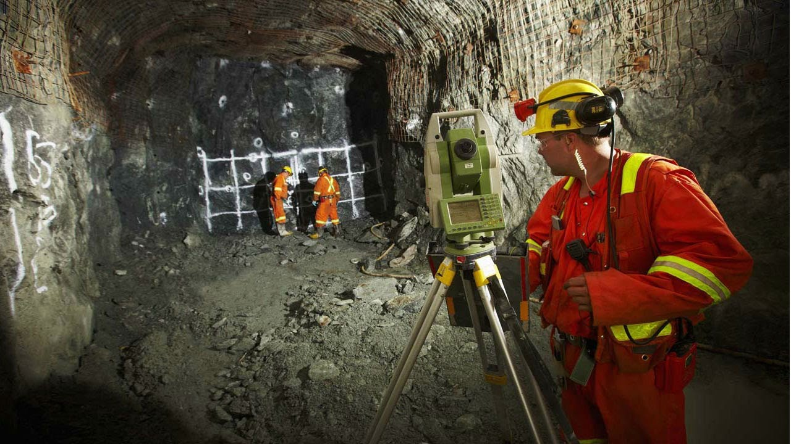
Changes for the Better
There are different movements to stop the massive amounts of CO2 being released into the atmosphere by the mining industry. There is different plans that would reduce the amount of CO2 released. FOr platinum it was a 95% reduction in how much CO2 is released. As for working conditions, South Africa is currently doing more to help the miners. There are still strikes and violence between the workers and the employers, but it is improving.

Slide 10
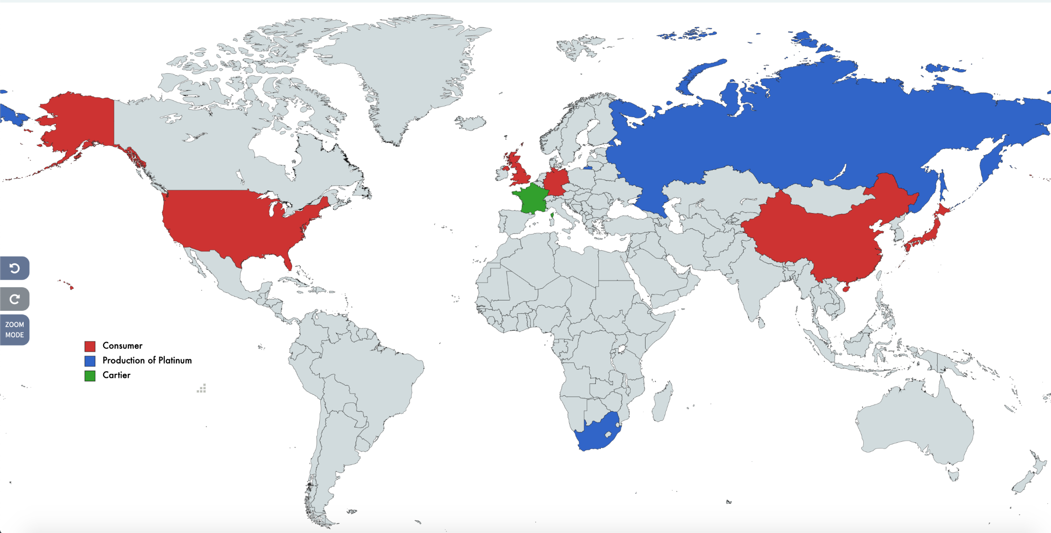
Route of the Jewelry

Slide 11
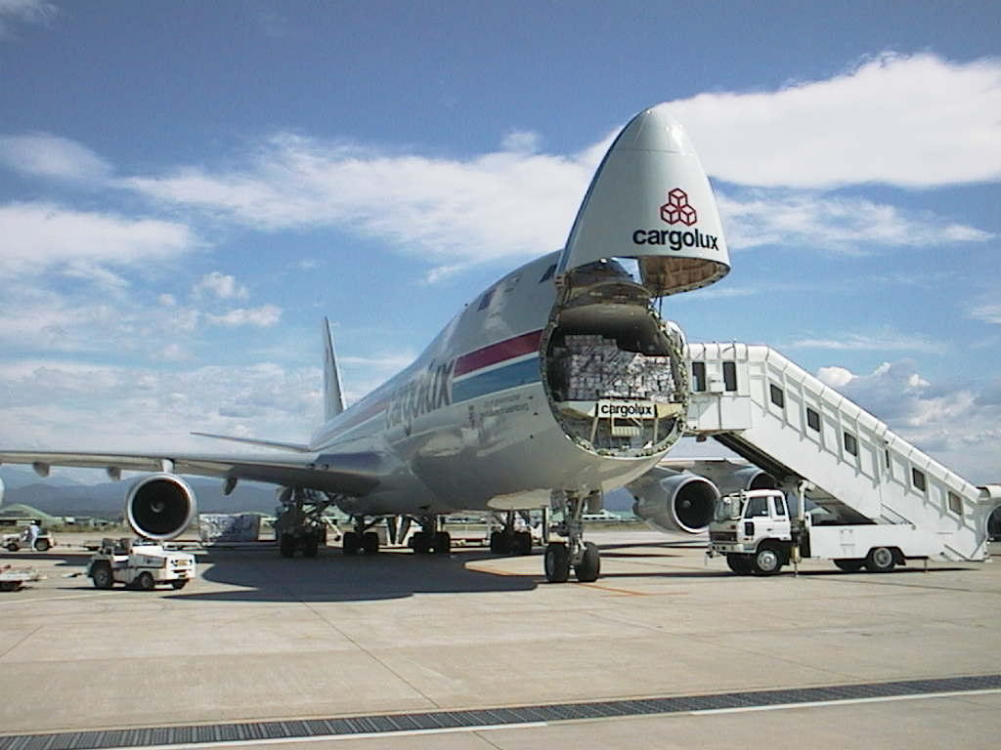
Problems with Trading
Another hindrance with the trade is the sustainability of platinum. Like most metals it is becoming more rare as time goes on, and this is more so than other metals due to how naturally rare platinum is already. It is not a material that is recycled often.
There are few problems with the trading and shipment of platinum. The only problems is how costly it is due to how heavy the material is and the amount of caution used to transport it. They need tight security incase of a robbery and either multiple shipments by plane due to the vehicles only carrying a certain amount of weight.

Slide 12
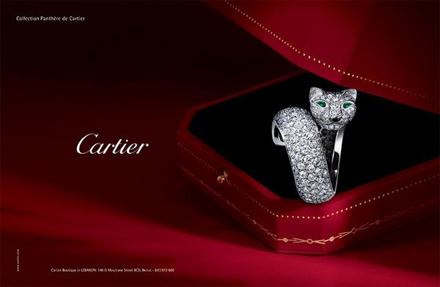
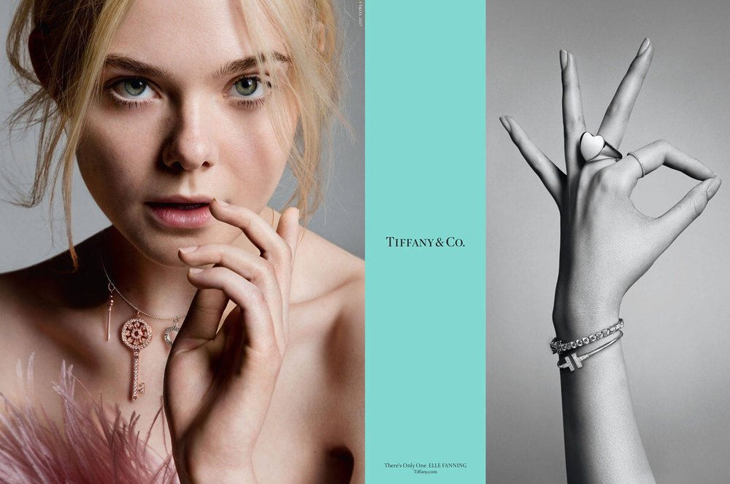
Advertising and Demand
Advertising consists of basic commercials and billboards in places of significance
Low demand due to the advertising not being very abadundent and due to the high price
The low demand makes it desirable to higher class people, they find it appe;ing due to how expensive it is and how little known it is

Slide 13
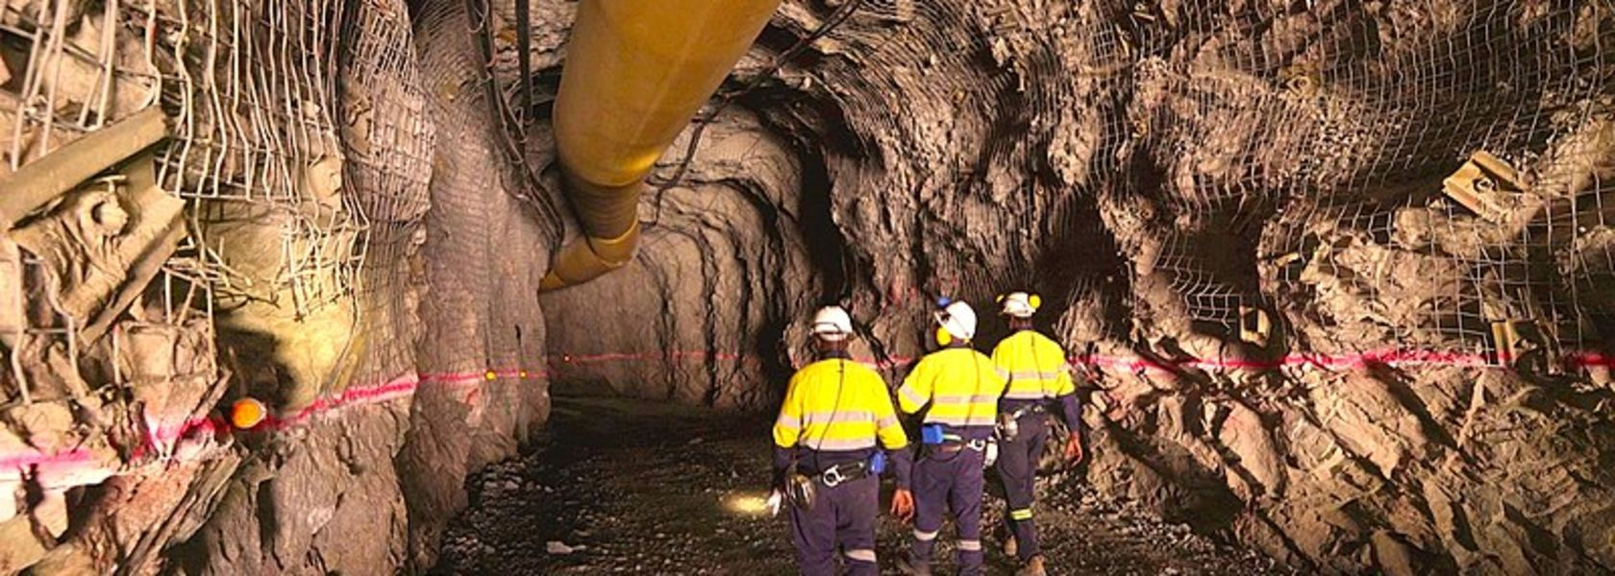
Fetishesim
The commercials will show a lively city in the background or some fancy place while showing a famous actor or model wearing the jewelry in the foreground. They won’t mention anywhere the abuse of miners or the extremely dangerous nature of the job. They just focus on the luxury of having the jewelry, never how its made.

Slide 14
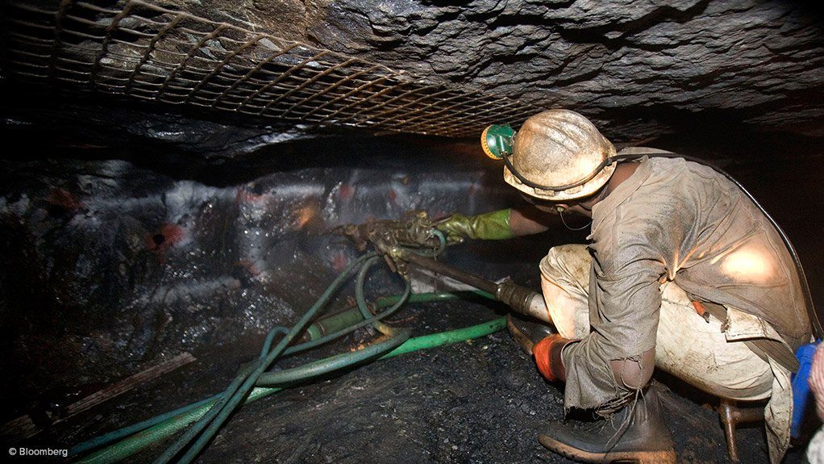
Fixing the Problems
Multiple unions and politicians advocate for better working conditions for miners in South Africa. They use a strategy to put out more information to the public, showing the problems with the companies that claim they are improving but aren’t. There are movements trying to help the affected communities by large corporations harassing them for their lands.
https://www.change.org/p/department-of-mineral-resources-stand-with-mining-affected-communities-and-demand-the-right-to-say-no

Slide 15
Works Cited
https://www.thenaturalsapphirecompany.com/education/precious-metal-mining-refining-techniques/platinum-mining-refining/#:~:text=Modern%20Platinum%20Mining%20Techniques,to%20the%20surface%20for%20processing.
https://bennhw.medium.com/whats-the-carbon-cost-of-your-jewellery-907da828a364
https://www.researchgate.net/publication/223232620_The_environmental_costs_of_platinum-PGM_mining_and_sustainability_Is_the_glass_half-full_or_half-empty#:~:text=The%20environmental%20impacts%20include%20high,%2C%202010).%20…
https://www.jogiadiamonds.com.au/blog/white-gold-vs-platinum-what-jewellers-wont-tell-you/
http://www.industriall-union.org/south-africa-mine-responsibly-and-improve-working-conditions-recommends-report
https://commodity.com/precious-metals/platinum/
https://www.truefacet.com/guide/10-facts-cartier/

