Slide 1
Hand Sanitizer:
Final Presentation
Noelle Hermsen

Slide 2
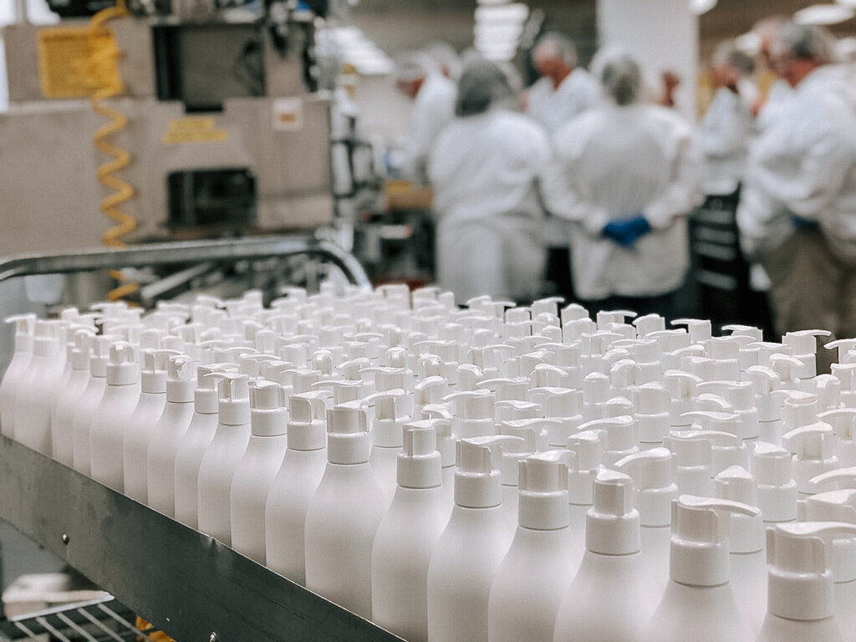
Basic Information
Trade value: 522,184.46 (USD)
Quantity: 134,408,000 Kg = 296,318,917 Lbs

Slide 3
Manufacturer
Purell is produced by GOJO Industries located in France
America’s #1 hand sanitizer brand
GOJO
Founded in 1946
Sales jumped 600% in 2020
2500 employees
Controversy
FDA warned GOJO not to market Purell as something that eliminates the flu, Ebola, and MRSA
Unproven claims
Marketed as a pharmaceutical drug rather than an over the counter antiseptic

Slide 4
Production Process
Most effective ingredient: alcohol
Minimum of 60%
Blended with aqueous gel
Ex. Carbopol (powder)
Important to avoid getting air into product
Include moisturizers and surfactants to protect skin
Fragrances and coloring are optional

Slide 5
Health & Environmental Impact

Slide 6
Human Health
Ethanol, isopropyl alcohols, hydrogen peroxides
Toxic when released by evaporation
9,504 exposure cases
Children under 12
Even a small amount of alcohol is responsible for alcohol poisoning
confusion
Vomiting
Drowsiness
Respiratory arrest
Death
Frequent uses can lead to antimicrobial resistance

Slide 7
Effects on Environment
Ethanol spills & Aquatic Animals
At a greater risk of toxification than land animals
Ethanol seeps into soil and water
Cause bioaccumulation and bioconcentration
Substances or chemicals building up within an organism
Oxygen depletion in water
Isopropyl Alcohol
Not as toxic as ethanol
Can’t bioaccumulate due to its rapid biodegradability
Like ethanol, depletes water of oxygen
Hydrogen Peroxide
Least toxic
Degrades in water & soil at a fast rate
Short-life substance
Short-term toxicity in aquatic life

Slide 8
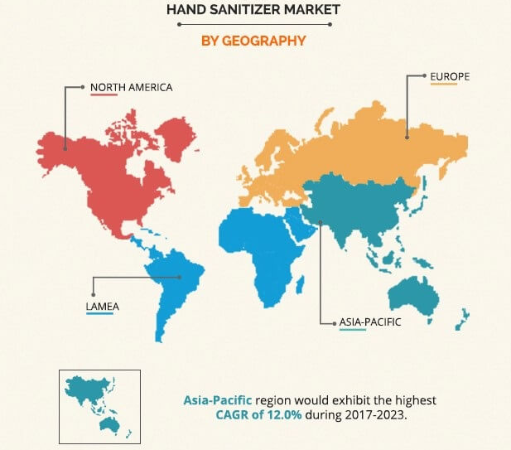
Flow of Production

Slide 9
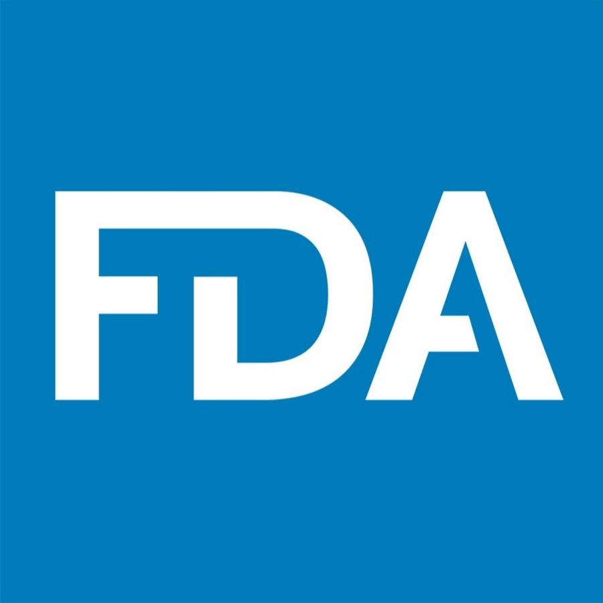
Processes and Institutions
Food and Drug Administration
Making hand sanitizer available to all Americans
Commitment
Guidelines
Certain guidelines for industries
Propanol and Methanol
List of Dangerous Hand Sanitizers

Slide 10
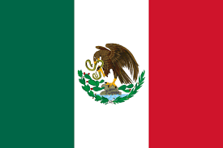
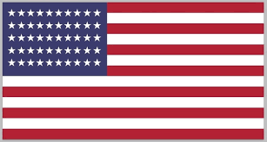
Violence & Injustice
Origin of distributors
21-China
27- Mexico
9- United States

Slide 11
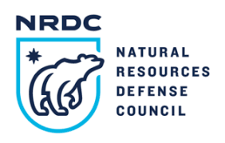
Social Movements
Production/distribution polluting ocean
Negatively affects aquatic life
Natural Resources Defense Council (NRDC)
Ocean communities
US economy

Slide 12
Advertising & Fetishism
Since FDA created ban list, usage over-the-counter, unregulated hand sanitizers may be frowned upon
Registration as OTC

Slide 13
Addressing Social Justice
Things we can do to reduce ocean acidification
Reduce carbon pollution
Contact policymakers
Reduce carbon footprint
Nitrogen pollution

Slide 14
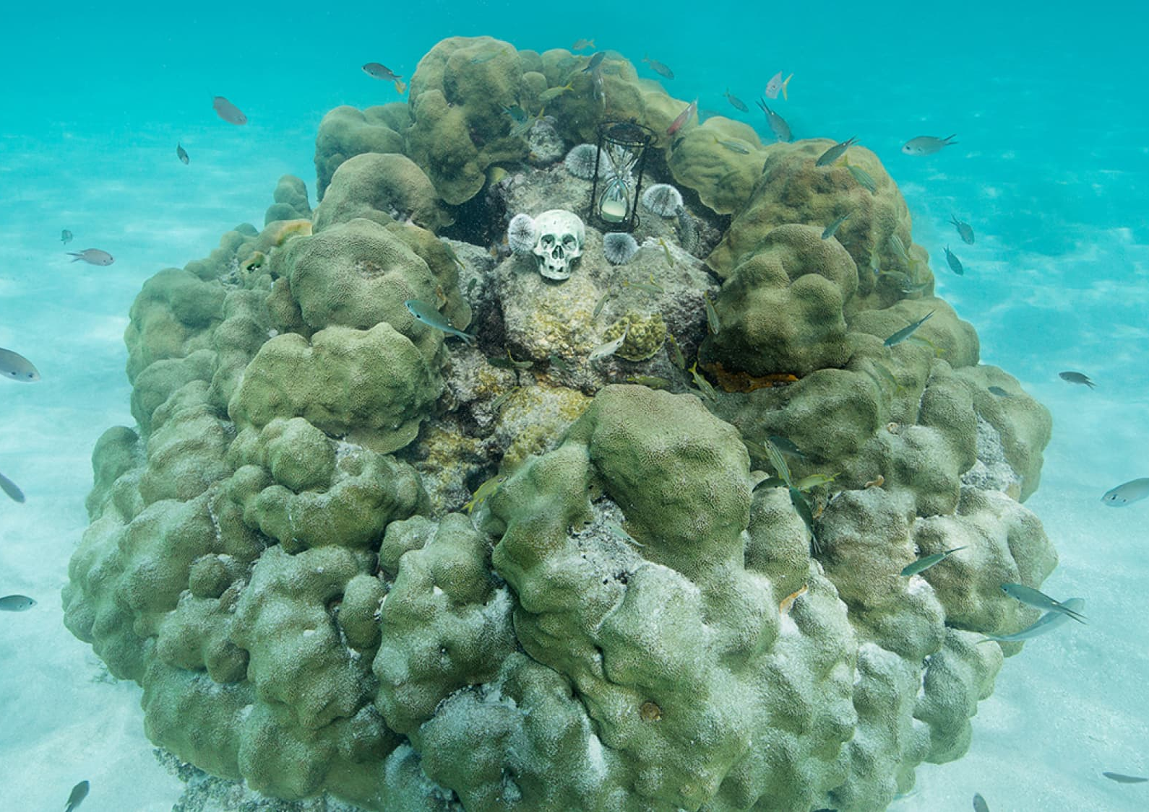
One Planet, One Future
Ongoing art installation project set to bring awareness to ocean pollution and inspire people to act upon it
https://oneplanetonefuture.org/

Slide 15
Center for Biological Diversity
Work to secure a future for all species that are on the brink of extinction through science, law and creative media, with a focus on protecting the lands, waters and climate that species need to survive.
https://www.biologicaldiversity.org/

Slide 16
Connection to Class Reading

Slide 17
Chapter 4: Economics and International Development
Sustainability
Monitoring global development
Damaged ecosystems
Limited resources
Short-term gains, long-term costs
Economics of sustainability
Connection to reading

Slide 18
References
Anderson, S., Peterson, M. A., & Toops, S. W. (2018). Economics and International Development. In International studies: An interdisciplinary approach to global issues (4th ed.). Routledge.
COVID-19 and frequent use of hand sanitizers; human health and environmental hazards by exposure pathways. (10, November). PubMed Central (PMC). https://www.ncbi.nlm.nih.gov/pmc/articles/PMC7320712/
U.S. Food and Drug Administration. (2020, August 31). Hand sanitizers | COVID-19. https://www.fda.gov/drugs/coronavirus-covid-19-drugs/hand-sanitizers-covid-19
U.S. Food and Drug Administration. (2020, August 6). FDA updates on hand sanitizers consumers should not use. https://www.fda.gov/drugs/drug-safety-and-availability/fda-updates-hand-sanitizers-consumers-should-not-use
What you need to know about ocean acidification. (2015, August 13). NRDC. https://www.nrdc.org/stories/what-you-need-know-about-ocean-acidification?gclid=Cj0KCQjwgtWDBhDZARIsADEKwgMXShmFTiCxlAx6TSkpQtPWAS9ks6LEeKLzOr66gAQFHIneoljmcNgaAk7VEALw_wcB

