Slide 1
Graphite in #2 Dixon Ticonderoga Pencils
By: Anastasia Deftalinskij

Slide 2
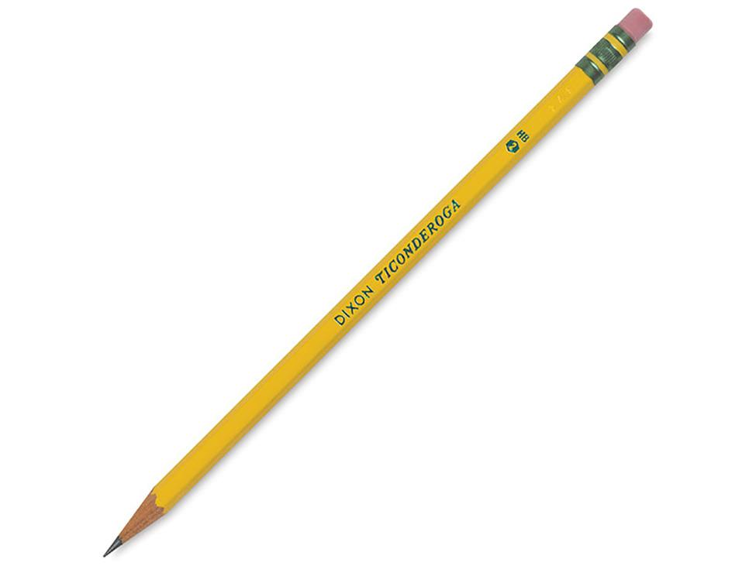
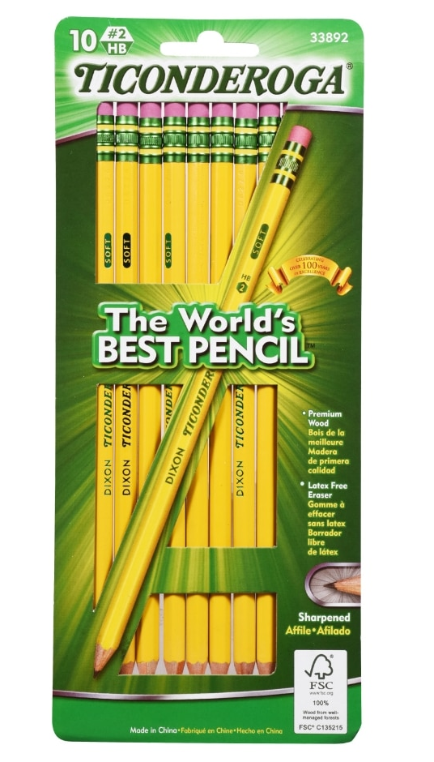
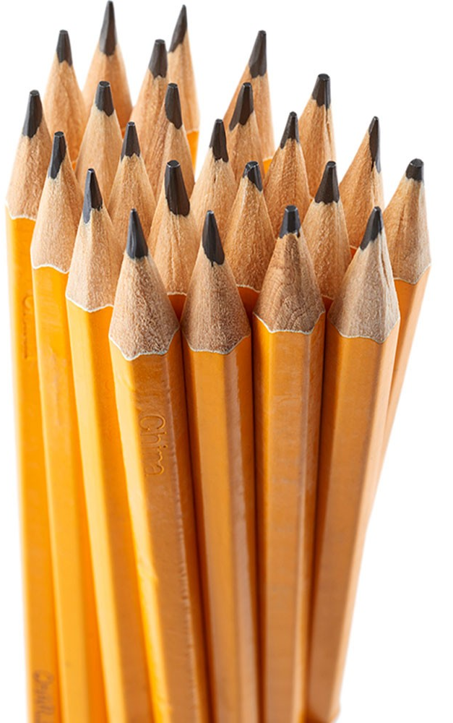
Pencils and Production
Pencils: One of the most common writing utensils.
Dixon Ticonderoga pencils have been around since 1794- 227 years
Originally located in downtown Jersey City, New Jersey.
Current domestic headquarters in Heathrow, Florida, most parts of the pencil are made overseas
Wood: Forests of California
Graphite: Mines of Sri Lanka
Aluminum: Australia
Rubber: The Congo
All parts are produced into a full pencil in factories in China where there they are shipped globally.
*In 2021- still considered one of the best pencils for a cheap price.

Slide 3
Who owns the parts of the Dixon pencil production?
Dixon Ticonderoga is the company that produces Ticonderoga pencils. They have a vertically integrated system: have control of their own producers of the raw materials, the producers of the finished product and the distributers of the good.

Slide 4
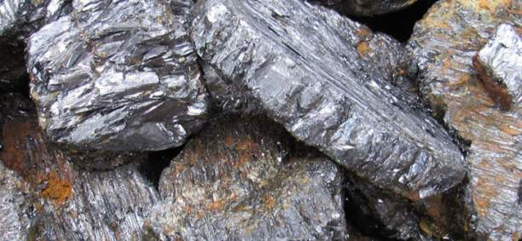
What is Graphite
Graphite: A crystalline form of the element Carbon
Used to be lead- which was very toxic; can affect every organ in your body
ruled unsafe due to fatal health risks if entered the body
Current graphite in pencils is a mix of clay with graphite powder and baked in kilns to form pencil lead.
Graphite in Rock form

Slide 5
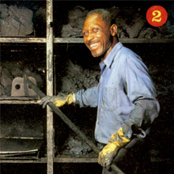
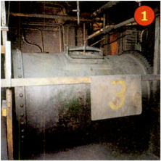
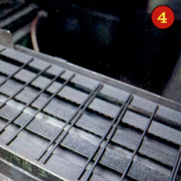
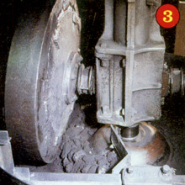
Graphite Production Process
1) Chunks of graphite and clay are placed inside a huge rotating drum. Large rocks inside the drum crush the graphite and clay into a fine powder. Water is added, the mixture is blended for up to three days
2) A machine squeezes all the water out of the mixture leaving behind a grey sludge. It then goes in a cabinet to dry for 4 days.
3) Huge wheels grind the dried sludge into another fine powder, and water is blended in again to make a soft paste.
4) The paste is pushed through a metal tube and comes out in the shape of thin rods. The rods are cut into pencil-length pieces, called leads, and sent along a conveyor belt to dry.
Notes:
`

Slide 6
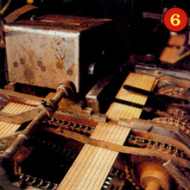
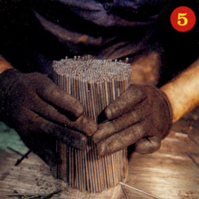
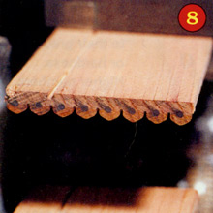
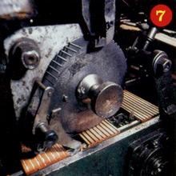
Production into a whole pencil
5
After drying, the pencil leads are put into an oven heated to 1,800 degrees F. The heat makes the leads smooth and hard.
The wood of the pencil is already in thin slats where it is cut into 8 long pieces
6
7
8
Glue is put on the one side of the wood then they put the dried lead piece on top and cover it again with glue and glue the top pieces of the wood over it
Sharp blades trim the wood to shape it into a round pencil shape.
Same machine also separates the wooden slabs making the individual pencils

Slide 7
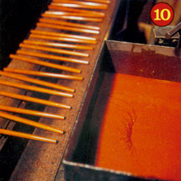
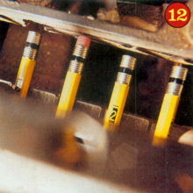
Production Cont’d
Step 10+11
Step 12
The pencils are covered in 8 layers of paint making them that bright yellow color
Then stamped with the Dixon Stamp to indicate brand and how hard the lead is.
A metal band, called a ferrule, is wrapped tightly around one end of the pencil which holds the eraser. The pencils are then ready to be sharpened, packaged, and used.
Learn it
Learn it
Learn it

Slide 8
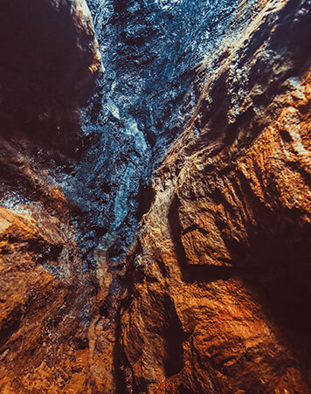
Background on Sri Lanka
Mine Site in Sri Lanka
The biggest contributors to graphite mining.
Their vein graphite is sourced naturally and has the highest degree of crystalline perfection amongst graphite materials.
Has a 121 square kilometer land package and four sites that each promise different levels of graphite production.
This “lump graphite” in only mined underground. The deposits are found in high-grade metamorphic rocks
Graphite production costs are kept low as the Sri Lankan graphite, also known as Plumbago graphite, is of the purest variety which keeps milling and refining costs low.
But at what cost to the workers/miners is it to keep the costs of production low??

Slide 9
Severely underpaid workers
“It took a two-day hunger strike for 50 workers at a state-owned graphite mine to secure a risk allowance increase from 16 Sri Lankan rupees (11 cents) per month to 300 rupees ($2.06) per month. They agreed that they would receive the allowance if they met a target of producing 70 metric tons per month.”
Since Sri Lanka is keeping their graphite costs low, they are paying the workers incredibly low wages, whether it be the miners or the factory production workers.
They have gone on many strikes to get a decent living wage from their work.
Other countries pay their workers “thousands of rupees” while they are getting paid mere dollars while they produce thousands of tons of graphite to support the demands on the world.
The low costs also doesn’t bring back excess profit to the factories, so their machines are very outdated and require more physical labor for the same pay.

Slide 10
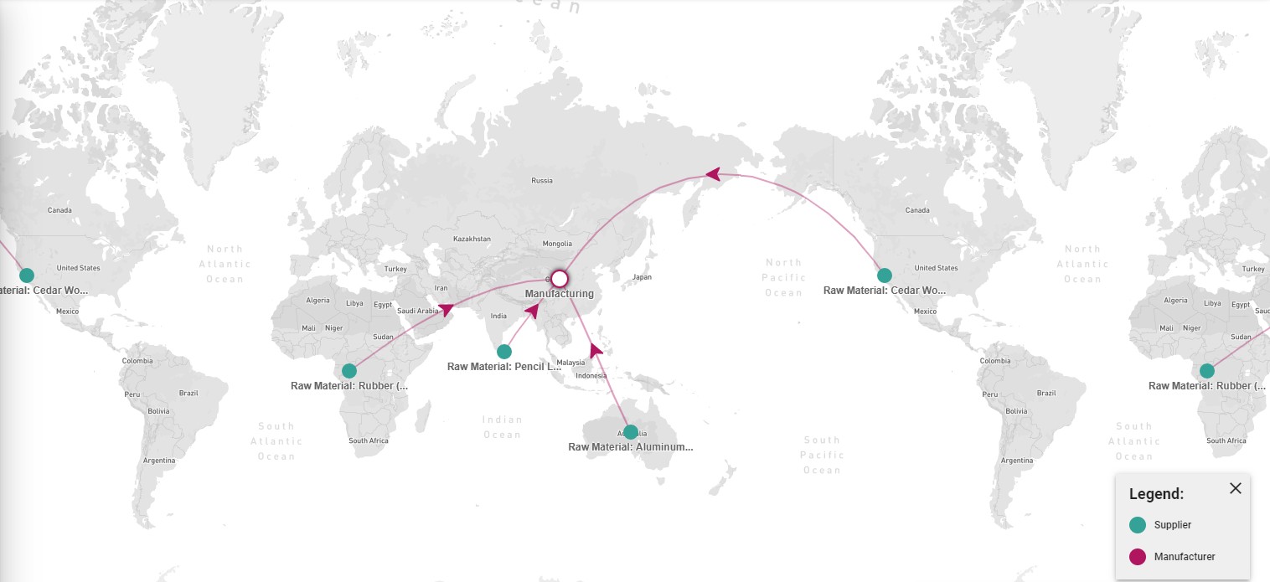
Flow Map
Notes:
Due to the distances the raw materials and finished goods are transported in a multitude of ways. Mostly ships and trucks transport raw materials to the production site depending on whether they must traverse a stretch of land or sea. Then similar methods are employed to transport the finished product.
No protests/violence regarding the trading of graphite- since it is under on company

Slide 11
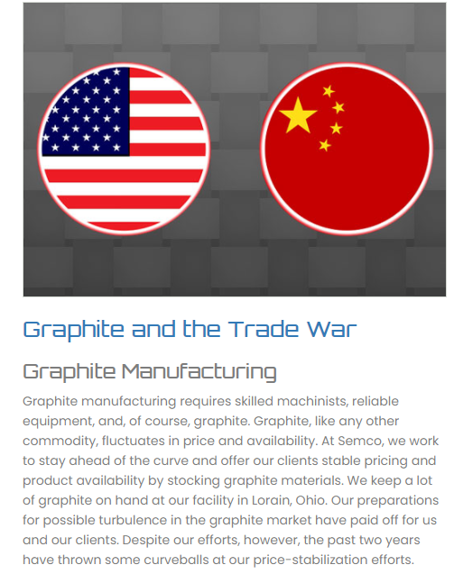
Trading and Regulations
Tariffs between China and U.S: correct the trade imbalances that the U.S. trade has imposed with China.
China has tried to use synthetic graphite which the U.S. slaps a 10% on for it being fake.
Mitigating the price and inventory fluctuations and bring our consumers the most reliable product and stable costs
Upscaling the Sri Lanka Production Equipment Issues
The ITC (Investment Tax Credit) and the PTC (Production Tax Credit) want to impose newer energy technologies, but local governments are frequently against these new machines and upgrades
-a lot of money is required for the upscaling of safer production.
(don’t want to use personal earnings to help factory workers)

Slide 12
Secracy of Interal Relations
Status of the firm is unclear
Has shed hundreds of jobs
imposed a 114.9 percent tariff on Chinese competitors
collected nearly $5 million in federal funding aimed at victims of foreign trade abuse since 2005 and has requested millions more
unclear if the U.S. operations even has a chief executive.
Distribution center in Macon, Georgia
*unknown number of surplus pencils are produced there
worldwide, it makes nearly 500 million pencils each year, but it would not release any details about its U.S. production
Argued new rewritten Free Trade Deals because existing policies allow companies to use cheap foreign labor and eliminate American jobs.
The pencils that are said to be manufactured domestically are actually made in Mexico

Slide 13
Advertising
Demands
Desires
Social Status
Schools demand pencils for classes like math and writing.
Standardized tests require number 2 pencils for their machines.
Students desire a writing utensil that they can use to erase any mistakes they do while learning.
Being that it is an inexpensive product, a pack of 18 costing 5$, there is no real social status created in buying the products/who can afford it.

Slide 14
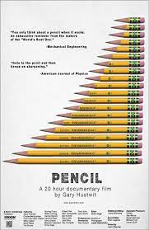
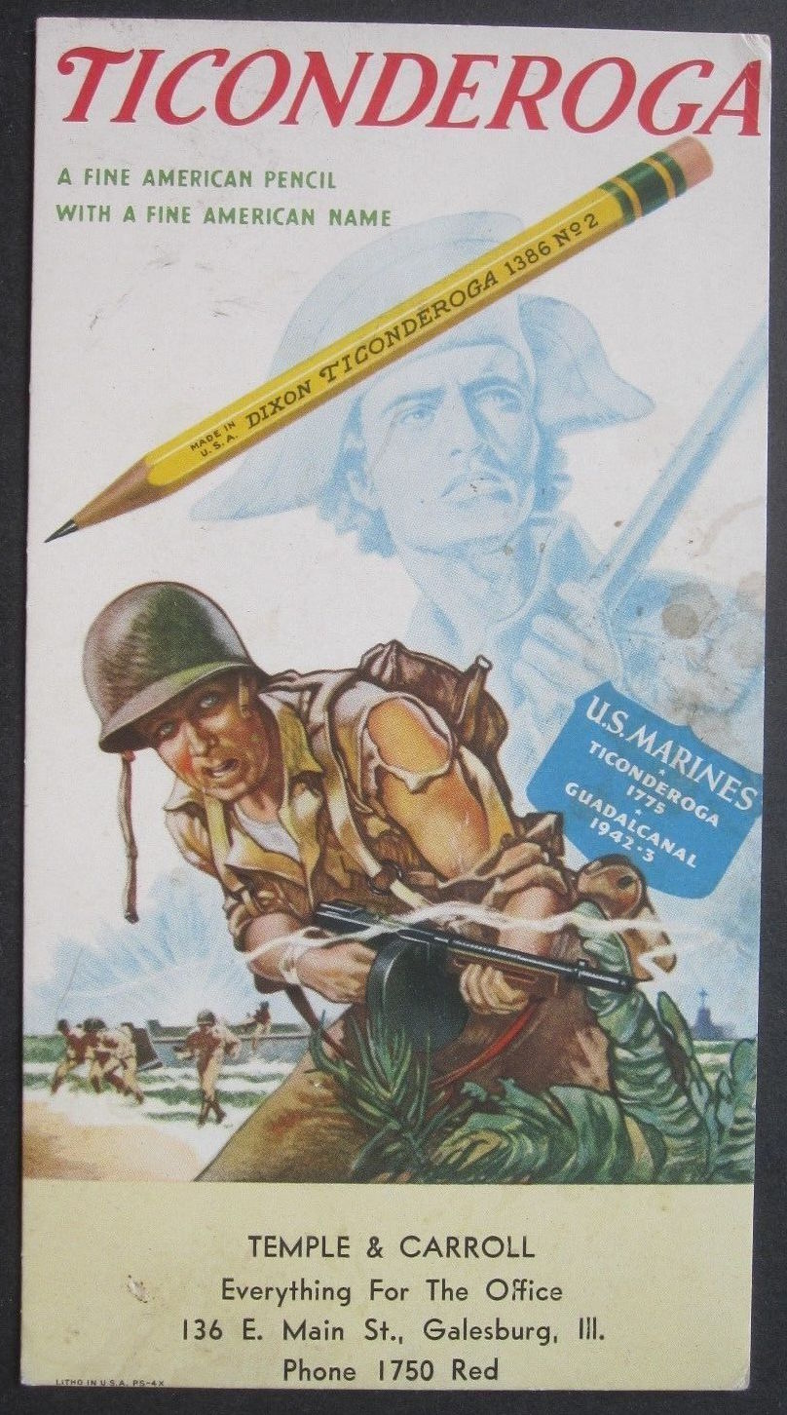
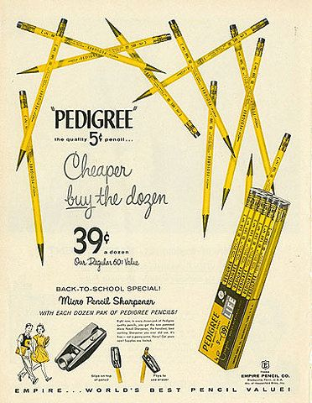
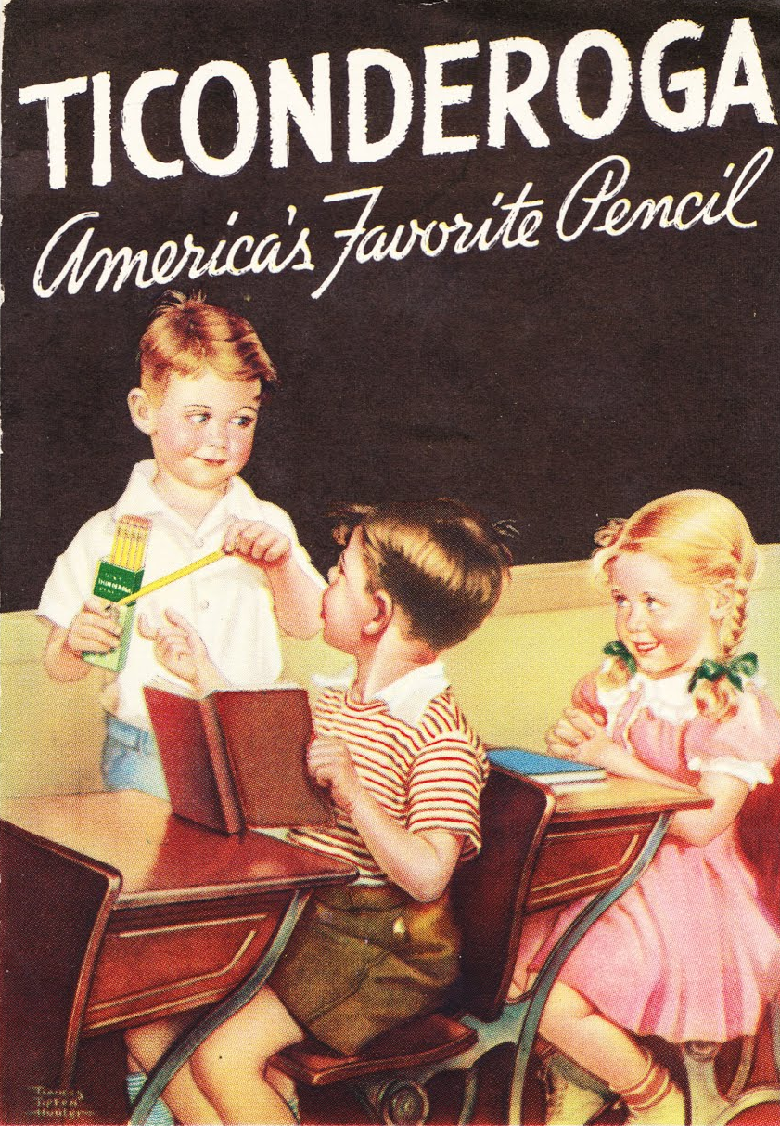
Advertisement Examples
Notes:
As the first rebel victory of the Revolutionary War, the Battle of Fort Ticonderoga served as a morale booster and provided key artillery for the Continental Army in that first year of war.
That is why a lot of the advertisements were war related since the pencils were being made during the Rev War (1777)

Slide 15
Strategy and Campaign for Consumers
1
Petitions
2
GoFundMe Links for Sri Lankan factory/mining workers
3
Refrain from buying Ticonderoga products
4
Social Media Posts to raise awareness for the statuses of these underpaid workers

Slide 16
Social Movements and Campaigns
Climate Change- Carbon Emissions Protest
Back in 2019, Millions of people worldwide demonstrated, demanding urgent action to tackle global heating.
Movement started by Greta Thunberg; carbon emissions are ruining the ozone layer.
This demand was an urgent step-change in action to cut emissions and stabilize the climate.
Environmentalists says there is a little more than a decade left to slash emissions and bring our climate back to normal before catastrophic changes.

Slide 17
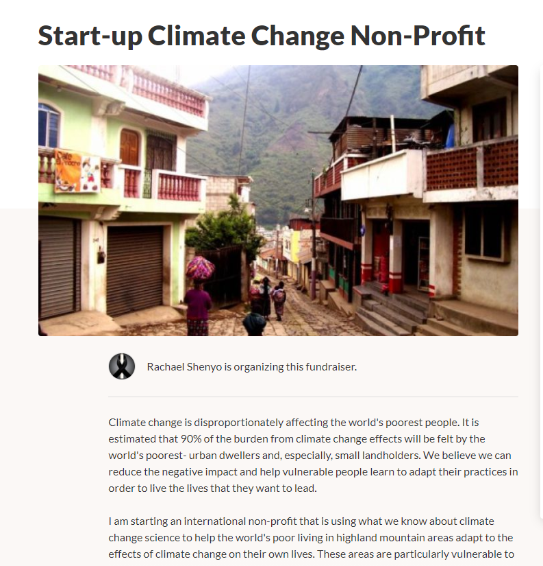
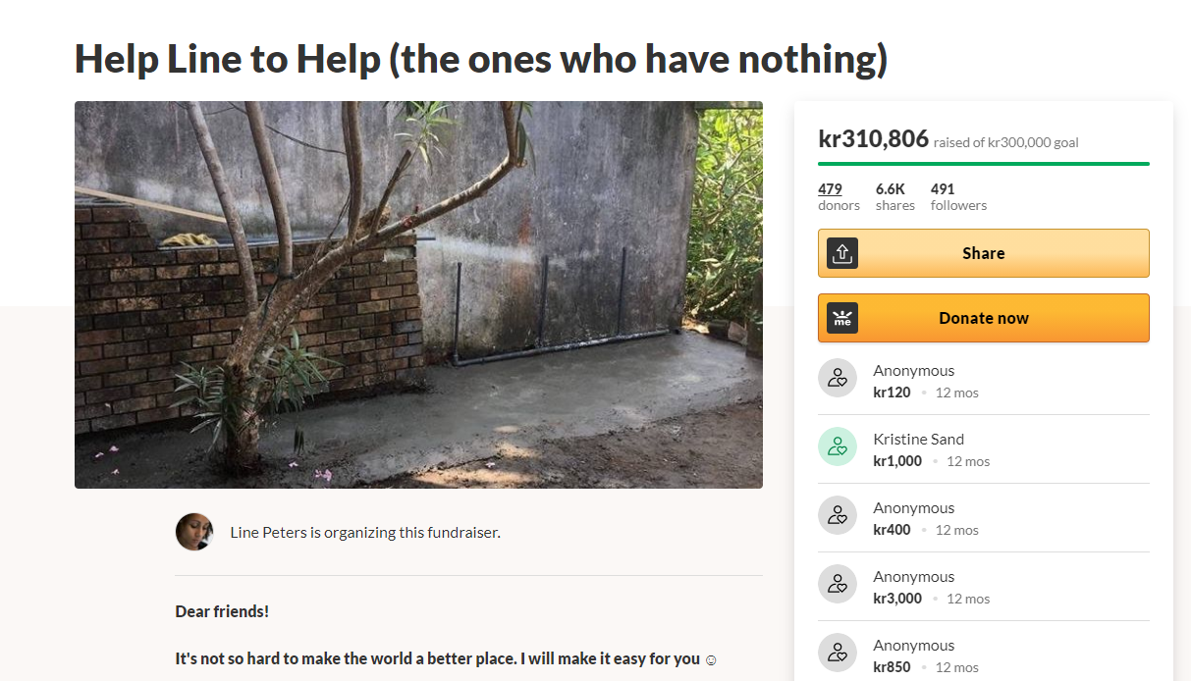
Take Action!
Donate to non-profit climate change organizations and to those who are trying to raise money for the workers who live in poverty
I donated to this one ☺

Slide 18
Class Reading Comparisson
Anderson “International Studies” Chapter 8. “East Asia, the Pacific, and International Studies”
Asia is the center of business
promote export-led industrialization as a development strategy
Since China has numerous exports as well as imports
they are good to partner/trade with because they will always have business for products.
Poverty districts will always need work in the factories for some money so the labor laws can be overlooked for a cheaper manufacturing price.

Slide 19
Works Cited
“Across the Globe, Millions Join Biggest Climate Protest Ever.” The Guardian, Guardian News and Media, 20 Sept. 2019, www.theguardian.com/environment/2019/sep/21/across-the-globe-millions-join-biggest-climate-protest-ever.
“Dixon Ticonderoga.” Wikipedia, Wikimedia Foundation, 8 Mar. 2021, en.wikipedia.org/wiki/Dixon_Ticonderoga.
Gordon, Jennifer T. “Government Intervention in Energy Markets Is Crucial. Get Over It.” Greentech Media, Greentech Media, 18 Apr. 2019, www.greentechmedia.com/articles/read/government-intervention-in-energy-markets-is-crucial-get-over-it.
“Graphite Production: Graphite Mining.” Ceylon Graphite, 15 July 2019, www.ceylongraphite.com/graphite-production/.
Guenther, Chet. “Ticonderoga #2 Pencils.” ArcGIS StoryMaps, Esri, 18 Oct. 2019, storymaps.arcgis.com/stories/ce4bda6fa9684c3dbe24d0b275a636d1.

Slide 20
Works Cited Cont’d
“How A Pencil Is Made.” General Pencil Co., Inc. - Pencil Makers in the USA Since 1889, www.generalpencil.com/how-a-pencil-is-made.html.
“Open Sourcemap #Sourcemap.” Open Sourcemap, 5 Aug. 2020, open.sourcemap.com/maps/57f3de23ea88e76b1055923a/things/57f3dffa2b9fab0f5b74a40b.
Paletta, Damian. “How Dixon Ticonderoga Has Blurred Lines of Where Its Pencils Are Made.” The Washington Post, WP Company, 27 Sept. 2018, www.washingtonpost.com/business/economy/how-dixon-ticonderoga-has-blurred-lines-of-where-its-pencils-are-made/2018/09/19/0e9be518-b207-11e8-9a6a-565d92a3585d_story.html.
Semco Carbon. “Graphite and the Trade War.” Graphite and the Trade War - How It Affects Graphite Manufacturing, 24AD, www.semcocarbon.com/blog/graphite-and-the-trade-war.
“Sri Lankan Mine Workers Demand Better Pay as Graphite Companies Fall Behind Globally.” Global Press Journal, 14 Oct. 2020, globalpressjournal.com/asia/sri_lanka/sri-lankan-mine-workers-demand-better-pay-graphite-companies-fall-behind-globally/.

