Slide 1
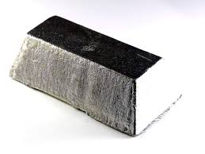
Tin
By, Jack Dardis

Slide 2
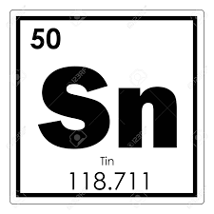
Tin
Tin is a chemical element belonging to the carbon family in Group 14
Tin is mainly used for plating steel cans used as food containers, in metals used for bearing, and in solder.
Tin is mainly found in China, Thailand, Peru, Indonesia, Bolivia and Brazil.
Tin made by reducing the ore with coal in a furnace.

Slide 3
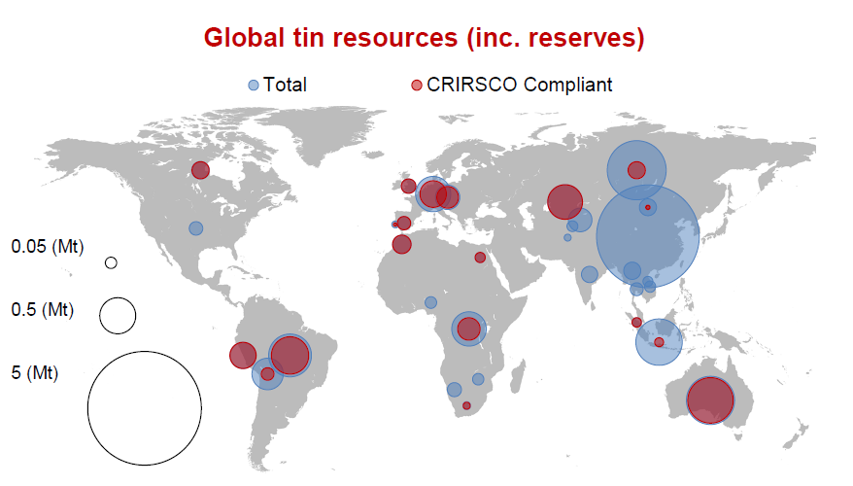
Place
Myanmar
Brazil
Nigeria
Republic of the Congo
Tin is produced in:
Chinas
Bolivia
Indonesia
Peru

Slide 4
Trade
The top three United States markets by value for Tin that is imported is Peru, Indonesia, and Bolivia.
The estimated value of imported refined tin in 2019 was $703 million.

Slide 5
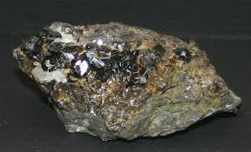
Corporations
Top producers of tin:
Yunnan Tin Company
PT Timah
Malaysia Smelting
Yunnan Chengfeng Non-ferrous Metals
Minsur

Slide 6
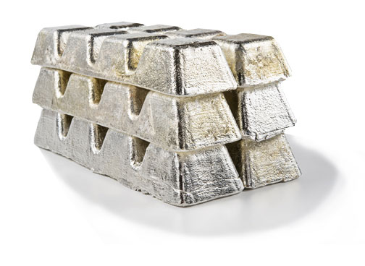
Yunnan Tin Company
The largest producer of tin in world.
Put out 74,500 tons of tin in 2017
Headquarter in Kunming, China
Net Sales of $44,232,000,000 in 2020
Operating Profit of $839,000,000 in 2020
15171 employees

Slide 7
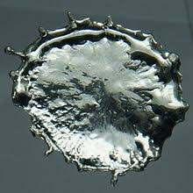
Production Process
Tin is most commonly produced from the mineral cassiterite, which is made up of around 80% tin.
Tin is mostly produced in China and Indonesia.
Tin is smelted at temperatures up to 2500 degrees Fahrenheit with carbon to produce low purity tin and CO2 gas.
Tin then would get refined to a high purity through liquation, boiling, or electrolytic methods.

Slide 8
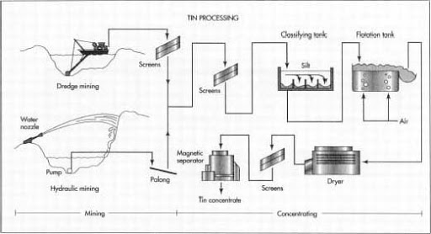

Slide 9
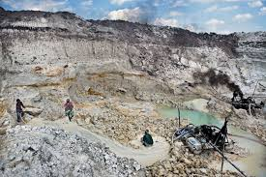
Controversy
Verisk Maplecroft’s analysis shows that 3TG minerals ( Tin is included in these minerals) are being produced under the control of armed groups in countries such as Myanmar and Colombia.
Health and safety violations occur with the mining of tin when surrounding communities get exposed to hazards, for example mine cave-ins and the spread of malaria in some of the largest tin producing countries.
Tech companies do not acknowledge the fact that the materials they are receiving are produced illegally or mined by workers against their will or even underaged workers.

Slide 10
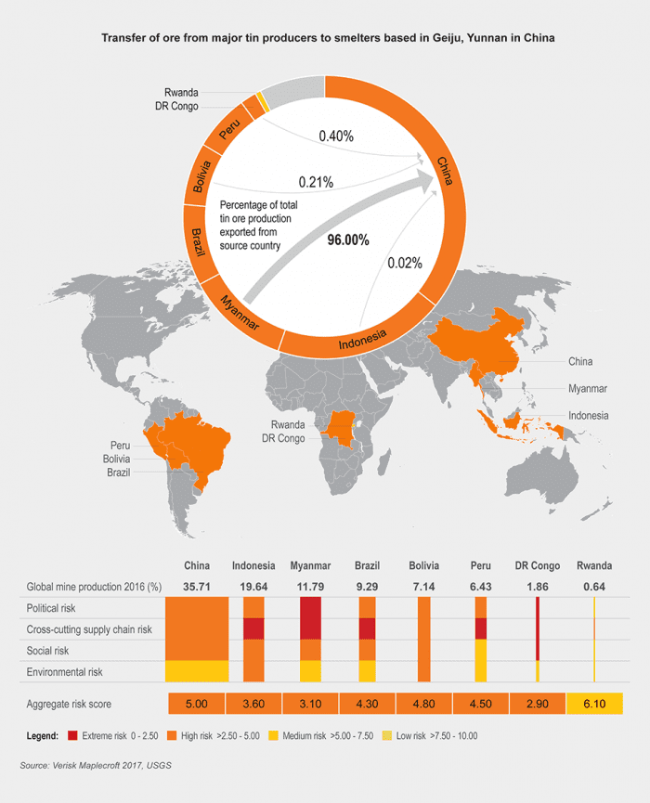

Slide 11
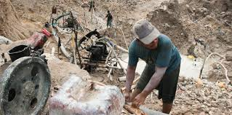
Protests
In June 1976, 50,000 tin miners went on strike in a Bolivia.
Bolivian mineworkers went on strike because they were against the state of siege declared by President Huga Banzer Suarez
Mineworkers in the Union federation consisted of 26,000 private company miners and 24,000 state run miners.
The mineworkers stayed on strike until troops were removed, union leaders were freed, salary talks reopened, and union radio stations returned to the miners.

Slide 12
Imports
The top three countries importing Tin to the United States is Peru, Brazil, and Indonesia.
Methods used to import the this raw material is imported through up to 450 airports, seaports, and through the border.
Around $703 million worth of Tin was imported into the United States in 2019.

Slide 13
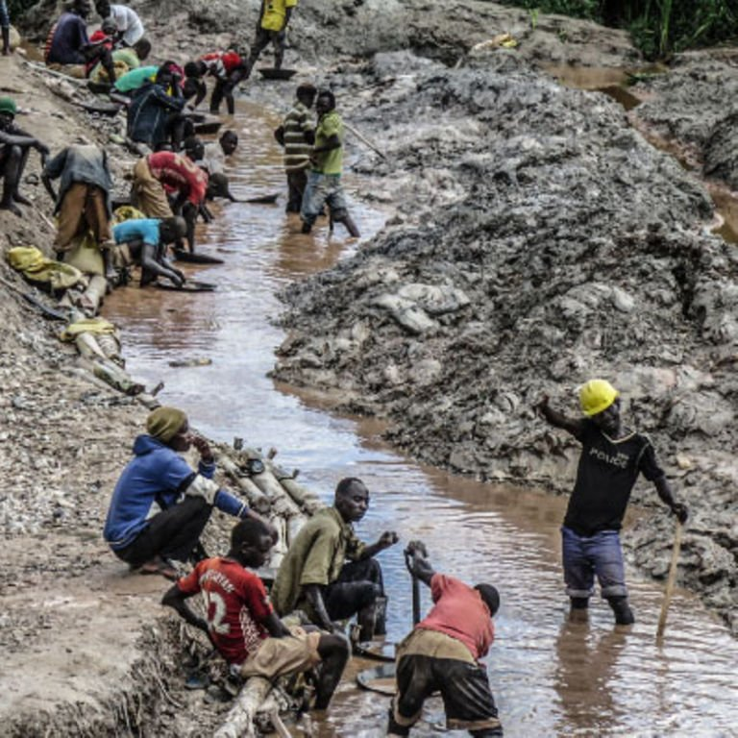
Social Movements
In late 2019 Artisanal tin miners protested low prices and the delayed payment.
Over 400 artisanal and smaller scale miners from Mwerasanhu tin mines in Rwamwire and Ruhaama parishes in Rahaama Ntumgamo district went on strkuke protesting harassment with little and late pay, with harsh conditions.
The company Zanack Holdings does not allow there miners to sell their Tin to other mineral companies that offer better prices.
This company claims because of the drop in price of tin they can’t pay their workers

Slide 14
Demand
The tin market will always be growing with demanded for canned foods and beverages.
Also as the electronics industry grows more and more so will the tin market, because tins various of purities and alloys are suitable bonding materials for the electronics industry.

Slide 15
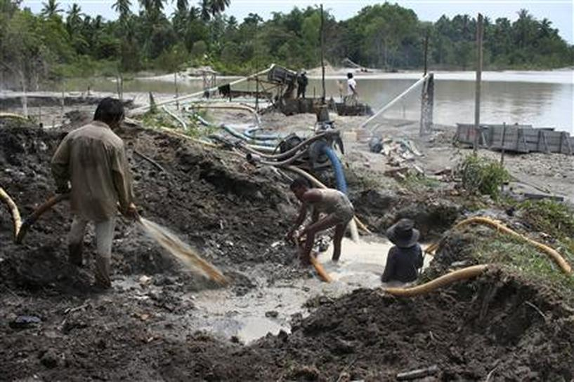
Strategy for consumers
The real problems with the tin industry is with the tin miners in third world countries getting their rights violated, underage workers, health and safety issues, lack of payment, and more.
While buyers from more developed countries turn a blind eye to how their tin is being mined.

Slide 16
Take Action
In order to take action the abuse in these third world countries need to be brought to light.
Addressing these situations in the media and to our governments can incite countries to demand the mining countries fix the way they treat their miners and to enforce harsher laws to prevent violation of peoples rights.
This is a link for the Global Impact organization that shows more ways to help, explains the hardships, and provides information where donations will go for these Tin miners. Pact illuminating hope for the mining industry | Global Impact (charity.org)

Slide 17
Sources
U.S. imports of Tin, unwrought decreased 13.53 percent through February to $97.93 million (ustradenumbers.com)
Conflict Minerals in East Congo | Global Witness | Global Witness
Tin miners protest harassment, falling prices and delayed payment - Daily Monitor
Global Tin Market Report 2020-2024: Growing Demand for Canned Foods and Lead-free Soldering Driving Growth - ResearchAndMarkets.com | Business Wire

Slide 18
Sources
Tin processing | Britannica
U.S. imports of Tin, unwrought decreased 18.67 percent through December to $547.46 million (ustradenumbers.com)
YUNNAN TIN GROUP (ytc.cn)
List of countries by tin production – Wikipedia
tin | Definition, Properties, Uses, & Facts | Britannica

Slide 19
Sources
The Properties, Production, and Applications of Tin (thoughtco.com)
Tech supply chains risk links to human rights abuses outside ‘conflict minerals’ hotspots - Research - Democratic Republic of the Congo | ReliefWeb
50,000 Tin Miners On Strike in Bolivia - The New York Times (nytimes.com)

