Slide 1
Aluminum Foil
A Presentation By Matthew Conboy

Slide 2
Where Does It Come From?
The largest producer of pure aluminum in the world is China, which produced roughly thirty three million tons of pure aluminum.
More top producers are India, Australia, Canada.
Aluminum does not exist in a pure state. It is created by process of combining bauxite ore with silica and iron oxide.

Slide 3
Where Does It Go?
The United States imported roughly four million tons of aluminum in 2019
Consumption in the United States totaled roughly 3.4 million tons
Canada is the largest exporter of aluminum to the US, and plays a key role in US manufacturing industries

Slide 4
Top Exporters
Alcoa (United States)
Alumina Limited (Australia)
Chalco (China)
Emirates Global Aluminium (United Arab Emirates)
Hindalco Industries (India)
Norsk Hydro ASA (Norway)
United Company RUSAL (Russia)

Slide 5
The Production Process (The Bayer Process)
Phase 1 – Digestion: During the digestion stage, the bauxite is ground and mixed with sodium hydroxide before being pumped into large, pressurized tanks. The pressure then breaks all this down to a saturated solution.
Phase 2 – Clarification: The solution is passed in-between tanks with catching cloths which trap it.
Phase 3 – Precipitation: In this phase large chunks of aluminum hydrate begin to form and are filtered out.
Phase 4 – Calcination: The aluminum hydrate is exposed to incredibly high temperatures which forms aluminum oxide.

Slide 6
The Production Process (Smelting)
Phases 5 Through 7 – Smelting: The alumina is dissolved in a smelting cell, a deep steel mold lined with carbon and filled with a heated liquid conductor that consists mainly of the aluminum compound cryolite.
Next, an electric current is run through the cryolite, causing a crust to form over the top of the alumina melt. When additional alumina is periodically stirred into the mixture, this crust is broken and stirred in as well. As the alumina dissolves, i decomposes to produce a layer of pure, molten aluminum on the bottom of the smelting cell. The oxygen merges with the carbon used to line the cell and escapes in the form of carbon dioxide. Still in molten form, the purified aluminum is drawn from the smelting cells, transferred into crucibles, and emptied into furnaces. At this stage, other elements can be added to produce aluminum alloys with characteristics appropriate to the end product, though foil is generally made from 99.8 or 99.9 percent pure aluminum. The liquid is then poured into direct chill casting devices, where it cools into large slabs called "ingots" or "reroll stock." After being annealed (heat treated) the ingots are suitable for rolling into foil.

Slide 7
The Production Process (Rolling)
Phase 8 – Cutting: The product of the smelting product is a massive block of pure aluminum, which is then doubled and set on rollers in order to thin the aluminum into paper thin sheets.

Slide 8
Does Aluminum Foil Fuel The Drug Epidemic?
No, it definitely does not. But, being that aluminum foil is used in various ways from beauty salons to kitchens it is not shocking drugs users would find a use for it also. Supposedly aluminum foil can be used to create makeshift pipes and other forms of drug paraphernalia.
One site I came across suggests keeping aluminum foil out of the hands of troubled youths.

Slide 9
Market Concerns
One site suggests that since a large portion of aluminum based products are manufactured and shipped out of China, the United States government must be careful with the amount of tariffs it places on the country. As mentioned above, aluminum foil is incredibly universal in its uses and various industries rely on it.

Slide 10
Social Impacts
Although I did not come across any movements currently against or pertaining to the aluminum foil industry, the data dictates that the market is only getting larger with each passing year (mainly fueled by the fast food and pharma markets) so naturally you would have to assume that with time there will certainly be some social impact.

Slide 11
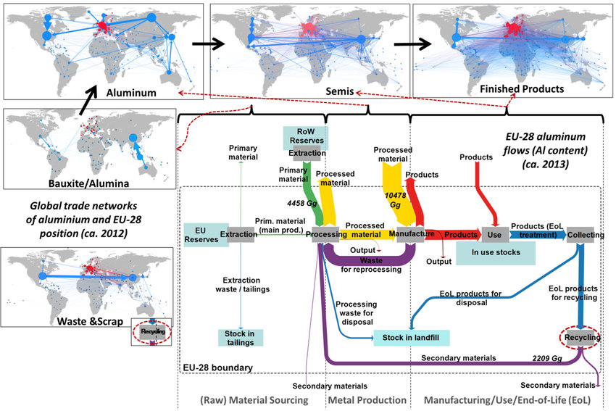
Aluminum Flow Map

Slide 12
Processes/Institutions Which Hinder The Aluminum Trade
During my research, the only instance I could locate on the hindrance of the aluminum trade actually came from the United States. In March of 2018 Donald Trump imposed a global tariff on all markets which manufactured steel and aluminum except for Canada and Mexico. I find it interesting this occurred being that the U.S. is one of the largest consumers of aluminum.

Slide 13
Violence/Injustice In The Aluminum Trade
During my research I found no instances of violence within the aluminum trade. Injustice is found largely within aluminum pollution.
Fresh water ecosystems

Slide 14
Violence/Injustice In The Aluminum Trade (Cont)
Both open and underground mines affect the plant and animal life immediately surrounding an area and beyond for multiple generations. Clear-cutting trees and grasslands contributes to biodiversity loss, habitat loss, carbon emissions, and erosion.
A silver lining? Roughly 75% of all aluminum manufactured in the U.S. is still in use today.

Slide 15
Advertising And Desires?
Being that aluminum foil, and aluminum products in general (cans, electrical product, computer components) are standard within our homes and gadgets/devices there is no particular advertising field. No clout with aluminum foil.

Slide 16
Product Distribution/ Production
The processes involved in the production and distribution of aluminum foil are quite transparent as it is one of the largest and fastest growing industries on the globe. Basic information can be found by doing a simple search on Youtube, Google, Etc.
https://www.youtube.com/watch?v=yn9qhQSMCRk
https://www.youtube.com/watch?v=eGdXxFjqFsg
https://www.youtube.com/watch?v=t4HAzfhWtqE

Slide 17
How The Consumer Can Help
Recycle, recycle, recycle!
https://www.aluminum.org/common-alloy-aluminum-sheet-antidumping-and-countervailing-duty-petitions

