Slide 1
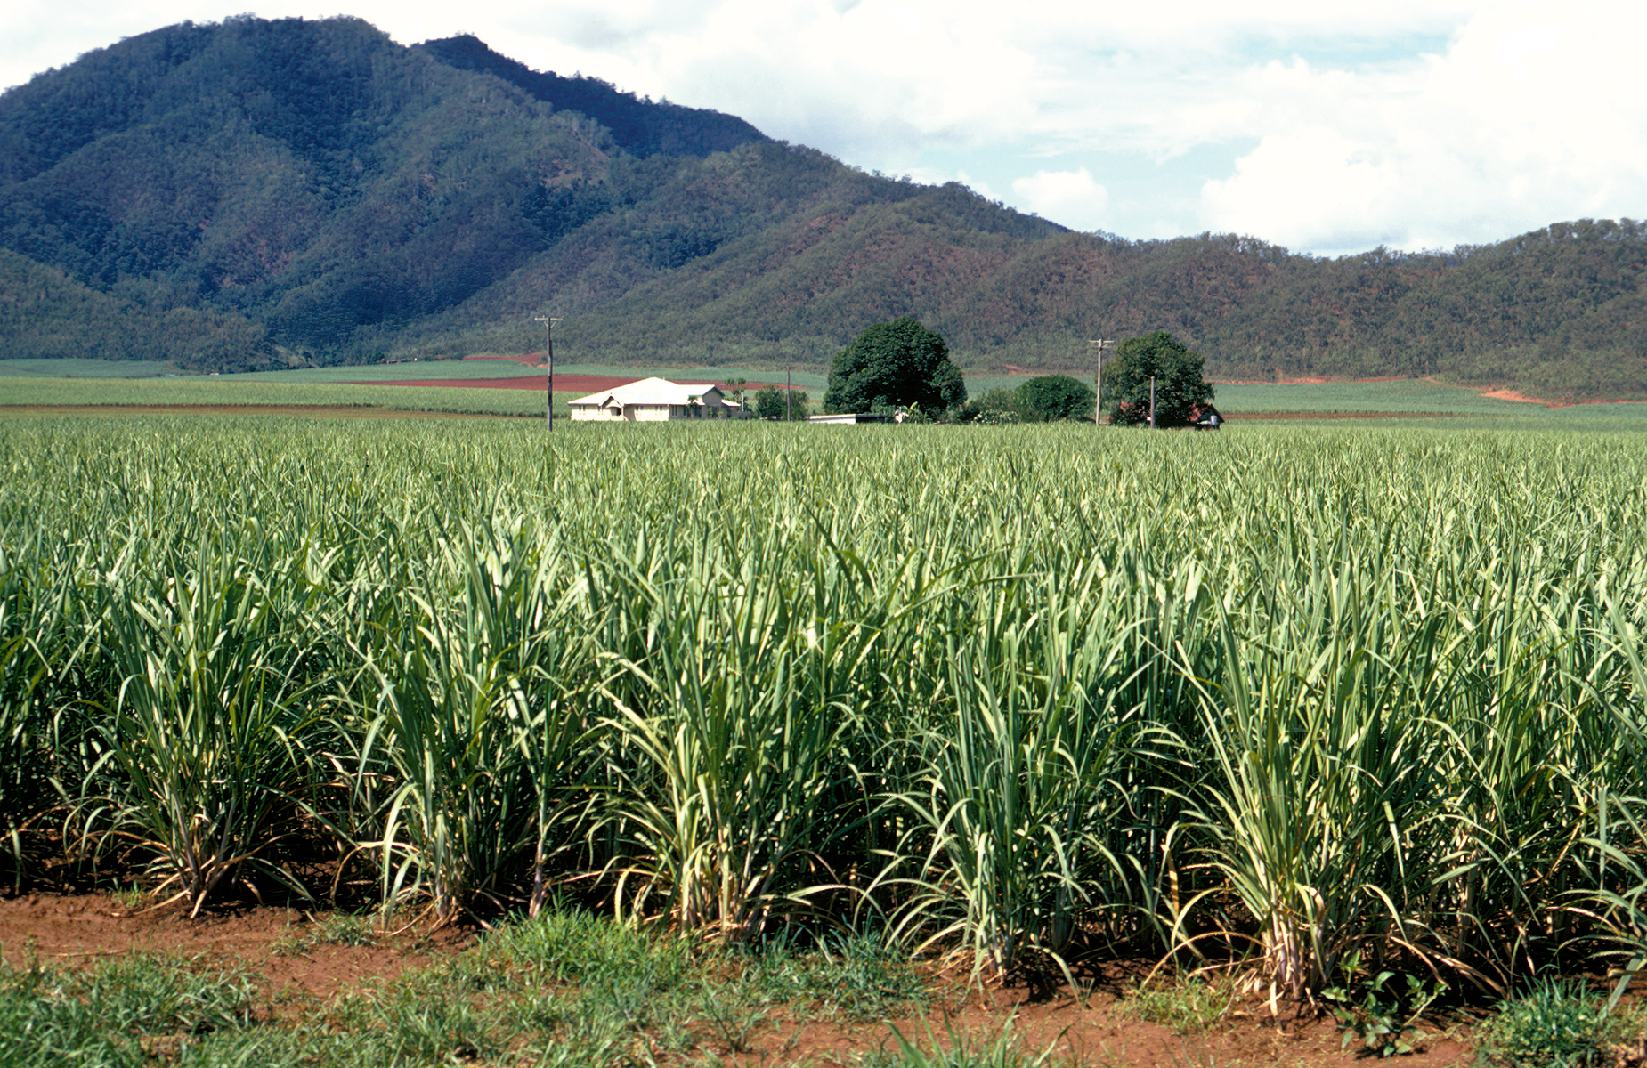
Sugarcane
Lionel Chen

Slide 2
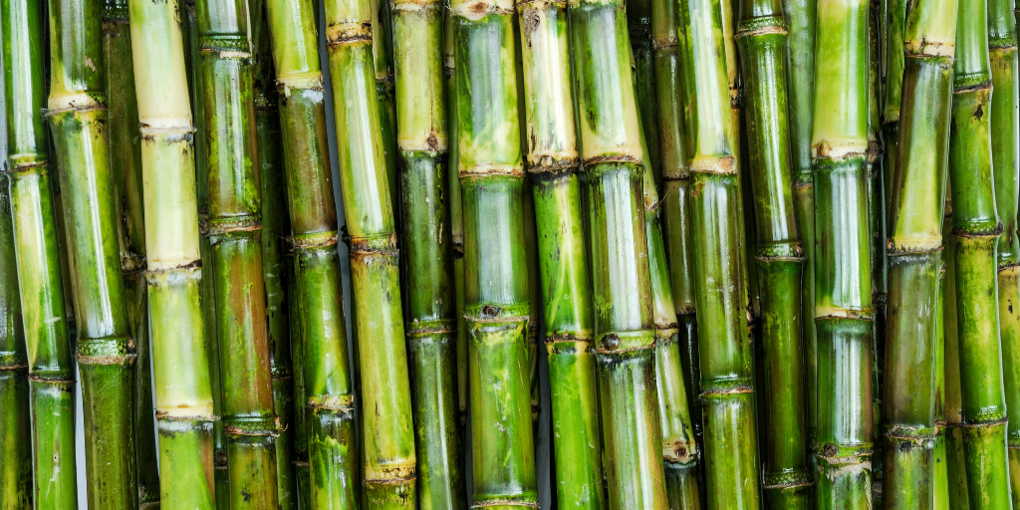
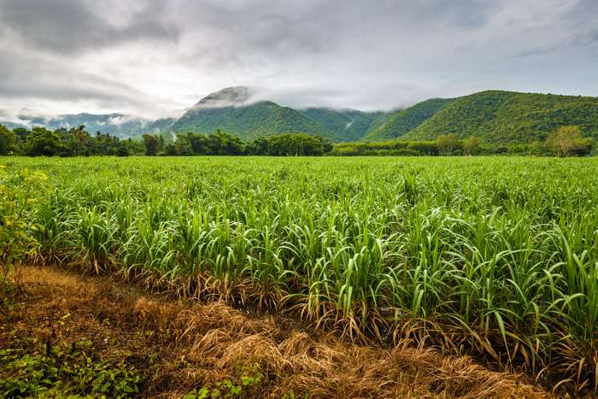
Sugarcane is a plant, it is part of grass family.
They can grow up to 12 feet.
The juice from the Sugarcane is extracted from the plant and turned into sugar.
A majority of sugar that we use everyday comes from sugar cane.
Notes:
Find image showing the height sugarcane can go.

Slide 3
Sugarcane
Top Producing Countries:
Brazil
India
Mexico
China
Australia

Slide 4
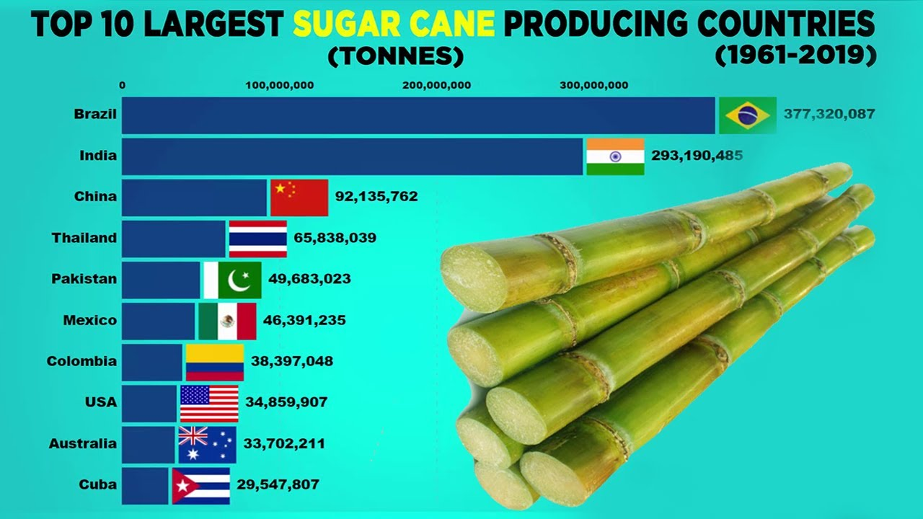
Top 10 Producing Countries (1961-2019)

Slide 5
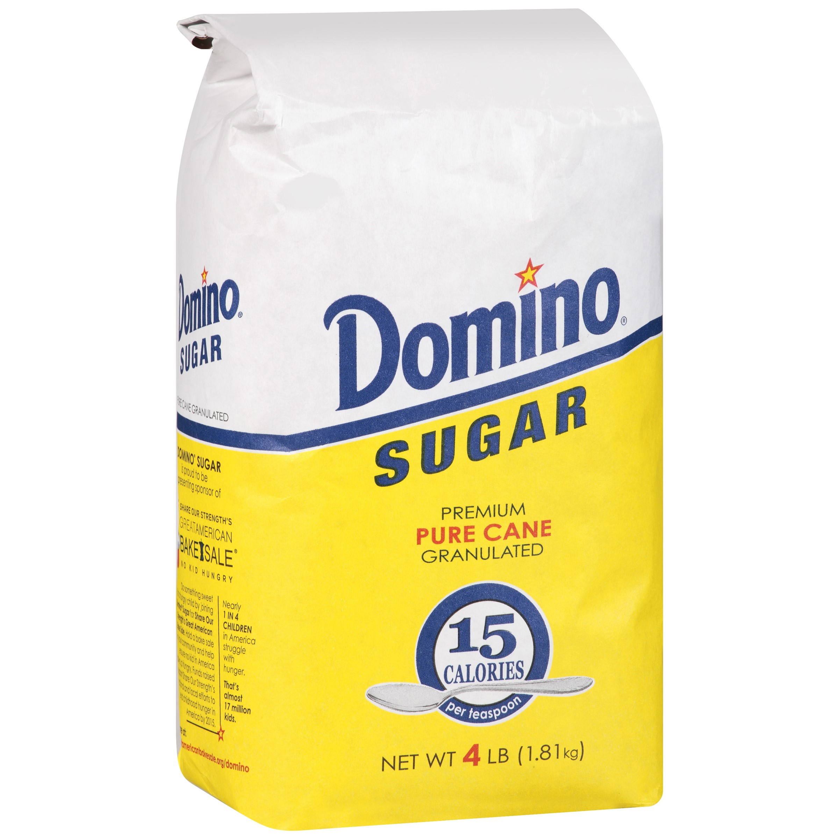
Corporations
Domino Sugar
Founded in 1901
Headquarters located
Yonkers, NY
Maryland, VA
Chalmette, LA
Has 4,500 employees
Net worth 8.2 billion

Slide 6
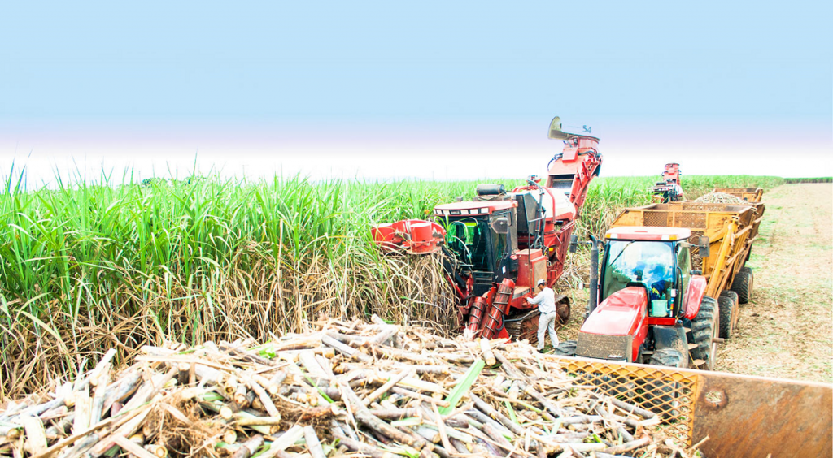
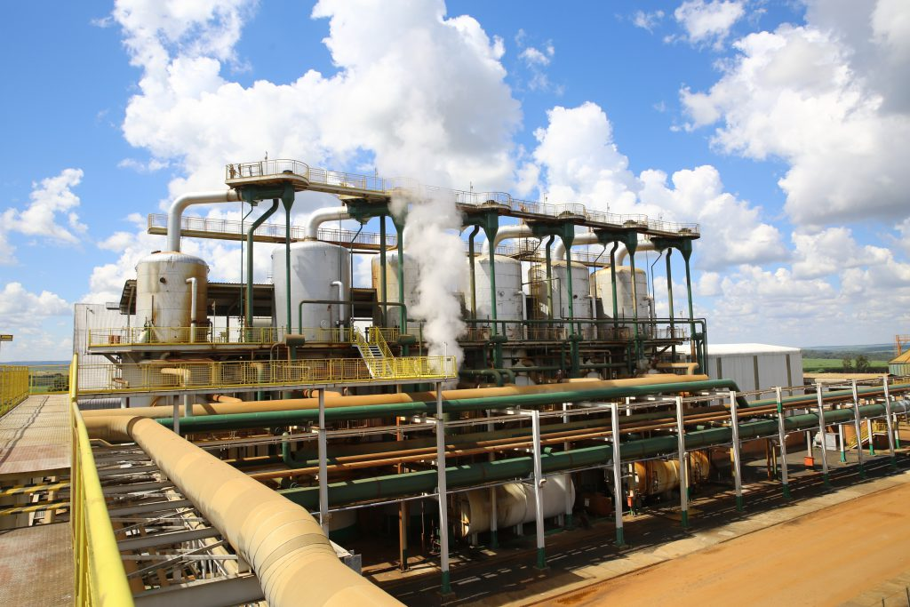
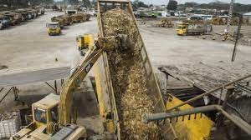
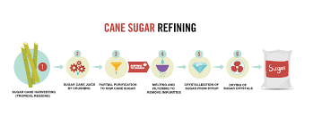
Production Process
Sugarcane is collected
Washed with water
Then it is grinded up to extract the juice from the plant
Boil the juice until it thickens into syrup
Put into a machine that spins it rapidly until granulated crystals form
Ship to warehouse for packaging.
Notes:
Find images showing each step.

Slide 7
Controversies
Process of turning sugar cane into sugar has devastating effects on the environment.
Plant matter and sludge leftover from the extraction of sugar ends up in lakes and other bodies of water affecting the fish population.
Harmful pesticides sprayed on the plants can cause terrible health effects on the farm workers and on the sugar sold to consumers.
Notes:
Include picture of pesticides being sprayed or yucky water

Slide 8
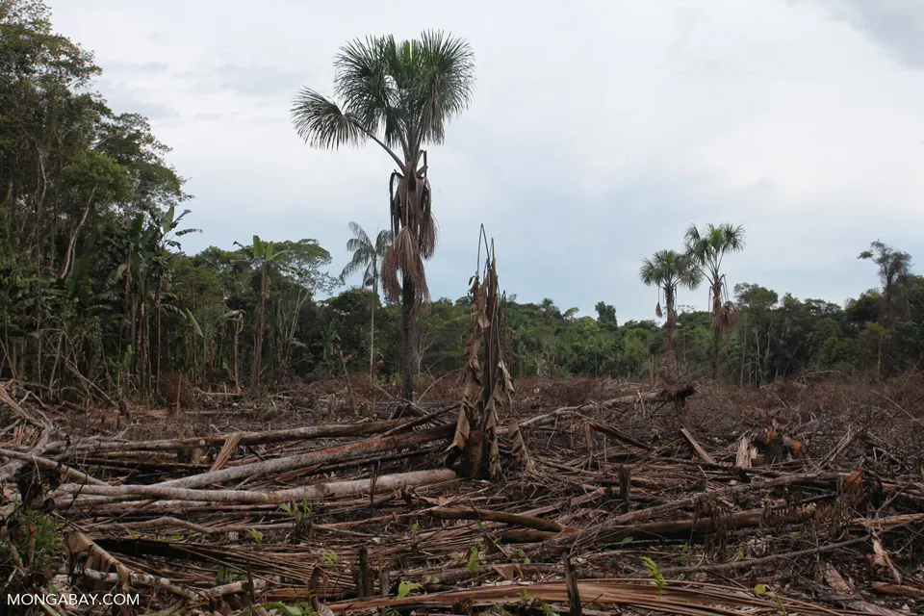
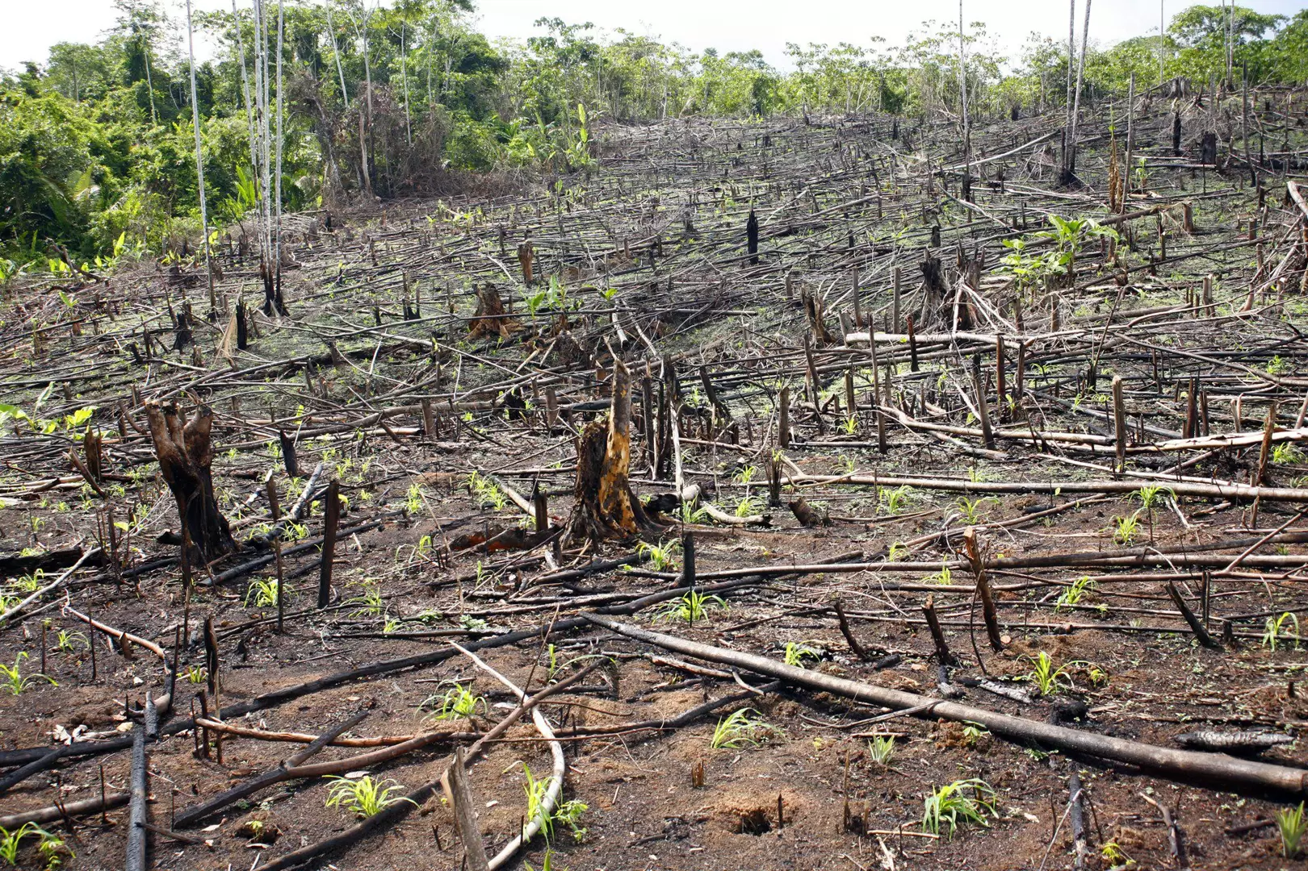
Controversies
Sugarcanes NEGATIVELY affect the ecosystem of many poorer countries.
Brazil's Atlantic Forest --> has been reduced to just 7% of its original size.

Slide 9
Controversies
The NEGATIVE effects of harvesting sugarcane:
removing natural rainforests, mangroves and other sensitive environments,
reduced wildlife biodiversity,
polluted rivers and seas,
eroded fertile soils,
careless use of pesticides and fertilisers,
poor management of irrigation,
air pollution from burning cane, and
damage to coral reefs such as the Great Barrier Reef.
Notes:
Add pictures of this environmental destruction. https://www.sustainweb.org/foodfacts/sweet_and_sour/

Slide 10
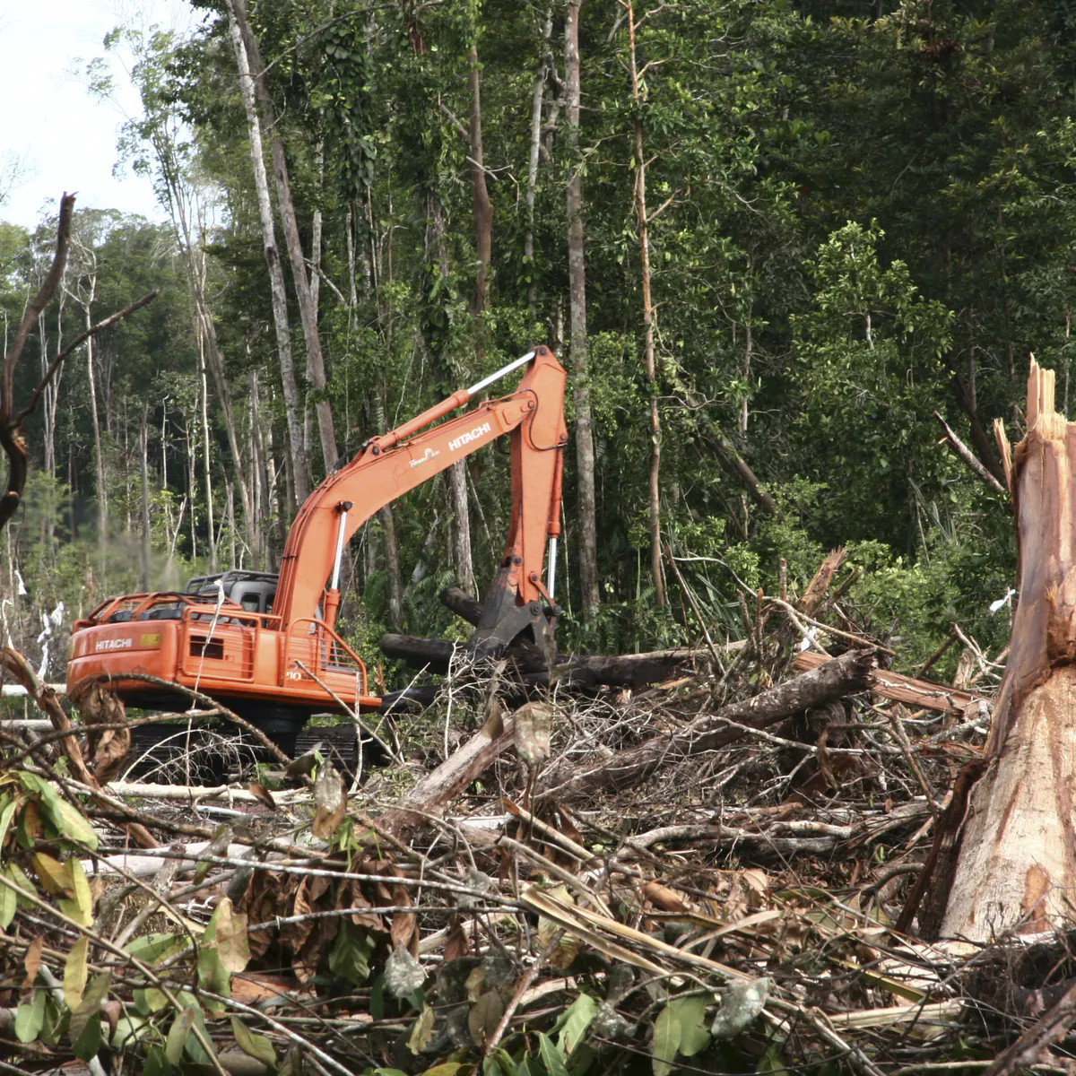
Controversies
To meet projected global sugarcane demand:
Growers will need to cultivate almost 50% more land by 2050
Less forests
Destruction of diverse natural environments
Use of more harmful pesticides and chemicals

Slide 11
Environmental Protests
Environmental Organizations:
Deforestation
Advocating for a better way to dispose the waste created from the extraction process
Limit the land use
Harmful pesticides and chemicals
Water pollution

Slide 12
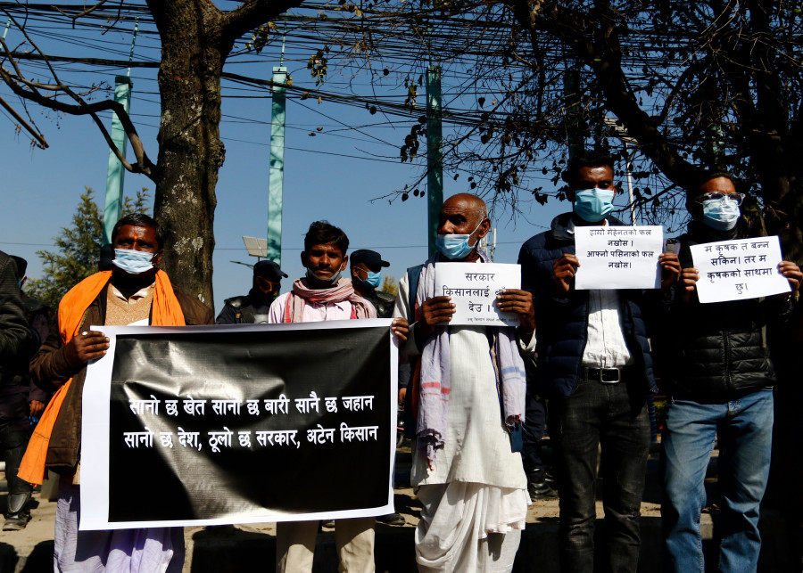
Workers Protest
Government failed to pay farmers
Farmers protested by marching to capital
Government makes deal to pay but then does not keep their end up of the agreement
Farmers march again to protest lack of payments
Notes:
This occurred in Kathmandu but farm workers are protesting throughout for better wages and working conditions.

Slide 13
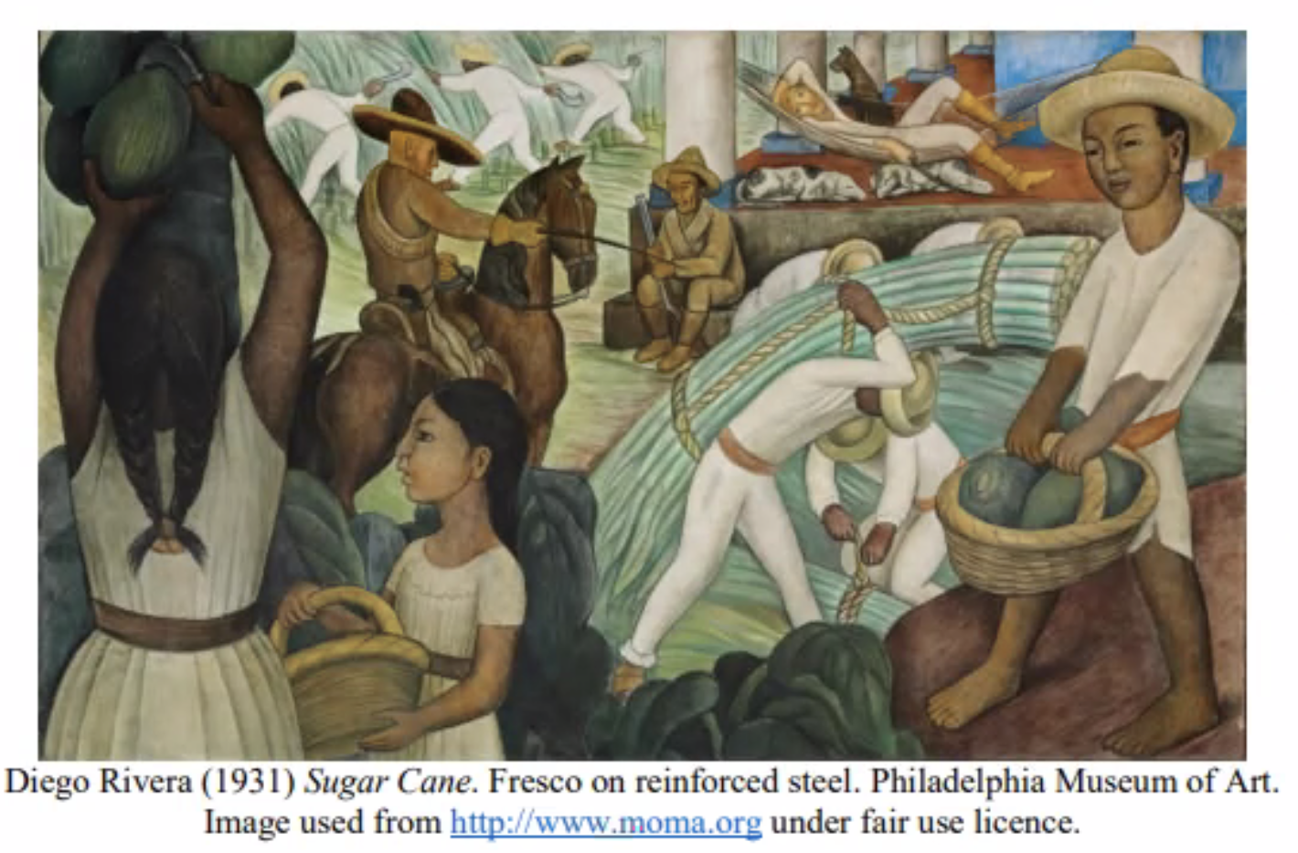
Social Inequalities
Two class system:
Poor farm worker
Wealthy lander owners
Wealthy countries hold the most control over sugar imports so much so that poor countries can not competitive

Slide 14
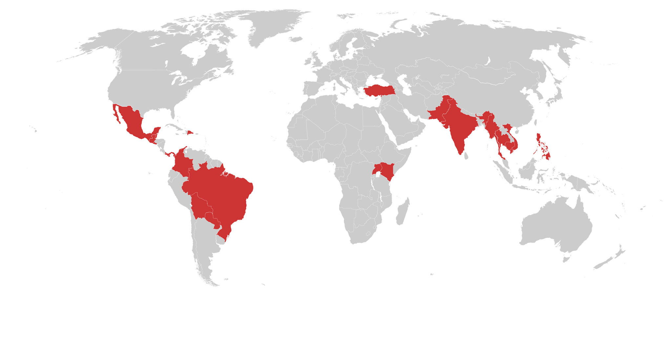
Map Flows
Top Exporting Countries:
Brazil
India
Mexico
China
Australia
Mexico
India
Brazil
Australia

Slide 15
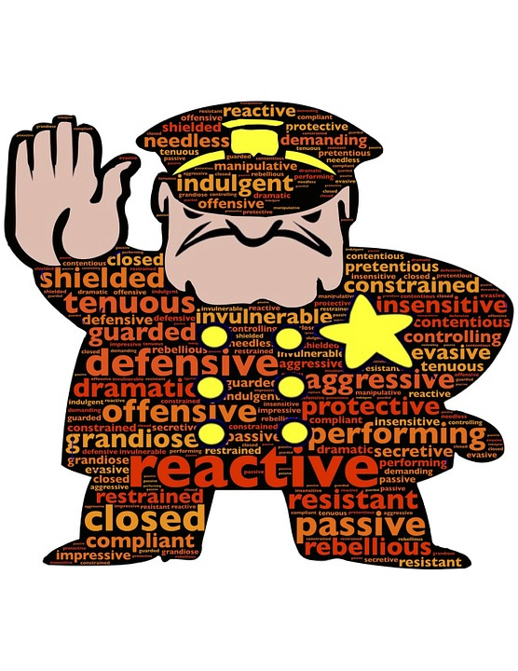
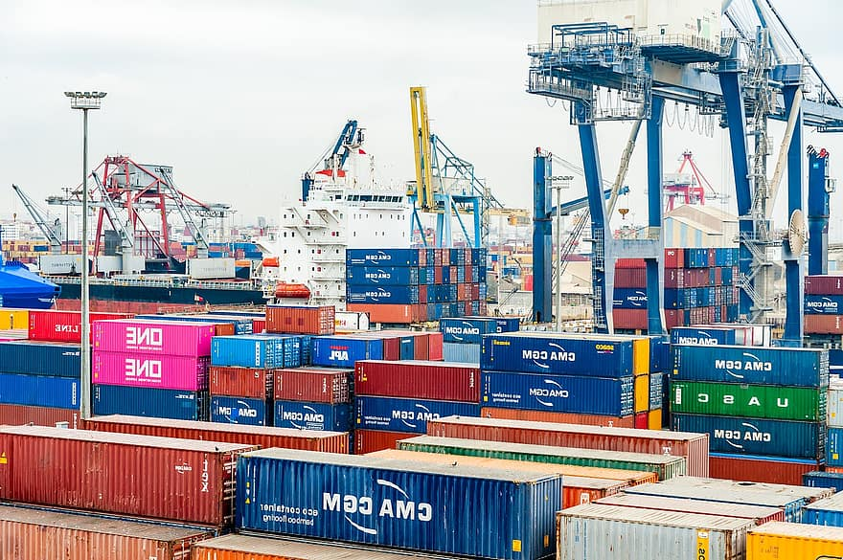
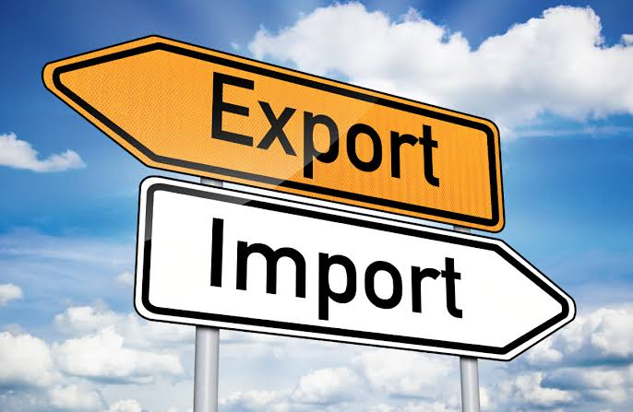
Global Flow Hinders
European Union, Japan, and the United States strictly control the sugar markets and receive more than double the world market price due to
government guaranteed prices
import controls
production quotas.

Slide 16
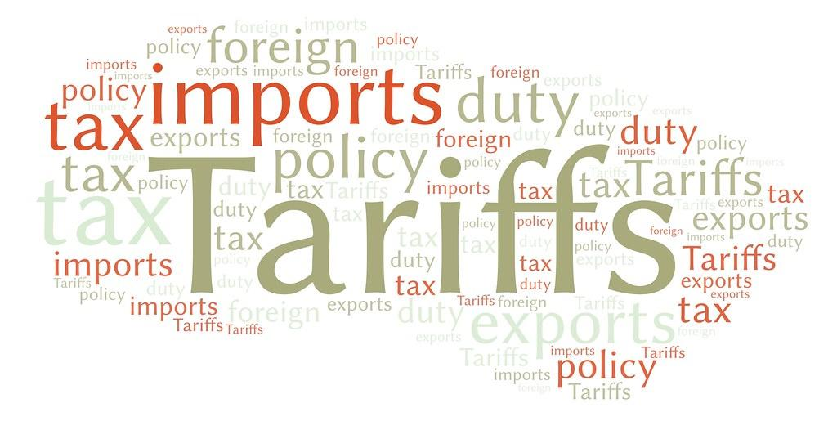
Domestic Flow Hinders
United States and Mexico have an agreement that is key in limiting the supply of imported sugar.
Dumping is when a product can not be exported at a higher cost than the purchase price.
Cumulative Volume Delta - Limits the amount of a product can exported and the prices it’s sold at
Mexican producers must comply with the rules set by the United States such as minimum prices and maximum quantities for suga .

Slide 17
Organization Fighting For Fair Trade
Fairtrade Labelling Organizations International.
World Fair Trade Organization.
Network of European Worldshops.

Slide 18
Steps Toward Equal Trade
Increase consumer awareness of price discrepancy
Bring awareness of US import controls that benefit US farmers but hurts Mexican farmers and US consumers
Lift restriction on the amount of sugar can come into the US
Slow the environment devastation by limiting deforestation
Penalties for companies that do not comply with workers’ health and safety laws
Impose significant penalties on wealthier countries that pull valuable resources from other countries without equal compensation.

Slide 19
commodity fetishism:
Consumer of sugar often time take for granted the wide availability of sugar.
Do to the abundances of advertisement of sugar products Consumer are unaware
Of the social inequality serenading sugar.
in recent years the topic of overconsumption of sugar has been brought to the attention of Consumer however social inequality issue has been kept in the dark.

Slide 20
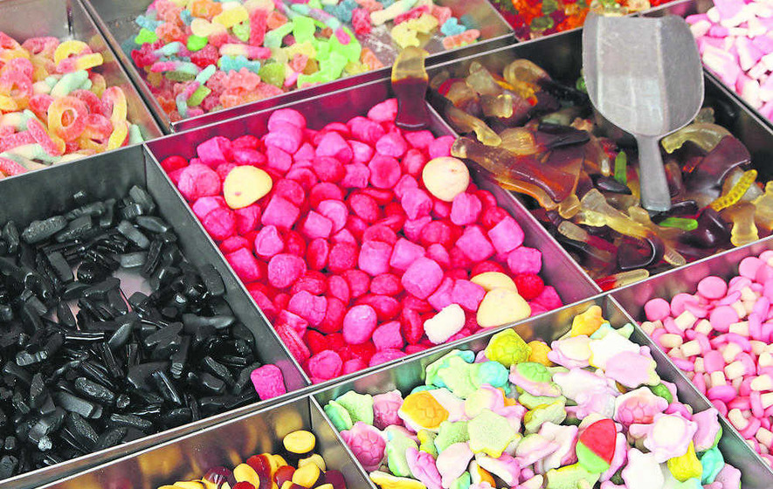
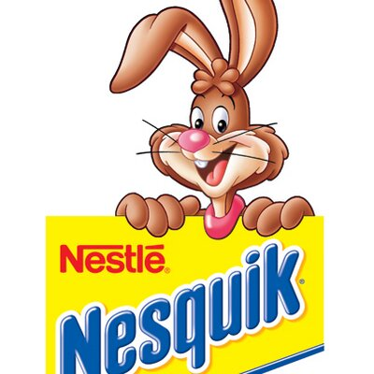
Advertising
Consumers enjoy sugar in many different foods but more specifically, it’s used in candy production.
Ad companies target young children by using colorful designs, kid-friendly music and cartoon mascots that attract their attention.

Slide 21
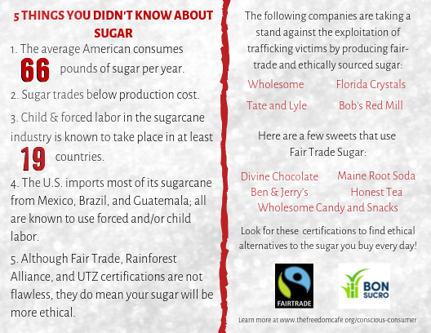
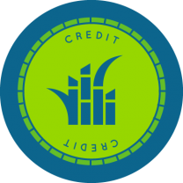
Actions I Have Taken
Reduced my daily sugar intake by not putting sugar in my morning coffee.
Purchase sugar products that are fairtrade certified.
If enough consumer choose certified, it will show companies that we care about where and how how the sugar is obtained.
Join Bonsucro
a non-profit organization that works for farmworkers to get fair wages and helps with the trading process of sugarcane.
Notes:
https://thefreedomcafe.org/sugar

Slide 22
Citations:
Massarani, Luisa. 2020. “Brazil Transgenic Sugarcane Controversy”. Science & Development website, June 17. Accessed on February 15, 2021. https://www.scidev.net/global/news/brazil-transgenic-sugarcane-controversy.
World WildLife. 2015. “Sugarcane Farmings Toll on the Environment”. World Wildlife Magazine website, Summer 2015. Accessed on February 15, 2021. https://www.worldwildlife.org/magazine/issues/summer-2015/articles/sugarcane-farming-s-toll-on-the-environment#:~:text=Sugarcane%20farming%20has%20fueled%20deforestation,meet%20projected%20global%20sugarcane%20demand.
Baucum, L., Rice, R. W. & Muralles, L. (2009). Backyard sugarcane. University of Florida IFAS Extension. http://edis.ifas.ufl.edu/pdffiles/SC/..... Plant Village, website. Accessed on February 15, 2021. https://plantvillage.psu.edu/topics/sugarcane/infos
Martin, Freddie & Hoy, Jeffrey. 2005. “Sugarcane An Important Industry Facing Many Challenges”. LSU College of Agriculture website, May 31. Accessed on February 15, 2021. https://www.lsuagcenter.com/portals/communications/publications/agmag/archive/2001/fall/sugarcane-an-important-industry-facing-many-challenges#:~:text=A%20short%20growing%20season%20that,the%20cane%20to%20produce%20sugar

Slide 23
Citations
The Record. December 13, 2020. “Swindled sugarcane farmers stage protests in the Capital amidst Covid crisis”The Record website. Accessed on February 16, 2021. https://www.recordnepal.com/covid19/swindled-sugarcane-farmers-stage-protests-in-the-capital-amidst-covid-crisis/
Prasain, Krishana. December 29, 2020. “Sugarcane farmers call off their protest as government promises payment in 21 days” Kathmandu Post website. Accessed on February 16, 2021 https://kathmandupost.com/national/2020/12/29/sugarcane-farmers-call-off-their-protest-as-government-promises-payment-in-21-days
Dr. Richardson, Ben. October 8, 2005. “The Unequal Embodiment of Sugar” The University of Warwick website. Accessed on February 17, 2021. https://warwick.ac.uk/fac/soc/pais/people/richardson/richardson_-_the_unequal_embodiment_of_sugar.pdf

Slide 24
Citations
Gaudoin, Christopher. 2018. “The Sugar Policy in the United States a Continuous Manan=gment of the Internal Market” Agriculture Strategies website. October 1. Accessed on March 12, 2021. https://www.agriculture-strategies.eu/en/2018/10/the-sugar-policy-in-the-united-states-a-continuous-management-of-the-internal-market/
French, Simone & Story, Mary. 2004. “Food Advertising and Marketing Directed at Children and Adolescents in the US” International Journal of Behavioral Nutrition and Physical Activity. February 10. Accessed on March 12, 2021. https://www.ncbi.nlm.nih.gov/pmc/articles/PMC416565/.
Tsing, Anna. 2000. The Global Situation. University of California. American Anthropological Association. Accessed on March 12, 2021. https://ramapo.instructure.com/courses/10732/files/864395/download?download_frd=1

Slide 25
Citations
Shahbandeh, M. 2020. “Sugar imports to the United States from 2009/2009 to 2019/2020 (in million metric tons)” Statista website. Accessed on February 17, 2021. https://www.statista.com/statistics/249666/us-sugar-imports/
Cirad, Agriculture Research for Development. “Sugarcane: Plant and Uses” Accessed on February 17, 2021. https://www.cirad.fr/en/our-research/tropical-value-chains/sugarcane/plant-and-uses
Khushboo, Sheth. 2017. “Top Sugarcane Producing Countries” World Atlas website. Accessed on February 17, 2021. https://www.worldatlas.com/articles/top-sugarcane-producing-countries.html

