Slide 1
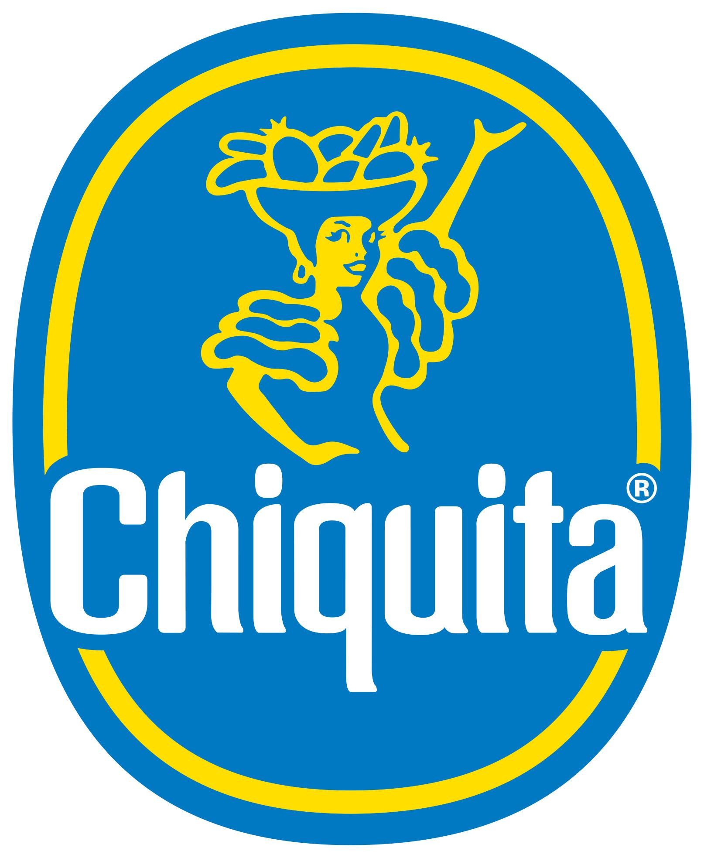
By Angely Montilla

Slide 2
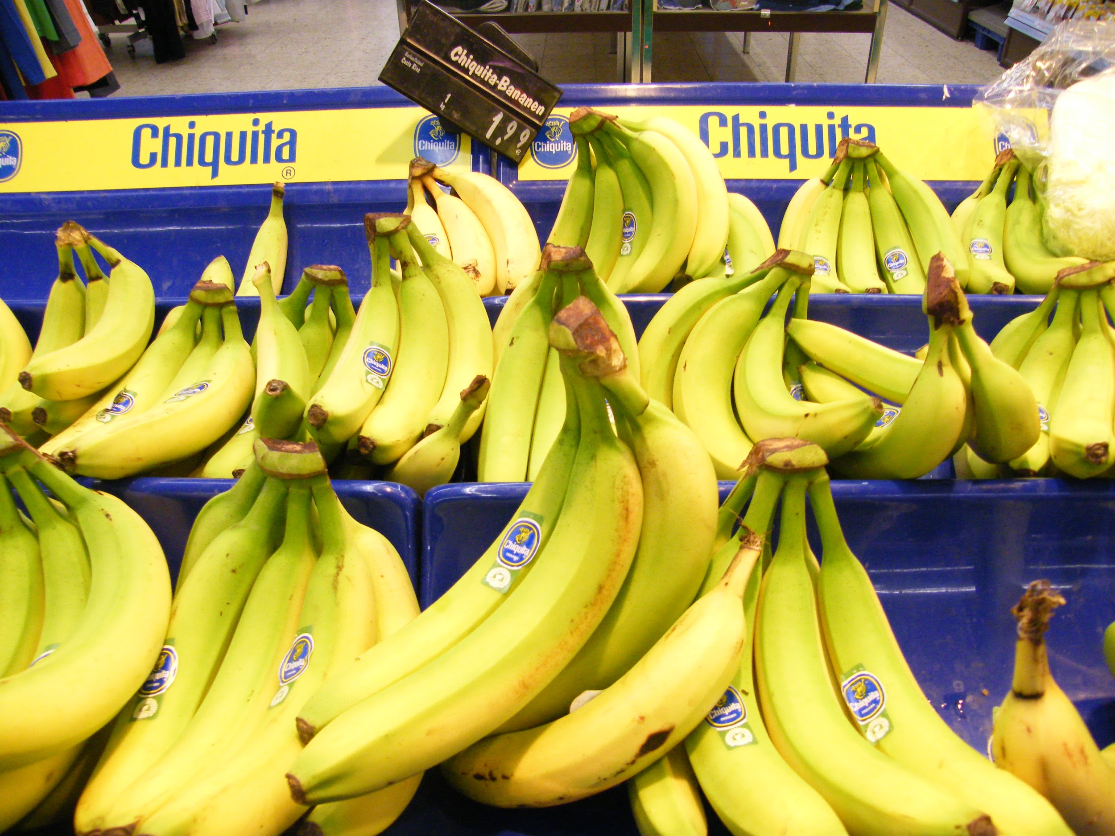
Bananas!
the world’s most popular fruit
they account for roughly 75 percent of the tropical fruit trade
more than a hundred billion are eaten annually
1890- Americans had never heard of bananas, by 1930- they were available at any supermarket, any time of the year

Slide 3
History
United Fruit needed to assure output of bananas to its consumer market in the USA
distribution network between the tropical Caribbean and the United States that included plantations railways, ports, telegraph lines, and steamships.
1900: United Fruit owned 212,394 acres of land; by 1954: 603,111 acres scattered in Central America and the Caribbean
Eliminated all their competitors in the region
major employer and largest investor in infrastructure in some countries.
Countries such as Guatemala, Panama, and Honduras depended on bananas for more than 60 percent of their total exports-- permissiveness

Slide 4
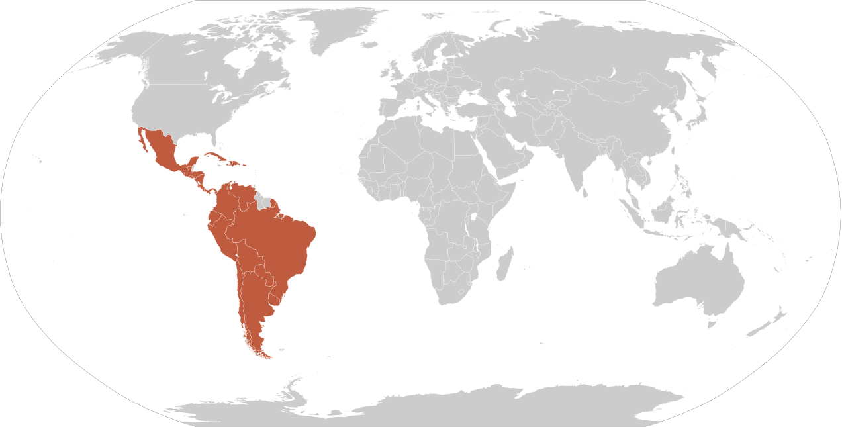
The Good and the Bad
Chiquita brought jobs, money, modernism, trains, electricity
It also brought was environmental destruction, and danger
Chiquita’s monopolies on ports and railroads expanded over the years to monopolize the telegraph, the mail, even the electric company of Guatemala was provided by Chiquita at one point

Slide 5
Controversy
When non-local, export-based industries control regional production like Chicquita did, it allowed them to operate with minimal regulations throughout Central America
Resisting government controls
Exploiting workers
Damaging the environment
Contributing to a series of booms and busts that wreaked havoc for the poor
Underpaying
Child labor
Violence
bribing government officials

Slide 6
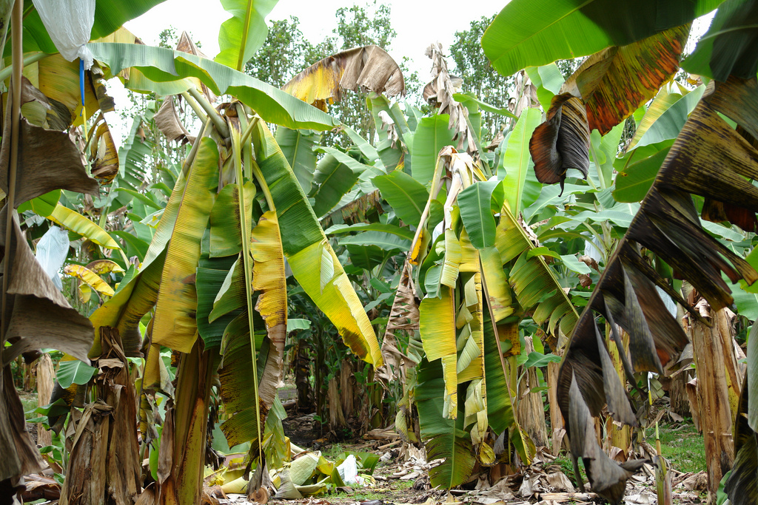
Colombia
The workers of the banana plantations in Colombia went on strike in November 12, 1928. The workers made nine demands from the United Fruit Company:
Stop their practice of hiring through subcontractors
Mandatory collective insurance
Compensation for work accidents
Hygienic dormitories and 6 day work weeks
Increase in daily pay for workers who earned less than 100 pesos
Weekly wage
Abolition of office stores
Abolition of payment through coupons rather than money
Improvement of hospital services

Slide 7
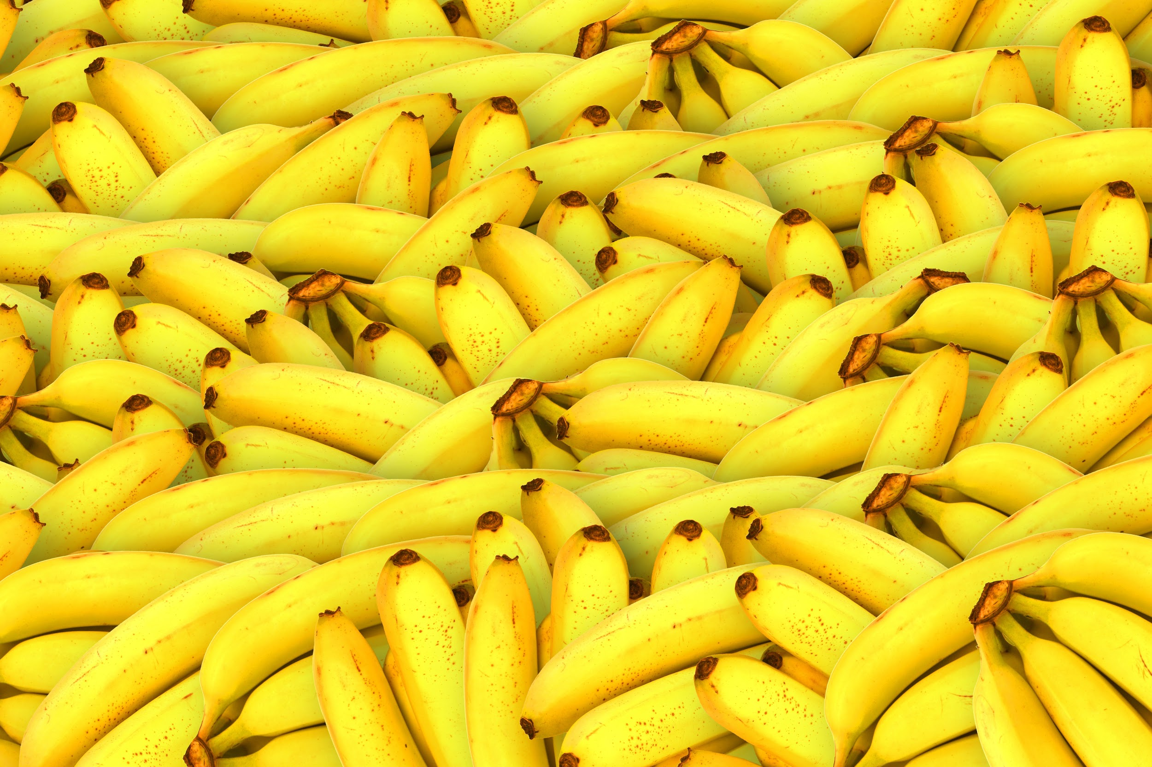
Chiquita admitted paying 1.7 million dollars to the paramilitary group AUC (United Self Defense Forces of Colombia)
Financed war machines by paying this terrorist group
Did so in order to maintain its profitable control of Colombia’s banana growing regions starting in the mid-1990s.
AUC responsible for some of the worst massacres in Colombia’s civil conflict and for a sizable percentage of the country’s cocaine exports.
The U.S. government designated the right-wing militia a terrorist organization in September 2001/
Consequently:
Colombian Army troops opened fire on a crowd of strikers and massacred 3,000
Sunday crowd of workers and their families including children who had gathered
claimed that the army had acted under instructions from the United Fruit Company.
The Banana massacre is said to be one of the main events that preceded the Bogotazo and then La Violencia

Slide 8
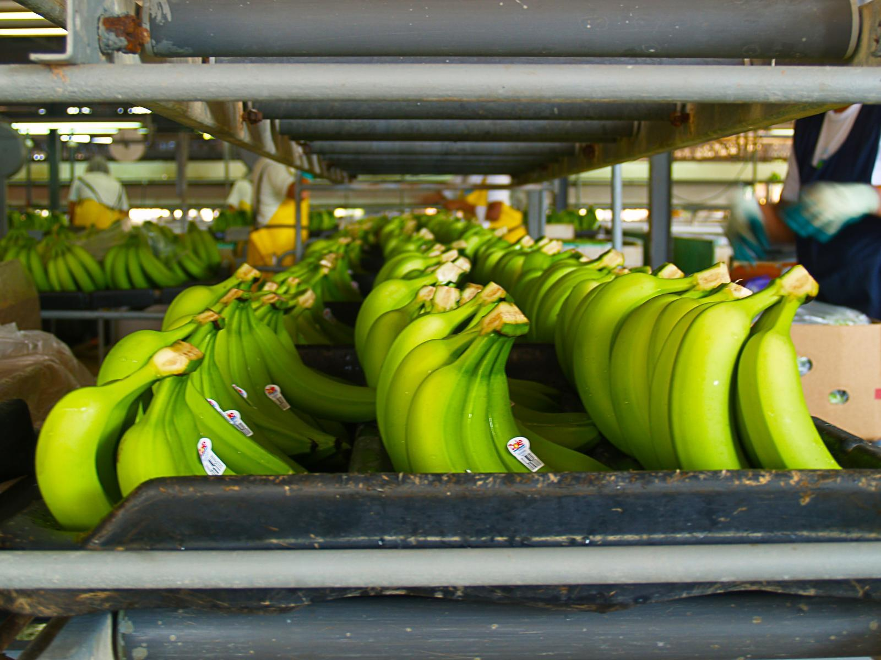
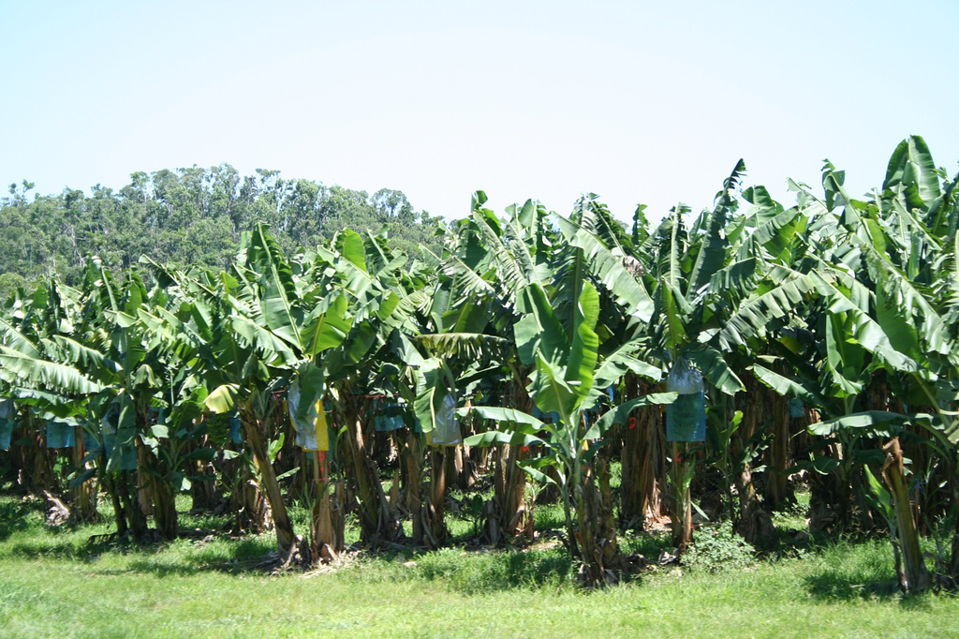
Chiquita Raid on Tacamiche, Honduras
July of 1994: Chiquita tried to relocate villagers off land to sell it to ranchers and developers.
Chiquita deemed the soil infertile and wanted to sell it, but peasants who had worked and lived there for generations refused to leave.
In February 1996, army troops, police, and Chiquita work crews raided the settlement, evicted 123 families, destroyed crops, and proceeded to burn down homes and three churches
ColombiaL
lthough Chiquita ceased payments to FARC and ELN when they were added to the US’s Foreign Terrorist Organizations list, it continued payments to a rogue group called the United Self-Defense Forces of Colombia (AUC) for two years after it was added to the Foreign Terrorist Organizations list, which was considered a federal crime in the US.
When the Department of Justice pressed charges, Chiquita pled guilty and was given only a $25 million fine. No individual executives at Chiquita were charged with any crimes.

Slide 9
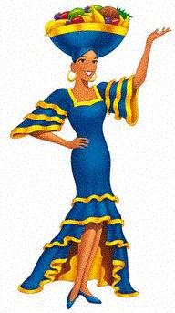
From a racialized and sexualized animated banana into a racialized and sexualized woman

Slide 10
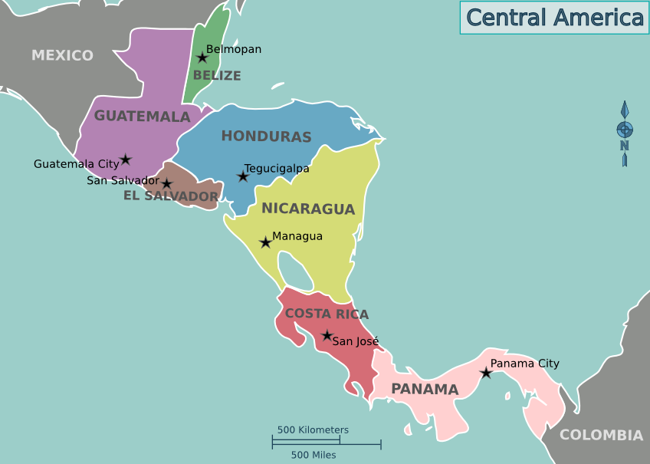
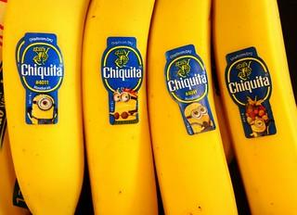
The journey of the Chiquita banana
Farming
production of the banana: mostly from Ecuador, Guatemala, Honduras, Rica, Brazil and India.
only 15–20% of banana plants produced, worldwide, end up traded in the global market
the Cavendish banana

Slide 11
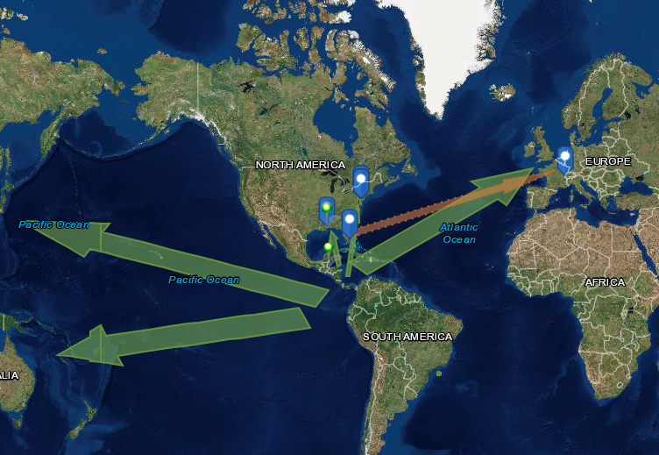

Slide 12
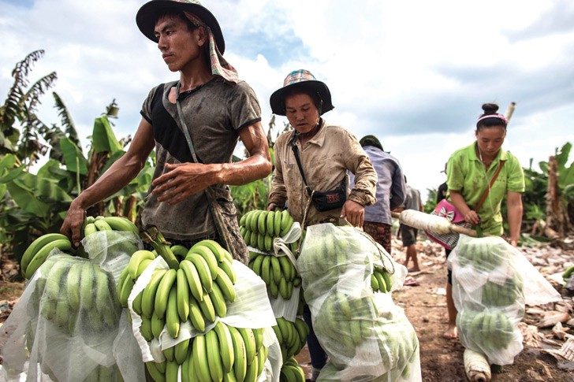
The farming of banana plants has become a hot button issue in the context of sustainability and ecological living.
One of the areas for concern is the GHG emission created during farming
Chiquita been called out in recent years for abusing the human and worker rights at production plantations.
Chiquita has run an employee home ownership program in Honduras, Guatemala, and Costa Rica: this program gives Chiquita control over workers’ homes.
workers stay at Chiquita under bad working conditions, since they are aware that if they leave, they stand to lose their not only their source of income, but also their house”
This gives Chiquita even more leverage over their workers.

Slide 13
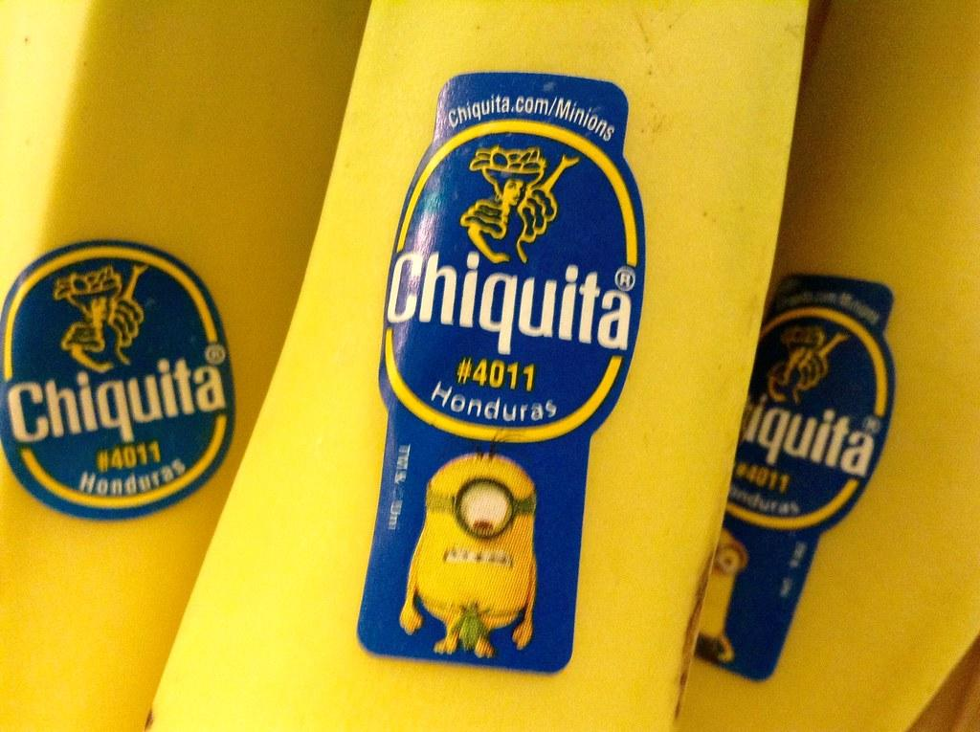
2. Packaging, Traceability and Sourcing
After harvesting is complete, the fruit is washed, labeled and packaged at adjacent plants; in many productions.
allows farmers to ensure quality-control before their product leave their sight.
farms work directly with Chiquita
production sites utilize box code labeling for tracking purposes.
this number enables the identification of the farm where the bananas were harvested, the facility where they were boxed, and the time and date when they were boxed,
ensures the traceability of the bananas, which makes it possible to trace them back to the area of production immediately in the event of a quality problem or the like at the sales destination
this is when the banana becomes visible in the global supply chain.

Slide 14
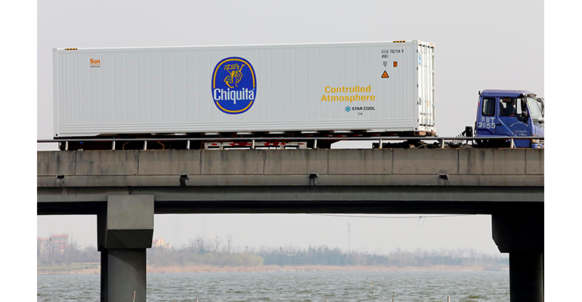
3. Transportation, Logistics and Ripening
When local production sites have packaged the yield, the Chiquita distributors load up massive cargo freights on company ships, or those of 3rd party logistic providers.
This part of the banana’s life cycle tangers eco-fanatics, and for good reason.
The transportation process of shipping, trucking and refrigeration contributes to 62%-67% of the total carbon footprint created during the life cycle of the banana value chain

Slide 15
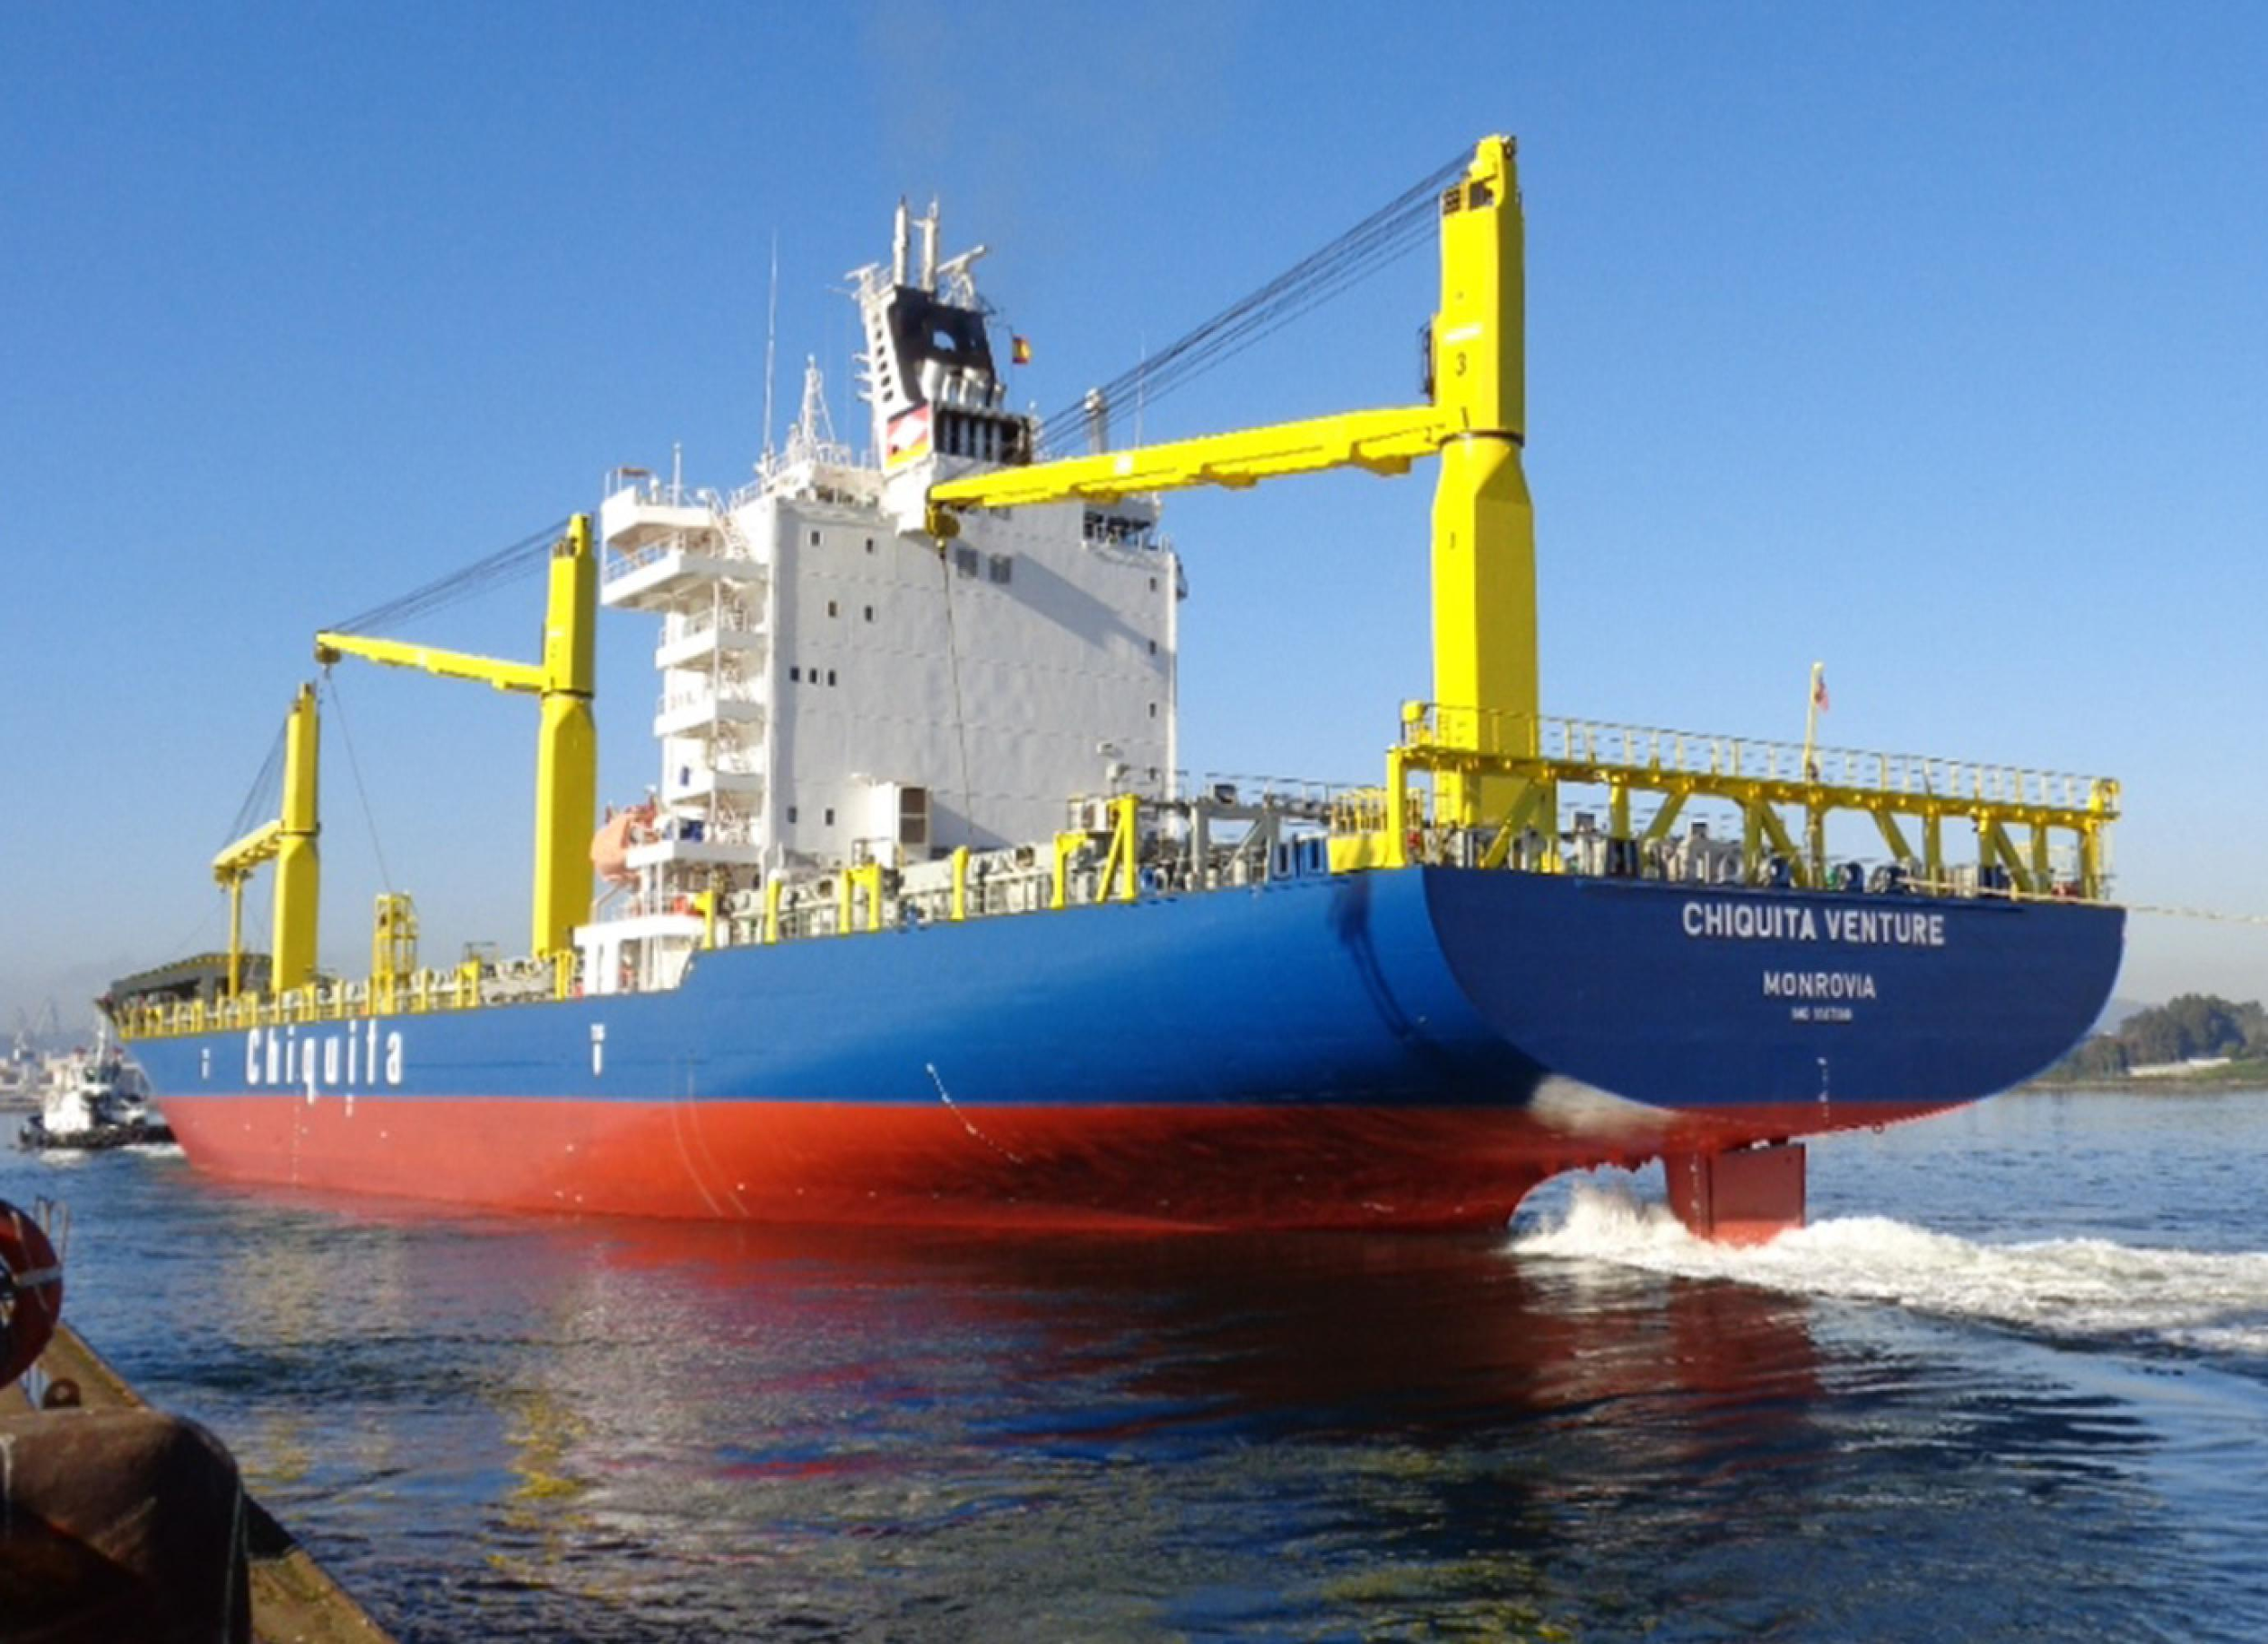
During maritime transport:
bananas are required to be stored in large refrigeration containers.
after the transportation process, bananas are required to be treated in ripening locations in the countries of their final destination.
pallets of packaged bananas are transported from sea to land, and loaded into ‘forced-ripening’ centers.
The product sits in the temperature-controlled rooms for 5–7 days at a time.
Air must continue to be circulated in the storage rooms. Simultaneously, controlled amounts of ethylene gas and hydrocarbons are fed into the rooms, which triggers a ripening of the banana.

Slide 16
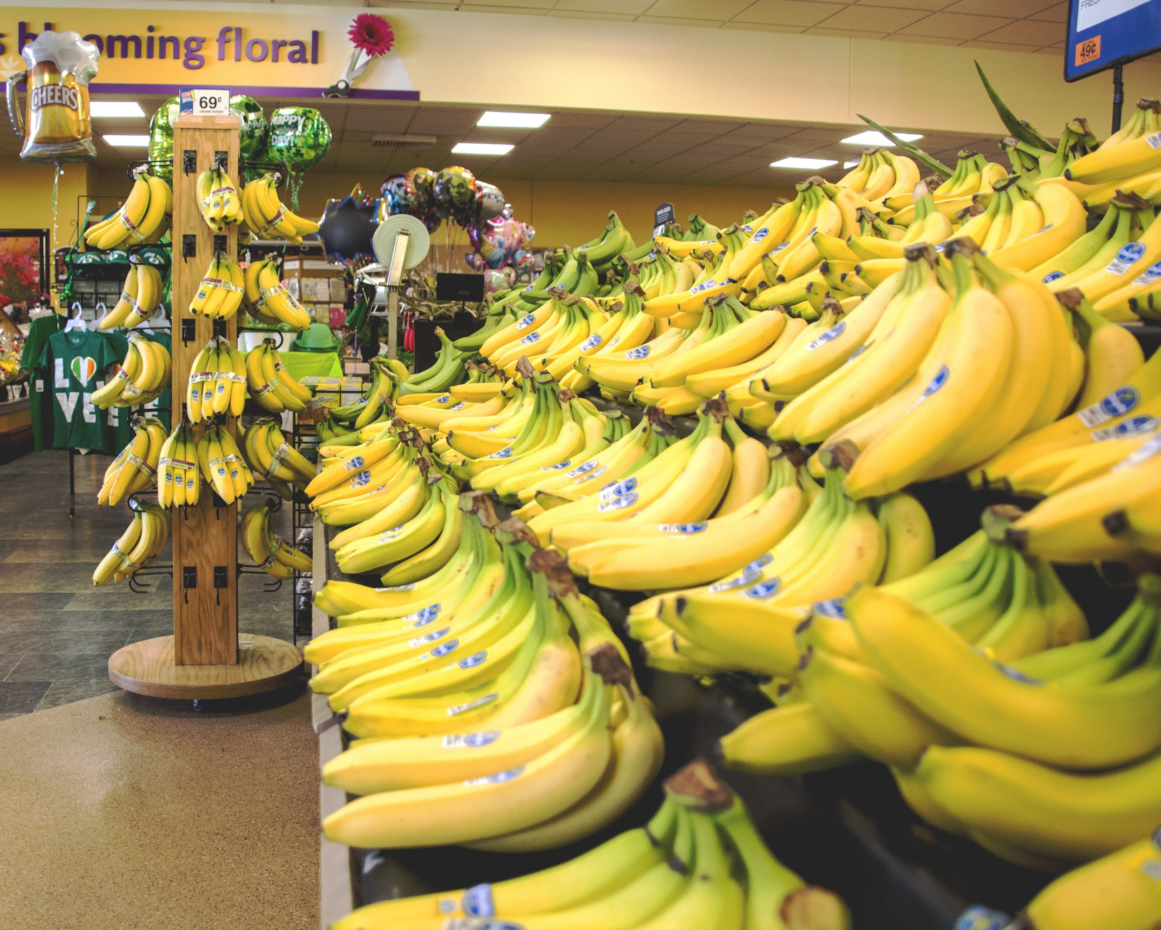
4. Retail and Consumption
the final step before retail is inspection by a governed body to ensure quality and health & safety of the product.
last step of the supply chain is last-leg logistics to retailers. At stores, unpacking, shelving and direct consumer-sales take place.

Slide 17
Injustice/ Demand/ Controversy/
Historically, Chiquita’s monopolies on ports and railroads allowed it to maintain a stranglehold over the Latin American economy, which allowed it to do as it pleased with little to no consequences
Chiquita was the first major banana exporter to be involved in certification.
In 1992 Chiquita, with the help of the Rainforest Alliance started the Better Banana Project (BBP).
As early as 2001 Chiquita was able to get all its farms in Latin American certified under these standards as a way of restoring its reputation
Many other companies and NGOs saw the BBP as just a Chiquita program, even though this certification was open to other corporations. Chiquita has made a startling turn around in its image.
Using certification programs and working with NGOs Chiquita has been trying to transform its image into one of a responsible company. ​

Slide 18
Chiquita and the WTO vs. the EU
the US and several Central American Countries began challenging tariffs, called “banana regimes”
EU imposed on banana imports that were not from the Caribbean, Africa, or the Pacific, all former colonial areas of Europe.
these tariffs did not hurt the US’s economy, but Chiquita claimed it reduced its share of the European market by over 50%.
CEO of Chiquita and other executives were some of the largest campaign contributors to both the Republican and Democratic Parties in the 1993-1994 election cycle. This is often cited as the reason why the US would become involved in a lengthy trade dispute for a company whose majority workforce and facilities were outside the US.
After years of debate, the World Trade Organization ruled against the EU’s tariffs, and forced the EU to reduce taxes on banana imports from Central America.
While Chiquita “claimed victory, stating that for every ten-euro reduction in tariff, the brand will save about twelve million dollars a year”, the Caribbean's banana industry was effectively destroyed as it could not compete with Central American banana plantations without the higher tariffs

Slide 19
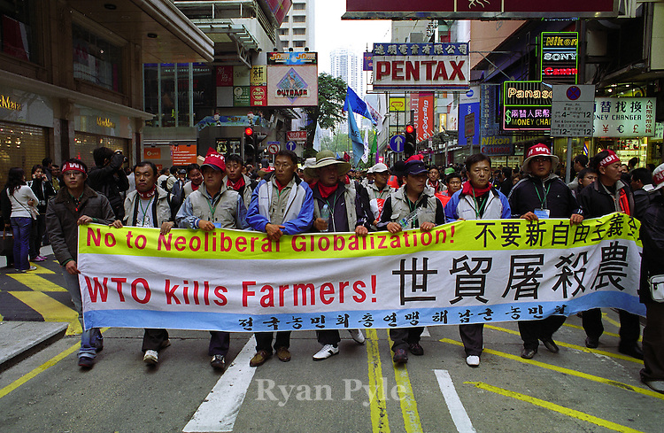
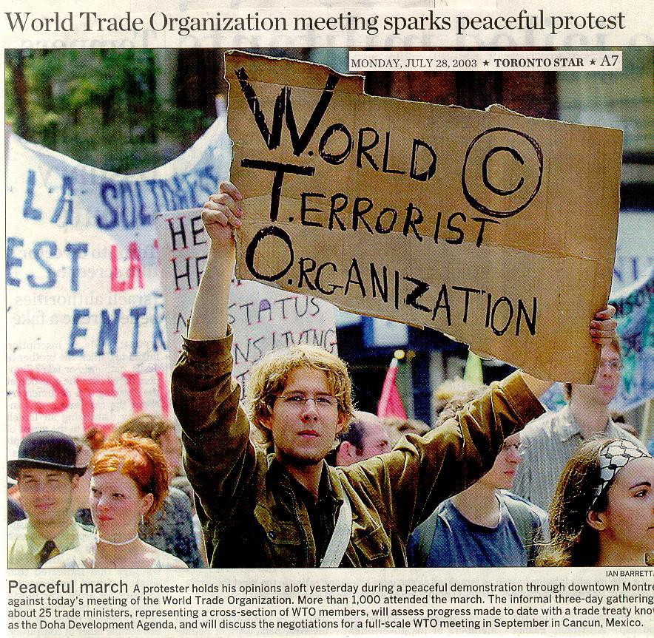
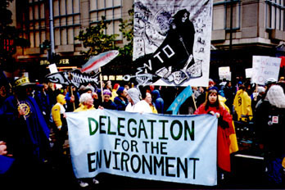

Slide 20
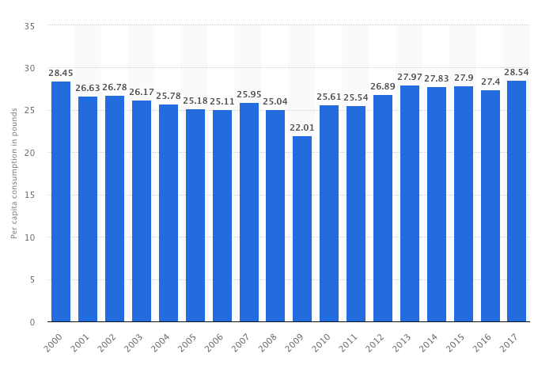
Consumption
Bananas top the list of most popular fresh fruits
According to the report, the U.S. per capita consumption of fresh bananas amounted to approximately 28.54 pounds in 2017.
Per capita consumption of fresh bananas in the United States from 2000 to 2017 (in pounds)*

Slide 21
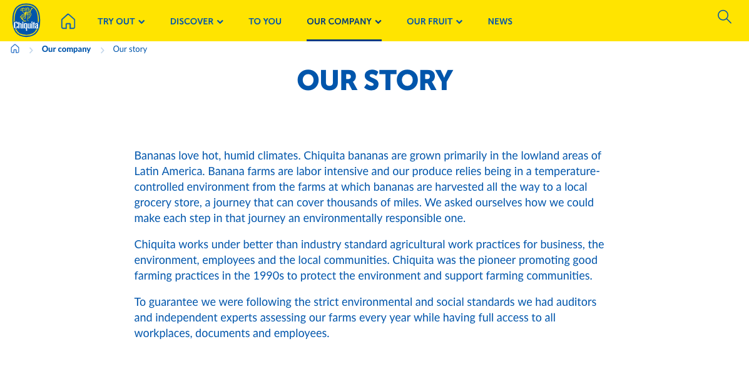
How does the company present itself?

Slide 22
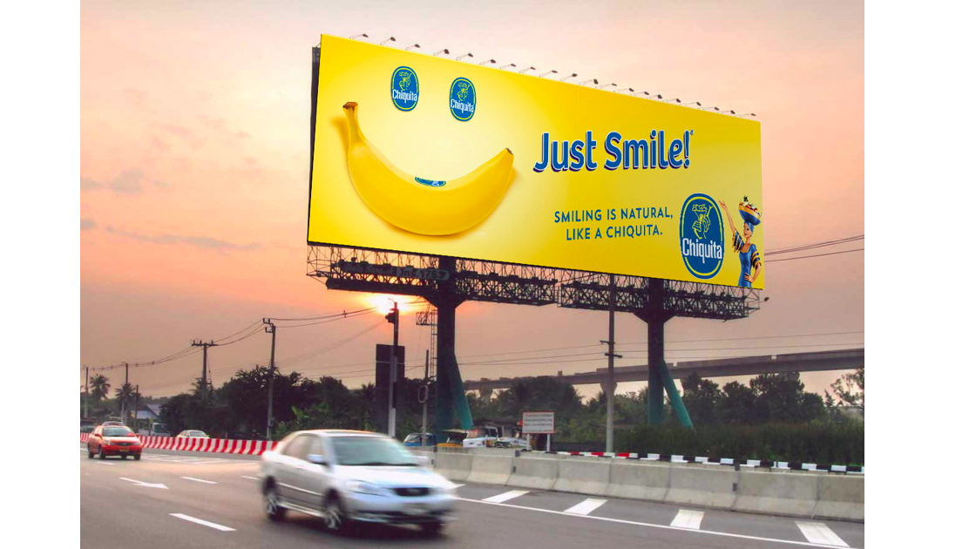
Attempts at redemption:
In recent years Chiquita has tried to fixed its bad public image and improved its ethical performance through the development of a comprehensive Corporate Social Responsibility policy
Chiquita has also used its Better Banana Project as a sales argument to European retailers.
In 2016 they rebranded their banana as “playful by nature” and launched their “Just Smile Campaign”

Slide 23
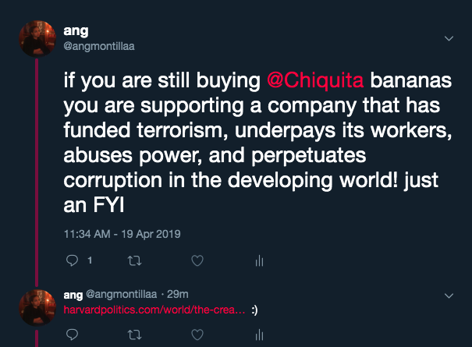
What can we do?
Talk about it, tweet about it, post about it.
Speak to dining services
Protest!
Start a petition at Ramapo
Buy ethically sourced bananas
Whole Trade Guarantee.
Whole Foods has built relationships with some of the world's best and most socially and environmentally innovative banana growers.
They are now stickered with the Whole Trade seal and are available in stores nationwide every day.
“Considering the social and environmental problems that have resulted from large scale banana production in many Latin American countries, we are proud to offer this excellent fruit from growers that are truly part of the solution”

