Slide 1
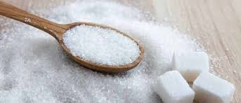
Sugar
Nicole Ceballos
International Studies
Neriko Doerr
February 7, 2019

Slide 2
Fun Facts about Sugar!
Sugar was once considered a spice, not a sweetener.
It was used as a medicine for centuries.
Sugar cane was first domesticated in New Guinea around 8000 BCE.
Can be used as a food preservative.
Average American consumes 76.7 pounds of sugar a year.

Slide 3
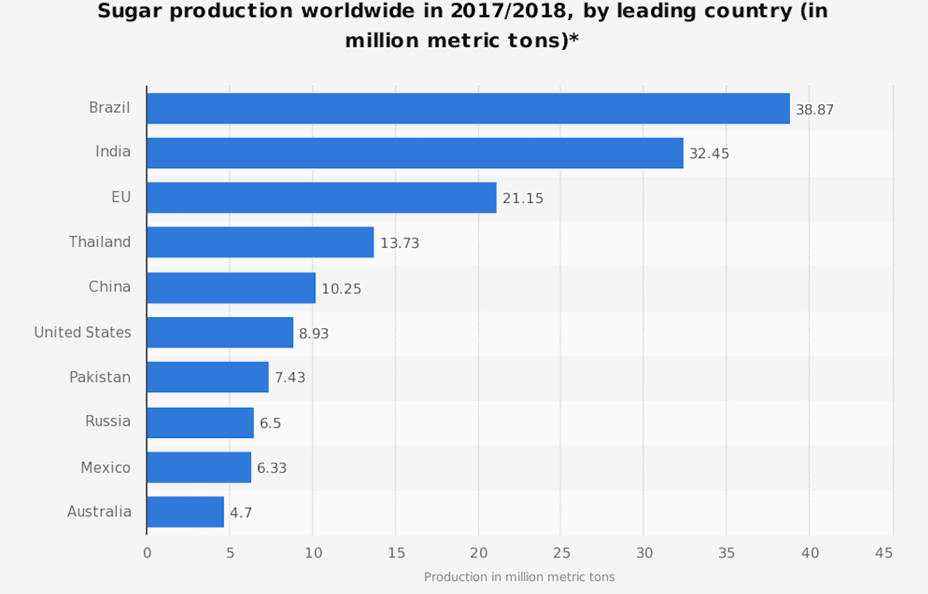
Sugar Production around the Globe!
Listed below are a list of countries that produce the most sugar!
Brazil- 38.87 million metric tons of sugar
India- 32.45 million metric tons of sugar
EU- 21.15 million metric tons of sugar

Slide 4
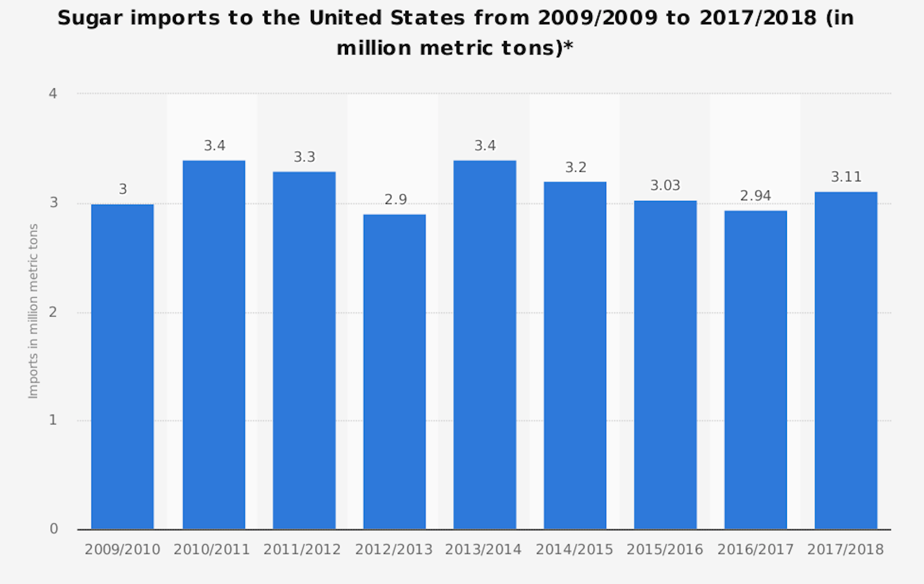
Imports to the U.S
Import to the U.S-
2017-2018- 3.11 million metric tons
2016-2017- 2.94 million metric tons
2015- 2016- 3.03 million metric tons

Slide 5
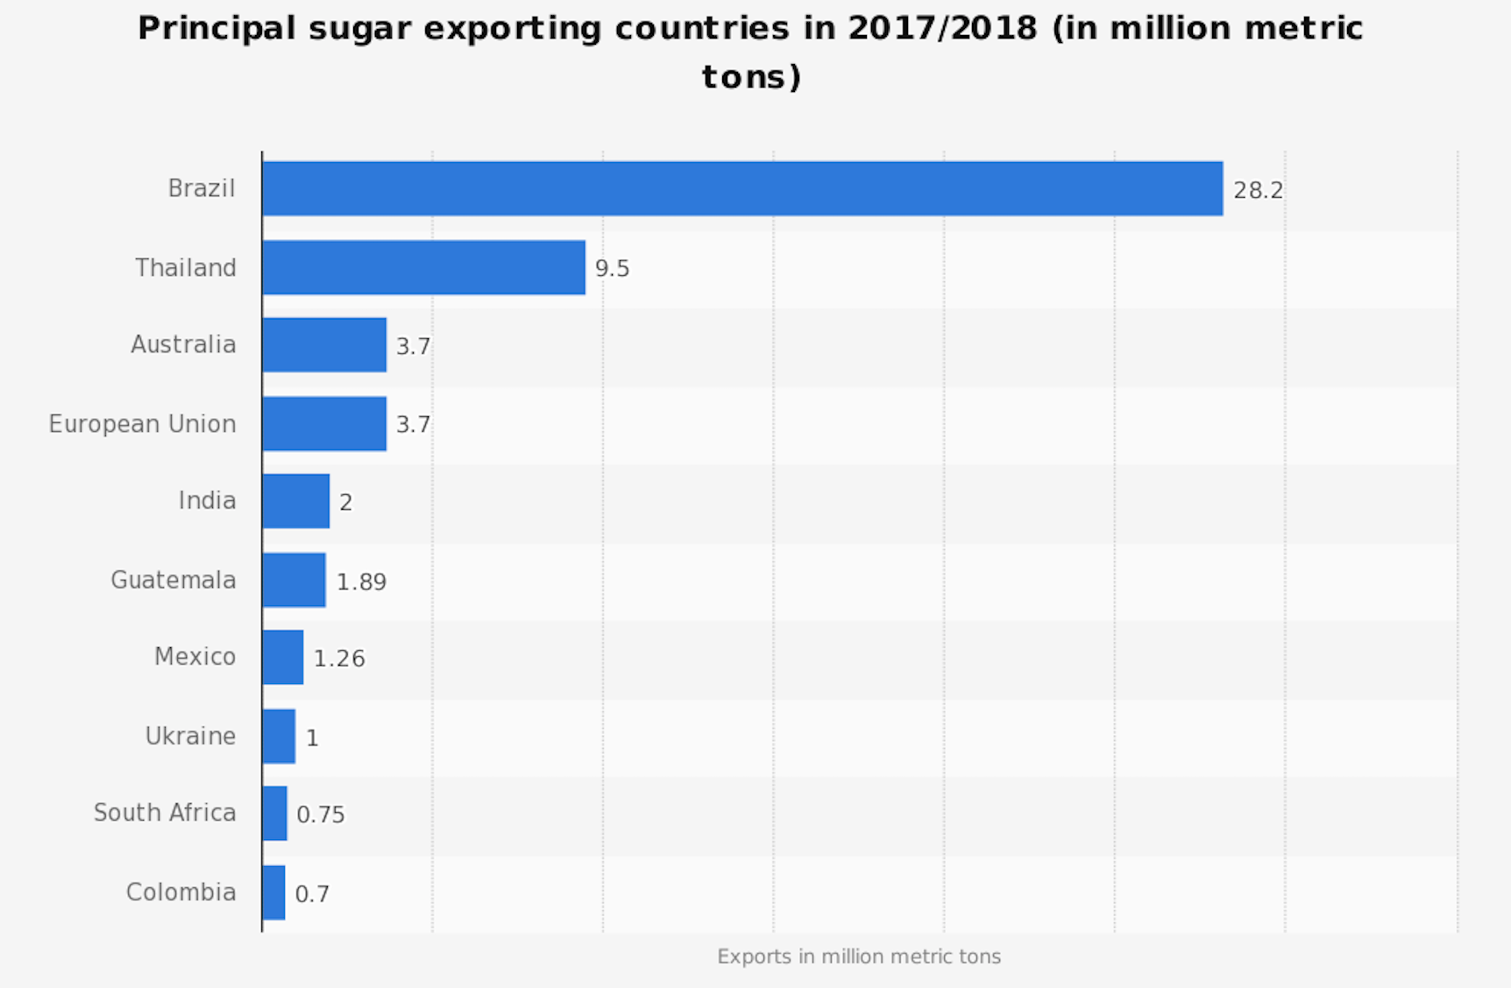
Exporting
Exporting countries- (2017/2018)
Brazil: 28.2
Thailand: 9.5
Australia: 3.7

Slide 6
Major Sugar Corporations outside the U.S
France
Brazil
Britain
Thailand

Slide 7
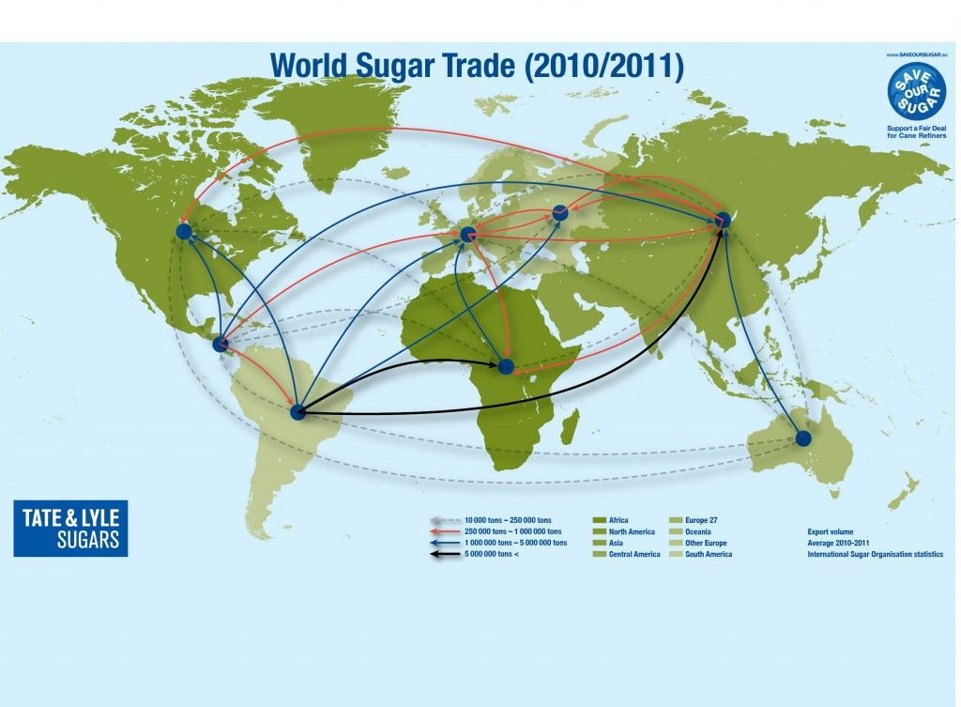
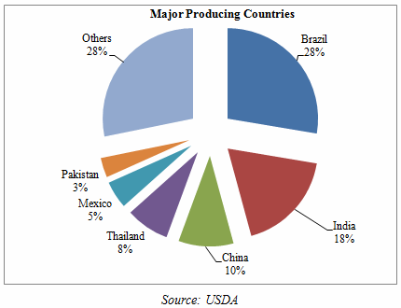
Map Flows and Frictions

Slide 8
Sugar Corporations in the U.S
U.S Sugar Corporation-
Privately owned agricultural business
Founded in 1931
Located in Clewiston, Florida.
Largest producer of sugarcane in the United States. (Produces over 700,000 tonnes per year.
Company farms over 230,000 Acres of land in the counties of Hendry, Glades and Palm Beach
U.S Sugar Mill located in Clewiston, FL
Approximately 2,500 employees

Slide 9
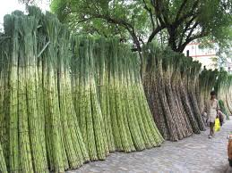
Production Processes
( Sugar Cane)
Harvest the Sugar cane
Crush, soak and squeeze the sugar cane
Boil the juice until the syrup thickens and crystallizes
Spine the crystals
Transport the raw sugar
Melt the raw sugar
Crystallize the sugar
Dry the sugar crystals
Package the sugar

Slide 10
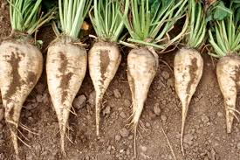
Production Process of Sugar ( Sugar Beets)
Harvest the sugar beets
Wash, slice and soak the beets
Produce sugar syrup
Crystallize the sugar
Spin the crystals
Dry the sugar crystals
Package the sugar

Slide 11
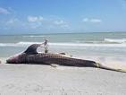
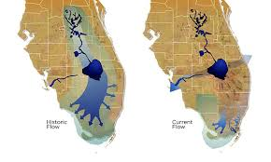
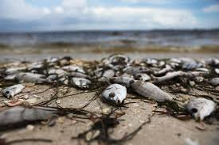
Florida’s Everglades (Environmental Impact)
Over the recent years, one of America’s largest sugar producing companies known as U.S Sugar has sparked controversy in the Florida region. They are known for being the cause of the infectious algae that has taken over the coast of Florida. During their production process they use a chemical harmful to the environment called Phosphorus- laden.
Between the years 1994- 2016, the sugar company has paid over 57.8 million dollars in “contributions” to state and local political campaigns.

Slide 12
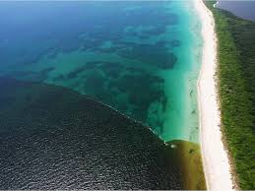
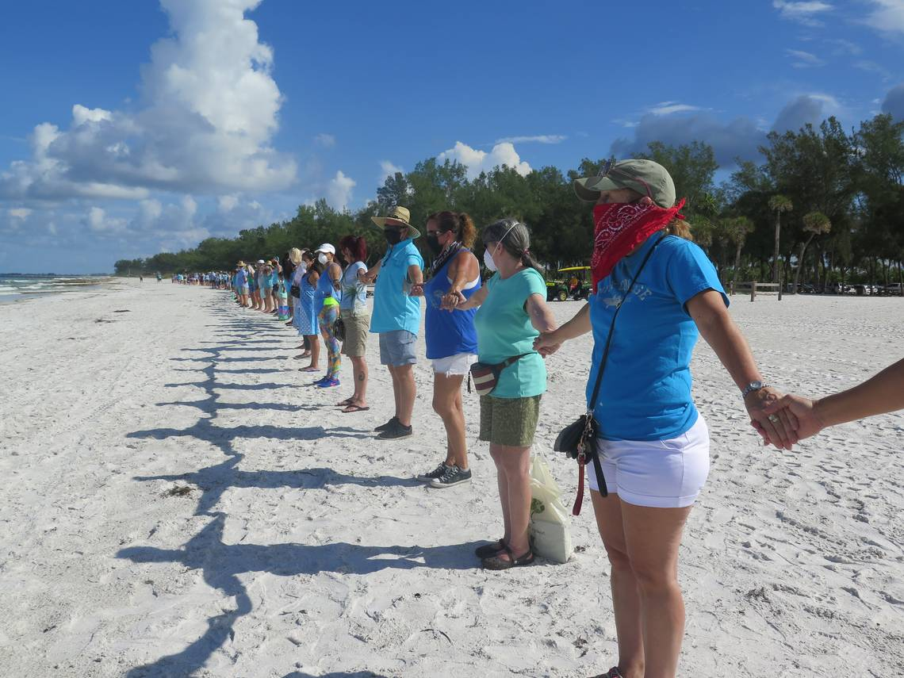
Social Movements, Protests and Campaigns
On July 4, 2016, several fisherman, environmentalist and Florida's residents gathered on the beaches along the coast of Florida joined in hands protesting the pollution caused by the U.S Sugar Company.

Slide 13
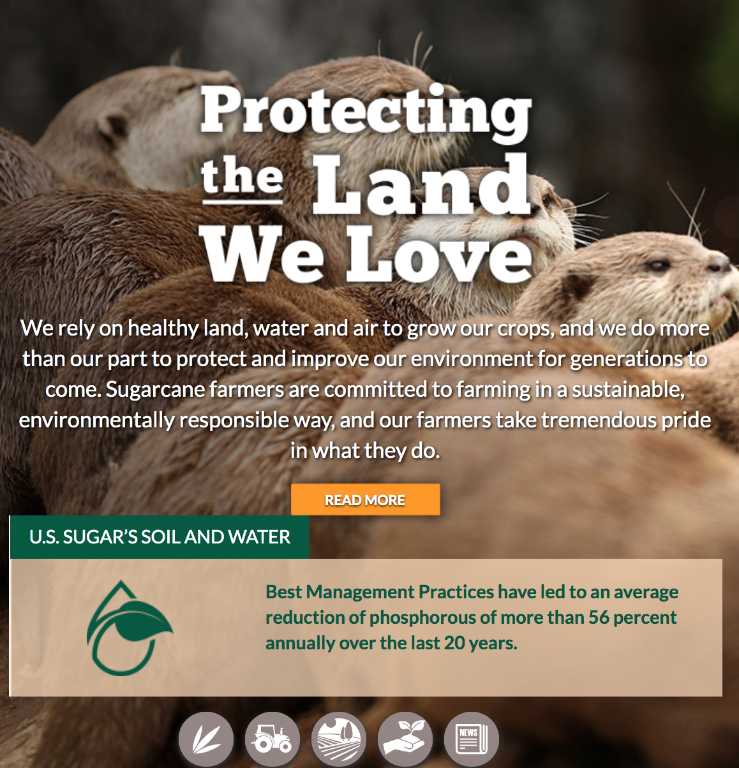
What U.S Sugar wants consumers to see

Slide 14
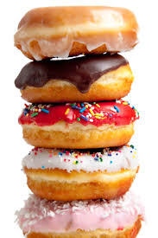
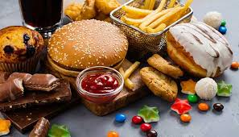
Use of Sugar
Sugar is seen in a lot of products and is used in our everyday meals.

Slide 15
Commodity Fetishism
In the 1960’s study a sugar industry had funded for research linking sugar to high blood cholesterol and cancer in rats. The Sugar association ended without publication. Consumers were not aware of this since recently it had come out in the news. The study worked upon proves evidence of the harmful health impact of eating too much sugar.

Slide 16
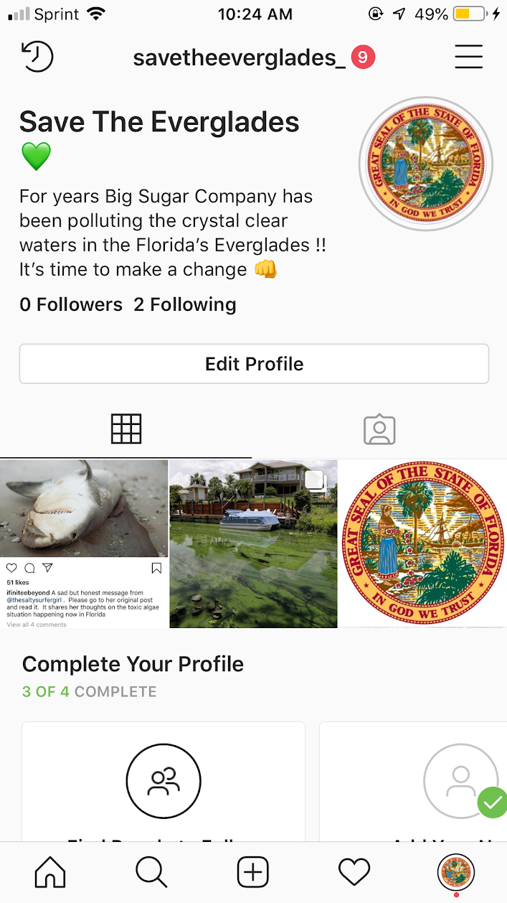
Strategy/ Campaign
One way to stop the pollution in the Everglades is if Florida can find new ways on how to get rid of the waste from the sugar production.
In order to achieve this method, gaining the media’s attention will shine light on the environmental destruction in Florida.
Follow the instagram account @savetheeverglades_ !!!!!

