Slide 1
Strawberries
Masayo Mandeles

Slide 2
Where strawberries are produced
Strawberries are produced in the United States, Mexico, Germany, Poland, Spain, Egypt, Turkey, Russia, South Korea, and Japan
California is the biggest strawberry-producing state in the United States; it accounts for nine-tenths of all the strawberries grown in this country
The second largest strawberry producer in the United States is the state of Florida

Slide 3
How many strawberries are produced in the United States each year?
In 2014, three billion pounds of strawberries were produced in the United States
In an average year, fresh-market strawberries account for 81 percent of total production
The other 19 percent involves processed strawberries

Slide 4
Who are the main producers of strawberries in the United States?
Driscoll’s (California)
Red Blossom (California)

Slide 5
How are strawberries farm-grown?
Strawberry plants are set into relatively flat ground, mulched with straw, and irrigated by sprayers
For mass production, ever-bearing and June-bearing plants are common
Ever-bearing plants produce strawberries gradually throughout the growing season
June-bearing plants, the preferred type for industrial production, produce one large crop for harvest

Slide 6
How are strawberries processed?
Once the strawberries are picked, they are stored in “first in/first out coolers” which make sure the berries are quickly sorted and processed
Stems are removed and the strawberries are washed in water
Next, the strawberries go to a vibratory sorter, where they are separated by size
Then, the strawberries are checked by hand and defective is fruit removed

Slide 7
How are strawberries processed
Strawberries that are going to be frozen are put into large buckets, and then loaded onto pallets before being flash-frozen
Other strawberries, to be used in jams, syrups, and juices, are put aside to be distributed to food industries

Slide 8
Map flow of strawberries

Slide 9
Controversies surrounding strawberries
Driscoll’s, a California-based strawberry grower, has been accused of paying its workers very low wages with terrible working conditions
Workers for Driscoll’s have complained about verbal abuse during work hours

Slide 10
Other controversies surrounding strawberries
Familias Unidas por La Justicia (FUJ) is an independent farmworker union of indigenious families based in Burlington Washington
FUJ represents the Spanish speaking workers at Sakuma Bros. Berry farm

Slide 11
Other controversies surrounding strawberries
Driscoll’s has been vague about environmental conditions at its farms
The company has not responded to the FUJ-sponsored boycott
The state of California is planning to impose limitations on the use of pesticides on strawberry farms
Pesticides can cause headaches, and stomach aches

Slide 12
Driscoll’s and fair trade
In an effort to improve working conditions, Driscoll’s started a Fair Trade Program, in Baja Mexico working with independent growers to establish global labor standards, improve ranches, and perform audits
Driscoll’s began selling Fair Trade certified organic strawberries in 2016
The Fair Trade certification indicates that Driscoll’s is following global labor standards
Driscoll’s also partners with a non-profit organization called Fair Trade USA

Slide 13
Driscoll’s and fair trade
The Fair Trade Program supports the grower’s business and, at the same time, empowers workers to address the needs of their community
The program provides an opportunity for both the company to have a direct impact on the local community and the people who live in the area, and shoppers to have a positive impact on the lives of the farmers

Slide 14
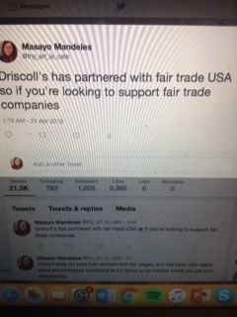
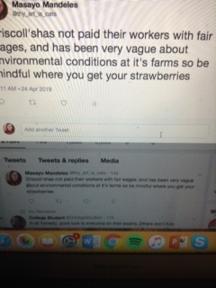
How to solve the problem
Tweet about the Driscoll’s controversy
Write a letter to local politicians
Buy Driscoll’s strawberries

