Slide 1
Shoes
By Gianna Garrick

Slide 2
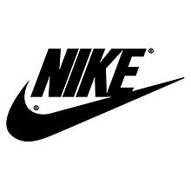

Slide 3
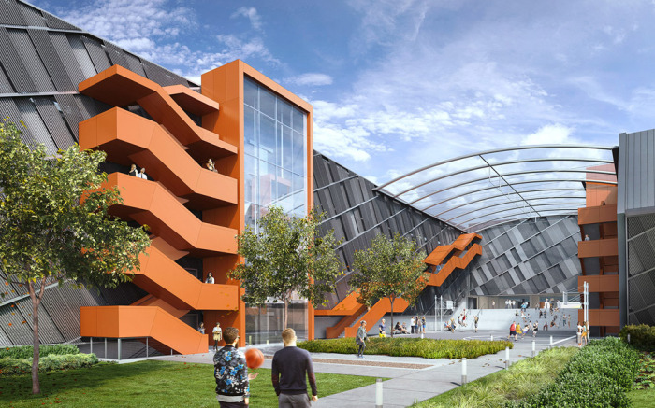
Nike HeadQuarters is located in Beaverton, Oregon.

Slide 4
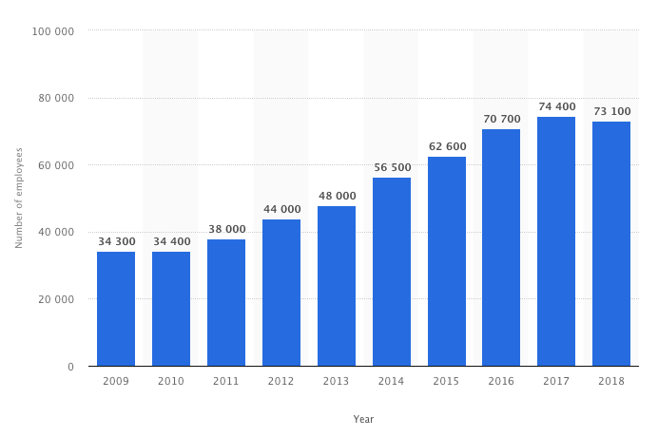

Slide 5
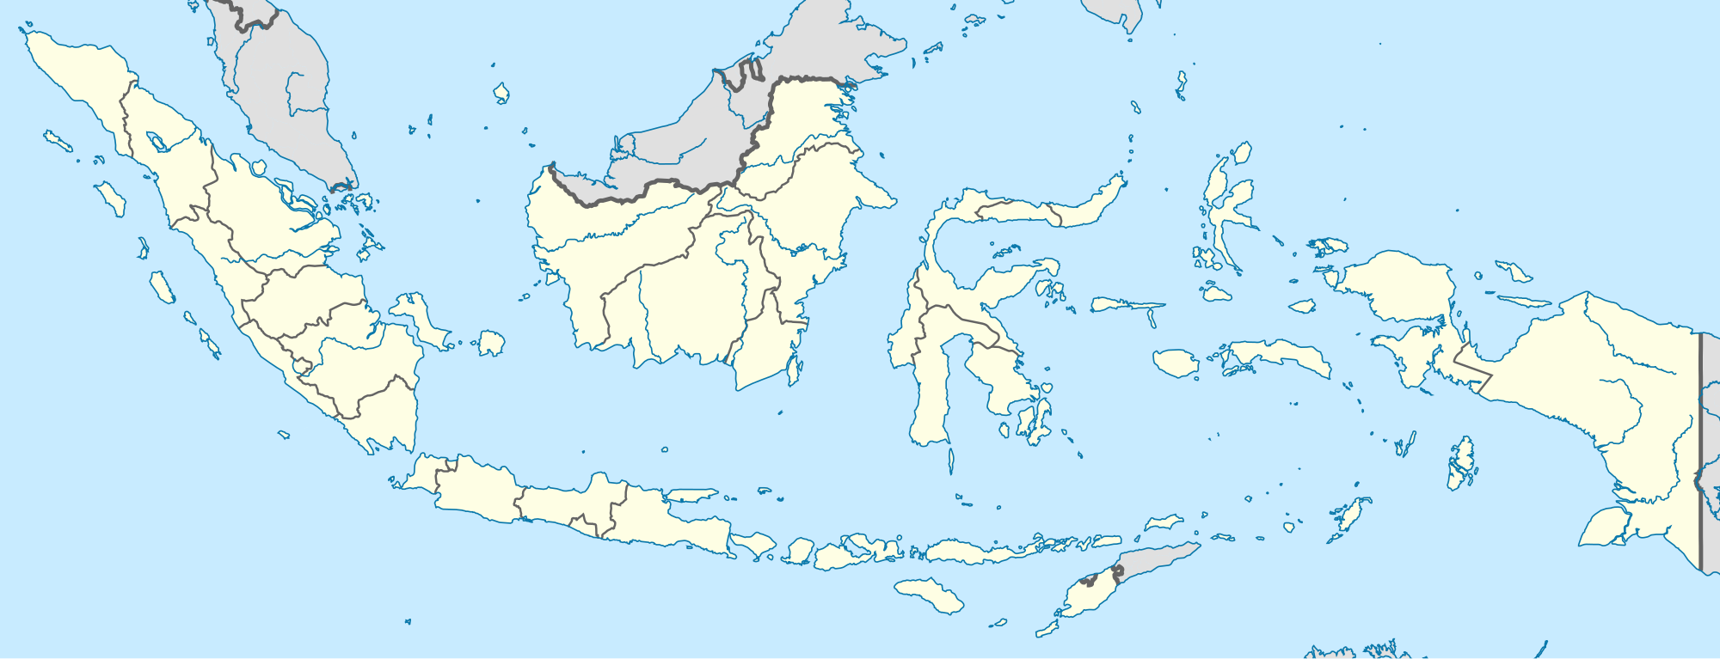
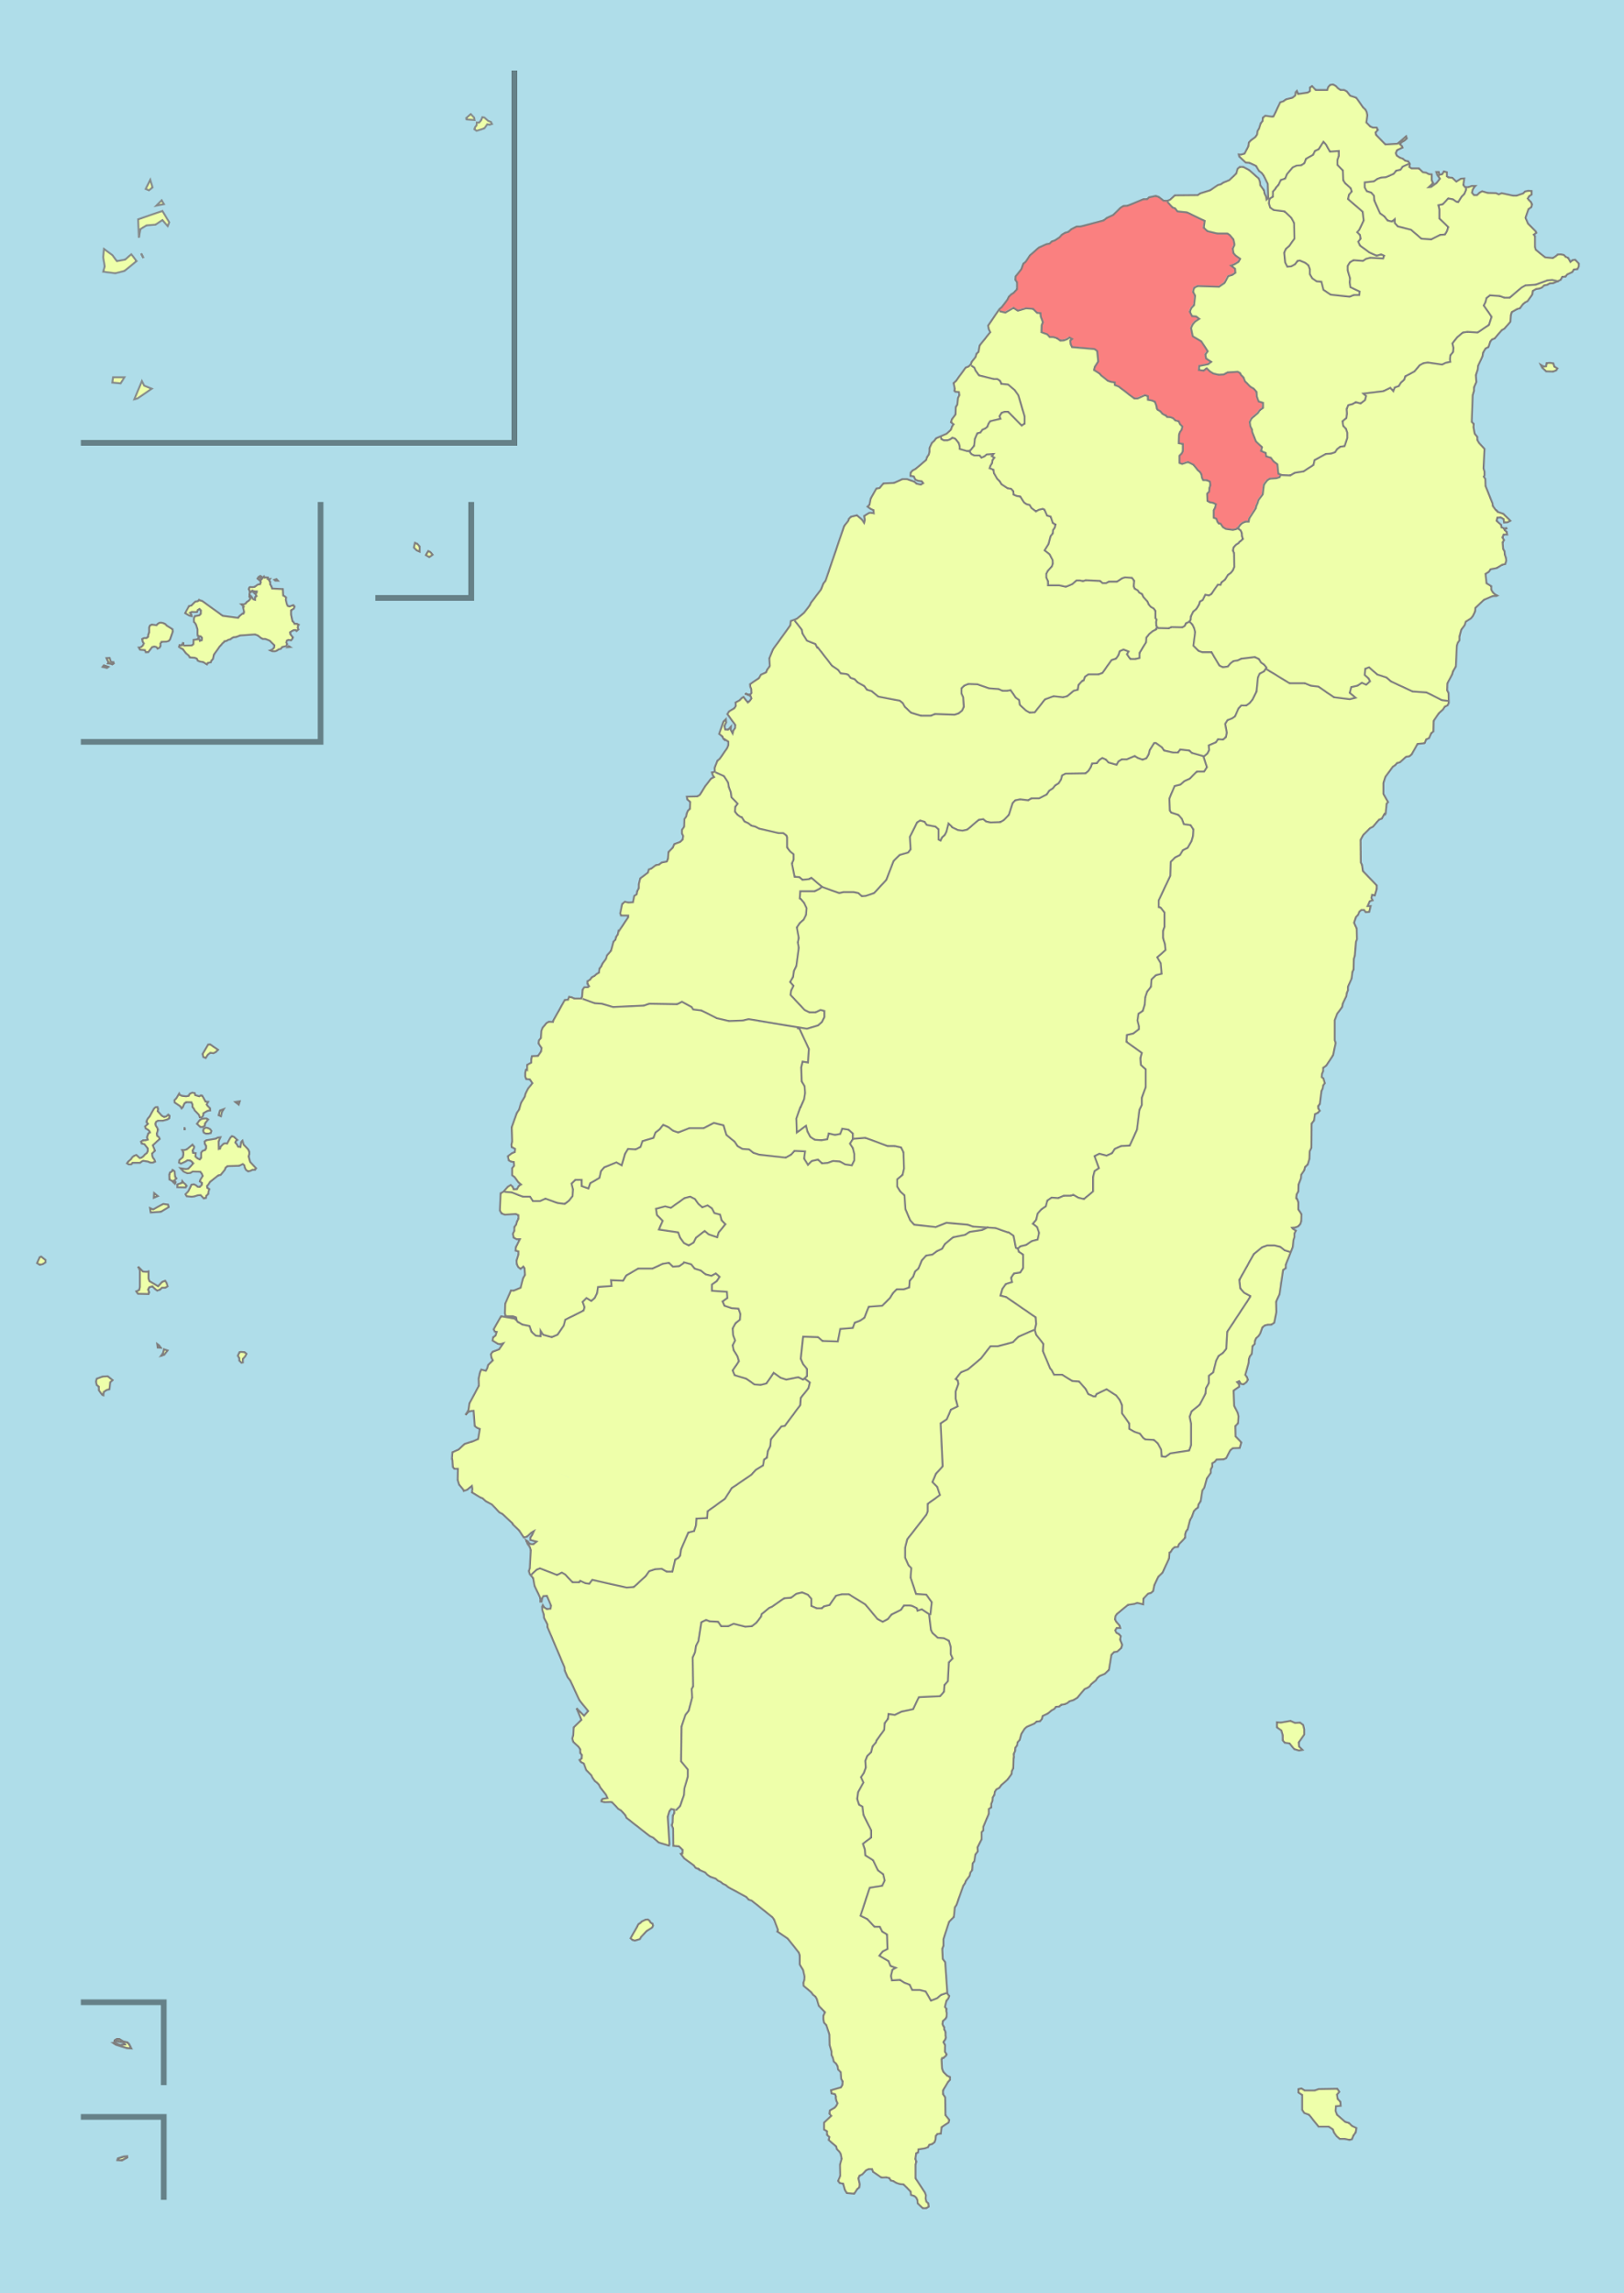
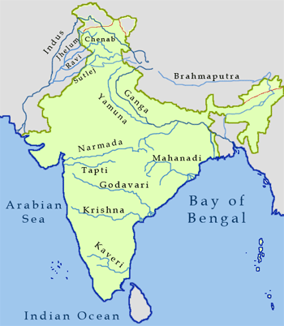
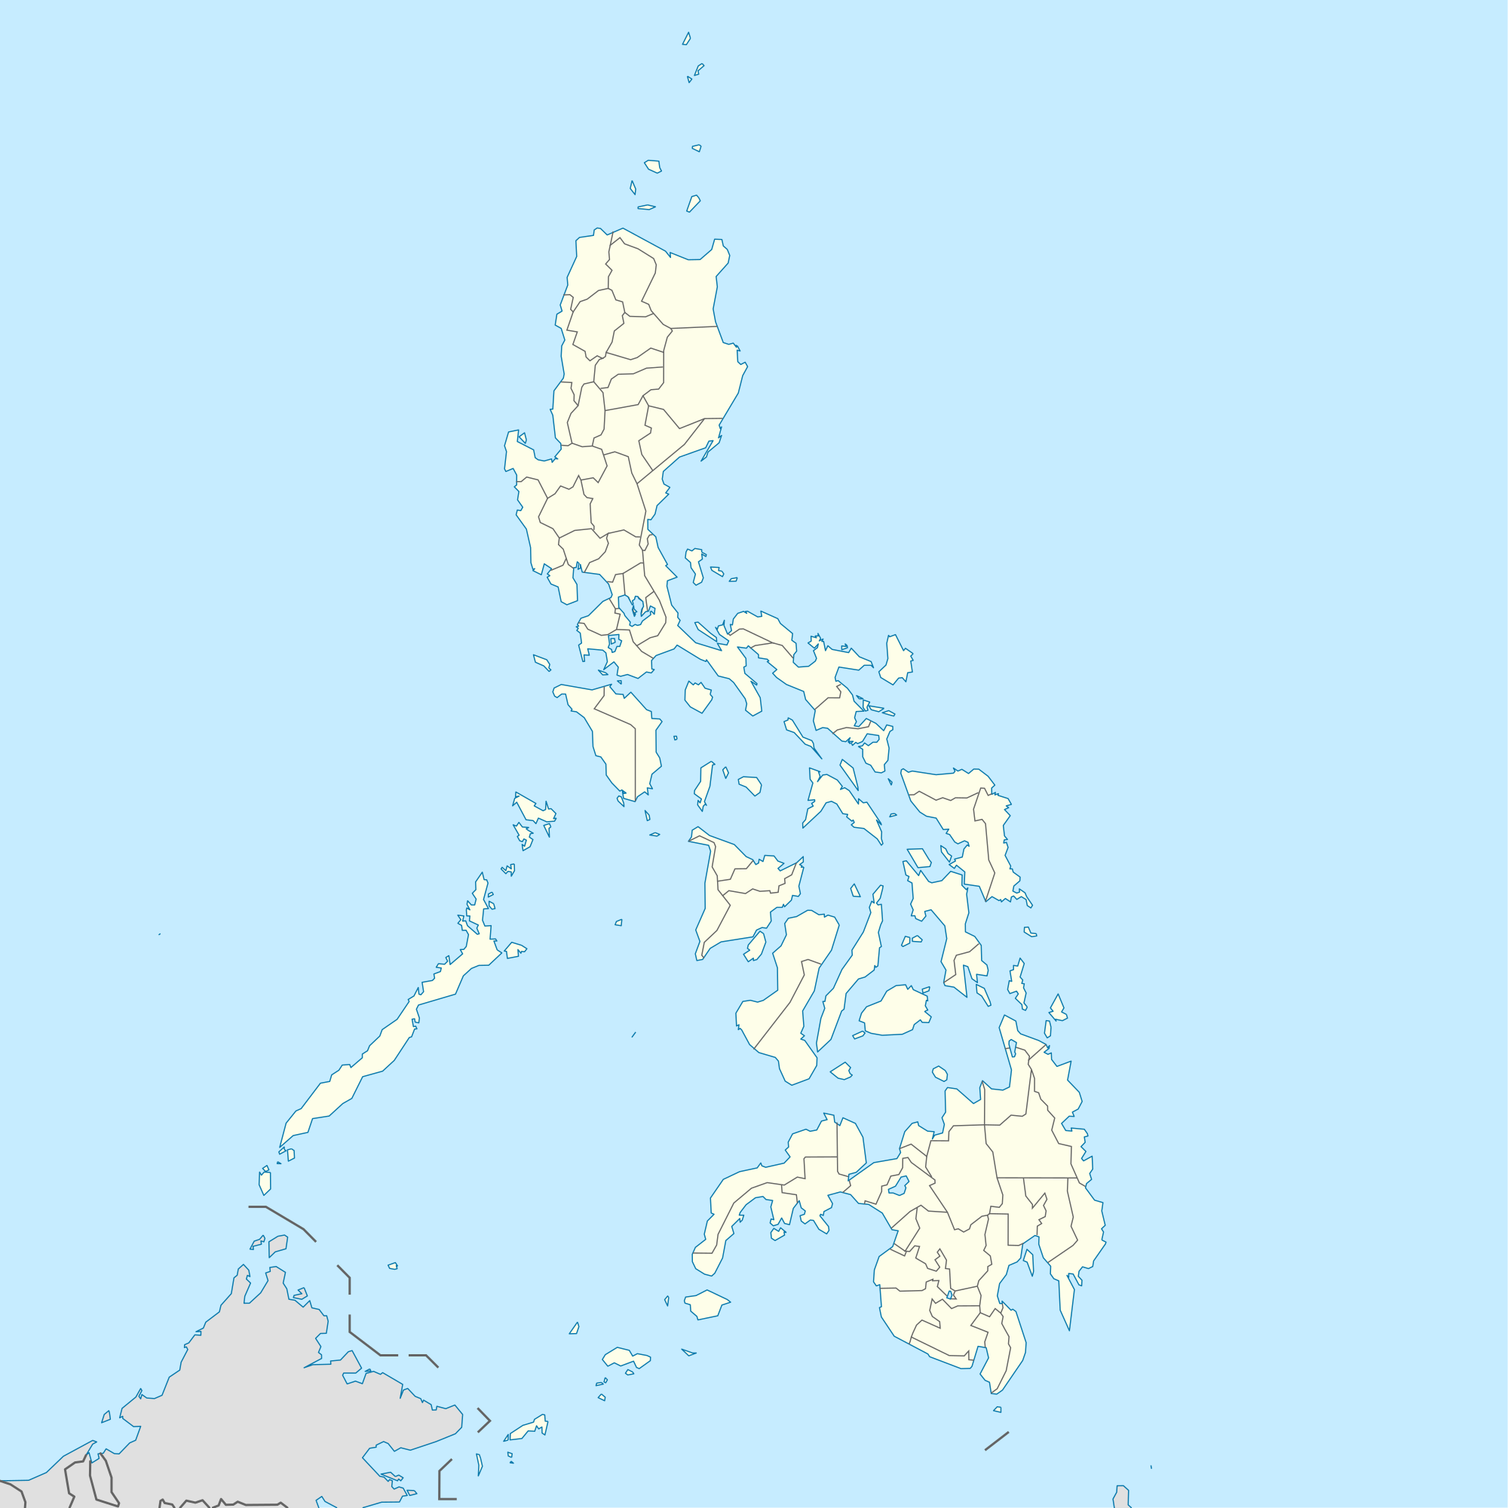
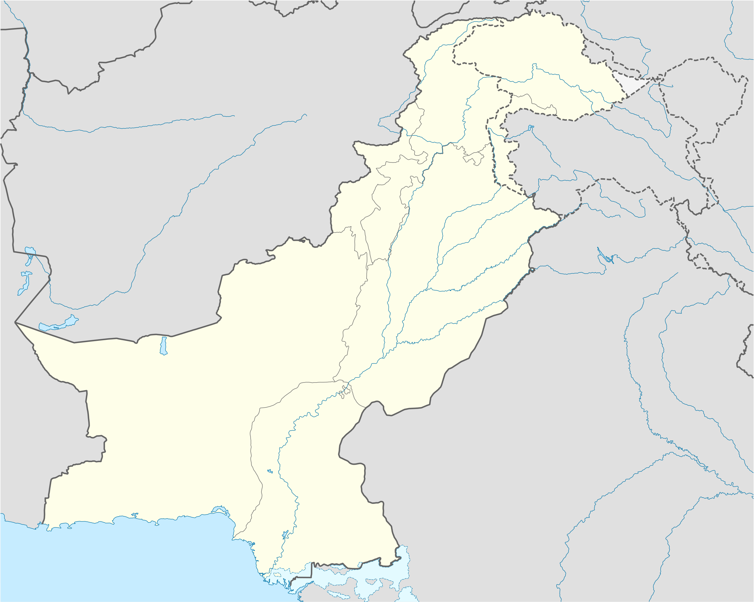
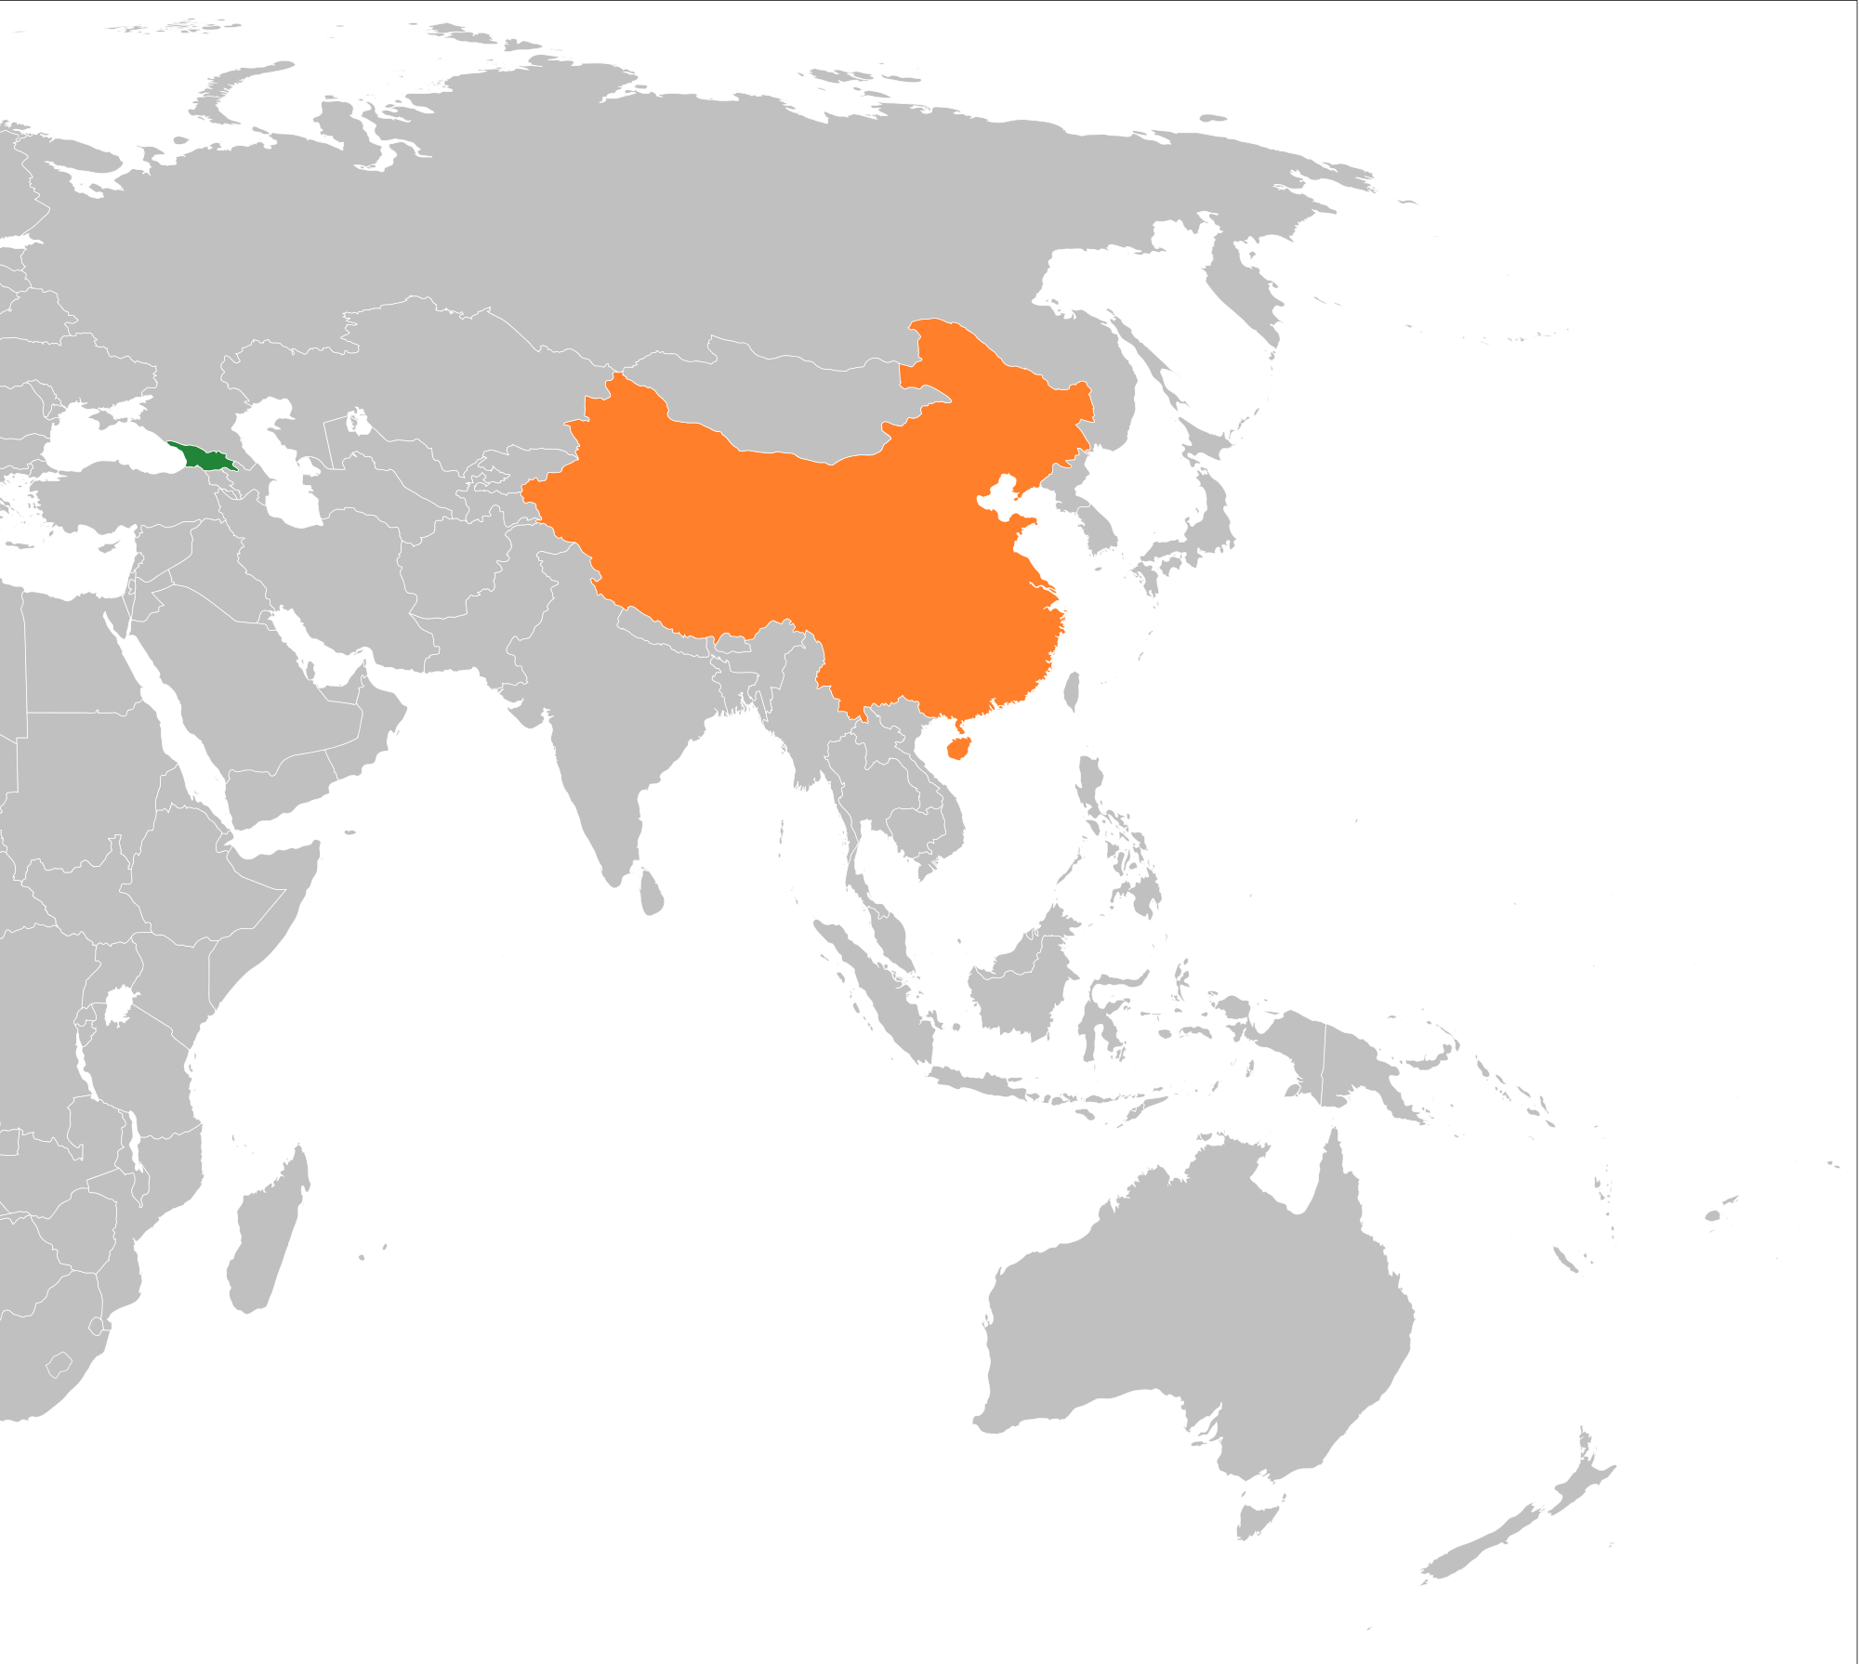
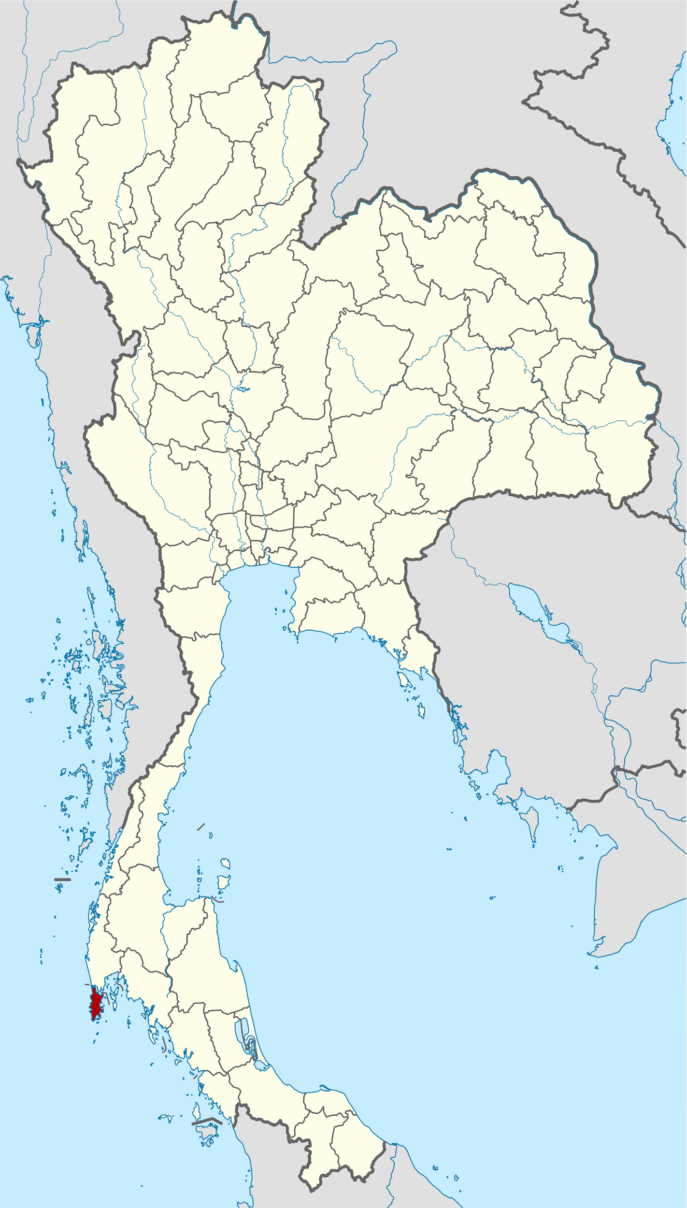
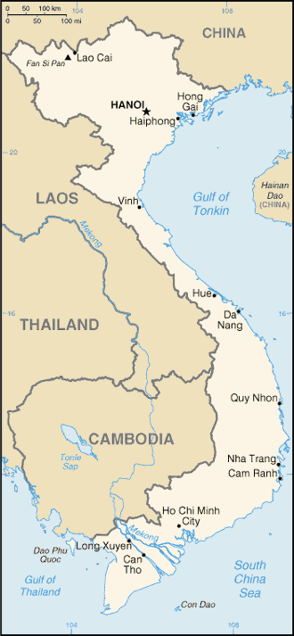
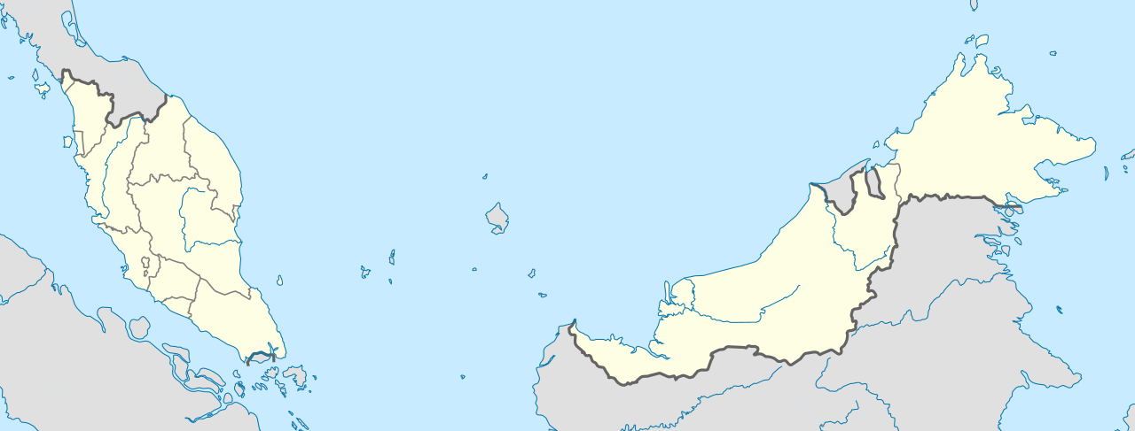

Slide 6
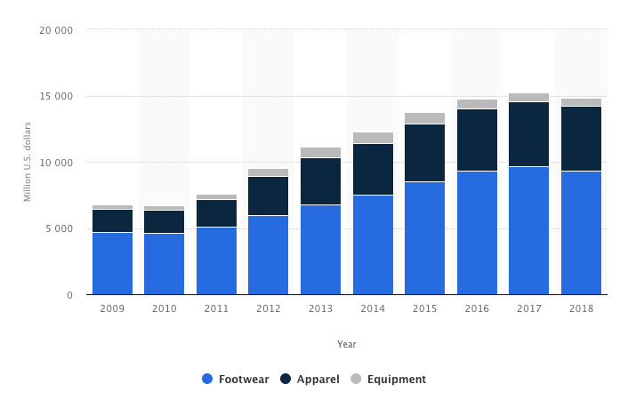

Slide 7
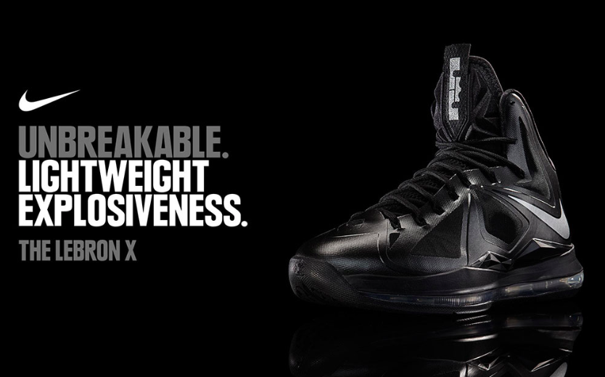

Slide 8
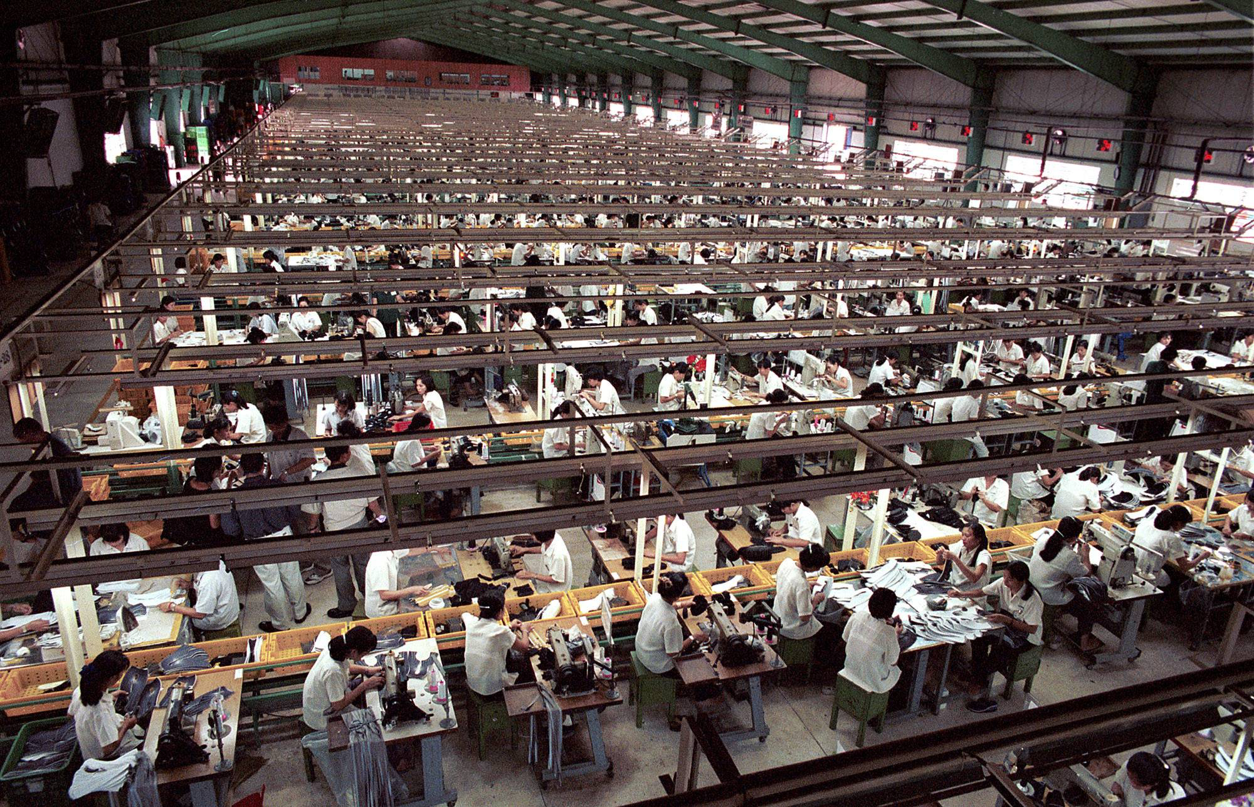

Slide 9
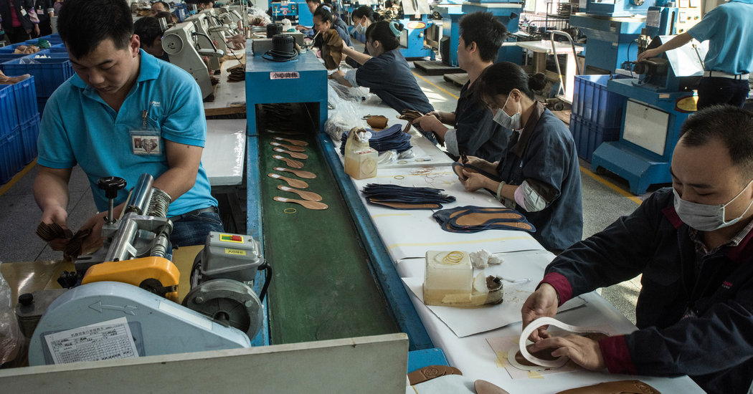
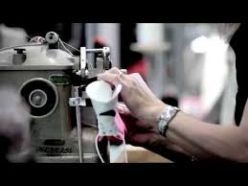
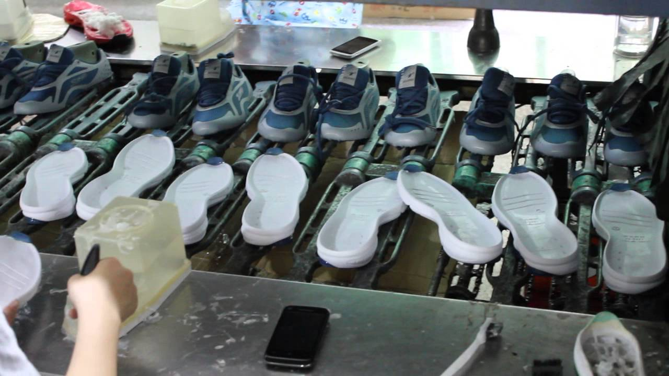
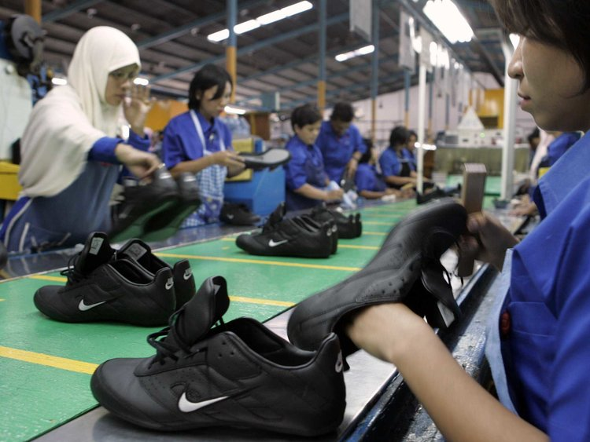
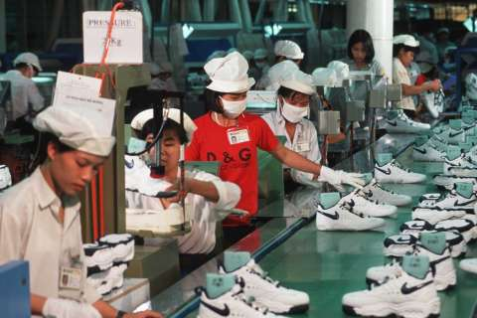
Step 1:
Step 2:
Step 3:
Step 4:
Step 5:

Slide 10
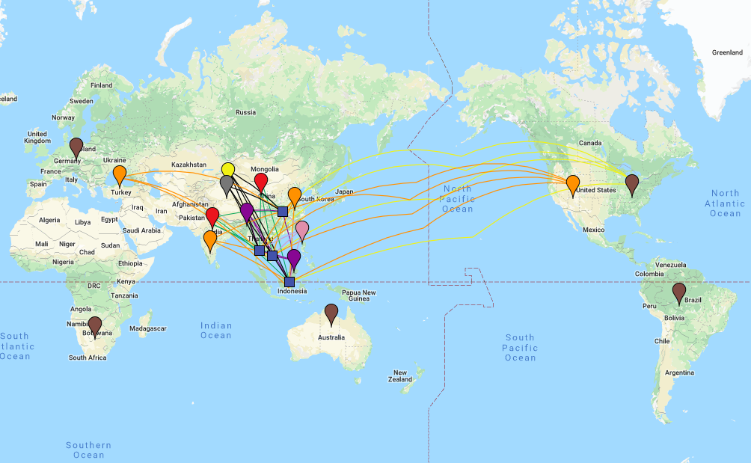
Red: Polyester Producer
Purple: Rubber Producer
Grey: Leather Producer
Orange: Cotton Producer
Blue Squares: NIke Shoe Factories
Brown: Nike Distribution Centers

Slide 11
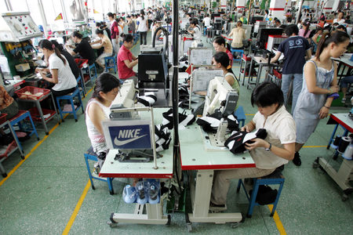
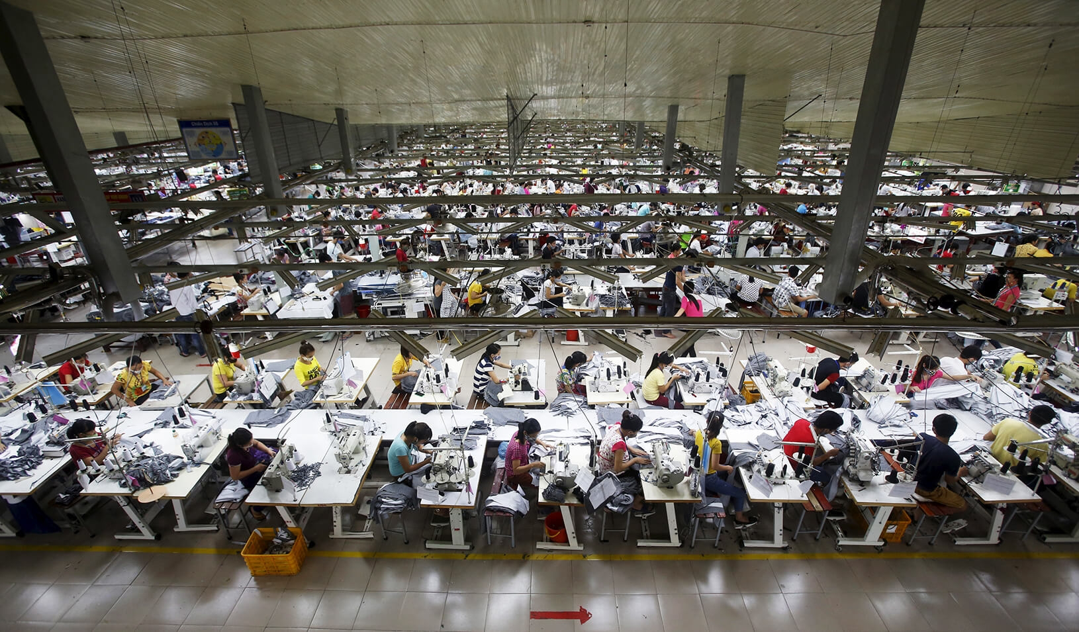
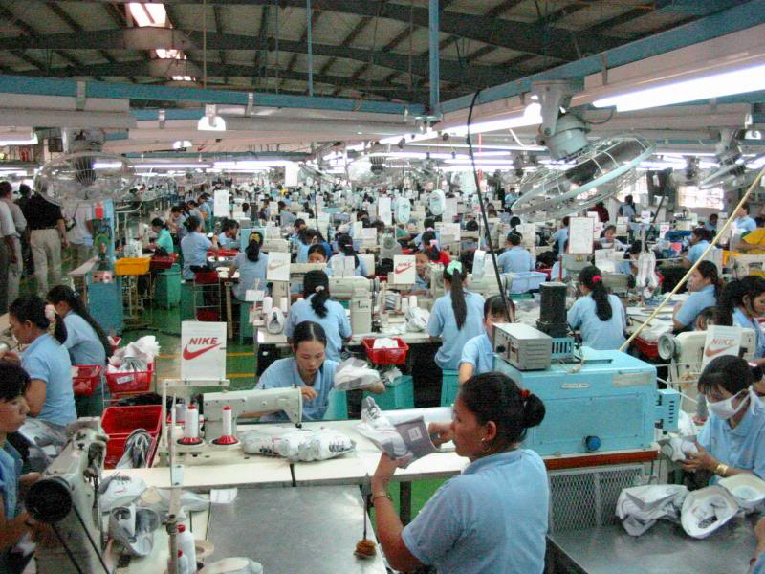

Slide 12
An article published on the Institute for Global Labour and Human Rights (IGLHR) website in April 2015 which slammed Nike for its sourcing in Vietnam.
The article states that, " Nike’s presence in Vietnam led to a continuation of wages as low as 27 cents an hour in 2012, with a slight increase to 48 to 69 cents an hour in January 2015, which is well below subsistence levels... For years, Nike has been exploiting the 330,000 Vietnamese workers, mostly young women, who are poorly paid and denied their most fundamental rights."

Slide 13
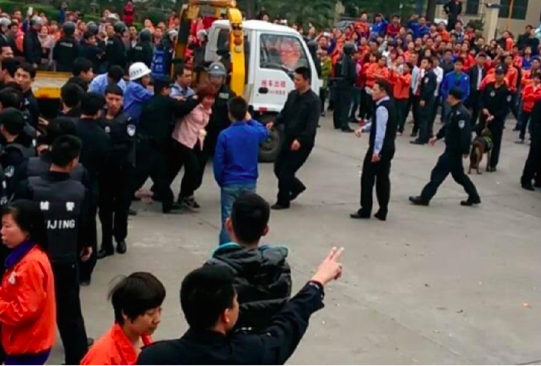
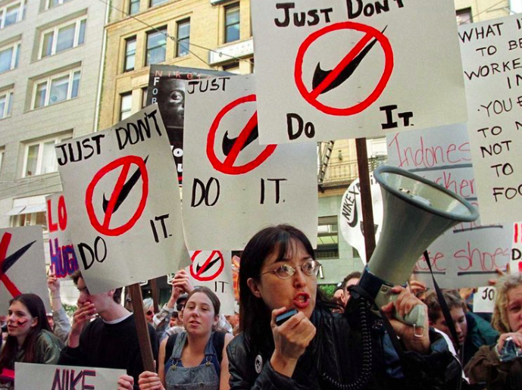
Strikes/Protests

Slide 14
FY07-09 CR Report, a Corporate Responsibility Report,
“out of 618 factories examined globally, there were 25 factories in 2009 which received a D rating for having 72 hour work weeks reported and 125 received a C rating for having between 60-72 hour long work weeks”
This is in direct violation of Nike’s Code of Conduct which states,
“contractor’s employees do not work more than 60 hours per week, or the regular and overtime hours allowed by the laws of the manufacturing country, whichever is less”

Slide 15
USAS (United Students Against Sweatshops)

Slide 16
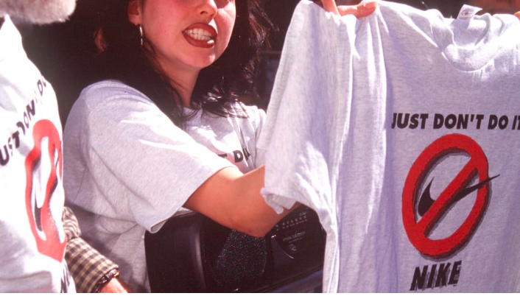
“We heard about how this had devastated the local economy there and how those workers were fighting for production–and their livelihoods–to come back… Hearing about that firsthand had a big impact on me. I’m down to support any campaign that will improve people’s lives and show solidarity with people who are being exploited.” - Simonds-Malamud

Slide 17
@UnitedStudentsAgainstSweatshops
@USAS

Slide 18
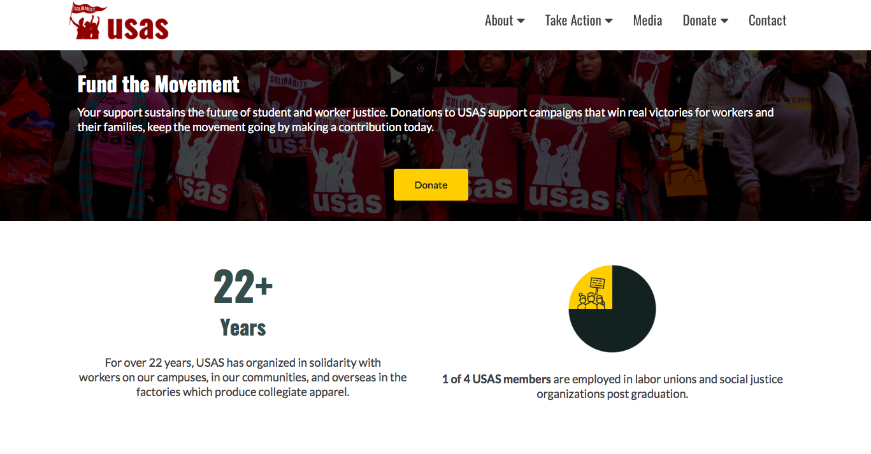
https://usas.org/your-impact-2/

Slide 19
Commodity Fetishism
Overall, finding the production and distribution processes of Nike Shoes was difficult to find. Nike themselves does not provide this information. All of the research of Shoes came from private researchers and outside stories, articles, and databases. A consumer can easily find the controversies that Nike has had in the past, but it is more difficult to find the current controversies that Nike has not really addressed.

