Slide 1
Pearls
Kat Ceberio

Slide 2
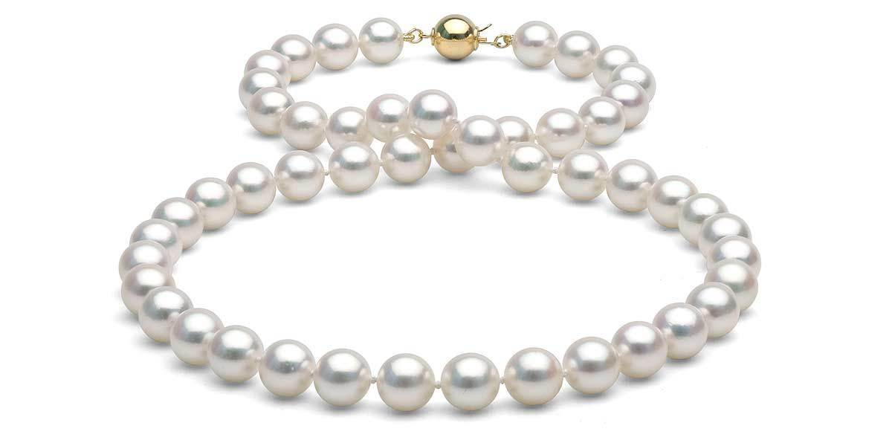
Uses
Jewelry
Decorations

Slide 3
Notable Companies
American Pearl Company
Kojima Pearl Company
Mikimoto Pearl Company

Slide 4
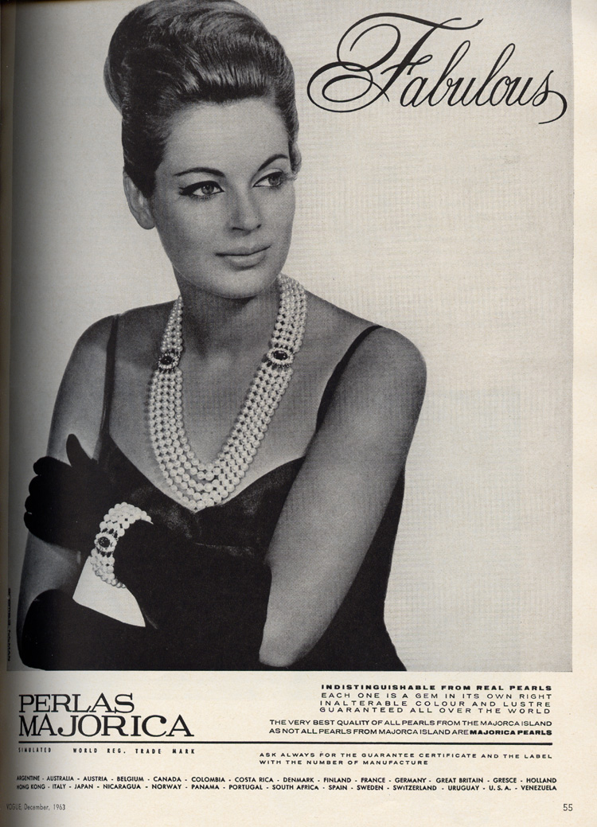
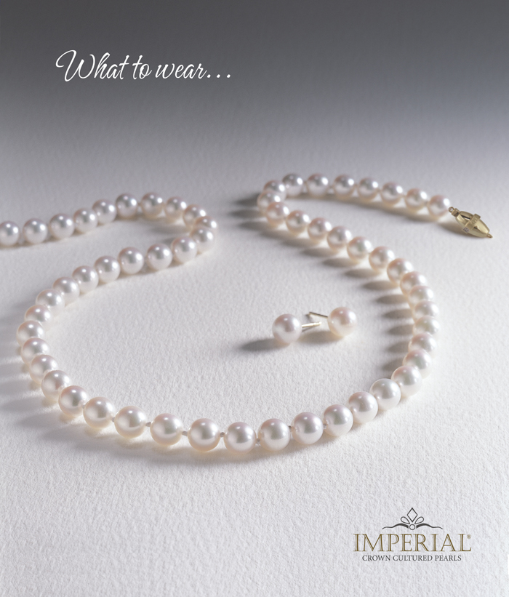
Advertising
Pearls are generally viewed as a symbol of wealth, refinement, and sophistication

Slide 5
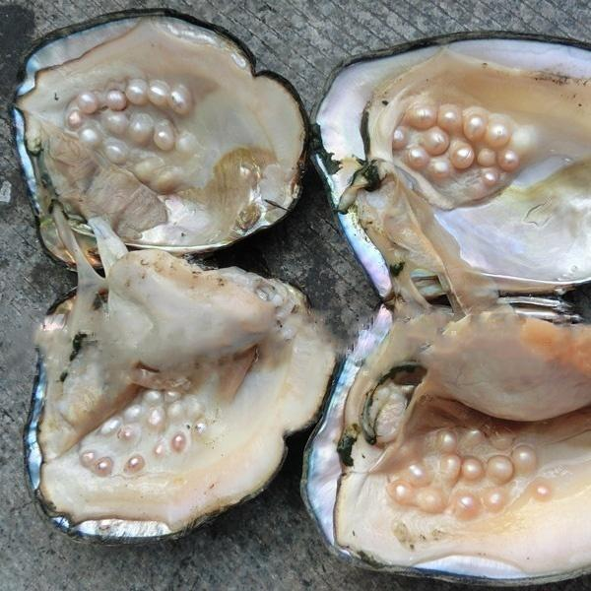
How They’re Made
Produced in mollusks such as oysters & clams
Natural:
Irritants enter animal
Fluid called nacre coats irritant in layers until pearl is formed
Cultured:
Irritant is inserted manually by humans
Often takes several years to fully form
Imitation:
Not real pearls
Mostly glass beads dipped in shiny solution (often made from fish scales)

Slide 6
Controversies/Frictions
Some argue that the creatures feel discomfort in culturing process
Several animal rights groups have concerns about the comfort of the animals
To harvest the pearls, the mollusks must be killed. In pearl farming, mollusks are bred specifically for this purpose
During colonization in Australia, indigenous women were enslaved to harvest pearls; many drowned in the process
Conditions are better today, but harvesting is still fairly dangerous and accidents do happen

Slide 7
Commodity Fetishism
The industry is fairly transparent; no controversies are really hidden

Slide 8
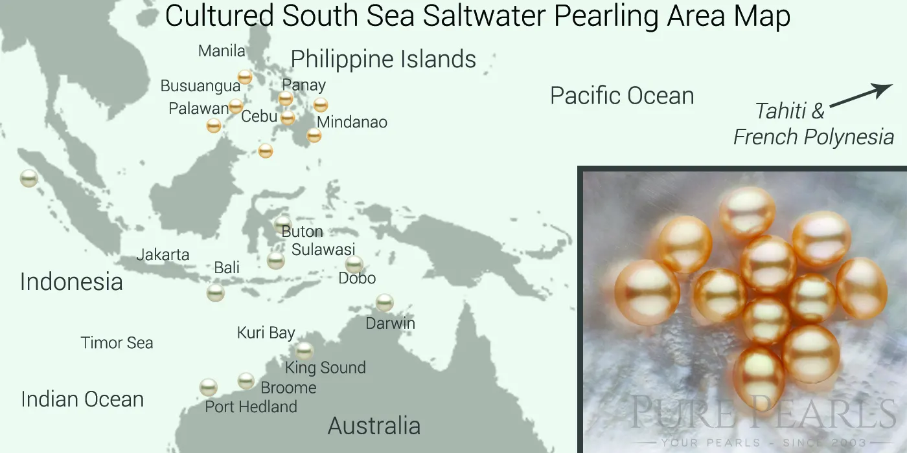
Map Flows

Slide 9
Map Flows (cont.)

Slide 10
Changes
Avoid buying pearls
Buy imitation pearls instead
Encourage companies to ensure safe conditions for their workers

Slide 11
References
https://pearls.com/pages/how-pearls-are-formed
https://www.thepearlsource.com/blog/are-pearls-eco-friendly-gems-some-say-no/
https://www.purepearls.com/pages/pearl-types
https://thepearlgirls.com/kill-the-oyster/
https://www.theguardian.com/australia-news/2016/jan/03/its-not-for-everyone-the-hot-dangerous-work-behind-the-lustre-of-the-worlds-best-pearls
https://www.americanpearlcompany.com/
https://kojimapearl.com/
https://www.mikimotoamerica.com/

Slide 12
Photo Credits
https://www.google.com/url?sa=i&source=images&cd=&cad=rja&uact=8&ved=2ahUKEwj1i5Su7-zhAhUSd98KHQukAPIQjRx6BAgBEAU&url=https%3A%2F%2Fwww.pearlsofjoy.com%2Fproducts%2Fakoya-pearl-necklace-8-0-8-5mm&psig=AOvVaw0BOUAolY8Totf9VBN-f3dz&ust=1556337558426746
https://www.google.com/url?sa=i&source=images&cd=&cad=rja&uact=8&ved=2ahUKEwiz773b7-zhAhURd98KHeGpDL8QjRx6BAgBEAU&url=https%3A%2F%2Fwww.nicerin.com%2Fproducts%2F20-50-pcs-pearls-in-a-large-clam-wish-pearl-mussel-pearl-oyster-drop-pearl-for-pendant-diy-pearl-decorations-margarita-vacuum-packaging&psig=AOvVaw0D6LN2_URiz-QLUMoZ_06I&ust=1556337608578773
https://www.google.com/url?sa=i&source=images&cd=&cad=rja&uact=8&ved=2ahUKEwjl--2K8uzhAhVQmeAKHbZvByIQjRx6BAgBEAU&url=https%3A%2F%2Fwww.coroflot.com%2FJillDorvalWinitzer%2FPrint-and-Web-Advertising&psig=AOvVaw0_PIgHwJTHEQPaQWKEGwBQ&ust=1556338039625004
https://www.google.com/url?sa=i&source=images&cd=&cad=rja&uact=8&ved=2ahUKEwjDnLDX8uzhAhVShuAKHa60B7MQjRx6BAgBEAU&url=http%3A%2F%2Fwww.jacksonjewels.com%2FReference%2FJewelry%2520Ads%2520M-P.htm&psig=AOvVaw0_PIgHwJTHEQPaQWKEGwBQ&ust=1556338039625004

