Slide 1
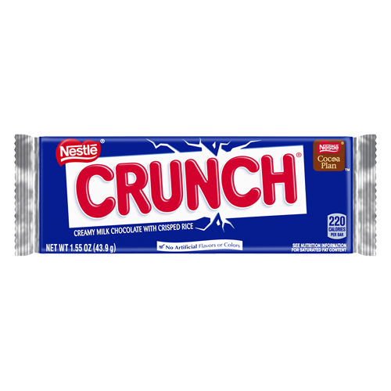
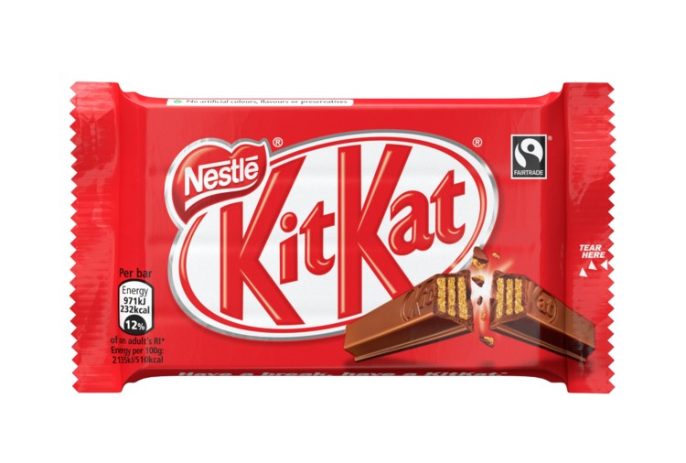
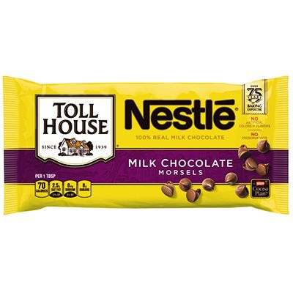
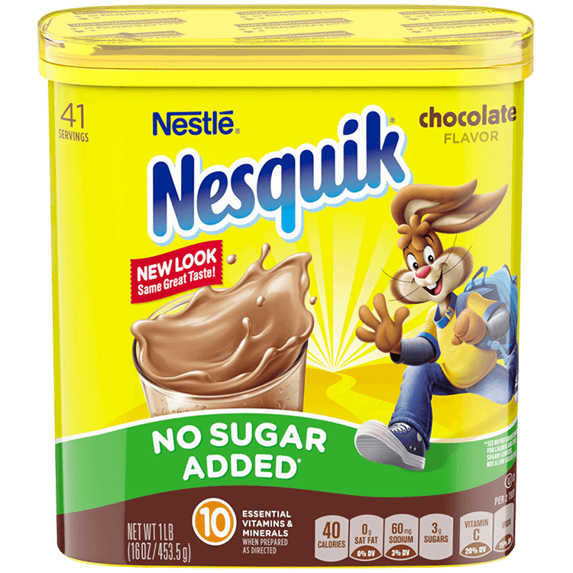
Nestlé Chocolate
By Courtney Ottaviano

Slide 2
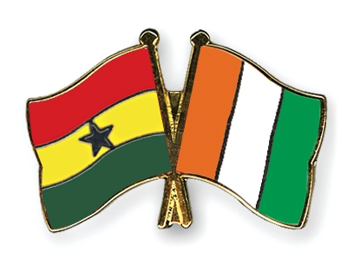
Where is the cocoa produced?
The cocoa used in Nestlé chocolate products, according to their website, is produced primarily from The Ivory Coast and Ghana
However, other West African countries also produce cocoa, such as Nigeria and Cameroon
Cocoa beans are also produced in Indonesia, Ecuador, Brazil and Papua New Guinea

Slide 3
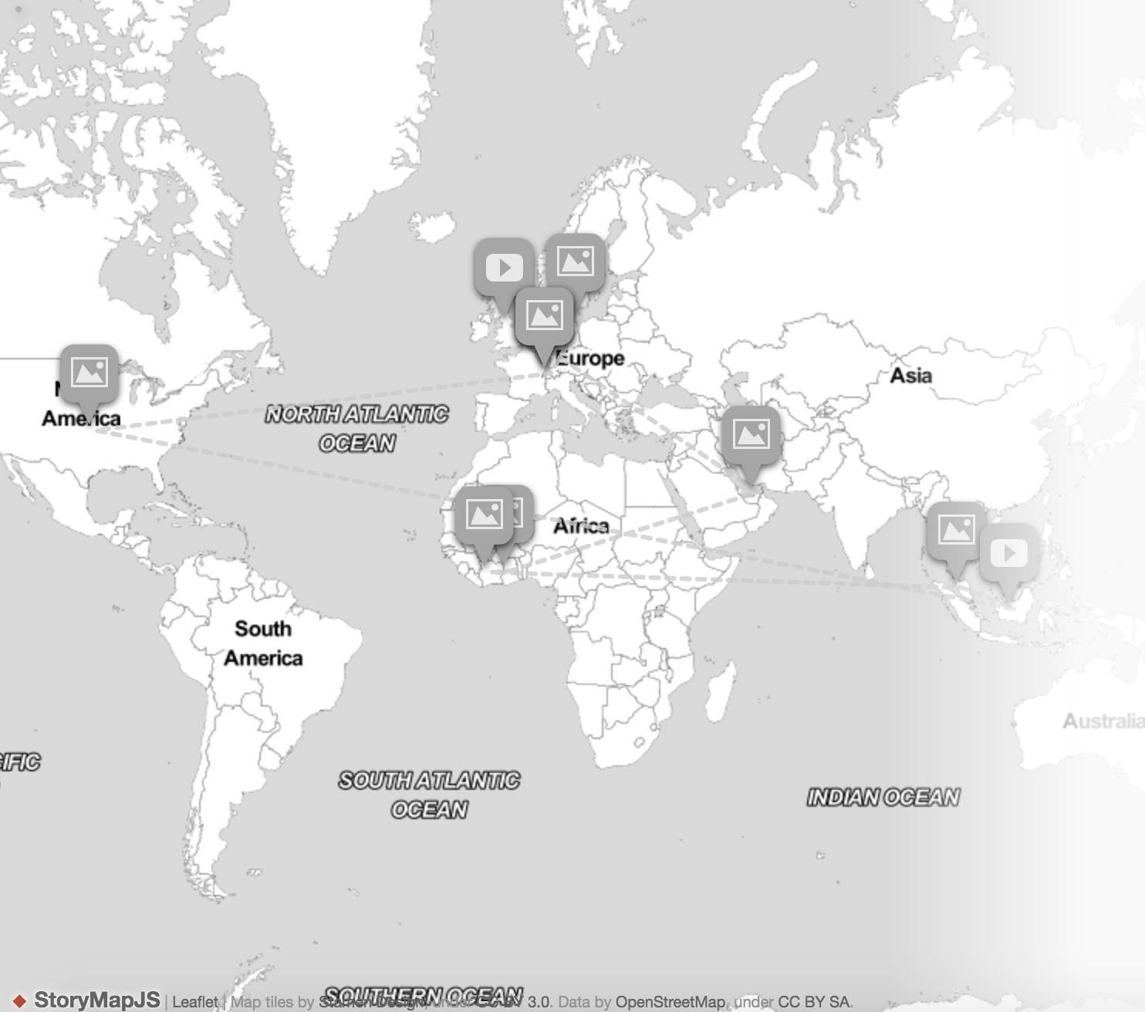
Map of Production

Slide 4
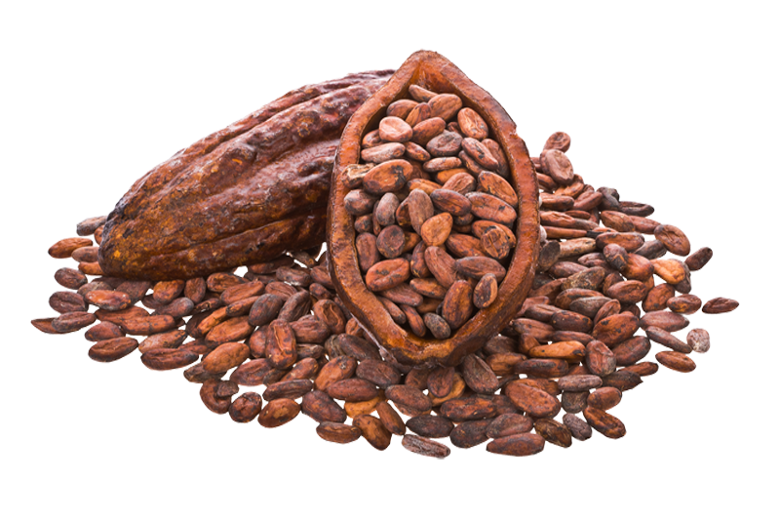
How Much Chocolate is Imported to the United States? And Who Produces It?
According to Statista, the most revenue from cocoa imports is the United States with $1.38 billion
In 2016, according to Statista, “the U.S. import of cocoa and cocoa products amounted to about 5.21 billion U.S. dollars”
There are many major corporations that produce, manufacture or distribute cocoa/chocolate. Some examples are:
Nestlé
The Hershey Company
Mondelez
Mars
These companies are referred to as “Big Chocolate”

Slide 5
Nestlé
Nestlé headquarters is located in Vevey, Switzerland
Nestlé USA headquarters is located in Arlington, Virginia
In 2017, Nestlé had a net profit of $7.7 billion which was down from $9.23 billion in 2016
Sales were around $89.8 billion
There are 323,000 employees worldwide
There have been major controversies regarding child labor in Nestlé cocoa production that led to lawsuits against the company
Nestlé has tried to combat their child labor problem, but it still remains a major issue within the company

Slide 6
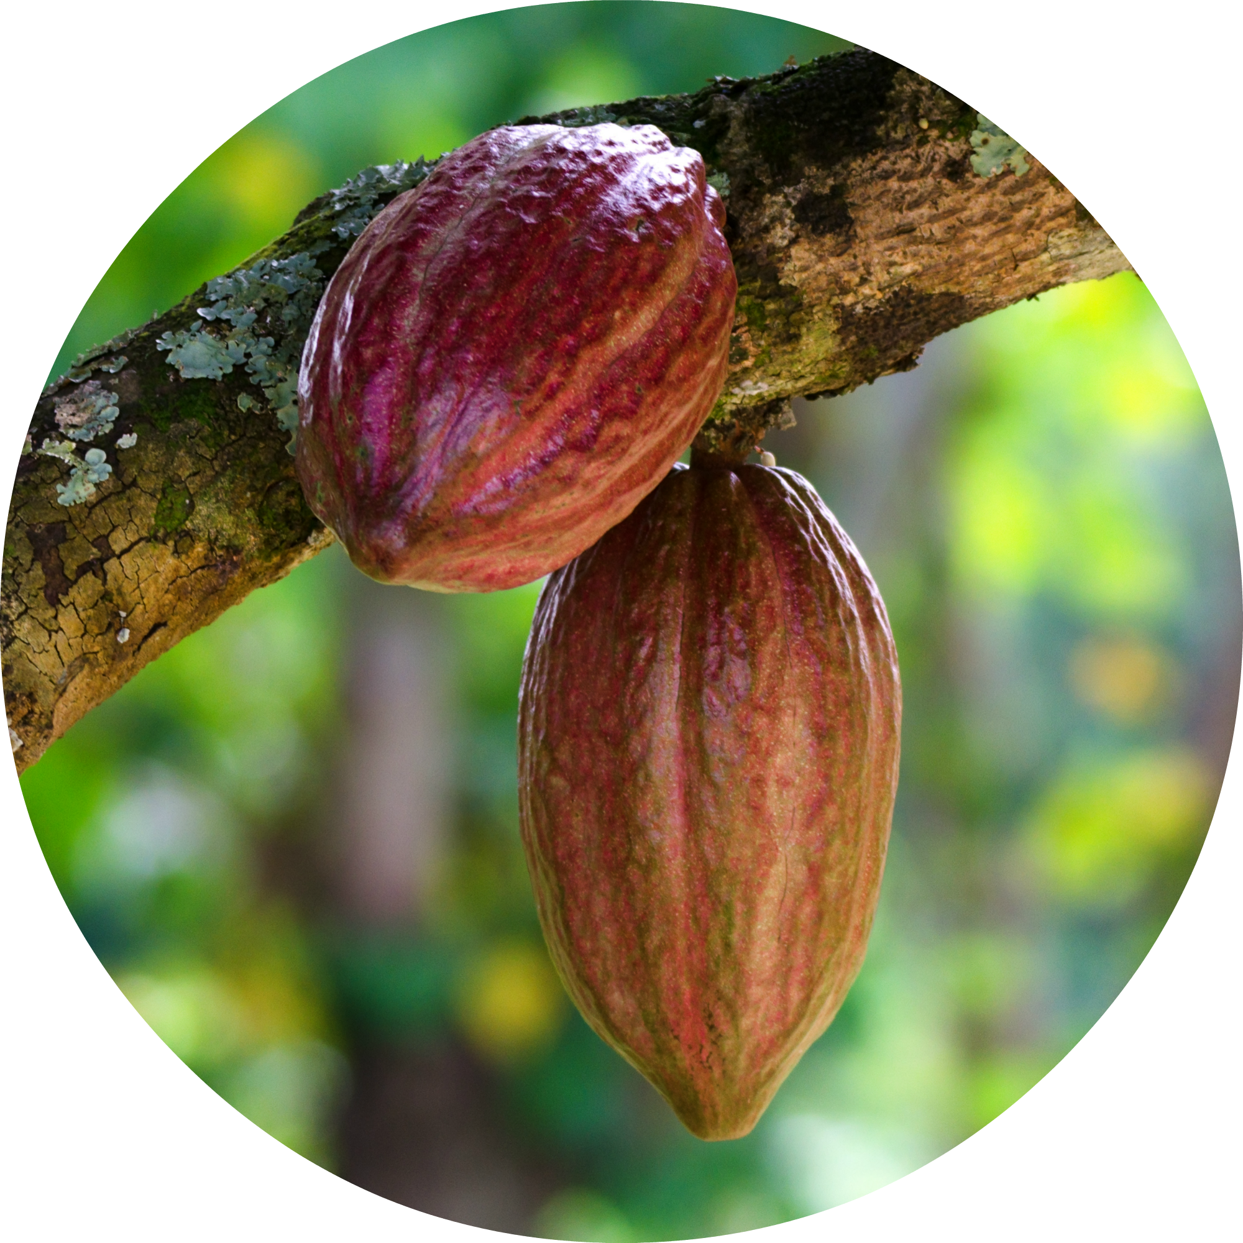
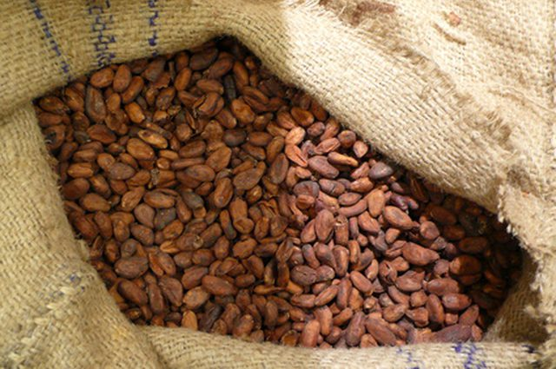
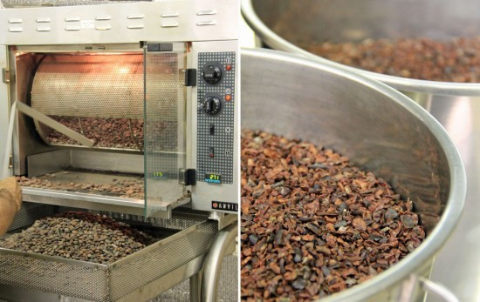
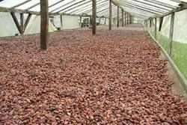
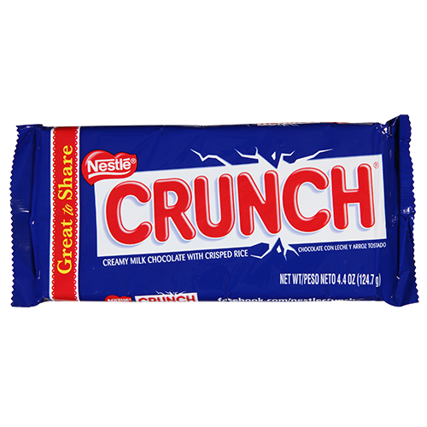
Nestlé Chocolate Production Processes
Step 2:
Fermenting
Step 4: Cocoa to Chocolate
Step 1: Harvesting
Step 3:
Drying
Step 5: Chocolate Bar

Slide 7
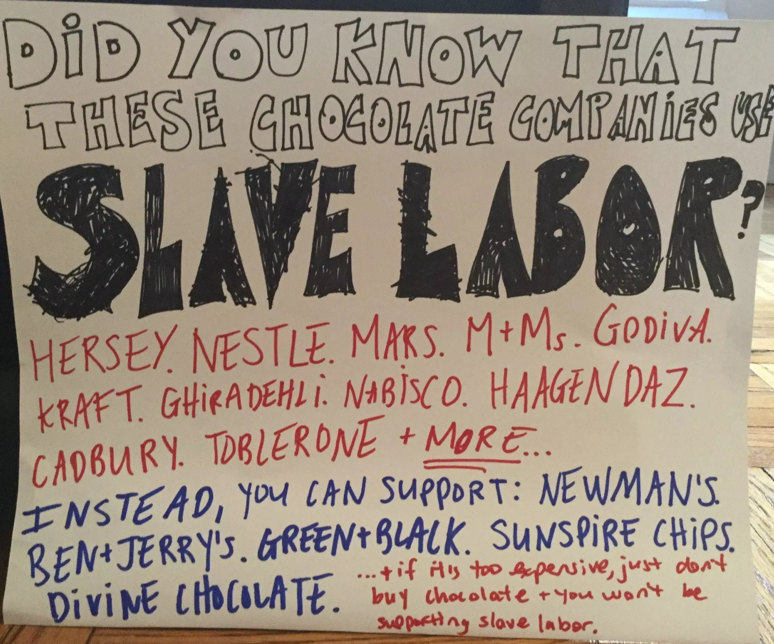
Child Labor, Abuse and Trafficking
In 2005, “The International Labor Rights Fund filed a lawsuit against Nestlé (among others) on behalf of three Malian children. The suit alleged the children were trafficked to Côte d’Ivoire (The Ivory Coast), forced into slavery, and experienced frequent beatings on a cocoa plantation.”
In a report by the Fair Labor Association, they said they had found “‘multiple serious violations’ of the company’s own supplier code. It was reported that Nestlé hadn’t carried out checks against child labor and abuse. Additionally, many injuries caused by machetes, which are used to harvest cocoa pods, have been reported.”

Slide 8
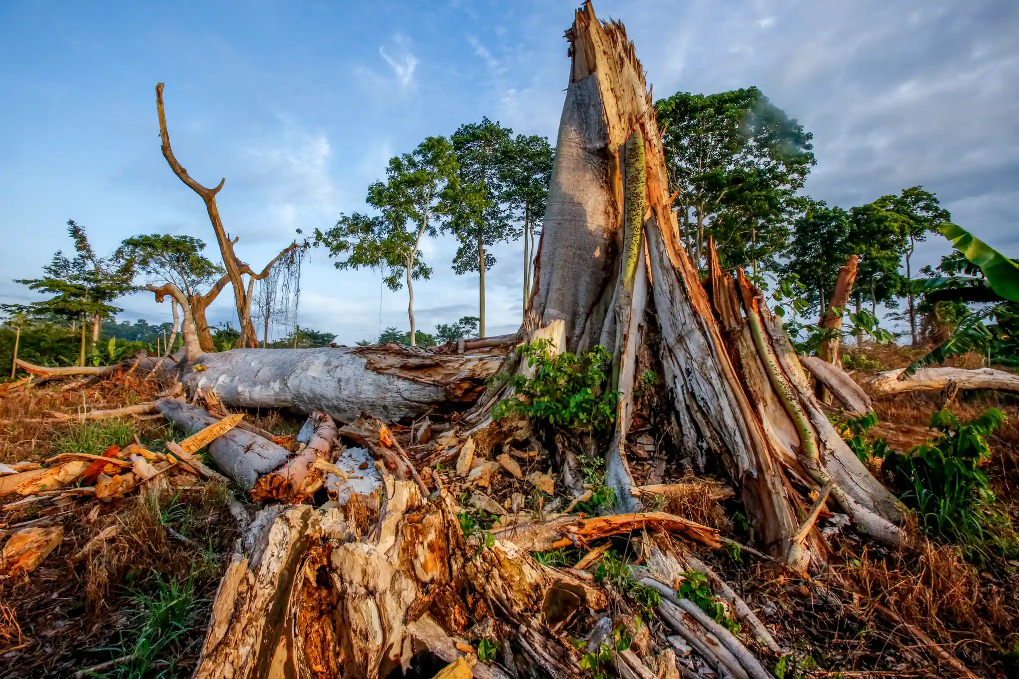
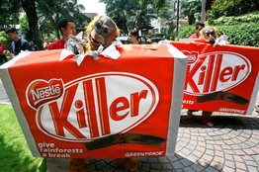
Pollution/Deforestation
According to an article from The Guardian, “The world’s chocolate industry is driving deforestation on a devastating scale in West Africa…”
“Cocoa traders who sell to Mars, Nestlé, Mondelez and other big brands buy beans grown illegally inside protected areas in the Ivory Coast, where rainforest cover has been reduced by more than 80% since 1960.”

Slide 9
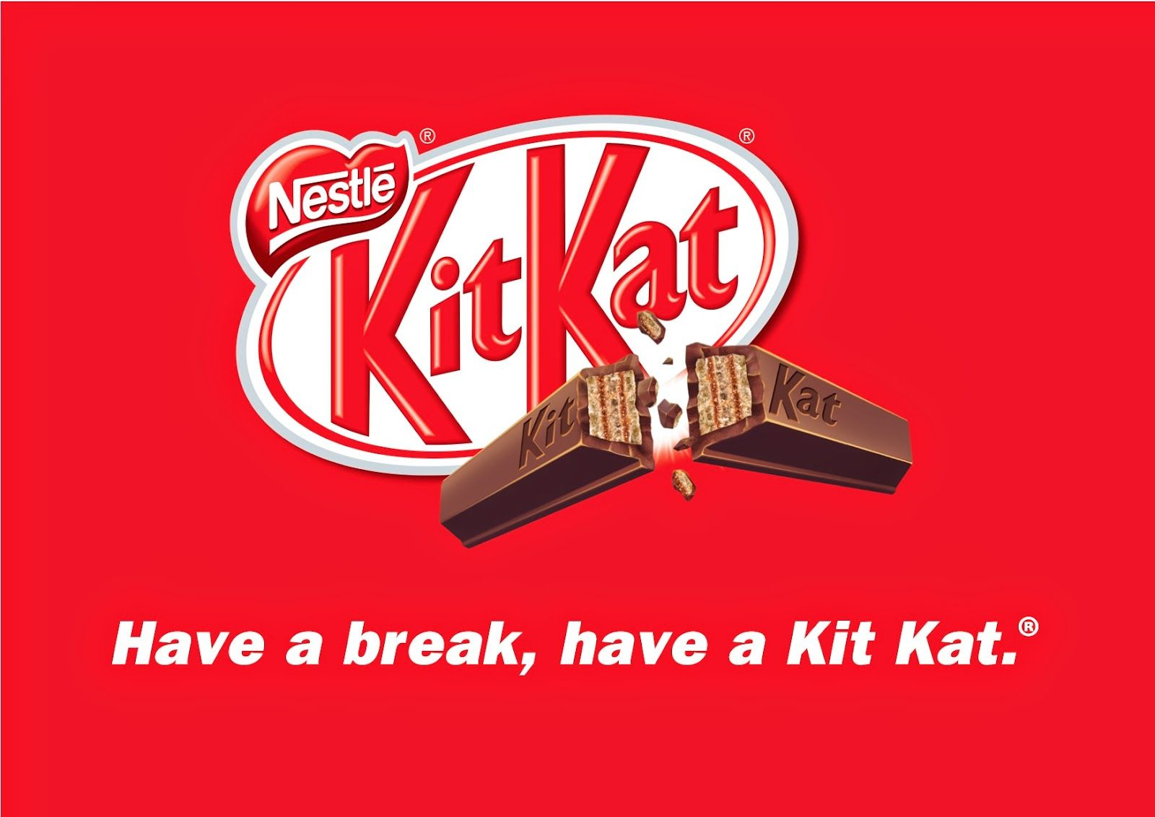
Advertising
Nestle’s makes use of its advertising by using celebrities to sell the products
Chance the Rapper advertised Kit Kats, and the commercial eventually went viral
With celebrities, it may encourage fans of the artist to buy the product
Also, during the Halloween season, candy advertisements are usually everywhere and it encourages parents to purchase their candy for their children and the holiday

Slide 10
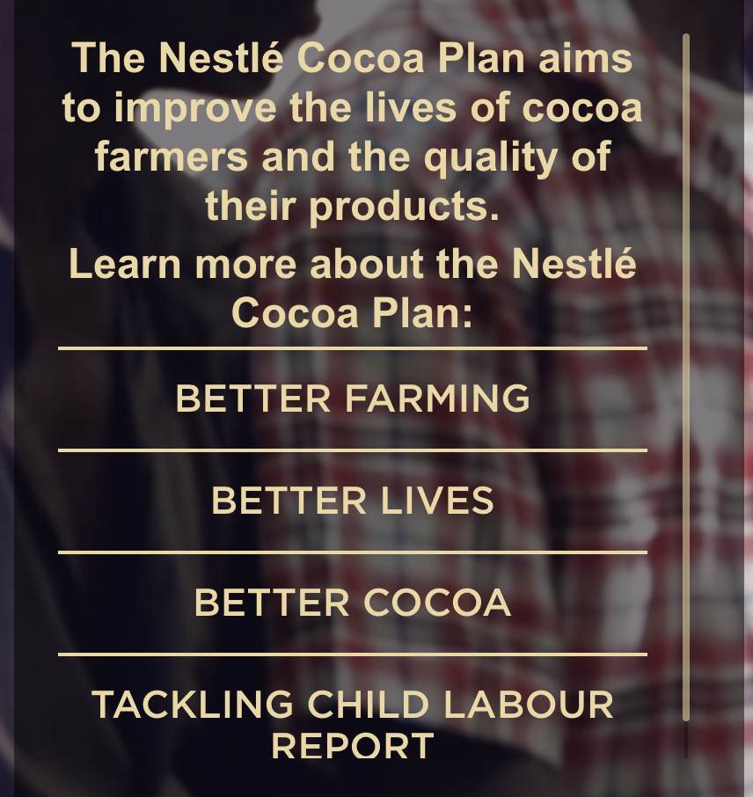
Commodity Fetishism
Nestle provides a decent amount of information on the production and distribution processes.
However, the information is basic and not very specific and
Also, they do mention their child labor controversies, but do not mention the specifics of them.
They do, however, have step by step information on the production of their chocolate on their Better Cocoa website, but again, it is not very specific.

Slide 11
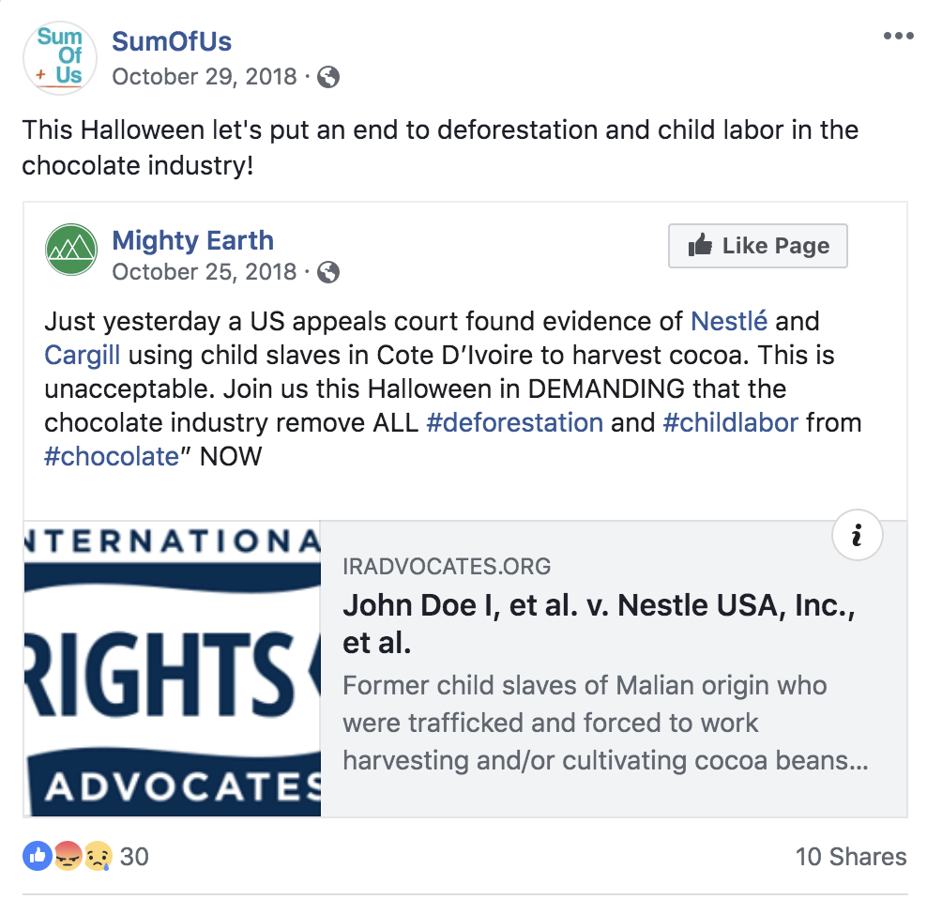
Social Movements, Protests, Campaigns
Many lawsuits have been filed against Nestlé by consumers who argue that Nestle failed to disclose that their cocoa may be cultivated by child and/or slave labor.
A global advocacy organization SumOfUs urged consumers in October of 2018 to boycott Nestlé Halloween candy because of its child slavery/child labor allegations

Slide 12
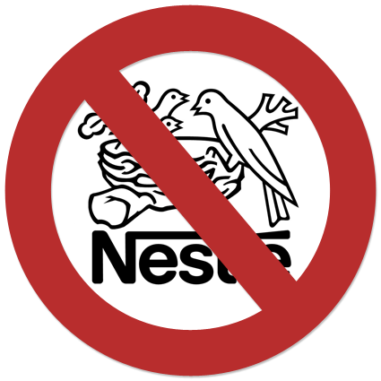
Strategies/Campaigns
Consumers of Nestlé chocolate can address the problems of sustainability and injustice regarding the production of their cocoa by:
Contacting Nestlé
Making social media posts about Nestlé’s controversies
Organizing protests against the company at their local school or college campus
Boycott Nestlé or purchase chocolate from other companies that provide sustainable chocolate

Slide 13
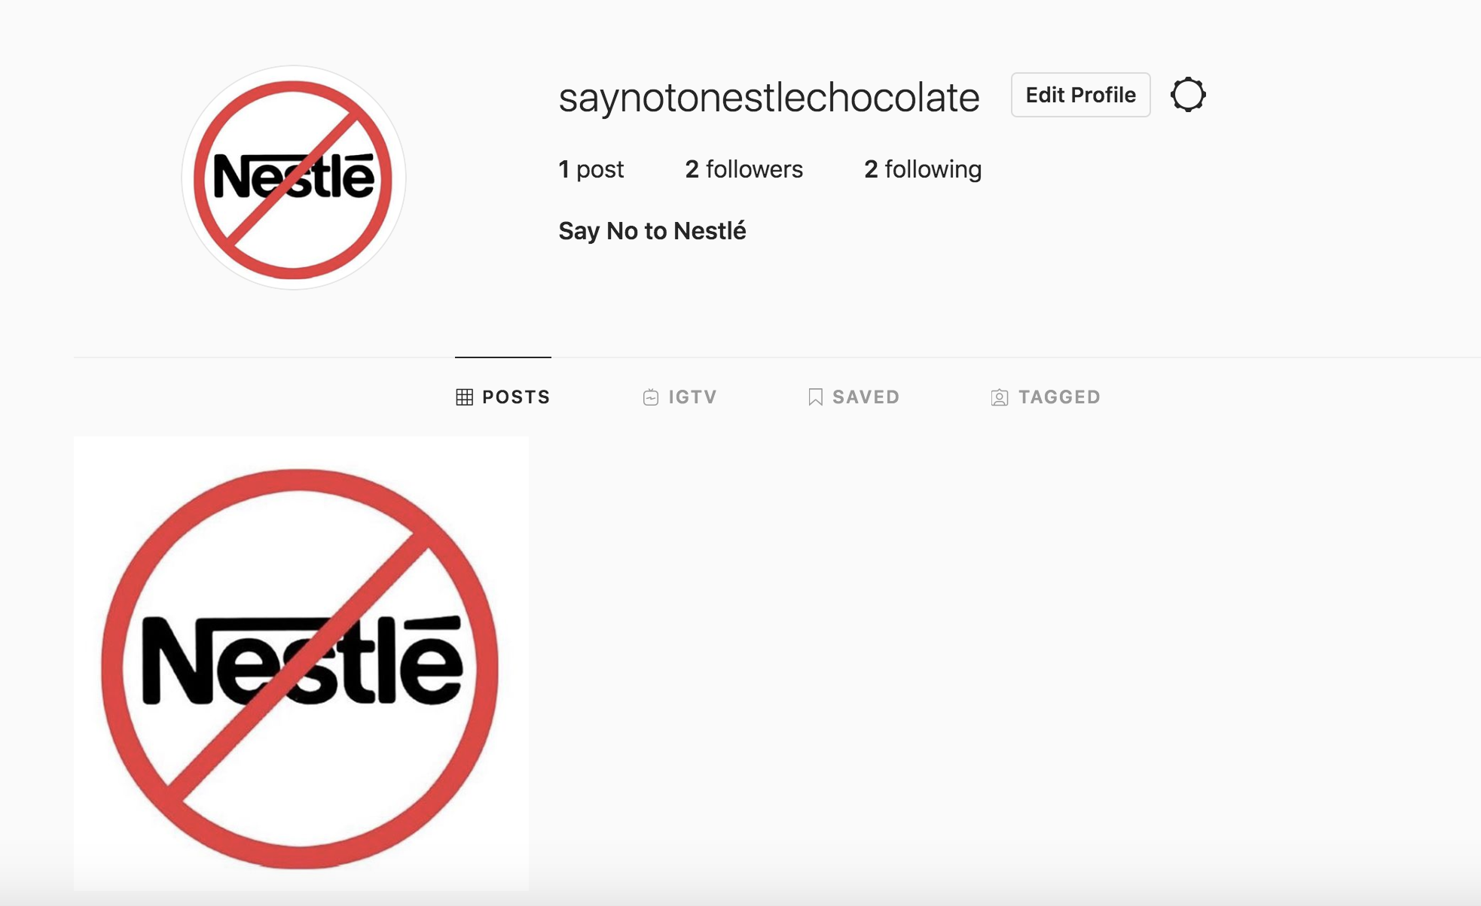
Taking an Action
In order to inform people about the problems such as child labor and deforestation within Nestle cocoa production, I created an Instagram page.
Hopefully with this, I can inform my friends and family about these problems and I can encourage them to reach out to Nestle and encourage others to do so as well
@saynotonestlechocolate

