Slide 1
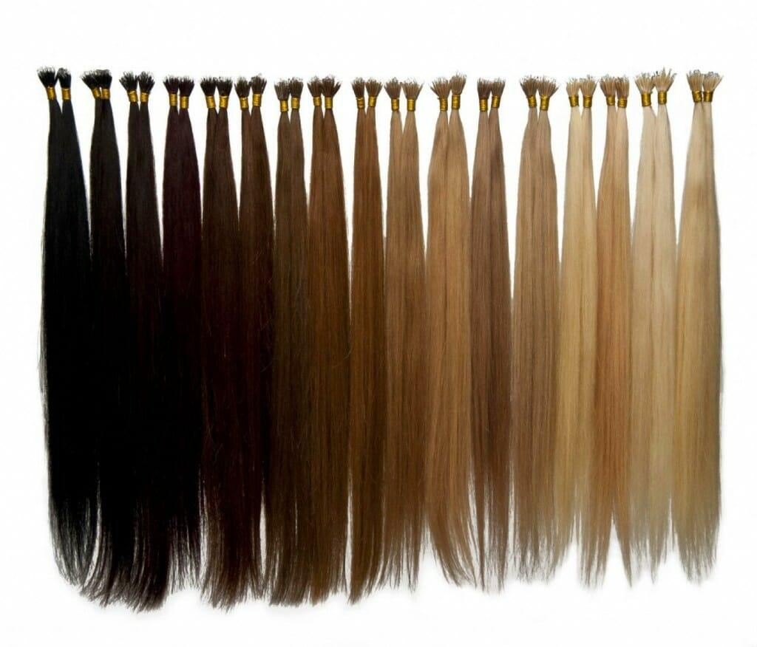
Human Hair Extensions
Yuka Fukuyama

Slide 2
Human Hair is a commodity
The global Human Hair Extension market is valued at 1.35 billion US$ in 2017
Black Gold
Virgin hair (the donor of hair has never used chemical products)
High Demand in the US, Europe, China, Japan, Africa etc.
Market will reach 2.35 billion US$ by the end of 2025

Slide 3
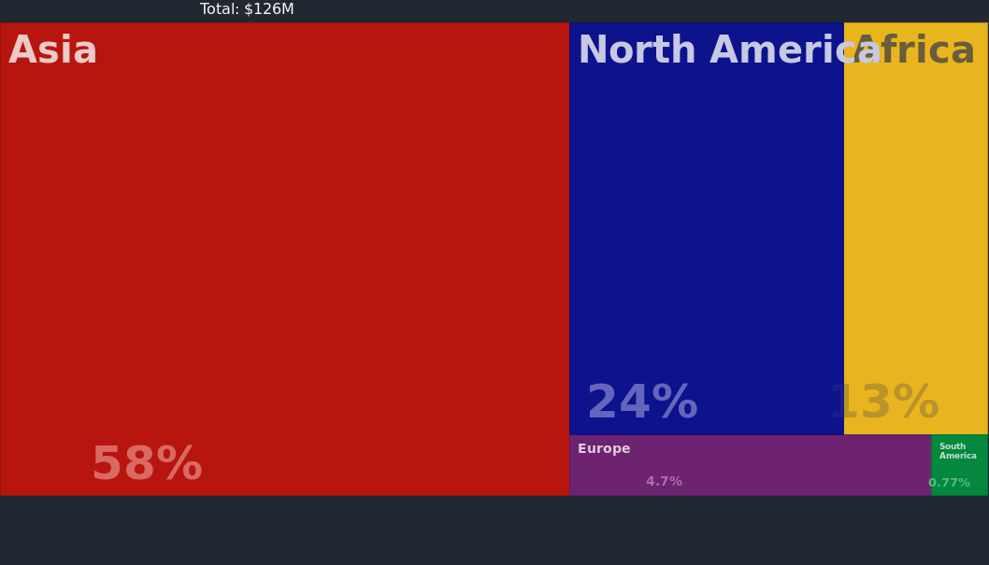
Which countries export Hair, human, unworked, waste of human hair? (2017)

Slide 4
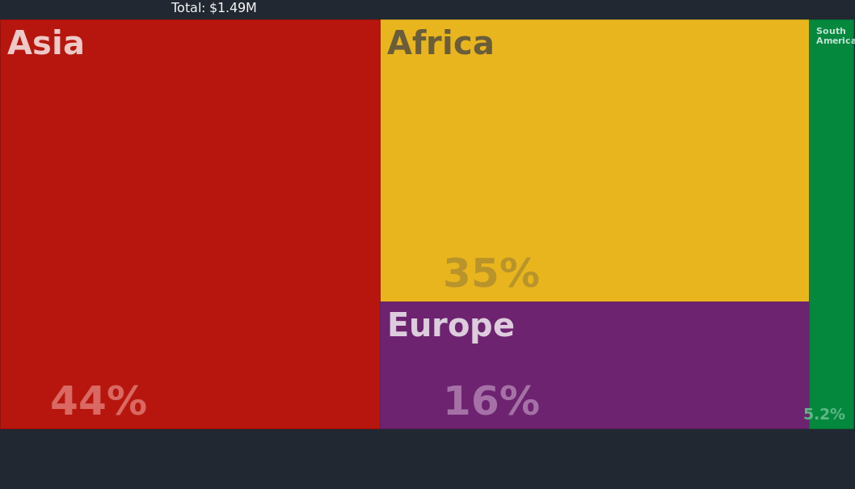
Where does the United States import Hair, human, unworked, waste of human hair from? (2017)

Slide 5
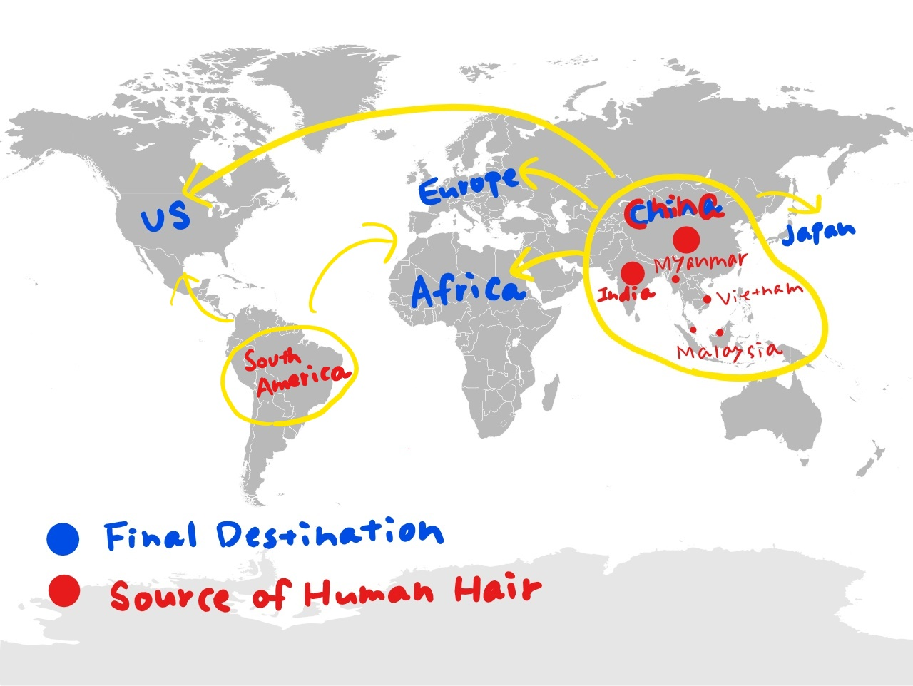
Map

Slide 6
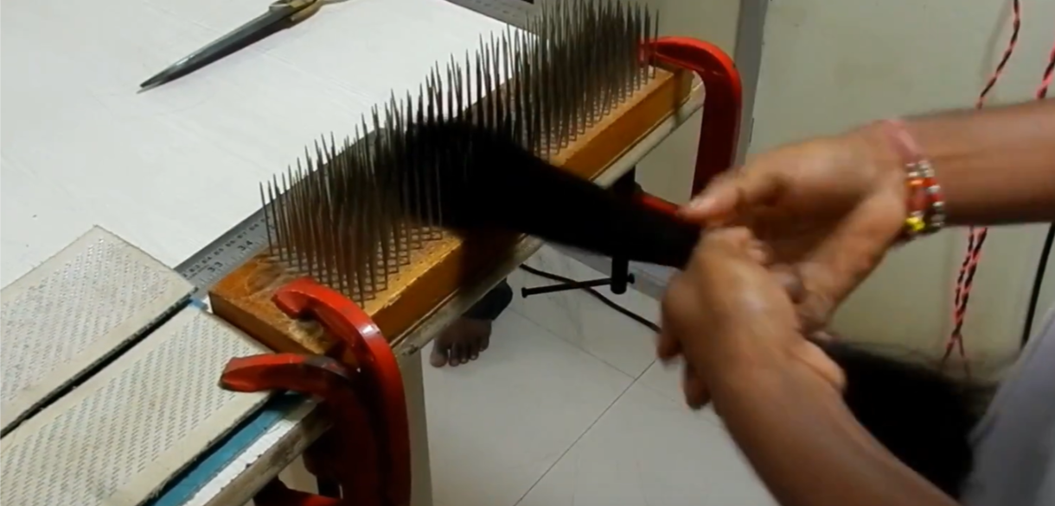
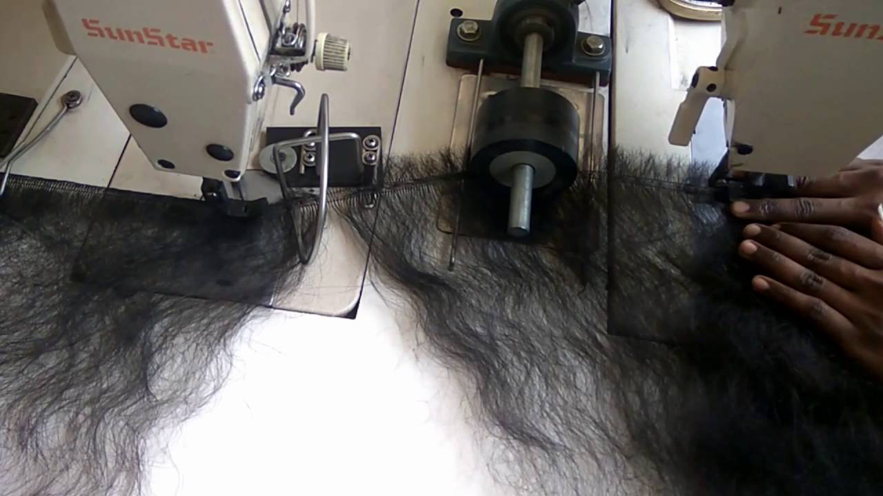
Production Process
・Washing
・Drying
・Hackling
・Wefting
・Packaging
Washing
Hackling
・Dying
・Curling
Wefting

Slide 7
Asian Countries
Source
of
human hair
Poor Countries/Areas in Asia
India, China, Myanmar, Malaysia, Vietnam etc.
To make money
Religious ritual (India)
Violence/ without consent
Factory
Low wage
Bad working environment

Slide 8
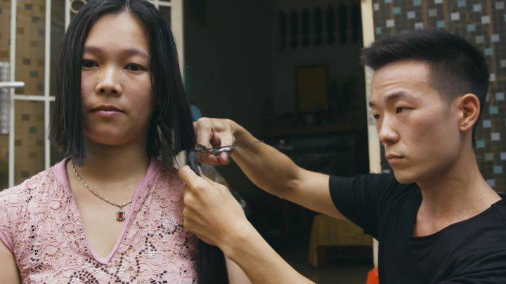
REMY NY Fair-trade hair Company
Founded by Dan Choi in 2017
-directly visit women in Vietnam, collect hair, and pay (5-10 times prices from competitors)
“It’s clear that there is no shortage of hair companies in the world—REMY NY is one of thousands. What differentiates us is that our priority focuses on the women who simply need an opportunity to thrive. Purchasing from REMY NY means helping women put food on the table, clothes on their children’s backs, and a roof over their heads. It means providing opportunities for women living in poverty to work and provide for themselves and their families. It is a means of survival and an opportunity for a better life.”

Slide 9
Advertising
Gorgeous/Confident/Beautiful
https://youtu.be/gkZtDFaFlp4

Slide 10
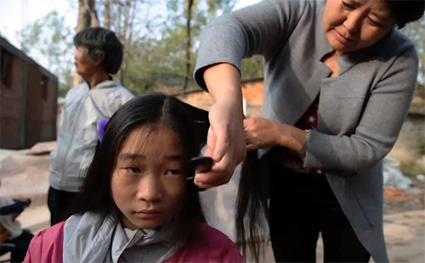
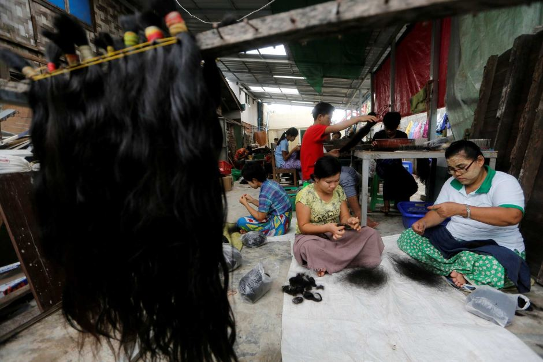
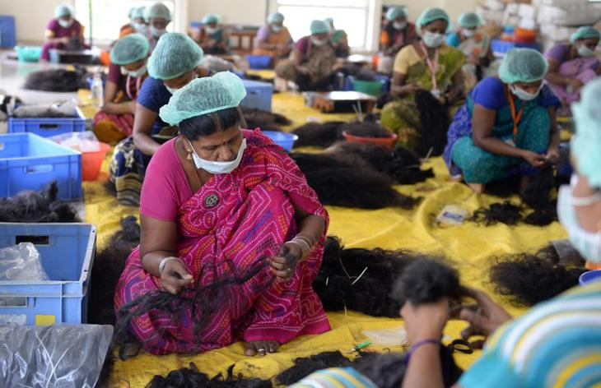
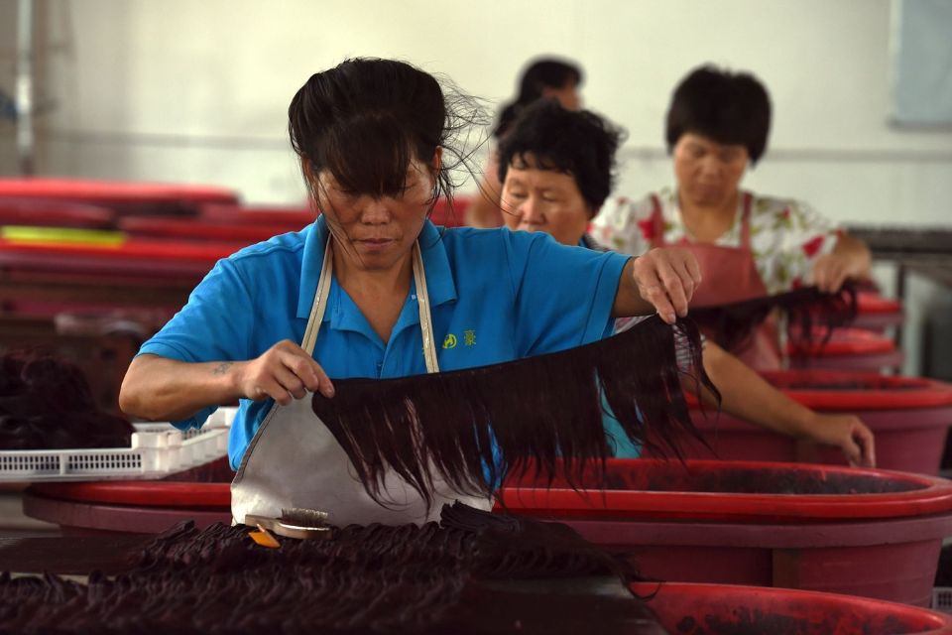
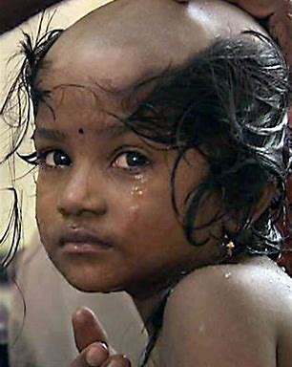
Reality
Sacrifice poor people

Slide 11
What can we do?
AVOID WEARING HUMAN HAIR EXTENSIONS PRODUCED BY EXPLOITATION
Purchase human hair extensions from reliable companies
-transparent supply chains
-good working environment in factories
Ask hair salons whether they order human hair extensions from reliable companies

Slide 12
Thank you for listening

