Slide 1
Gasoline
By Mac McCabe

Slide 2
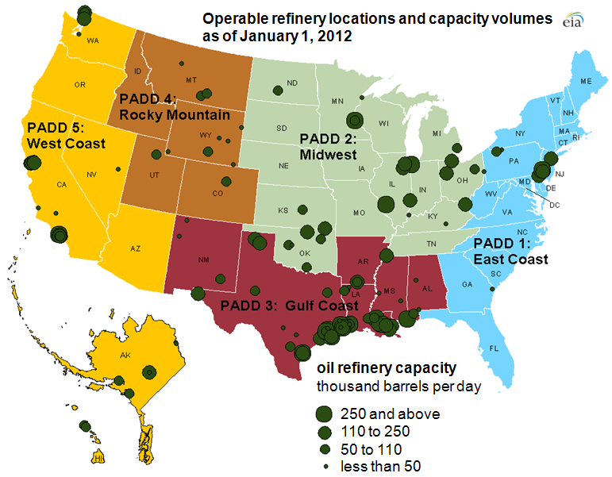
Where it is Produced
35 of the States in the United States have oil refineries that produce gasoline.
The largest refineries are located in Texas and Louisiana
The top countries that produce gasoline are Russia, Singapore, Netherlands, South Korea, Saudi Arabia, Belgium, and China.
The United States imports 10.14 million barrels of petroleum every day.

Slide 4
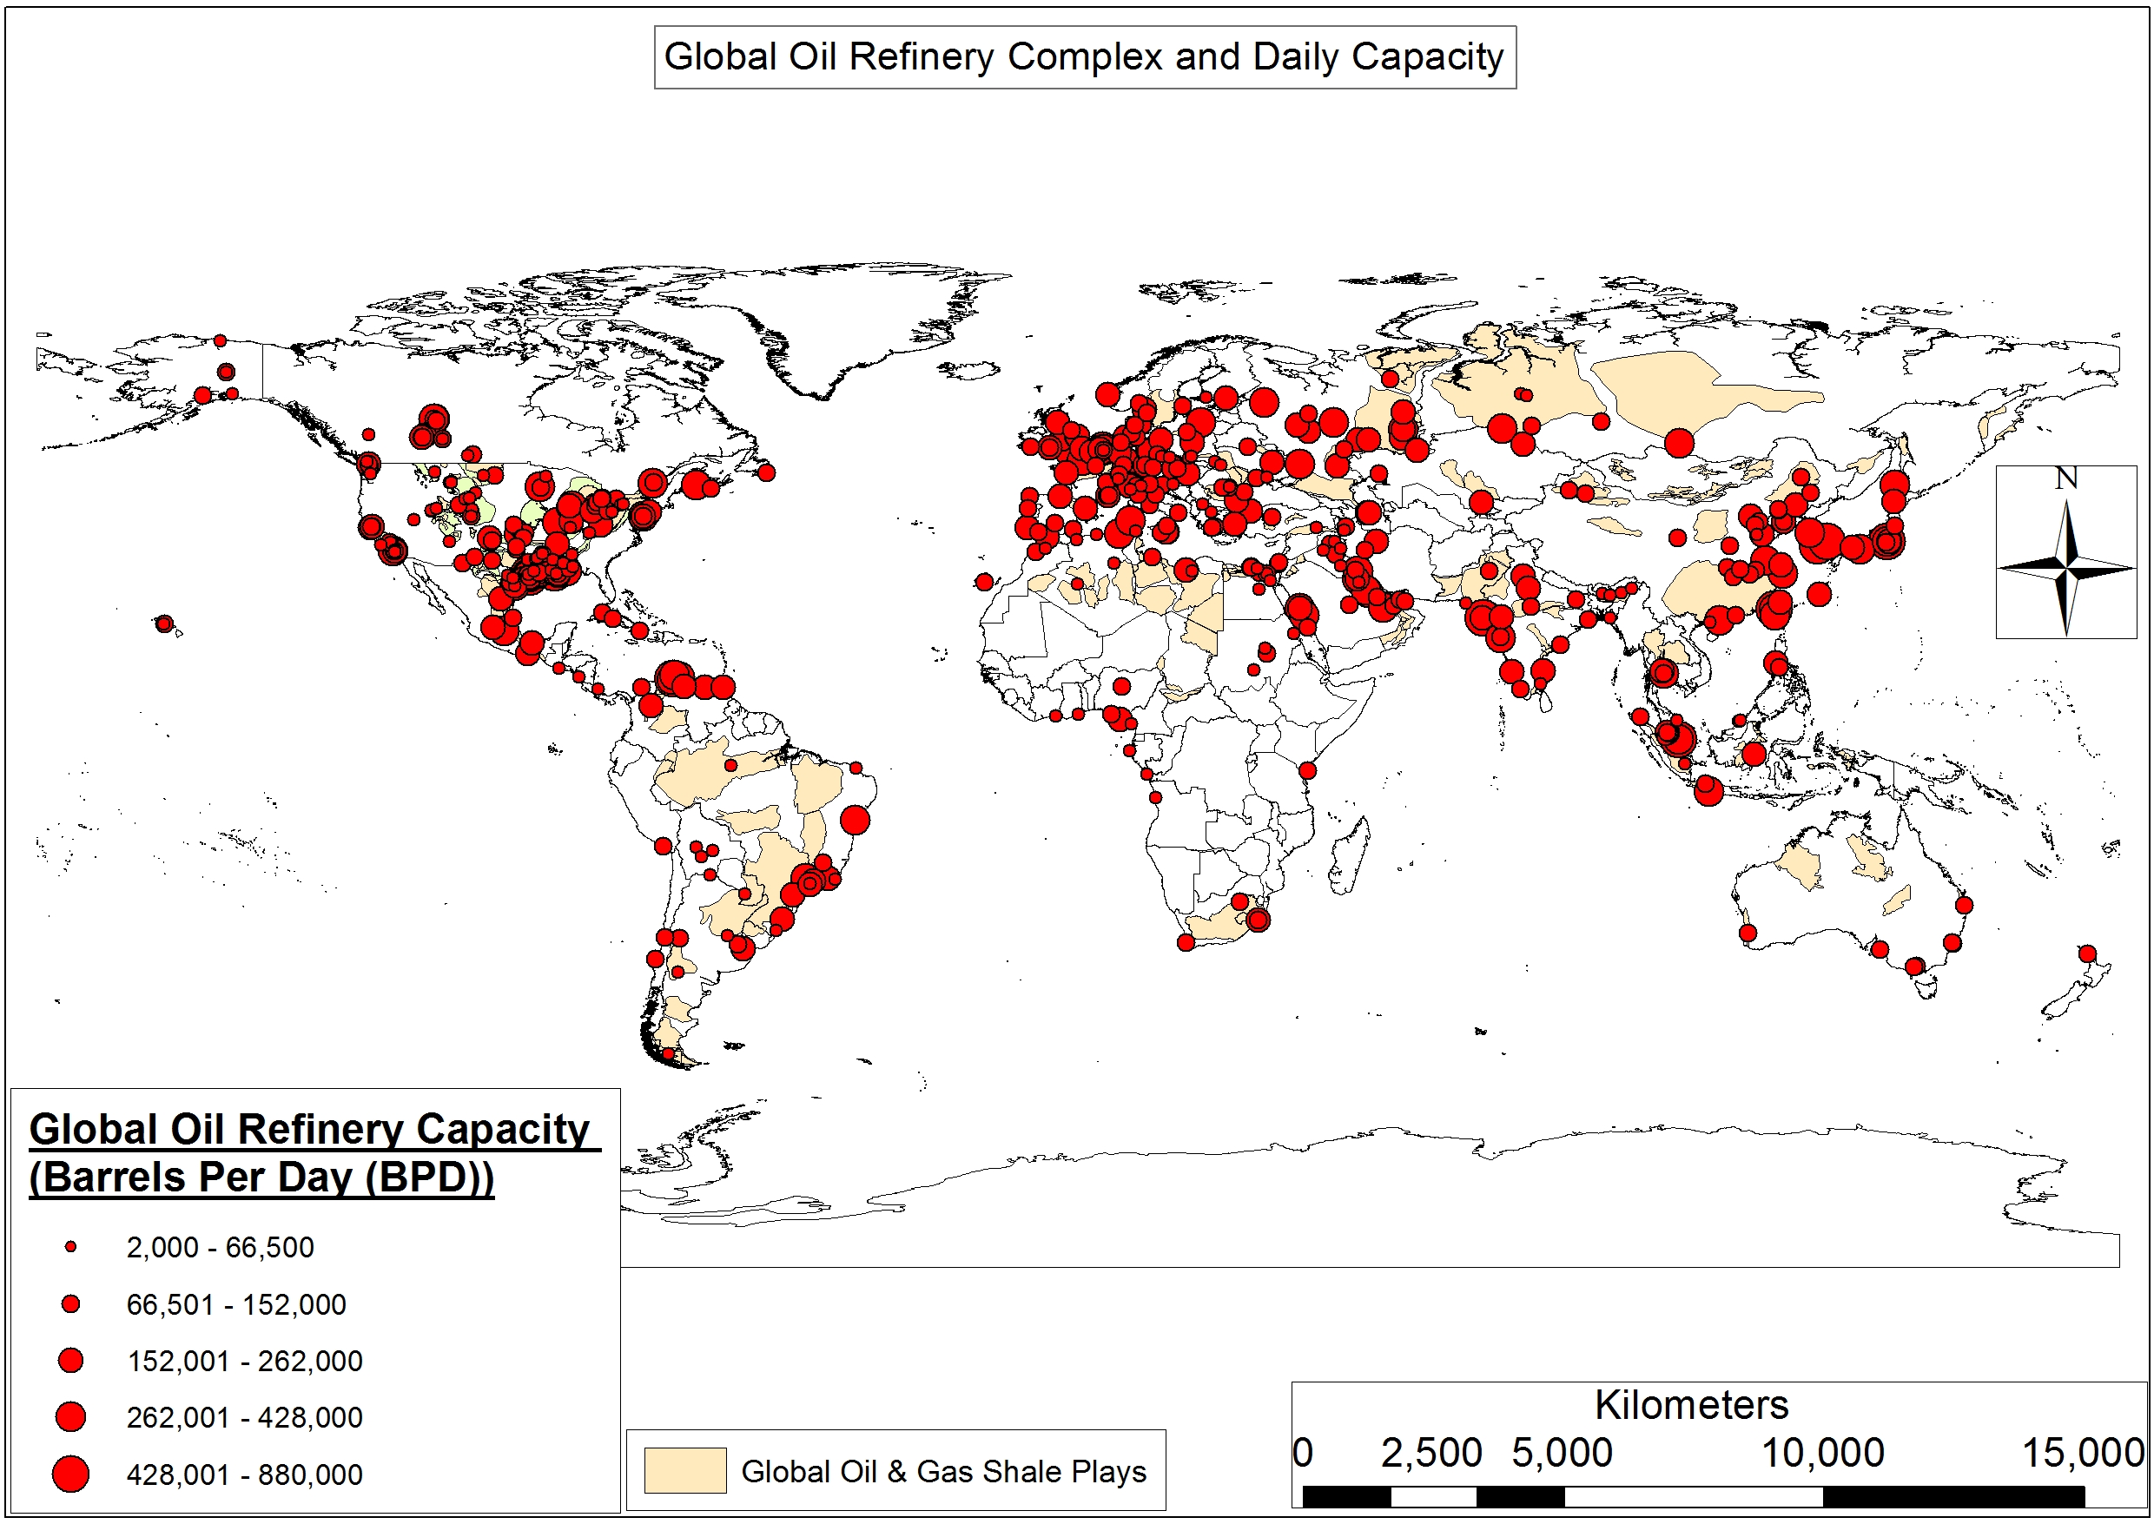

Slide 5
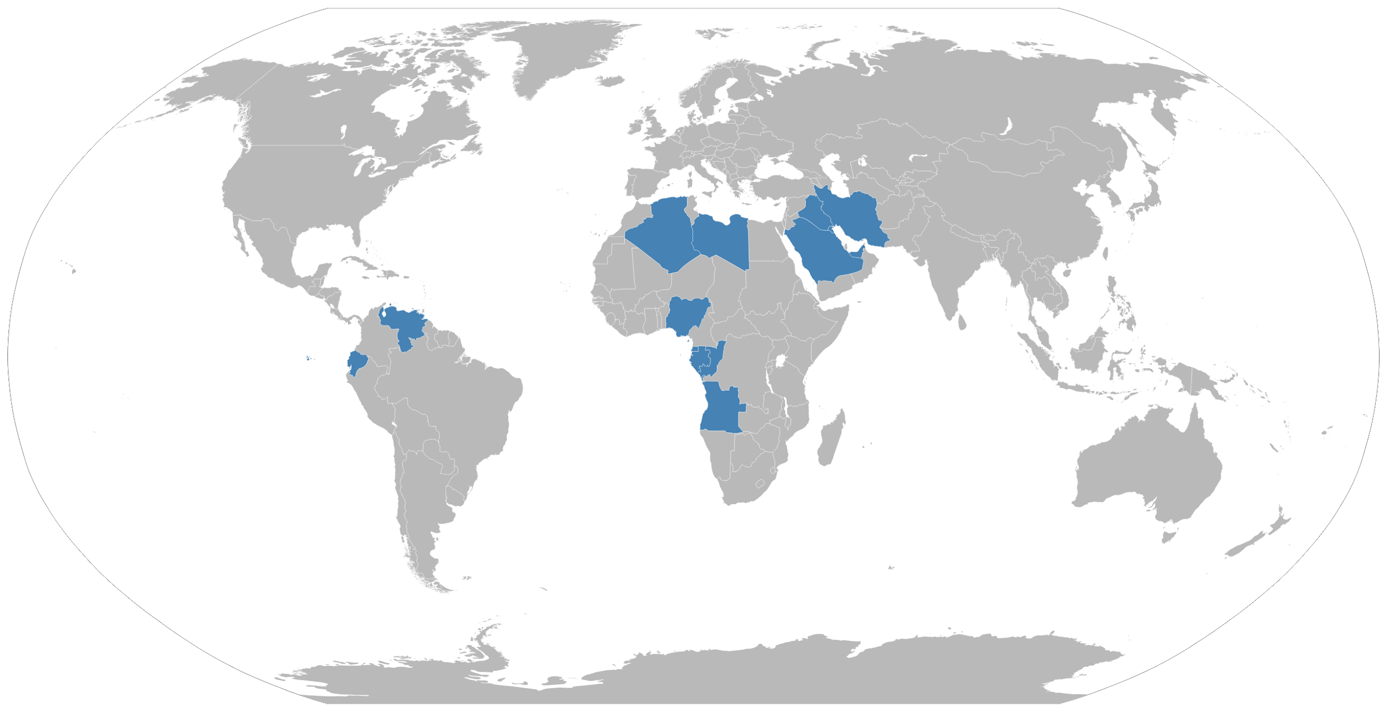
OPEC
-Consists of 14 members states.
-Algeria, Angola, Congo, Ecuador, Equatorial Guinea, Gabon, Iran, Iraq, Kuwait, Nigeria, Saudi Arabia, United Arab Emirates, Venezuela.
-Goal is to to coordinate petroleum policies in order to secure the oil market for producers and consuming nations.
-Member states account for 44% of global oil production and 81% of the world’s oil reserves.

Slide 6
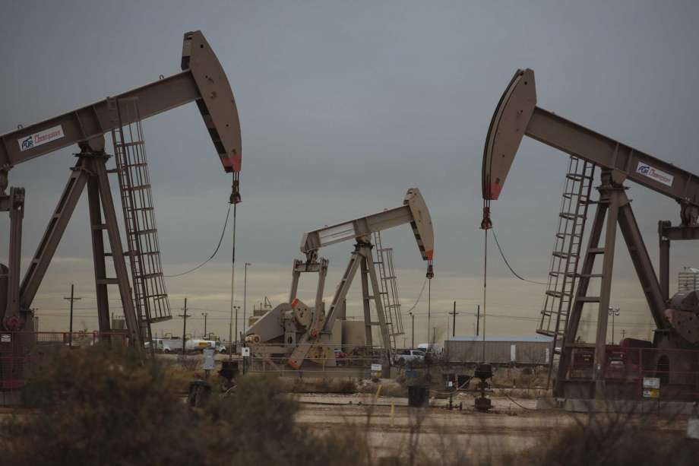
Extraction and Refining Process
Extraction of crude oil which is the base of all petroleum products.
-Crude oil is found in rock formations located underground or at the bottom of the sea.
-Companies extract the oil by digging deep well bores into the oil reserves which then pump out the oil.
-Crude oil is then transported to a refinery to be made into gasoline.

Slide 7
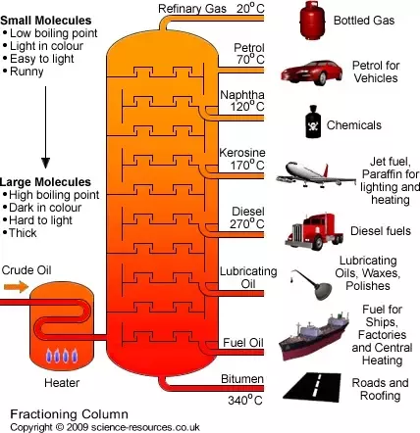
Extraction and Refining Process(Cont)
-Most refineries utilize fractional distillation.
-Breaks down the crude oil into different distillates which includes gasoline.
-Crude oil has to be heated to 400 degrees celsius.
-Turns into vapor which cools down as it exits the furnace.
-Once vapor hits 150 degrees celcius it transforms into a liquid state.

Slide 8
Additives
Final step is placing additives into the raw fuel.
-The purpose is to make the fuel adequate for consumers.
-Certain additives are required by the EPA so the gasoline is healthy for the environment.

Slide 9
American Gasoline Companies
ExxonMobil is the largest gasoline corporation in the US, making $286 billion in revenue
Other major corporations that do business in the US include:Valero, Shell Oil Company , and Chevron

Slide 10
Shell Oil Company
Shell Oil Company is the subsidiary of Royal Dutch Shell which is of Anglo and Dutch origins.
There are 25,000 Shell gas stations in the United States.
Their headquarters in America is located in Houston but it’s parent company is headquartered in The Hague, Netherlands.
Shell operates three oil refineries which are located on the Gulf Coast.

Slide 11
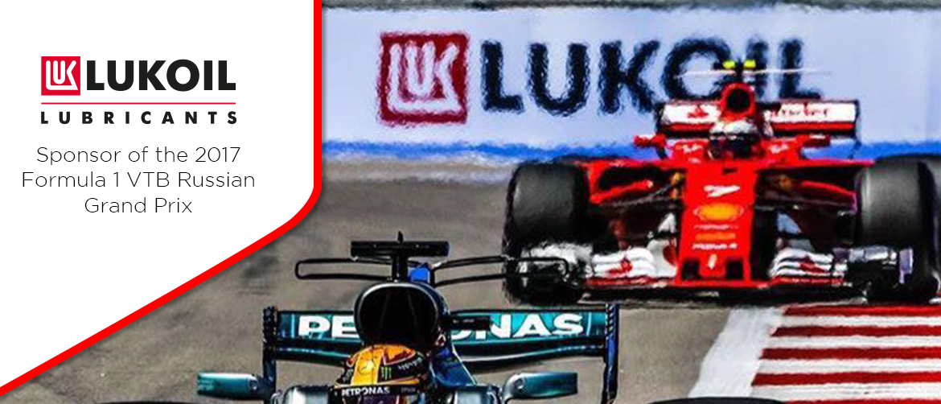
Advertising Strategies
-Utilizing Formula 1 and NASCAR racing.
-https://www.youtube.com/watch?v=1_kwxzU4wL4

Slide 12
Labor Conditions and Injustices
-From 2008 to 2017, 1,566 workers perished trying to extract oil in America alone. (Morris, 2018)
-Fatality rate is 5 times as much of all industries in the US. (Morris, 2018)
-Caused by production pressure and lack of workplace safety.
-OSHA has investigated 552 accidents in the gasoline industry.

Slide 13
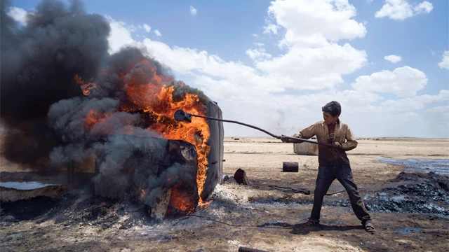
Labor Conditions and Injustices(Cont)
2,000 children are working at the oil fields in Deir ez-Zor, Syria.
-Many of the children are orphans whose parents were killed in the Syrian Civil War.
-Children are being burned by the chemicals used at the refineries.

Slide 14
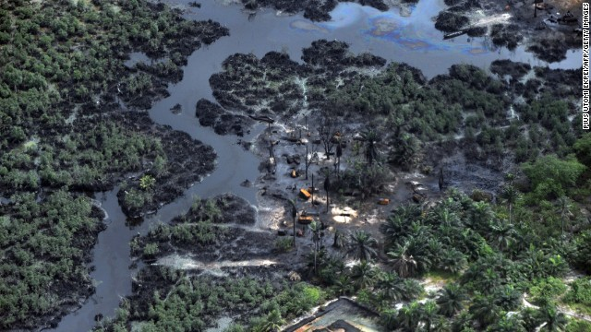
Niger Delta Oil Trade
-Crude oil coming from this region powers the economy of Nigeria.
-Oil industry has caused massive pollution in the Niger delta which has lead to health and economic consequences for those who rely on the Delta.
-In 2009 one of Shell Oil’s pipelines ruptured and spilled millions of litres of oil into the Delta
-Has resulted in armed revolt against the Nigerian government and attacks and oil facilities in the region.

Slide 15
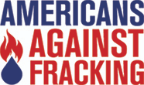
Protests and Organizations against Gasoline
-Global Climate Strike
-Extinction Rebellion
-Yellow Vest Protests

Slide 16
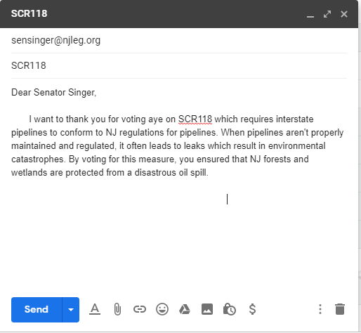
Strategies
-Utilize public transportation
-Use a bicycle instead of your car
-Contact your state senator or assemblyman

Slide 17
Works Cited
Auge-Napoli, Jean Rene. 2013. Syria’s Oil Industry Uses Lots of Child Labor. November 27. Accessed March 13, 2019. https://news.vice.com/en_us/article/j54dwp/syria-s-oil-industry-uses-lots-of-child-labor.
Bardoff, Jeanna. 2014. 10 Phenomenal Organizations Working to End Offshore Drilling. Accessed March 14, 2019. https://www.onegreenplanet.org/animalsandnature/organizations-working-to-end-offshore-drilling/.
Kendrick Oil Company. 2015. Gasoline Manufacturing Process. August 7. Accessed March 14, 2019. http://www.kendrickoil.com/gasoline-manufacturing-process/.
Morris, Jim. 2018. Death in the oilfields. December 21. Accessed March 13, 2019. https://apps.publicintegrity.org/blowout/us-oil-worker-safety/.
Okonkwo, T. and Etemire, U. (2017) “Oil Injustice” in Nigeria’s Niger Delta Region: A Call for Responsive Governance. Journal of Environmental Protection,
De Witte, Melissa. 2019. France’s yellow vest movement has morphed far beyond a carbon tax protest, Stanford economist says. January 23. Accessed April 18, 2019. https://news.stanford.edu/2019/01/23/know-frances-yellow-vest-movement/.
Gerretsen, Isabelle, Sarah Lazzarus, and Yoonjung Seo. 2019. Global Climate Strike: Meet the teenagers skipping school to fight for a greener planet. March 15. Accessed April 18, 2019. https://www.cnn.com/2019/03/14/world/global-climate-strike-teenagers-school-walkout-greta-thunberg-intl/index.html.
Terry, Hallmark. 2017. Oil And Violence In The Niger Delta Isn't Talked About Much, But It Has A Global Impact. February 13. Accessed April 18, 2019. https://www.forbes.com/sites/uhenergy/2017/02/13/oil-and-violence-in-the-niger-delta-isnt-talked-about-much-but-it-has-a-global-impact/.
Auch, Ted. 2017. https://www.fractracker.org/2017/12/global-oil-refineries-emissions/. December 19. Accessed April 18, 2019. https://www.fractracker.org/2017/12/global-oil-refineries-emissions/.

