Slide 1
E-Cigarettes
By Alan Bogdanov

Slide 2
About
Known as e-cigarettes, e-vaporizers, or electronic nicotine delivery systems
Battery operated device that people use to inhale aerosol
Can either contain nicotine or without nicotine
China is the largest exporter of vape in the world, 95%
Hon Lik is the creator of vape in 2003

Slide 3
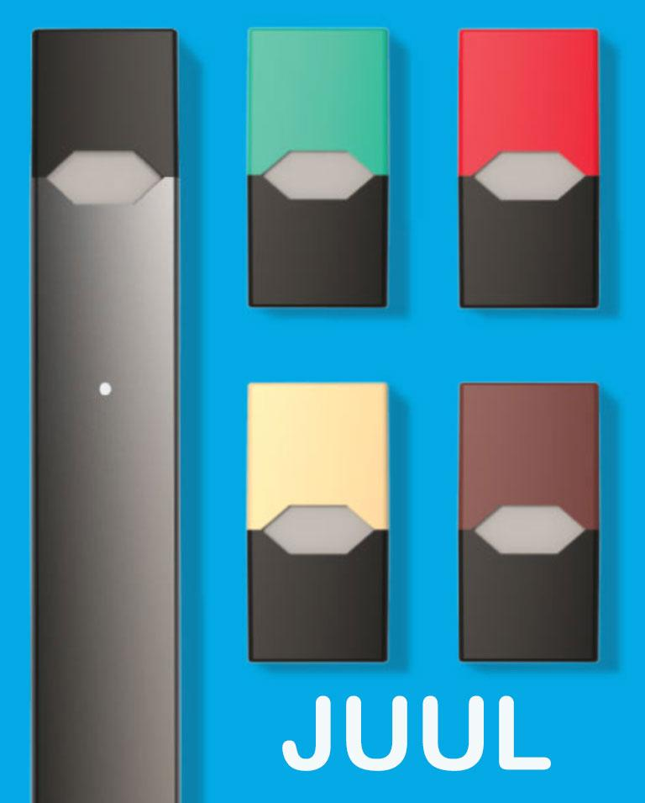
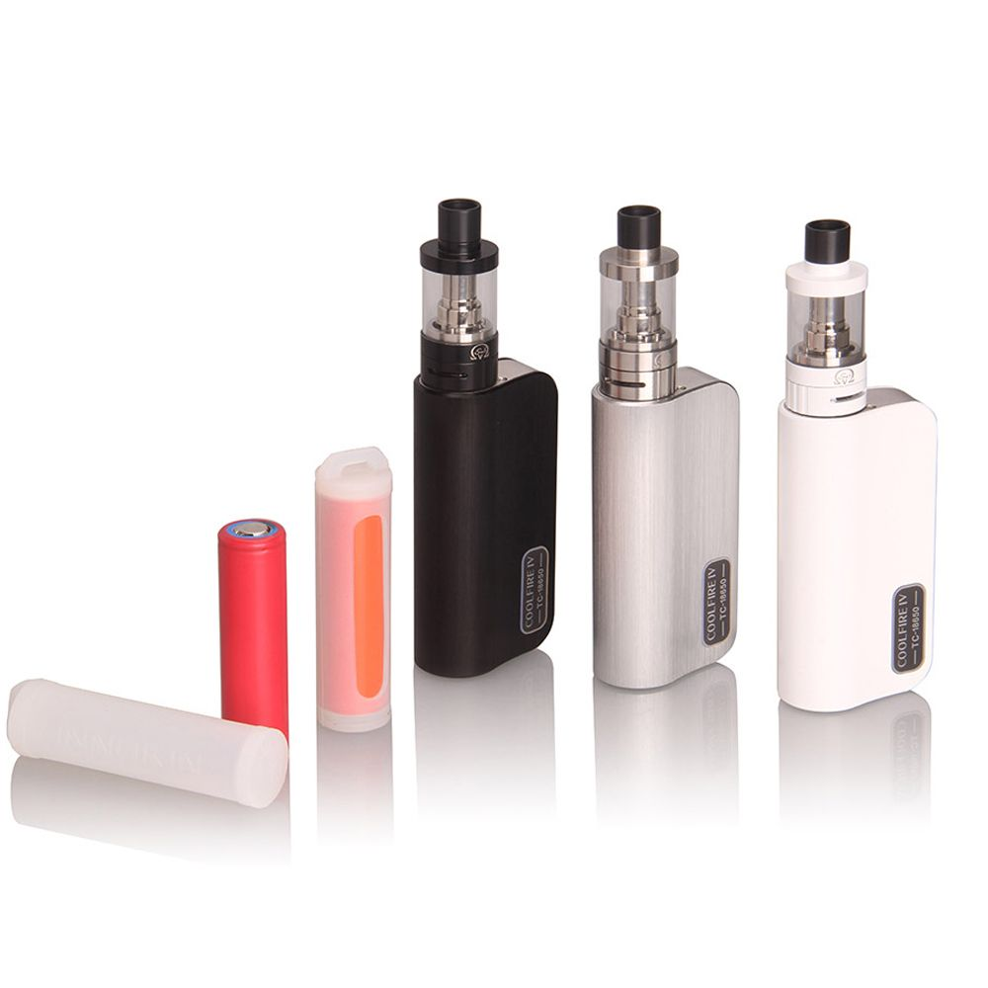
Types
People who smoke e-cigarettes are typically split into two categories.
People who vape and people who Juul.
Kanger Tech, SMOK, GeekVape, Pax Labs, and Juul are 5 major brands
Juul exclusively makes Juul products while the others make vape with some juul products
Juul used to be part of Pax Labs, then split in 2015

Slide 4
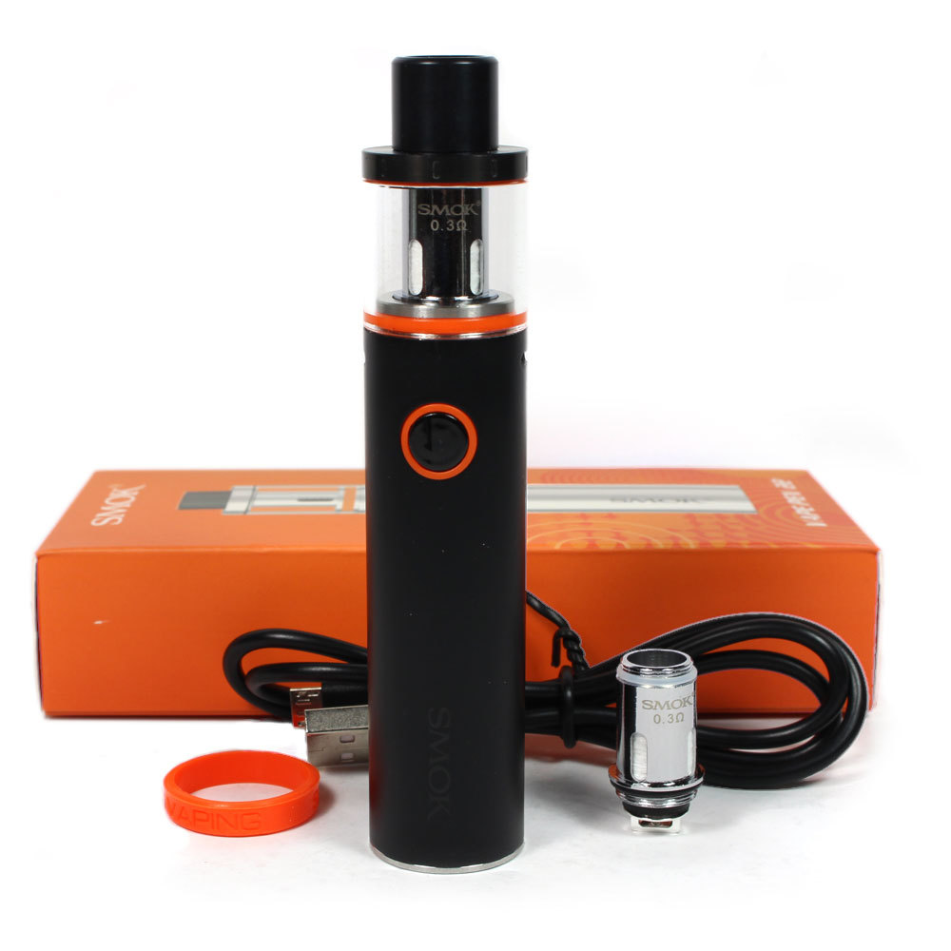
Components of Vape and Controversy
Can be split into several standard pieces
Mouthpiece used to inhale
Cartridge used to hold the liquid
A heating element, typically an atomizer used to turn liquid into gas
Power source, typically a rechargeable battery like the 1300mAh EVOD Twist VV
Controversy over nicotine in Juul and vape
Over health concerns, unsure of dangers to body

Slide 5
SMOK and Juul
Chinese company
Located in Shenzhen, Nanshan district which is the global manufacturing center of vape in the world
Ingredients include liquid include water, vegetable glycerin, propylene glycol, flavouring, nicotine
Around 80 million people and more vape or juul in the world today
Juul in 2018 raised 650 million and was valued at 15 billion

Slide 6
Production and Controversy
Vape juice is typically made from propylene glycol, glycerin, water, nicotine, and flavorings. Can be made with or without nicotine.
Most ingredients in juice’s are safe for consumption, although some combinations of flavors could create new chemicals which are unknown if they have harmful effects.
As this product is relatively recent in its inception, the only controversy is over health effects as compared to smoking traditional cigarettes.
There is no violence, social movements, or injustice in the creation of vape and juul mods along with their respective juices

Slide 7
Vape Juice and how its made
Vape juice is primarily propylene glycol or vegetable glycerin. One of these two typically composes 90% of the juice.
The remaining 10% is water, food flavoring, and nicotine depending on preference
The food flavoring is the same as what is used in items like ketchup or ice cream
The PG or VG is primarily meant to help spread the flavor and/or nicotine within the liquid of the juice

Slide 8
Juul Juice and how its made
Juul Juice is primarily made from glycerol, propylene glycol, natural oils, extracts and flavors, nicotine and benzoic acid
Juul products com prepackaged small capsules that all come with nicotine
All Juul products have nicotine as opposed to vape that comes with or without
Juul packaging has no way of being recycled when thrown out which creates more waste in the environment
The vapor itself has no harmful effects on the environment and won’t cause second hand smoking

Slide 9
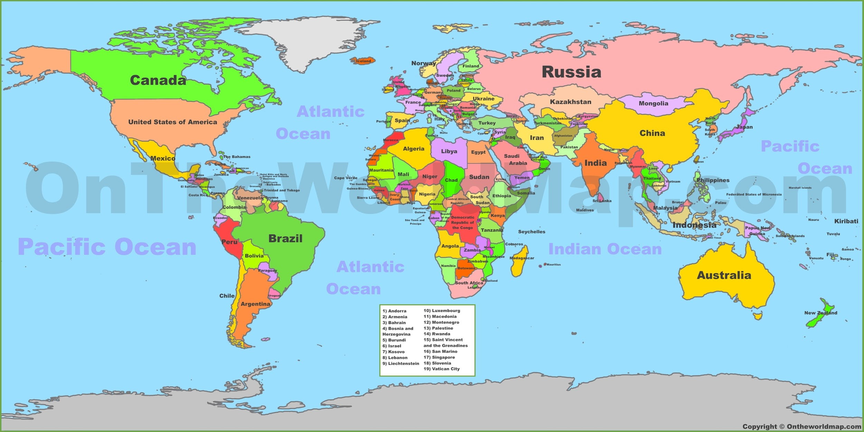
Map

Slide 10
Map Flows
The world’s largest exporter of vape products is China
China exports 95% of the world vape supply with four companies basically having total control over the market
The US is the largest importer of vape products as well as having the largest user base at 9 million+
Europe has a wide vaping market but it is currently driven by only a handful of countries
It is mainly headed by five countries, in order from greatest to least, being the UK, Italy, France, Russia, and Poland
Asia is the most populated continent, so even though penetration density is not as high, the area still has the most vape user

Slide 11
Map Flows Continued
Asia’s largest market in terms of 1 per 100 is Malaysia at 1 million
Although Japan currently has a small market, its growth is the highest in the world, with the amount spent on products in 2016 a increase of 5x from 2015
Although China is the largest exporter, its own market is rather small
However this is relative as even with only 1% of people vaping would amount to 13 million people
South Korea has approximately 1 million users
Indonesia is estimated to have around 700,000 vape user while the Philippines could have anywhere up to 4 million users

Slide 12
Map Flows Continued
Australia has around 129,000 regular users of vape
Within Africa as a whole, vaping is mostly nonexistent
Only in South Africa has there been a rise in vaping with the numbers currently being around 200,000
South America also has nearly zero amount of vape users because of many countries inputting many regulations and restrictions
For instance, Argentina banned the sale and import of e-cigarettes in 2011, Brazil banned the manufacture and sale in 2014, and Uruguay banned the sale of vape products completely

Slide 13
Health Issues and Friction
The FDA has been running several programs in an effort to scare teens as to the health effects of vaping
For instance, saying that one Juul pod has 20x the concentration of nicotine within it as compared to typically cigarettes
The FDA is doing this because the rate of teens being introduced to vape is continuously on the rise to where the FDA calls it an epidemic
They say that it delivers nicotine which can harm the adolescent brain as well as heavy metals and other damaging chemicals
This is partially because vape is simply to new for there to be long term studies on if there is damage to health

Slide 14
Video
https://www.youtube.com/watch?v=1OGI4f6IwnM&list=PLDVVQDN6OECnkDWTaZoMlZH81376hREHF&index=1

