Slide 1
Coffee
By: Thomas Trento

Slide 2
Where does it come from?
Dominated by mostly South American, Central American, and African nations with few Asian nations as well.
Top 5 nations: Brazil, Vietnam, Colombia, Indonesia, Ethiopia.
Roughly 21 trillion pounds of coffee are produced each year.

Slide 3
Top Producing Nations
Rank | Country | Amount (in pounds)
1 | Brazil | 5,714,381,000
2 | Vietnam | 3,637,627,000
3 | Colombia | 1,785,744,000
4 | Indonesia | 1,455,050,000
5 | Ethiopia | 846,575,000
6 | Honduras | 767,208,000
7 | India | 767,208,000
8 | Uganda | 634,931,000
9 | Mexico | 515,881,000
10 | Guatemala | 449,743,000

Slide 4
How much is imported to the United States?
Colombia: US$1.3 billion
Brazil: $1.1 billion
Canada: $543.9 million
Vietnam: $541.3 million
Guatemala: $336.2 million
Indonesia: $319.3 million
Honduras: $297 million
Nicaragua: $295.1 million
Peru: $227.3 million
Mexico: $225.5 million
Switzerland: $189.1 million
Ethiopia: $149.7 million
Costa Rica: $145.1 million
Germany: $125.2 million
Italy: $112.2 million
US imports about $6.3 billion worth of coffee a year (19% of all globally imported coffee).
About 3 billion pounds
Top exporters: Colombia and Brazil

Slide 5
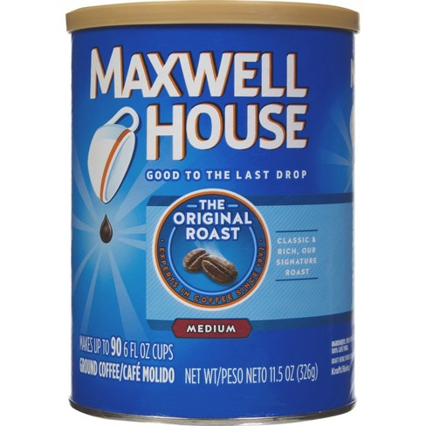
Major Corporations
Popular brands: Dunkin Donuts and Starbucks
Maxwell House, Folgers, and Chock Full O’nuts
Maxwell House:
Subsidiary of Kraft Heinz
$5.5 million dollars annually in profit
About 191 employees
Headquarters in Tarrytown, NY
Main production occurs in Jacksonville, Fl
Main Controversy:
They do not use Fair Trade coffee

Slide 6
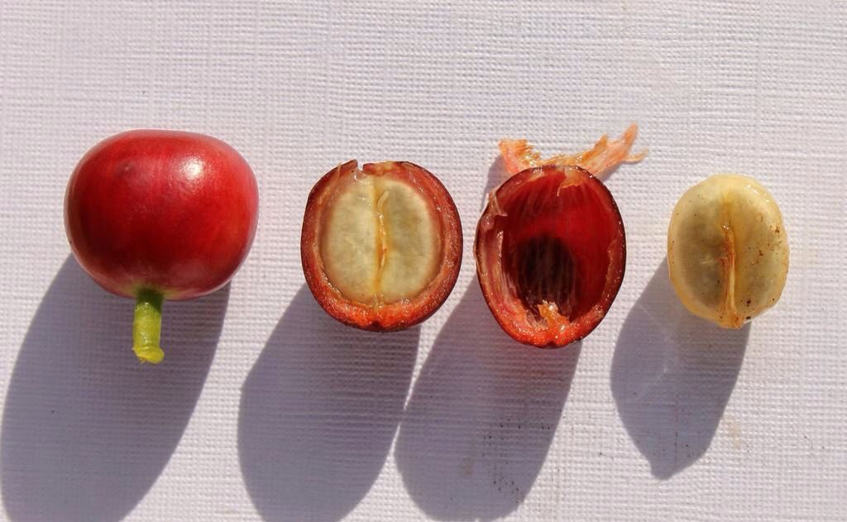
Production Process
Coffee plants usually begin to grow flowers 4-5 years after being planted
Picked by hand or machine by the farmers.
3 Main processes:
Wet Process
Dry Process
Semi-dry Process
Milling:
Hulling- removal of final pieces of fruit
Polishing- optional, used to enhance green look
Cleaning/Sorting- sort by size, weight, color
Grading- size, imperfections, altitude
Once in the US, corporations may choose to age their coffee beans or decaffeinate them.
Lastly, companies often select to roast their beans before packaging and selling them.

Slide 7
Controversy with Production
Environment
Wet process creates coffee wastewater which is a pollutant and harmful to the environment.
Use of pesticides
Deforestation and habitat destruction
Economic
People of smaller coffee producing nations cannot compete with larger ones and are fleeing their homes in search for better jobs and opportunities
Workers
Low wages
Long hours
No work benefits
Child labor
Violence
Murders
Robberies

Slide 8
Social Movements
The Fair Trade Movement is the most popular campaign involved with the production of coffee
Fight for higher, livable wages for all workers and to restrict the employment of children

Slide 9
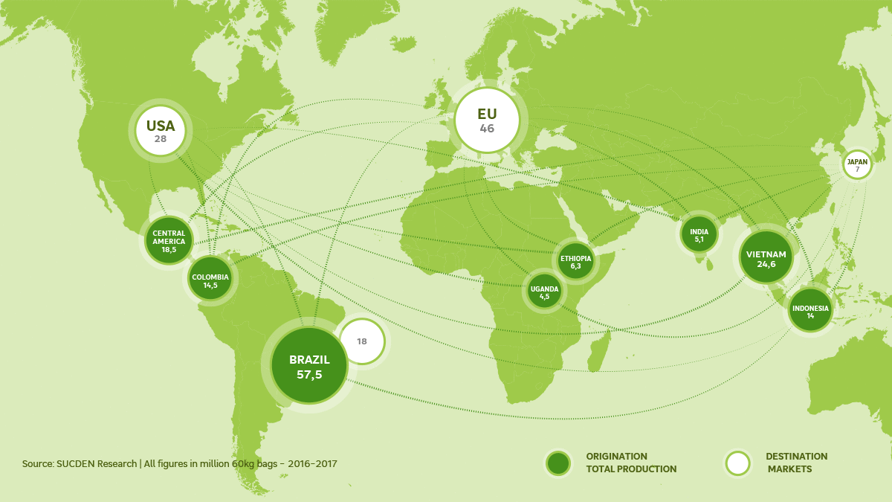
Map Flow
The US does not levy any import duties on coffee

Slide 10
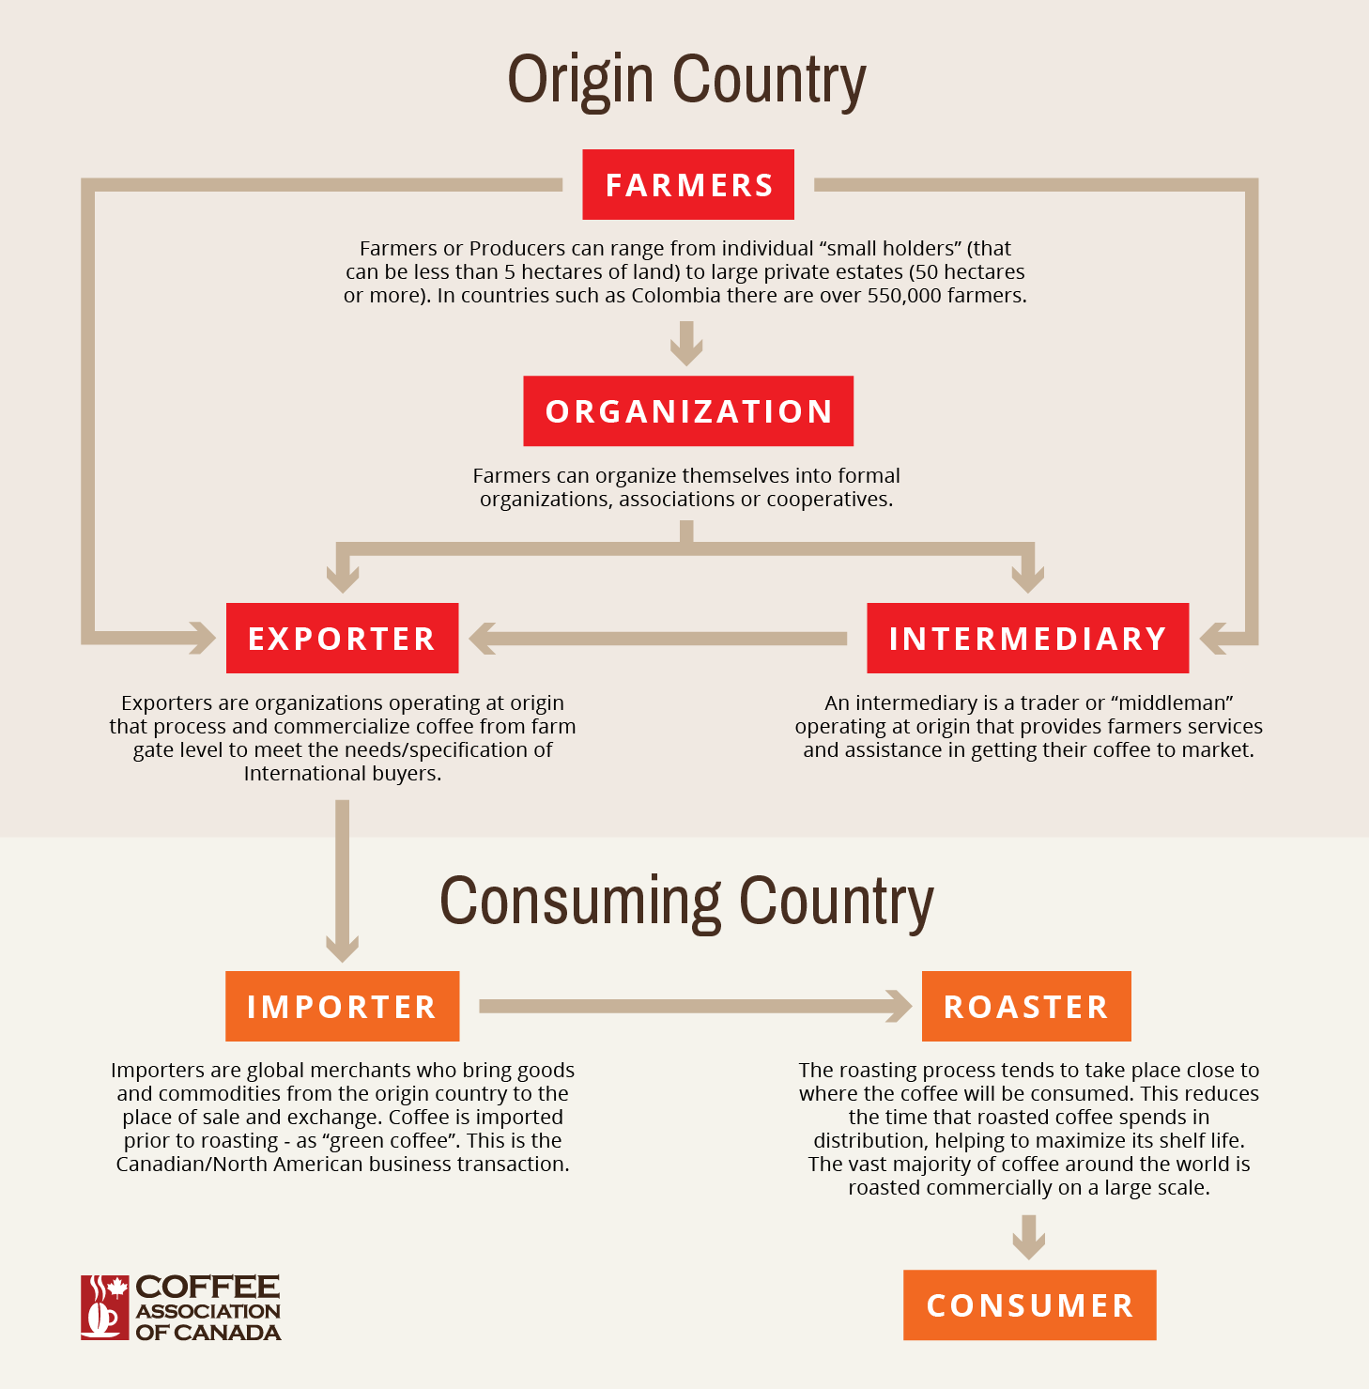
Map Flow

Slide 11
Injustice
8% of Starbucks’ coffee is Fair Trade coffee. 95% of the remaining 92% is considered “ethically sourced”.
World wide, Starbucks is trying to lower the standards for what is considered Fair Trade.
2012-2013 Starbucks donated millions of dollars to the Grocery Manufacturers Association (GMA) to defeat Washington’s (state) I-522 which would require agricultural products to be explicitly marked as organic or GM, as well as require companies to obtain a certain amount of Fair Trade products. The resolution ultimately failed to pass by a margin of 1%.

Slide 12
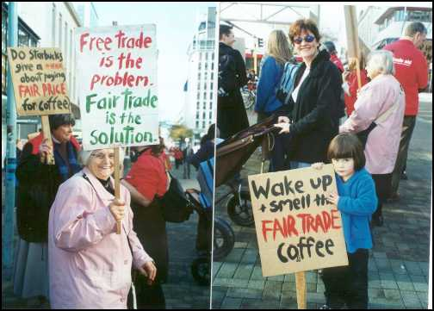
Campaigns and Protests
The Campaign to Humanize the Coffee Trade often sets up protests outside local Starbucks shops in Seattle to try to get the company to increase their use of Fair Trade coffee.

Slide 13
Advertising
Both Dunkin Donuts and Starbucks advertise their products as being helpful to one’s ability to work hard and get through the day.
Dunkin’s slogan “America Runs On Dunkin” is more of an all encompassing slogan aimed at the everyday person
Starbucks, with their free wifi and lounges (and slightly pricier products) creates a social status that many see to be of a higher class.

Slide 14
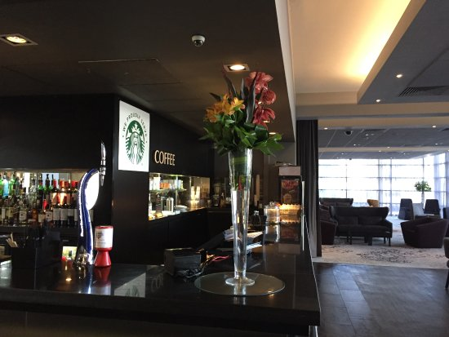
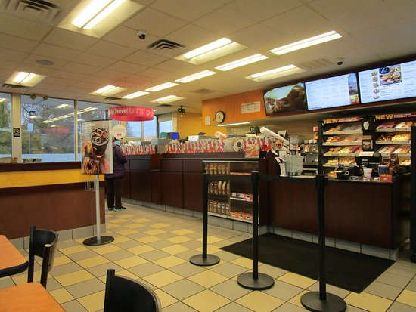
Advertising

Slide 15
Commodity Fetishism
A lot of information regarding the production of coffee beans and the trade of them are available online but are not directly linked to specific companies. When searching for information specific to companies like Starbucks and Dunkin Donuts, not as much detailed information is as readily available.

Slide 16
Protest/Boycott, Campaign, and Take Action
Protests and boycotts are often good ways to create change in an industry because they directly affect the pockets of the big corporations.
Create a campaign to educate others on Fair Trade practices.
Contact your local Congressman
https://www.govtrack.us/congress/members/NJ#representatives

