Slide 1
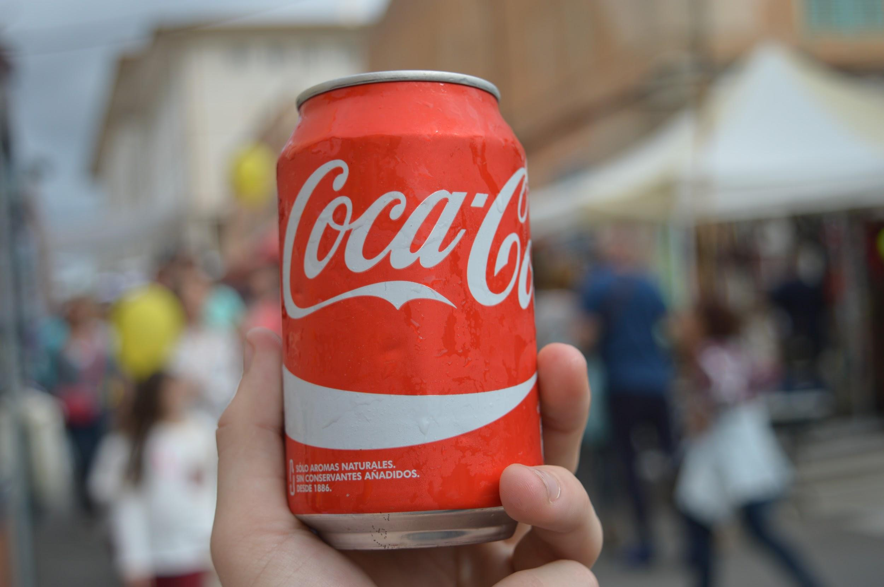
Coca Cola
By: Heba Hamdan

Slide 2
Where is Coca Cola produced?
Founded in 1892 by John Stith Pemberton
The Coca Cola company is an American corporation that was originally manufactured in Atlanta, Georgia.
The Coca Cola company has up to 900 bottling and manufacturing facilities all over the world.
( Ex: Europe, Latin America, Middle East, Africa, etc.)
The coca leaf is grown as a cash crop in Argentine Northwest, Bolivia, Colombia, Ecuador, and Peru.
Coca cola is flavored with a non-narcotic extract from the coca, the plant from which cocaine is derived.

Slide 3
Coca Cola imports
According to the site of worldtradedaily.com , Coca Cola imported 1.4 billion dollars worth of product from December 2010 to December 2011. 11,003 shipments carried the products to the United States, 11,001 came from Puerto Rico. ( the major source of coca cola imports to the U.S. in 2011.)

Slide 4
Coca-Cola beverages and products:
Coca Cola company is the world’s largest beverage company.
It owns brands including Diet Coke, Coca-Cola Zero, Fanta, Sprite, Dasani, Vitamin water, powerade, minute maid, etc.
It has contracts with Mcdonalds, Subway, and Burger King.

Slide 5
Coca-Cola’s net operating revenues
Net revenue by year
2017: 35.41
2016: 41.86
2015: 44.29
2014: 46
( in billion U.S dollars )

Slide 6
Coca-Cola
In 2017, the company employed some 61.8 thousand people worldwide.
Revenue amounted to about 35 billion dollars worldwide in 2017.
Controversies:
Coca-Cola was blamed for depleting the local supply of water in Kerala, India, even in communities it did not have operations, although coca-cola said the facts proved otherwise. Coca-Cola was challenged regarding its water stewardship in india and elsewhere, it then initiated a risk assessment. Water infrastructures came as a resolution and coca-cola then committed to fully replace the water it uses in its finished products.

Slide 7
Production Process
In today’s production the company Coca Cola uses de-cocainized versions of the leaves (called spent coca leaves) as flavoring.
There is only one company in the United States that processes coca leaves; that company is the Stepan Company of Maywood, New Jersey. This company legally produces cocaine for use in pharmaceuticals and then sells the unspent coca leaves for use in Coca-Cola.The plant grows almost exclusively in northern and western South America.
The coca plant grows best in the mountain and jungle areas of these countries.The hand picked coca leaves are soaked in gasoline and other chemicals to extract the coca base from the leaves in industrial-sized drums. Then the base is poured into brick molds. The water is pressed out, leaving a hard, easy-to-handle brick containing about 50 percent cocaine. The bricks are sent to collection points where they are shipped to markets in the U.S. and other countries.
https://www.youtube.com/watch?v=heQ-fAE8k2E

Slide 8
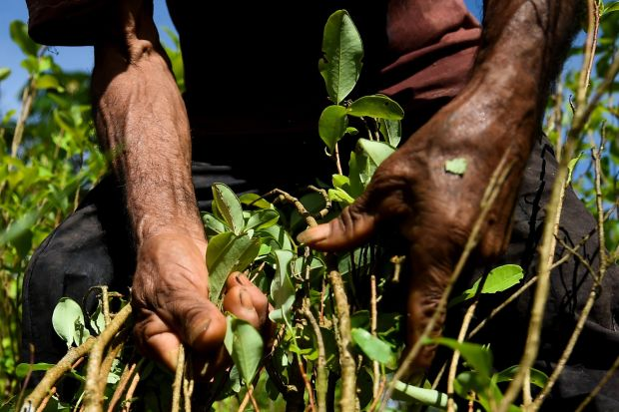
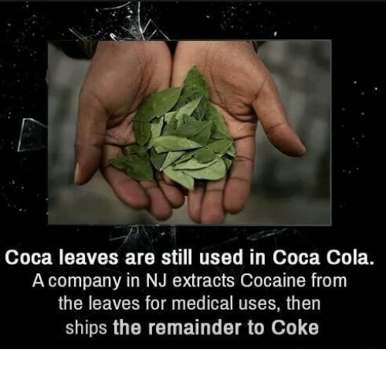
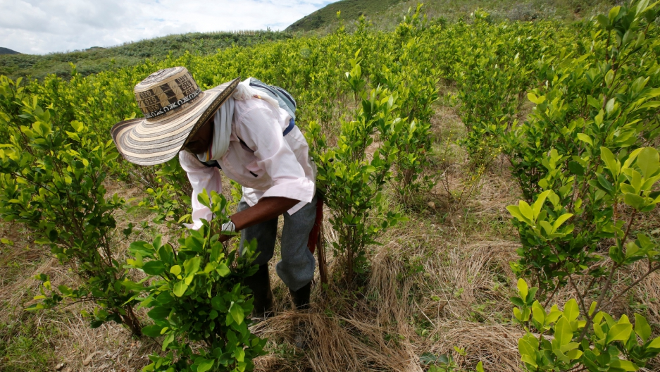
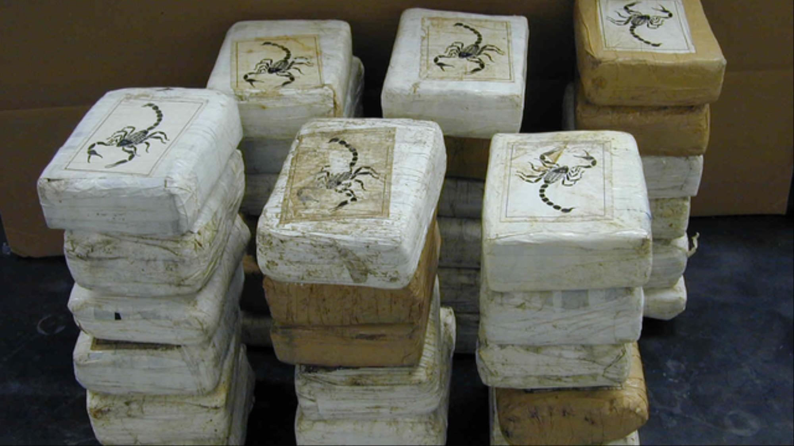

Slide 9
Coca Cola
Trade unions around the world have launched a boycott of Coca-Cola products, alleging that the company's locally owned bottlers in Columbia used illegal paramilitary groups to intimidate, threaten and kill its workers.
Coca Cola's Colombian bottlers have also denied the accusations. Colombia is the world's most dangerous country in which to be a union member, with 184 of the world's 213 confirmed killings last year, according to the International Confederation of Free Trade Unions.
On October 5, at least six coca growers were shot dead and 21 wounded while protesting against a coca eradication operation carried out by the Colombian army. ( highlights difficulties in implementing peace agreement.)
Many disadvantaged workers relied on the Coca plant, as it was their only source of getting any decent pay.

Slide 10
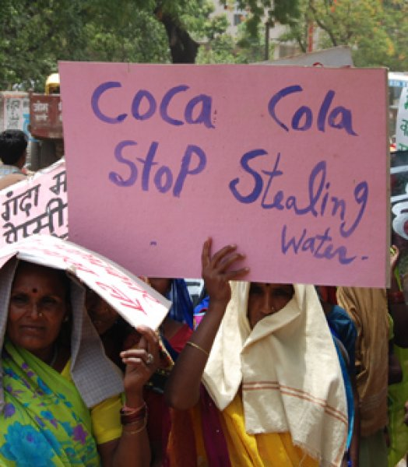
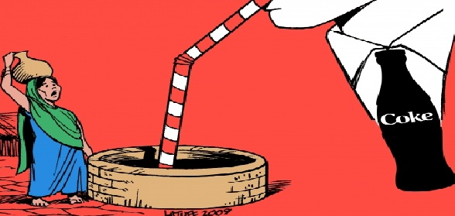
Coca Cola and Water Consumption
Many groups raised lawsuits against Coca Cola’s vast consumption of water, even in water scarce regions. People also blamed Coca Cola for contaminating water with pesticides.

Slide 11
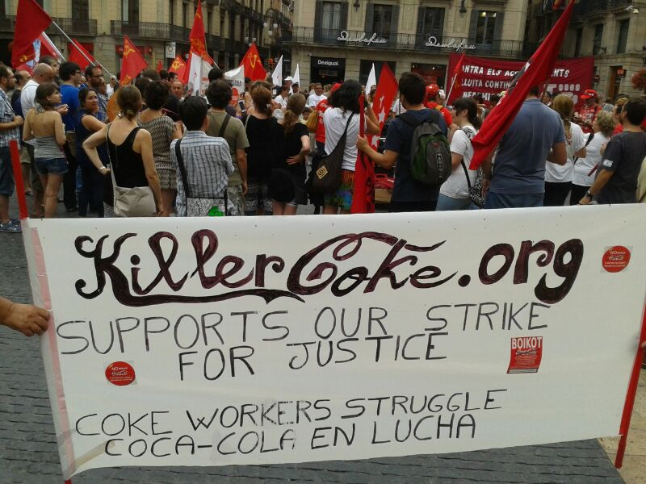
Social Movements
Coca Cola provided $10 million to start the Colombian Foundation for Education and Opportunity, an organization that addresses the needs of victims of violence.
On Nov. 18, students at the University of California Berkeley held a vigil to protest Coke's alleged human rights abuses and ask the university's administration to revoke its contract with Coke that allows the company exclusive marketing rights on the campus.On Nov. 18, students at the University of California Berkeley held a vigil to protest Coke's alleged human rights abuses and ask the university's administration to revoke its contract with Coke that allows the company exclusive marketing rights on the campus.

Slide 12
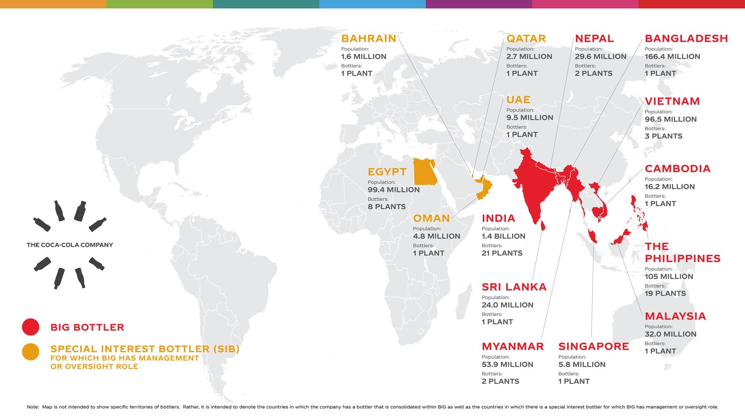
Map Flow
https://www.seair.co.in/us-import/product-coca-leaf.aspx.
BIG was created to ensure those bottling operations receive the appropriate investments and expertise to ensure their long-term success.

Slide 13
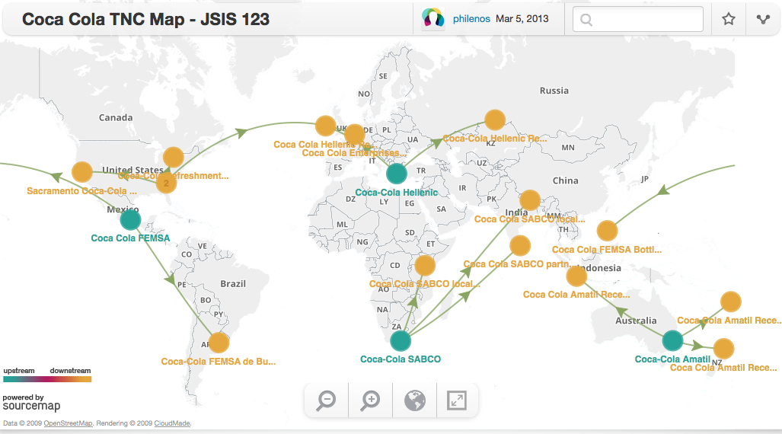

Slide 14
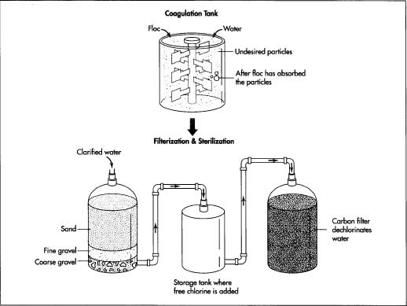
Manufacturing Process
Ingredient Delivery
Washing and Rinsing
Mixing and Blending
Filling
Capping
Labeling
Coding
Inspecting
Packaging
Warehousing and delivery

Slide 15
Ingredients
Sugar : Brazil , China , Columbia, Costa Rica , El Salvador
Caffeine: Brazil, Cameroon , China, Columbia , Ethiopia
Flavoring Mixture: Argentina, Australia , China, Mexico , Japan

Slide 16
Manufacturing and Distribution Policies
Coca Cola operating requirements ( KORE ) manages requirements and specifications.The quality and safety of all systemwide operations are monitored and measured using the same standards.
Program helps identify and mitigate risks and drive improvements.Test and measure the quality attributes of beverages in modern laboratories at every step of production.
Performed in all of the countries and territories where product is produced and sold.
Global Food Safety Initiative(GFSI)- program requiring suppliers to achieve certification under the standards of the program.Strengthens the quality and food safety assurance processes of the supply base

Slide 17
Transportation
Tribe Transportation
Tribe transportation’s partnership with Coca Cola
Tribe has delivered Coke products to 236 cities in 42 states. In central Florida, its work hauling products from Minute Maid, Simply Orange, Powerade and vitamin water has helped the company attract more drivers in the region, which is one of its largest hiring bases.
Additional Fact : Delivery Driver for Coca Cola company would earn about $18 $29 dollars per hour.

Slide 18
Trade Disputes
The two companies have a strategic partnership, which restricts Coke from encroaching on Monster’s core product line.As part of their original agreement, Coca-Cola agreed not to compete in the energy drink category with certain exceptions, a provision of the partnership that Monster now claims Coca-Cola is violating.Coca-Cola has been clear that it prefers having an equity investment in Monster over outright ownership, but Monster’s shares have still been trading with a takeover premium, they said.

Slide 19
What you can do
https://ramapo.sodexomyway.com/contact/feedback
https://www.greenpeace.org.uk/what-we-do/oceans/coke/
Up to 12 million tonnes of plastic is entering the oceans every year. This is affecting sea life – one in 3 turtles and 90% of seabirds are now estimated to have ingested plastic. Plastic is even ending up in the seafood on our plates. Coca-Cola produces an estimated 100 billion throwaway plastic bottles every year – and billions of these will end up on beaches, in landfill and in the sea.

Slide 20
Work cited
https://www.washingtonpost.com/news/business/wp/2018/05/31/how-coca-cola-came-to-terms-with-its-own-water-crisis/?noredirect=on&utm_term=.8ad488bfce12
https://www.statista.com/statistics/233371/net-operating-revenues-of-the-coca-cola-company-worldwide/
http://killercoke.org/campus_activism.php
https://waronwant.org/media/coca-cola-drinking-world-dry

