Slide 1
CANADA GOOSE PARKA
BY:
ALLIE ALLEN&
AMANDA GOULDSBURY

Slide 2
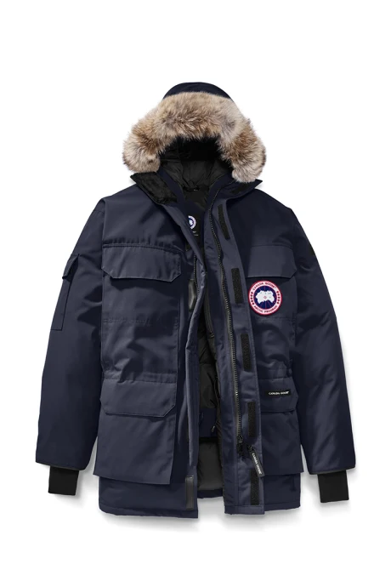
Canada Goose is a Toronto based company specializing in winter parkas.
Canada Goose uses coyote fur on along with duck and goose down filling for their widely known parkas.
There is a lot of controversy involving fair trade with this company.
Fur
Down
Shell
Lining
Patch

Slide 3
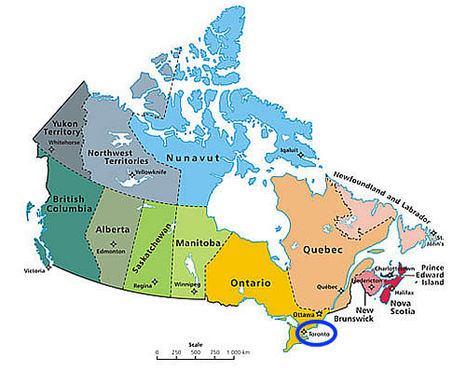
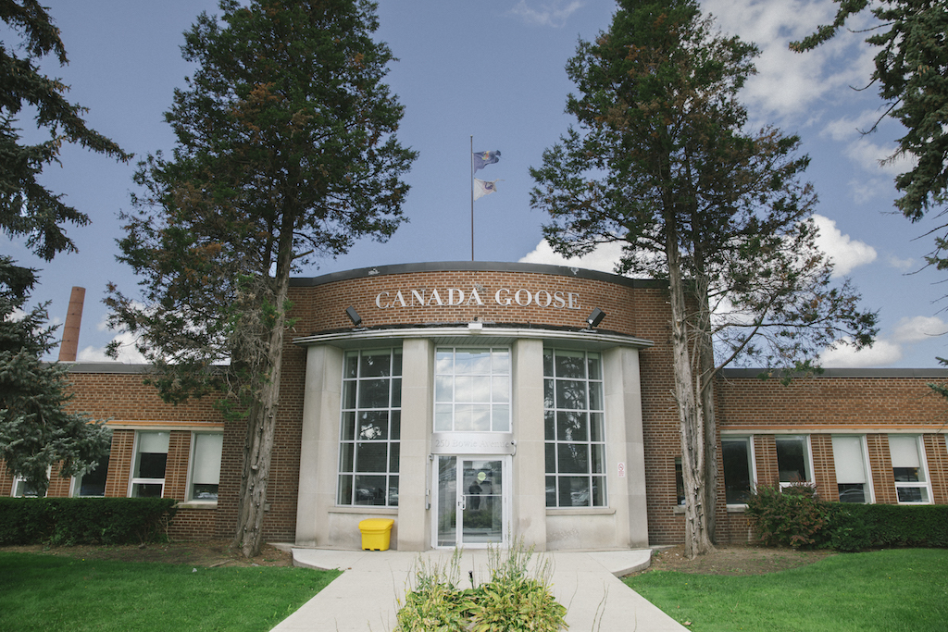
250 Bowie Avenue Toronto, ON

Slide 4
PRODUCTION PROCESS
At the company’s 90,000-square-foot headquarters uptown, 300 workers spend their days designing, cutting, sewing, stuffing and cleaning the ubiquitous coats.
The top 10% of sewers in Canada are employed to help create the jacket
The factory floor is divided into sections, each responsible for assembling a different piece of the parka. The coat travels from section to section until the production cycle is complete.
The jackets are stuffed with duck and goose down supplied from an outside supplier
Then a coyote fur trim is added to the hood of the coat

Slide 5
DUCK AND GOOSE DOWN
Canada Goose sources its duck and goose down from the Toronto-based company Feather Industry. Four blends are used, all of which incorporate high-quality Hutterite down.
Feather Industry purchases their down from suppliers such as, Manitoba’s James Valley Colony Farms (JVC) — which breeds 130,000 geese a year
At the slaughterhouse, workers shackle the ducks and geese, hang them upside down, and slit their throats as the other birds watch
Ducks and Geese necks are cut and their bodies are dumped into scalding-hot water.
Although Canada Goose tries to deny this, many “geese from the JVC farm where the video is shot are meant to provide down feathers for Canada Goose parkas. They’re shipped to a Manitoba processing plant. Toronto-based Feather Industries then buys the feathers for use in the coats, said Feather Industries spokesman Alex Pryde.”
https://youtu.be/qKRpJneXdw4

Slide 6
FABRIC
Arctic-Tech Fabric used for shell & lining
Designed by Canada Goose- “ to stay dry and keep you warm in extreme conditions and climates.”
[85%] POLYESTER + [15%] COTTON BLEND WITH DURABLE WATER REPELLENT FINISH

Slide 7
COYOTE FUR
Buys their fur from North American suppliers
Not much information because the coyotes are killed in the wild
The fur trim that lines the hoods of the company’s winter jackets comes from wild coyotes who are first trapped and killed
steel leg clamps, head-crushing traps, body-gripping traps, or neck snares.
If traps don’t work, they’re shot, strangled, stomped on, or bludgeoned to death
The Coyotes are then skinned for their fur

Slide 8
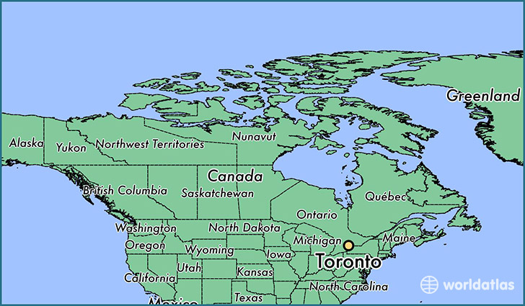
Feathers from James Valley Colony Farms, Manitoba Canada
Coyote fur from northern American States

Slide 9
PRODUCT PROCESS IN THE FACTORY
Product development department: designers dream up concepts for each coat. The line drawings are turned into patterns, which are copied onto large pieces of paper.
The spreading stage: up to 60 layers of fabric are laid out on a long table. The pattern for the coat is placed on top.
Once the pieces are cut, they’re bundled and distributed to different production lines.
The Canada Goose badge is attached to a separate piece of fabric using a specially designed sewing machine.
Workers sew a lining into the coat, leaving a hole where stuffing will later be inserted.
In the stuffing room, each section of the coat is pumped with down.
Once all the coat’s panels are stuffed, they’re sent back to the factory floor to be pieced together.
Once the lining has been assembled, it’s sewn into the outer shell.
In the finishing department, coyote-fur trim is added to the coat’s hood.

Slide 10
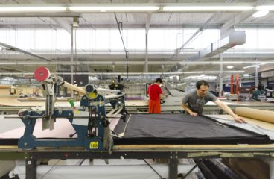
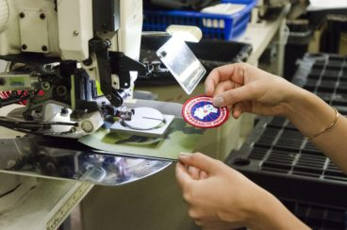
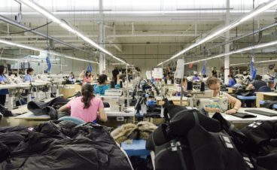
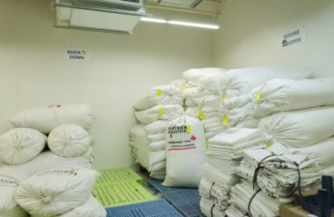
The spreading stage
The Canada Goose badge is sewn and attached
The stuffing room
Duck and Goose down separated ready for stuffing process

Slide 11
Commodity Fetishism
Throughout all the research done over the weeks none of the distribution process is 100% visible when the jackets are being promoted. You will only see the negatives to the jacket if you go and search for it or in the scandals on social media just like any other company.
As said before the only way you can learn about the process behind the jacket is if you go and search the information yourself

Slide 12
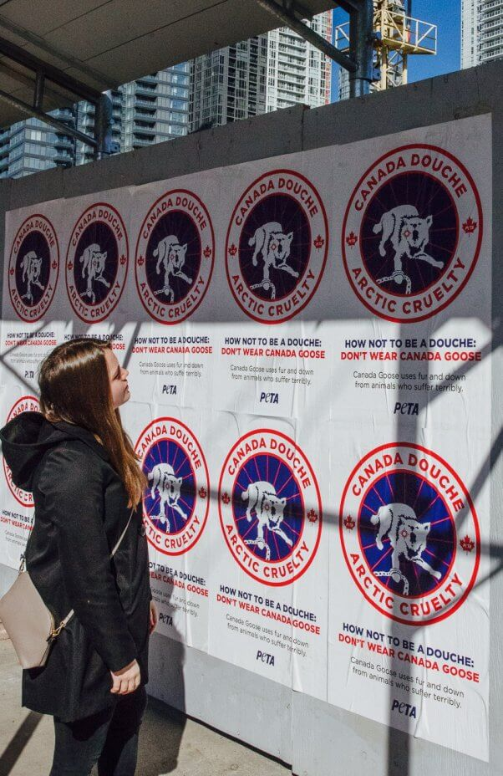
SOCIAL MOVEMENTS AND PROTESTS
From the Canada Goose website: “Our standards for the sourcing and use of fur, down and wool reflect our commitment that materials are sourced from animals that are not subject to willful mistreatment or undue harm.”
PETA, “People for the Ethical Treatment of Animals”: “There’s nothing ‘humane’ about a process in which geese are trampled and suffocated, grabbed by the neck and crammed into tiny cages for hours of terror and misery,” said PETA executive vice-president Tracy Reiman in a statement.
“Canada Douche” Campaign
Focus on educating people about the harm done to animals through Canada Goose parkas

Slide 13
WHAT WE CAN DO...
In order to address the problems of sustainability, equity, and justice they best way to go about it would be an organized protest or possibly a petition stating the beliefs of people against it.
Through both of these ways it would bring a lot of attention to the truths behind the jacket and force someone high up in the company to possibly revise the way they do things in order to make the jacket more sustainable.
Follow @stop.canada.goose on Instagram to join the petition to put an end to animal cruelty committed by Canada Goose (photos are graphic)
Sign a petition @ respectforanimals.org or send a message to the company @ supportpeta.org

