Slide 1
Bottled Water
Andrew Hoffman

Slide 2
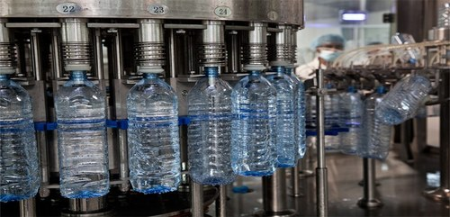
Domestic Production
The production of bottled water in the United States comes from numerous states across the country
Rural areas are the most common with locations in California, Texas, Colorado, New York, Tennessee and more states.
Ironically, water is produced in areas of the country which suffer greatly from drought

Slide 3
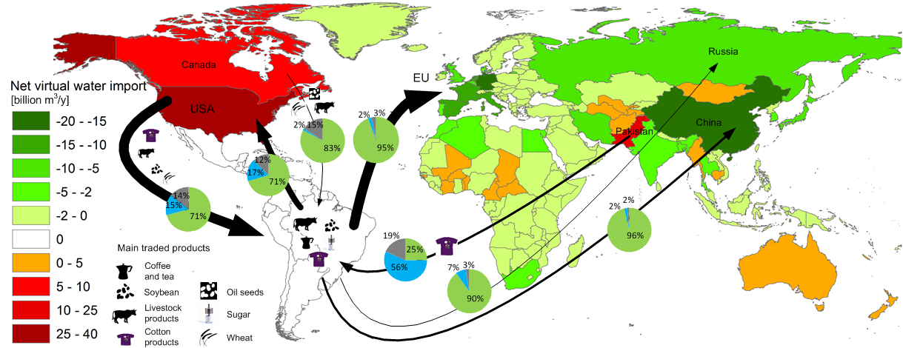
Imports to the United States
China exported over $800 million of bottled water across the world in a recent year
Of that amount approximately $48.6 million went to the United States
Several European nations are also bottled water producers such as France, Spain, Italy, Germany and Poland
These countries along with the United States domestically making bottled water contribute to almost all of it in the country

Slide 4
Corporations Producing
Bottled Water
Nestle- based out of Stamford, Connecticut, they have over 27 different production facilities
Sales in 2017 were $4.5 Billion and the company employs over 9000
Saint Geron Mineral Water- From the village de Saint-Geron in France, both headquartered and produced in that location
They sell over $1 Billion yearly and are one of the highest regarded bottled waters in the world
Other popular corporations: Aquafina, Fiji, Voss
These three corporations are also headquartered in the United States

Slide 5
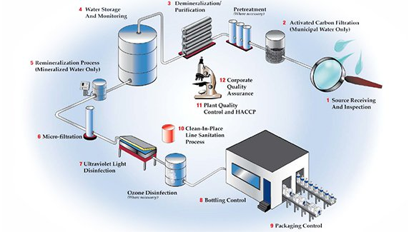
Production Process
The water is acquired from spring sources and underground aquifers which is then taken to production facilities
Water Filtration- The water must be free of any contaminants that will spoil its quality, reduce its shelf life, and be a pathogenic threat to consumers.
Tank Venting- The air in the storage tank must be free of microorganisms to ensure that the water stored will not be contaminated.
Bottle Blower and Washer- To maintain quality and shelf life, using a safe container is essential
Bottle Filler- Gas filtration can also be used during the filling process of carbonated drinks. In order for the filling to be possible, the filler bowl must be pressurized

Slide 6
The light blue circle indicates production facilities of Nestle water in Europe
Some of these countries include Spain, France, Italy, Switzerland, Germany and Poland
The bottled water produced in these countries stay domestically but are also exported to countries like the U.S.

Slide 7
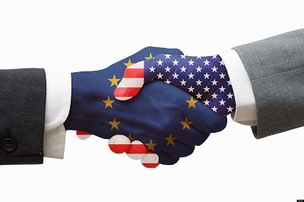
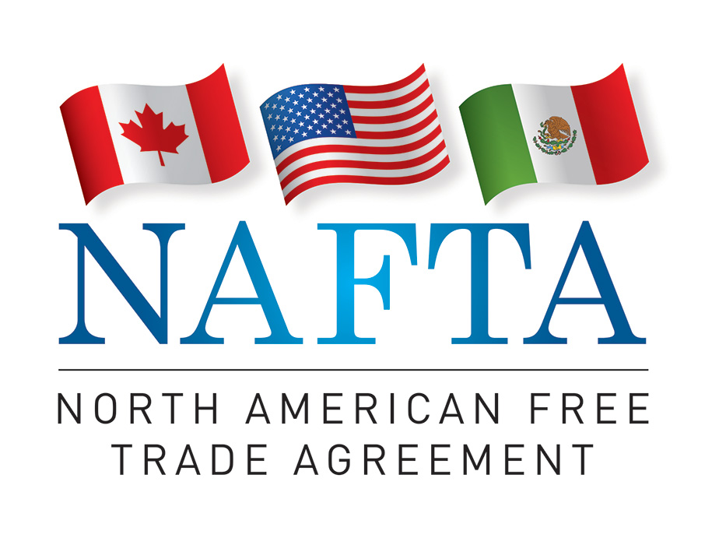
What Enables Trade To The United States?
Exporting products between countries in North America was already being done but when after NAFTA in 1994, importing and exporting between the countries became seamless
Transportation is a positive as the countries are directly next to each other
Overall there is little to no dilemma between North American countries in exporting and importing this product because it benefits everyone.
Europe and the United States also have trade agreements promoting importing and exporting products between different nations
Each country has laws in place that make sure each party benefits from trade and governments also monitor each trade

Slide 8
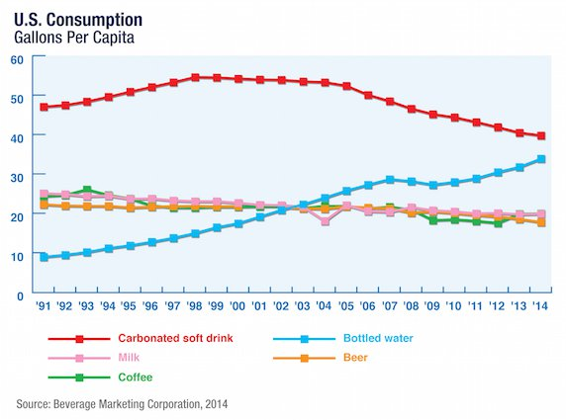
Consumption of Bottled Water
Water is an obvious demand as people need it in order to survive
As the population grows and humans knowledge continues to increase, so has the consumption of water
Each year in the past decade, consumption has grown by nearly 10% each year with over 30 billion bottles consumed each year in the U.S. alone
Advertising is quite simple because it’s something everyone will purchase as long as price and quality are up to par
Desire is at an all time high but prices are still very reasonable due to the quantity available and number of companies competing

Slide 9
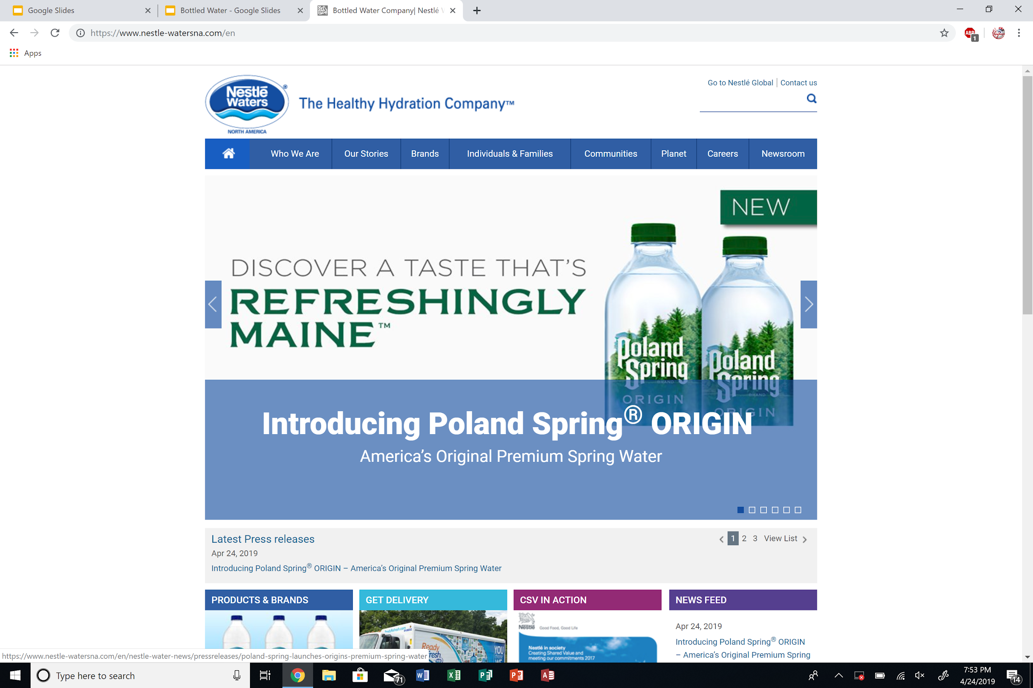
Commodity Fetishism
Nestle has been open regarding their production and distribution process but there's reason to believe there is more the public is not shown
Multiple documentaries have shown locations where their products are produced and at the location are forms of child labor, terrible working conditions and well below a living wage
Companies know that if all consumers see what they do behind the scenes of production, they will quickly fade and other businesses doing the same thing will take their business
Overall I have been able to obtain basic information from nestle, but the secondary sources have been better for finding more in-depth information

Slide 10
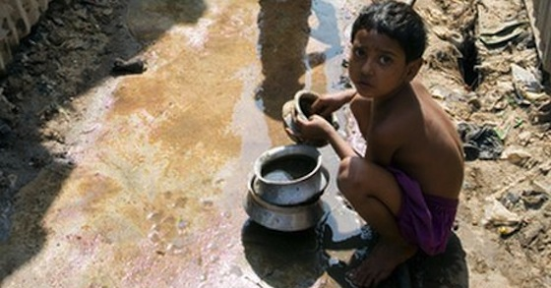
Nestle Bottled Water Production Inequality
First world countries are not known for inequality in trade with one another regarding bottled water
That is different for higher income countries when trading with lower income countries because they have the ability to take advantage of the lower income nations
Low income countries are desperate for business so they bid to pay the least which leads to unfair labor, terrible pay and no room for improvement
Governments do not change this because the benefits greatly outweigh what they risk losing without their imports
The small village of Bhati Dalwan is suffering a water crisis following the development of a Nestle water bottling facility.

Slide 11
Movements against Nestle and the Production of Bottled Water
Nestle is known for child labor, creating mass pollution and taking advantage of those around them as their empire continues to grow
This has prompted many protests and campaigns to slow down this growing monopoly
In a heated race for office in California, one of the stances for the democratic candidate is that action needs to be taken against these corporations while the incumbent believes everything is just fine.
The Global March against child labor is a prominent organization fighting for the children that are forced to work at such a young age for little to no pay. No matter the company they do not tolerate this behavior
Earthjustice is an organization fighting pollution around the globe and goes against large corporations that do not abide by the laws that save the environment

Slide 12
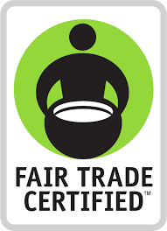
Strategies to fix the glaring problems
It would take a complete overhaul of the current system for complete change, but anyone can still help make a difference to fix the products and companies problems
Purchasing Fair Trade Items
Informing consumers of companies actions
Signing petitions for change
Sharing facts and information on social media
Not buying from corrupt companies
Donating to causes fighting against unjust corporations
An action that is achievable while also effective that I have taken is creating an online petition to create fair trade for bottled water as right now it is essentially non existent.
https://www.thepetitionsite.com/takeaction/578/490/266/

