Slide 1
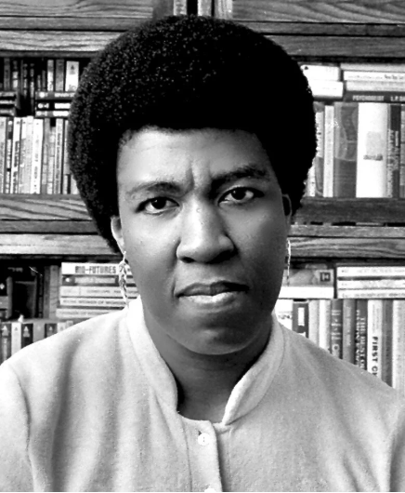

Summer Reading
“In the ongoing contest over which dystopian classic is most applicable to our time, Octavia Butler’s ‘Parable’ books may be unmatched.”—The New Yorker

Slide 2
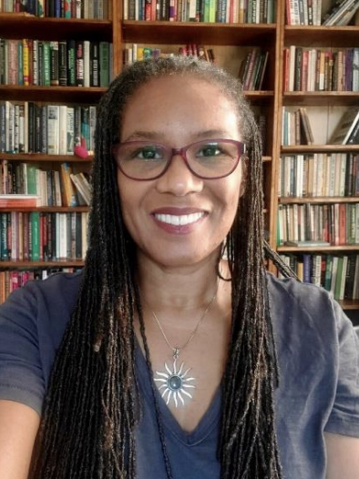
Convocation
Dr. Adenike Davidson serves as Dean of the College of Humanities, Education, and Social Sciences, Professor of Literature and Gender Studies, at Delaware State University, an HBCU. She has served as Director of Women’s and Gender Studies and teaches Literature and Gender Studies courses. Her research areas include African American Literature, Race/Gender/Class, Afro Futurism, and Literary Theory.
Please join us for Opening Convocation
Tuesday August 25 @1:30pm Bradley Center
All are welcome!

