Slide 1
FAIR
Faculty Advisory group on Integrity & Responsibility
4/8/2026

Slide 2
Task: Launched in Fall 2025
We will develop practical guidance and multiple sample syllabus language options that honor Academic Freedom while addressing different pedagogical needs and expectations. These samples will provide flexible ways to communicate expectations around academic integrity and responsible AI use when/if applicable.
Concurrently:
Work with the Academic Policy Council (APC) to revisit our current Academic Integrity Policy to ensure the process is transparent, equitable, and aligned with evolving practices and upcoming changes in teaching and technology.
Continue collaborating with the Faculty Resource Center (FRC) and the Instructional Design Center (IDC) to identify resources, trainings, and ongoing support for faculty.
Collaborate with the Faculty Assembly (FA) to provide updates and survey data on this topic and ask the Faculty Forum to discuss and offer feedback.

Slide 3
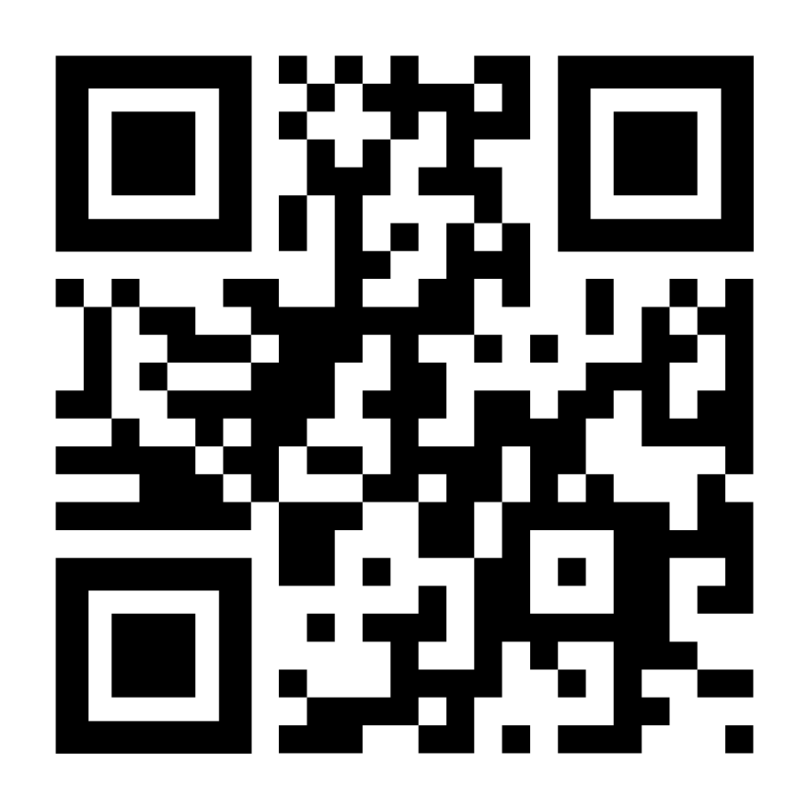
Membership Raw Survey Results
Sourav Dutta
Hugh Sheehy
Fariba Nosrati
Brian McSherry
Dean Chen
Joyce Shim

Slide 4
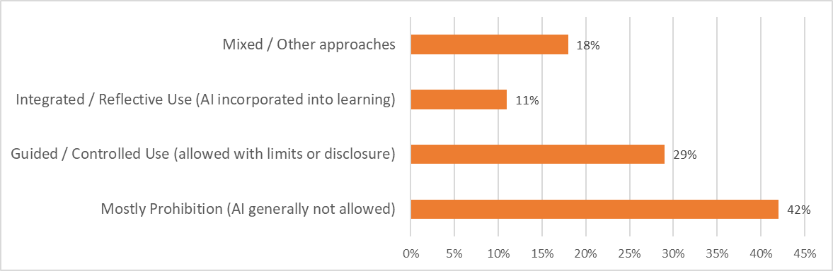
Faculty Survey Result (n=64):
Faculty Approaches to AI Use in Courses
Faculty responses show substantial variation in how AI is handled in courses
Many using either strict prohibition or guided and transparent AI use

Slide 5
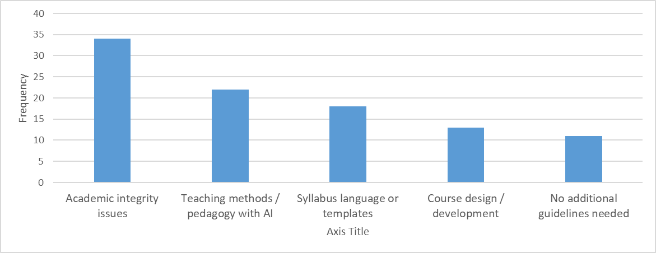
Faculty Survey Result:
Areas Where Faculty Want More Support
Faculty are primarily seeking practical support in three main areas:
Academic Integrity (appropriate vs inappropriate use of AI)
Teaching with AI (how to incorporate AI meaningfully)
Syllabus language (language or templates they can adapt)

Slide 6
Faculty Survey Result
Takeaways
Faculty views on AI tools in the classroom and student work vary. Those who allow or encourage AI tools in the classroom see them as supplements, not replacements, for thinking, knowing, or exercising creative or critical faculties.
Faculty continue to consider originality and academic integrity fundamental to student work.
Faculty are concerned about student skill loss in reading, writing, programming and software design, and critical thinking.
Faculty are witnessing an unprecedented level of academic integrity violations in student work.
Faculty feel they could use more institutional support at various levels, from assignment design to college-wide policy.
A significant minority of respondents (about ⅓) see no use for AI tools in the college classroom.
Many faculty see promise in (1) teaching students to use AI tools as supplements for academic work or (2) creating learning aids (e.g. assignment feedback and digests of difficult concepts).
Many faculty feel obligated to prepare students to use AI tools in the workplace.
Craft optional institutional guidelines to help faculty solve AI-related problems specific to their courses.
The college should supply technological resources to support academic integrity policy.
The college should revise its WI policies and develop courses in AI literacy, ethics, and use.

Slide 7
What we have done so far (In progress)
- FAIR Guideline to Follow
Since Fall 2025, FAIR has collaborated with faculty to draft optional syllabus language addressing artificial intelligence. Guided by your feedback, we have narrowed these down to three distinct sample templated tailored to different levels of AI integration or prohibition:
Prohibited Use
Selective Use
Integrated Use

Slide 8
Academic Integrity Policy Update (In progress)
- APC voted in March and currently in Public Feedback
Ramapo College requires all students to refrain from engaging in academic dishonesty, which includes cheating, fabrication, plagiarism, and other forms of academic misconduct. Students are not permitted to use artificial intelligence tools for coursework unless explicitly permitted to do so by the instructor.
Where students are suspected of academic dishonesty, such matters will be investigated, and penalties may be imposed.

Slide 9
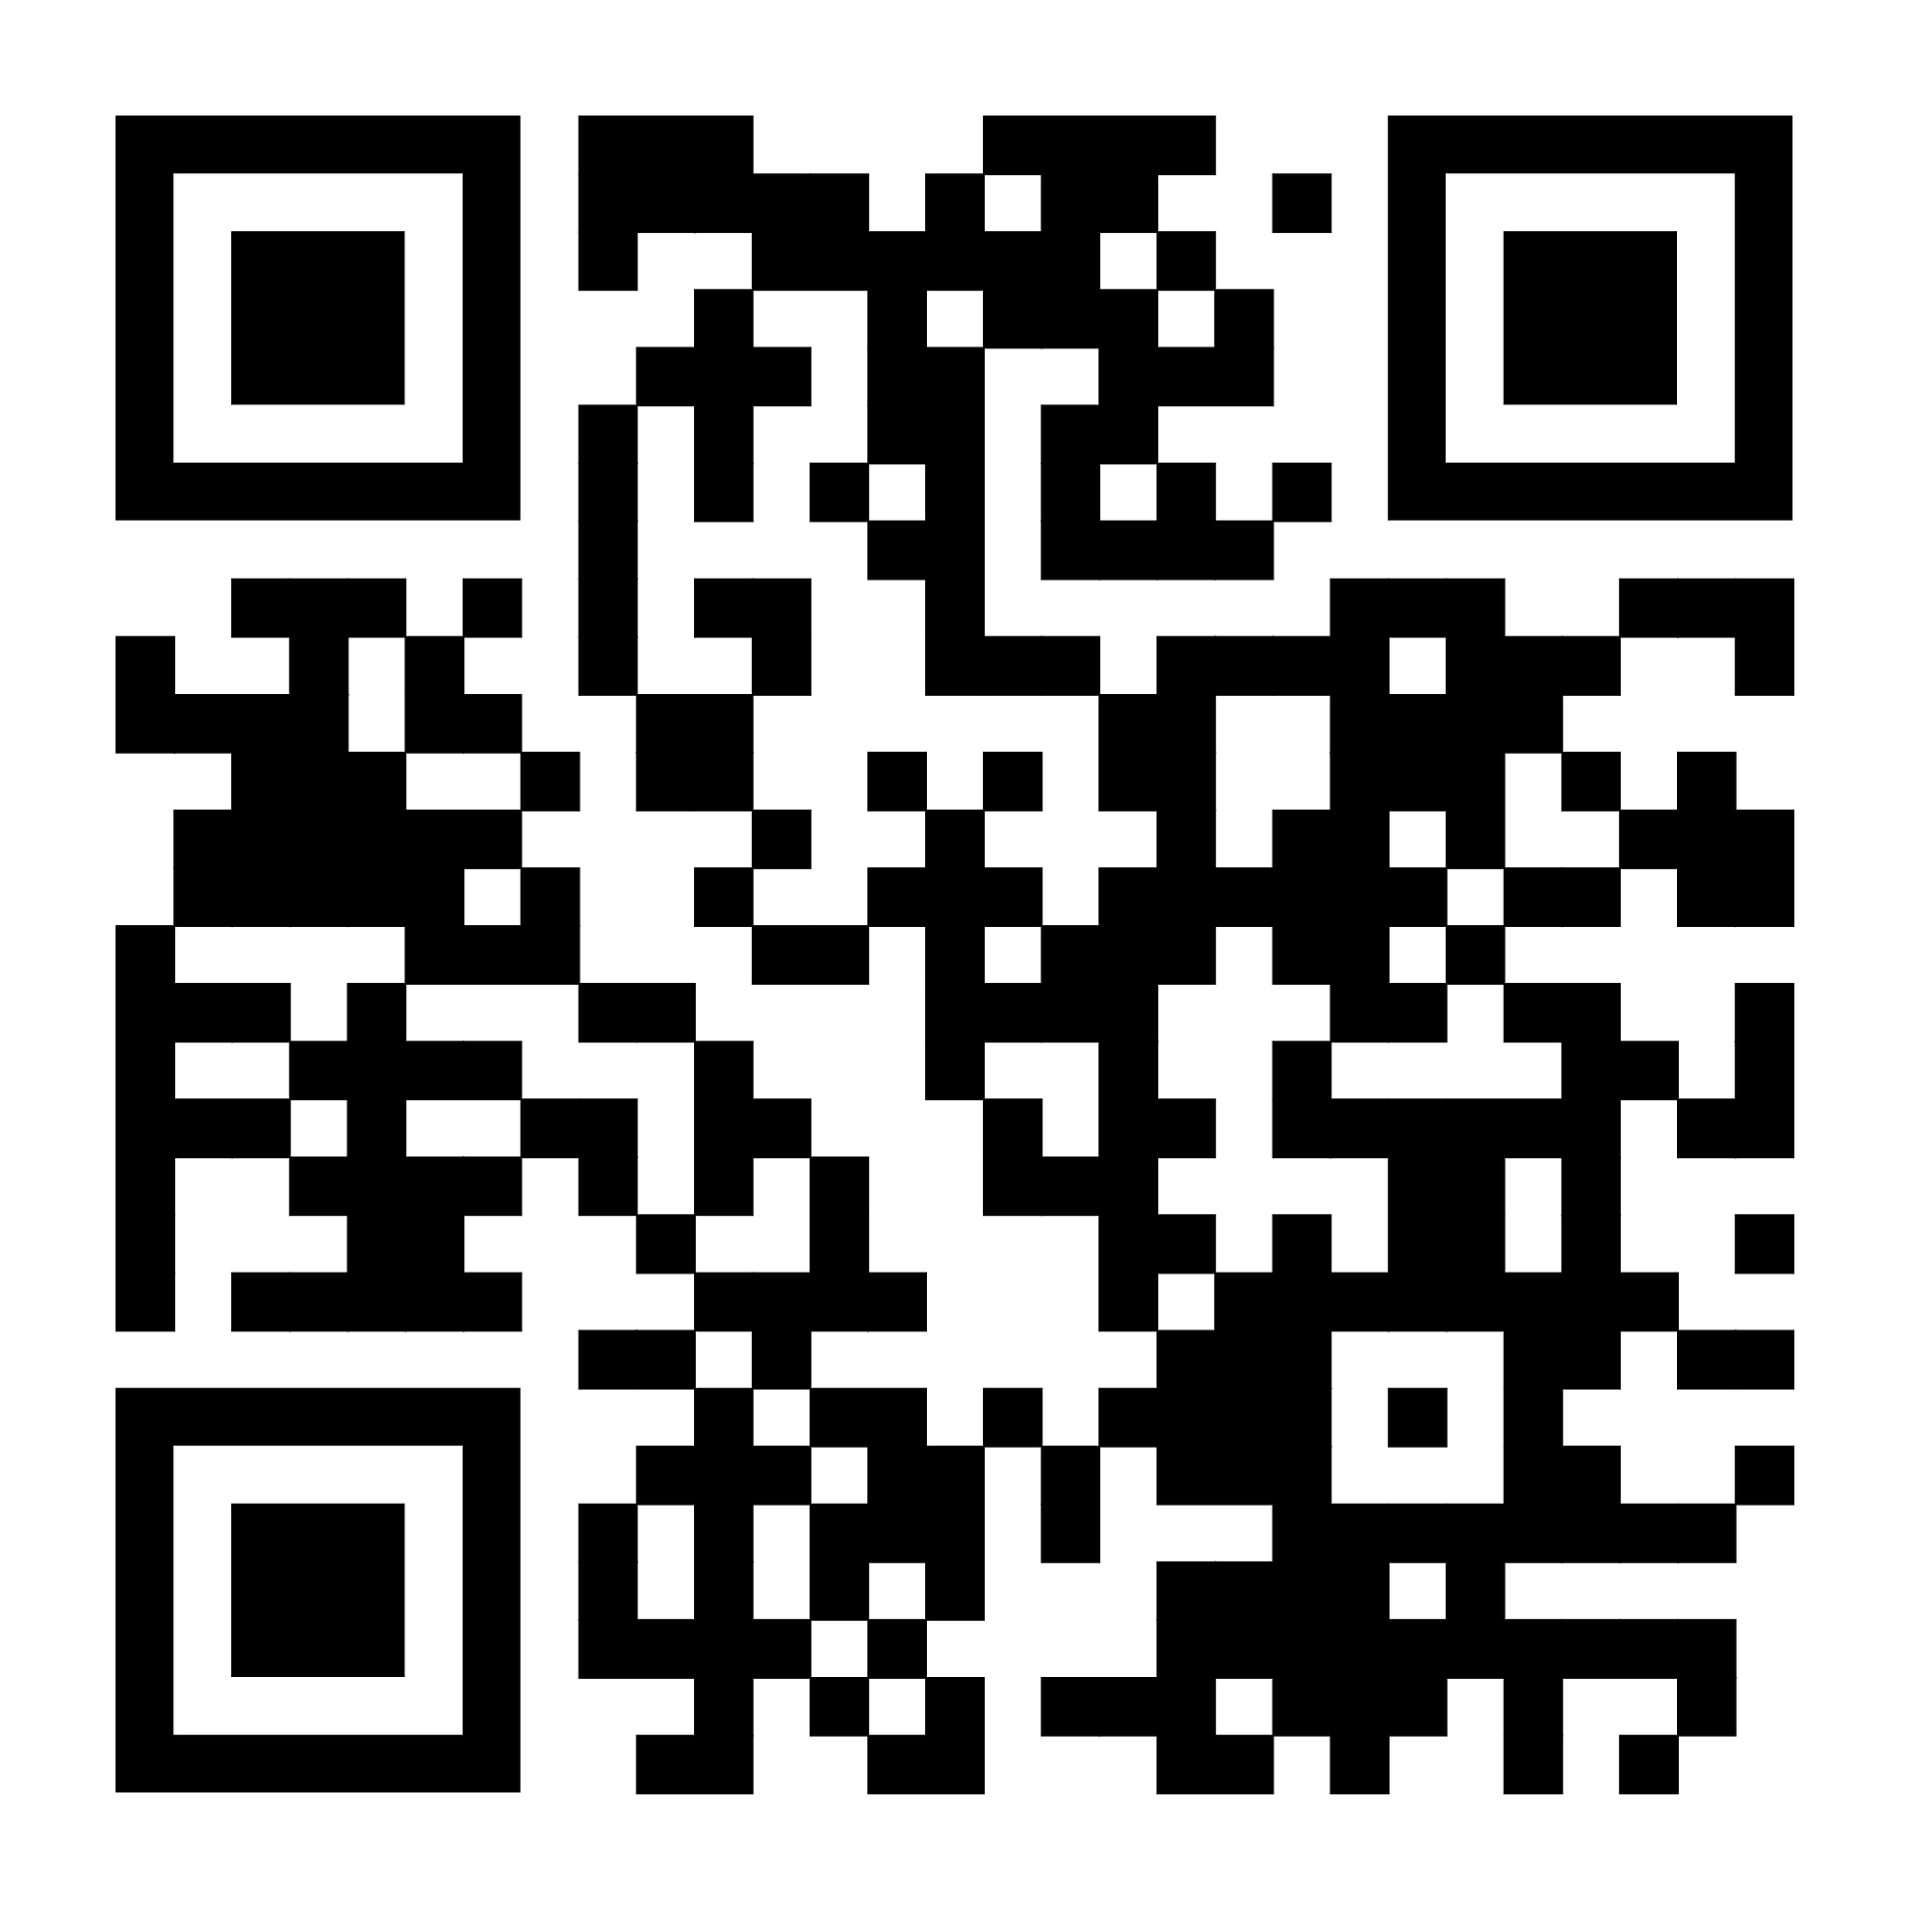
What we are looking for at the Forum
What are your reflections on the survey results?
Do you have any other questions or feedback or concerns?

Slide 10
Please use this QR code to add your voice!
Reminder:
4/8 FA - Survey Results Presentation and Forum Discussion
4/29 FA - Final Guidelines for Academic Integrity & Responsible Use of AI
Concurrent conversations with ARC, APC, ITS, and IDC

