Slide 1
GE Revision Updates
February 25, 2026

Slide 2
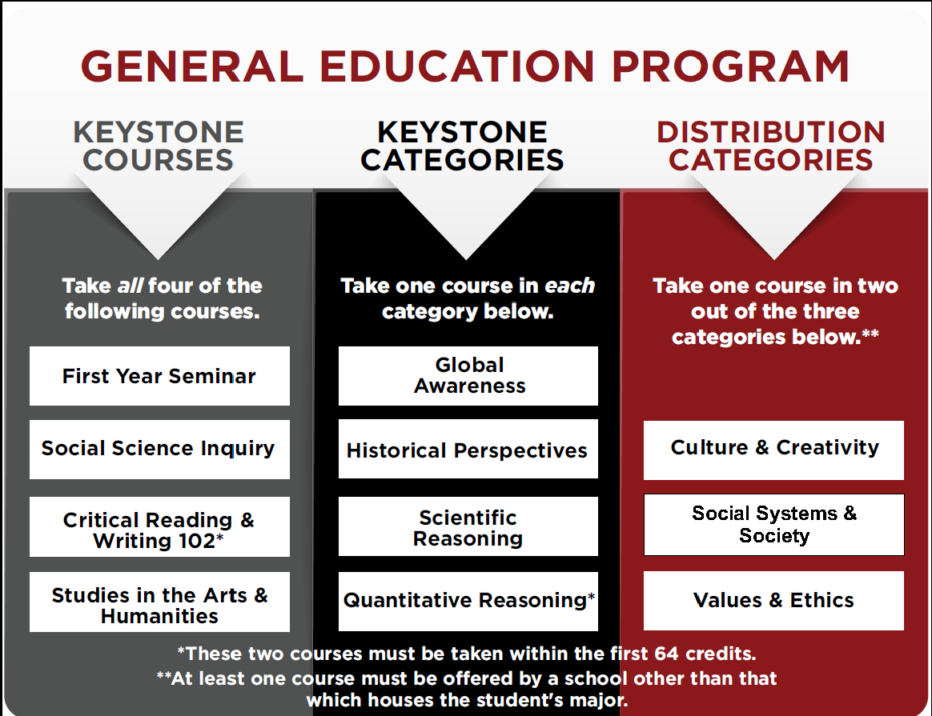
Distribution Categories Issue (2018 GE)
During the school transition, students will still have to take courses from two different distribution categories and should be advised to take one distribution category course outside of their home school. The out-of-school requirement will not be enforced in the degree audit to avoid penalizing students. This still allows for students to take a diverse array of courses and explore new areas. The new alignment of schools could create equity issues for students and there could be two different GE’s running as well.

Slide 3
GE Revision Summary
Program Revision Guiding Principles
  Reflects the RCNJ Mission and meets Middle States Commission on Higher Education’s (MSCHE) accreditation requirements.
  Aligns with and strengthens RCNJ’s liberal arts mission.
  It is viewed through the lens of students including four-year as well as transfers from county colleges and other institutions.
  Is inspirational, important and manageable to students, faculty and staff.
Timeline
  Feedback: Multiple Post-FA Sessions, December Survey is Still Open, Unit Councils, Meetings with Stakeholders (SGA, Student Success, Provost’s Office)
  Spring 2026: continue to gather feedback from students, faculty, and staff
  April 8, 2026: FA vote on GE program framework
  Summer/Fall 2026—early-Winter 2027: course approval process
    No rollover for “old” GE courses; different categories, different outcomes
  Winter 2027: GE courses loaded into catalog (Registrar)
  Fall 2027: launch of GE program for students
https://www.ramapo.edu/fa/gecco/

Slide 4
A Mission Driven GE Proposal That Meets Middle States Standards
RCNJ Mission & Vision | Middle States 14th Standards of Accreditation
Mission: Ramapo College is New Jersey’s Public Liberal Arts College, dedicated to providing students a strong foundation for a lifetime of achievement. The College is committed to academic excellence through interdisciplinary and experiential learning, and international and intercultural understanding. Ramapo College emphasizes teaching and individual attention to all students. We promote diversity, inclusiveness, sustainability, student engagement, and community involvement. Vision: Ramapo College delivers a transformative education in a diverse community dedicated to welcoming and mentoring students who bring with them a range of lived experiences. We will achieve national distinction for developing empathetic problem solvers, ethical change agents, and responsible leaders who make a positive impact and thrive in a changing world. | Standard III: Design and Delivery of the Student Learning Experience 5. at institutions that offer undergraduate education, a general education program, freestanding or integrated into academic disciplines, that: a. offers a sufficient scope to draw students into new areas of intellectual experience, expanding their cultural and global awareness and cultural sensitivity, and preparing them to make well-reasoned judgments outside as well as within their academic field; b. offers a curriculum designed so that students acquire and demonstrate essential skills including at least oral and written communication, scientific and quantitative reasoning, critical analysis and reasoning, technological competency, and information literacy. Consistent with mission, the general education program also includes the study of values, ethics, and diverse perspectives;

Slide 5
Revised GE Structure (based on feedback)
Two Stand Alone Courses
  INTD 101: First Year Seminar
  CRWT 102: Critical Reading and Writing
Six Categories of Courses
  Civic Literacy with Ethics
  Creative with Experiential*
  Inclusive with Sustainability
  Quantitative with Interdisciplinary
  Scientific with Critical Thinking**
  World with International
*was Communication; stay tuned
**New “attribute” - Critical Thinking (assessed in FYS and Scientific)

Slide 6

Writing in the GE Program: GECCo is responding to faculty, WAC and writing staff feedback. Discuss the following options among your group
Option 1
Option 2
Option 3
CRWT 102 and all Creative Category courses are Writing Intensive
CRWT 102 and reassign Writing Intensive by moving WI from Creative to another Category
CRWT 102 and “Floating” Writing Intensive requirement
The Creative would fulfill Experiential
Feedback suggests that a WI Creative course is not popular among faculty
Faculty submit a WI course to any of the six GE categories. Students get more choice?
Fill out the survey!

Slide 7
Announcements
Feedback survey is still open
Faculty Development Day
  The Gen Ed Quest: Leveling Up Student Success through Course Placement
  Wednesday, March 11, 1-2 in Padovano
  Join your colleagues from GECCo for a collaborative roundtable designed to navigate the landscape of the proposed General Education program. Instead of viewing curriculum revision as a logistical hurdle, we are approaching it as a collective quest: a mission to ensure every course positions students for maximum success.
If GE Revision Approved, future resources will include:
  Course Dog working sessions run where “super user” Course Dog experts will help faculty submit GE applications
  Syllabus and assignment working sessions with GECCo Reps

Slide 8
A Mission Driven GE Proposal That Meets Middle States Standards
RCNJ Mission & Vision | Middle States 14th Standards of Accreditation
Mission: Ramapo College is New Jersey’s Public Liberal Arts College, dedicated to providing students a strong foundation for a lifetime of achievement. The College is committed to academic excellence through interdisciplinary and experiential learning, and international and intercultural understanding. Ramapo College emphasizes teaching and individual attention to all students. We promote diversity, inclusiveness, sustainability, student engagement, and community involvement. Vision: Ramapo College delivers a transformative education in a diverse community dedicated to welcoming and mentoring students who bring with them a range of lived experiences. We will achieve national distinction for developing empathetic problem solvers, ethical change agents, and responsible leaders who make a positive impact and thrive in a changing world. | Standard III: Design and Delivery of the Student Learning Experience “5. at institutions that offer undergraduate education, a general education program, freestanding or integrated into academic disciplines, that: a. offers a sufficient scope to draw students into new areas of intellectual experience, expanding their cultural and global awareness and cultural sensitivity, and preparing them to make well-reasoned judgments outside as well as within their academic field; b. offers a curriculum designed so that students acquire and demonstrate essential skills including at least oral and written communication, scientific and quantitative reasoning, critical analysis and reasoning, technological competency, and information literacy. Consistent with mission, the general education program also includes the study of values, ethics, and diverse perspectives;

Slide 9
Two Stand Alone Courses
INTD 101: First Year Seminar (FYS)
First Year Seminar provides students with a strong foundation for success in college and achievement
Experiential: Experiential learning is a purposeful process of engaged, active learning in which the student constructs knowledge or skills, by means of direct experiences in real-world contexts.
Why Experiential Matters: Experiential learning bridges the gap between abstract theory and practical application, making learning more relevant and impactful for students.
Information Literacy: Ability to evaluate evidence, analyze arguments, and distinguish credible sources from misinformation.
Why Information Literacy Matters: Essential for navigating a world saturated with data, opinions, and disinformation.
Communication Skills Literacy: Introduction to written, oral, and digital communication tailored to diverse audiences and purposes.
Why Communication Matters: Essential for success in nearly every career and civic engagement.
Technology: Competence in using digital tools and platforms, and understanding their implications.
Why Technology Matters: Technology underpins nearly every field, and fluency enables innovation and adaptability.
CRWT 102: Critical Reading and Writing (CRWT)
Students will develop the skills required to think and write critically about a variety of texts. Students will learn techniques for performing close reading and critical analysis of texts.
Communication Skills Literacy: Introduction to written, oral, and digital communication tailored to diverse audiences and purposes.
Why Communication Matters: Essential for success in nearly every career and civic engagement.
Information Literacy: Ability to evaluate evidence, analyze arguments, and distinguish credible sources from misinformation.
Why Information Literacy Matters: Essential for navigating a world saturated with data, opinions, and disinformation.

Slide 10
Six Categories of Courses
Civic Literacy with Ethics
Students will gain knowledge necessary to understand their role in society in both historical or contemporary contexts. Must include discussions of ethics.
Civic: How students come to understand their world and act as competent participants in democracy.
Why Civic Literacy Matters: Prepares students to be active, informed, and ethical individuals.
Ethics: Reasoning about moral values and human conduct.
Why Ethics Matters: In thinking through ethics, we contemplate what we stand for, how we will treat others, and who we want to be.
Creative with ___.
Students will explore subjects in the creative arts to gain knowledge about creativity and critical thinking. Must include written communication that fulfills the WI requirements.
Creative: Integrating imaginative thinking, expression, and activities across all art forms and subject areas.
Why Creative Matters: Imagination is crucial for driving progress and innovation, as it allows for thinking beyond current knowledge.
Communication Skills Literacy: Introduction to written, oral, and digital communication tailored to diverse audiences and purposes.
Why Communication Matters: Essential for success in nearly every career and civic engagement.
*Based on feedback, attribute for Creative is not determined. Could be experiential instead of communication.
Inclusive with Sustainability
Students will examine how social identities and systems of power influence human experiences, and they will apply this understanding to promote inclusion of diverse perspectives across contexts.
Inclusive: Knowledge of social identity, social power, and diverse perspectives and ability to engage respectfully and effectively with others across differences to address inequity.
Why Inclusive Matters: Key to collaboration in a globalized world and for inclusive leadership.
Sustainability: Sustainability involves understanding how different groups relate to environments, and recognizing how benefits and harms are unevenly experienced within societies.
Why Sustainability Matters: Prepares students to address social and environmental challenges and promote long-term well-being.

Slide 11
Six Categories of Courses Continued
Quantitative with Interdisciplinary
Students will interpret and apply data. Must include real world interdisciplinary applications; using quantitative literacy to solve interdisciplinary problems.
Quantitative: Ability to interpret and analyze data, and apply quantitative reasoning in real-world contexts.
Why Quantitative Matters: Critical for decision-making in everything from personal finance to scientific interpretation.
Interdisciplinary: Interdisciplinary education is the interaction, integration, or syntheses of knowledge and learning across disciplines.
Why Interdisciplinary Matters: The modern world’s complex problems rarely fit neatly into the boundaries of a single academic discipline.
Scientific with Critical Thinking*
Students will understand the scientific method as well as scientific concepts and processes. Must include an experience that requires the student to use the scientific method to collect and analyze direct data from an experiment.
Scientific: The ability to understand, evaluate, and apply scientific knowledge to engage with science-related issues, make informed decisions in personal and societal contexts, and participate in reasoned discourse about science.
Why Scientific Matters: Basic proficiency in scientific literacy empowers people to make evidence-based decisions about their personal well-being and lifestyle, navigate misinformation, and engage with the world more effectively.
*Experiential or Critical Thinking. Critical Thinking definition is being developed.
World with International
Students will learn about a world that transcends boundaries and embraces cultural differences.
World: Engaging, understanding, and evaluating with the interconnected world from multiple cultural perspectives.
Why World Matters: Prepares students to be active and engaged in a global society by learning through different lenses.
International: International understanding involves a comprehensive approach to learning that intentionally prepares students to be active and engaged participants in a world that transcends boundaries and embraces cultural differences.
Why International Matters: Studying issues from multiple cultural, social, and geographical perspectives challenges students' assumptions and personal biases, leading to more sophisticated critical thinking skills.

