Slide 1
Digital Accessibility Compliance
Spring 2026 Faculty Assembly Briefing
Date: February 25, 2026
Presenters: Michael Bitz & Kat McGee

Slide 2
RCNJ Digital Accessibility Working Group
Patrick Aquino, Assistant Director of Marketing & Web Administration
Michael Bitz, Director of Instructional Design Center
Benny Chan, Dean of TAS
Patricia Chavez, CAE and Director of Internal Audit
Robert Doster, Chief Information Officer, AVP of ITS
Mark Gregorio, Director of Marketing and Branding
Kat McGee, Director of Title IX and Institutional Compliance
Nicole Morgan Agard, Chief Equity & Diversity Officer, VP for EDIC
David Nast, Director of Office of Specialized Services

Slide 3
Why Digital Accessibility Matters
Digital accessibility ensures that individuals with a disability can understand, navigate, and interact with all digital content.
Enhances access for all learners.
Digital access is part of our shared commitment to equity and student success.
Compliance with federal ADA law.

Slide 4
What’s Changing in April 2026
New federal ADA Title II digital accessibility requirements take effect on April 24, 2026.
Applies to Canvas content, PDFs, Word docs, PowerPoints, videos, and web-based materials.
This is a College-wide responsibility; faculty play a critical role because you create and share course content.
While April 24 is a target date, not everything needs to be reformatted by then. Focus on Summer and Fall and take things in small chunks.

Slide 5
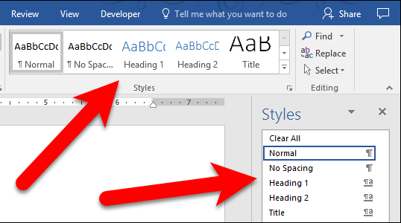
What “Accessible” Actually Means: Headings
Example 1:
Accessible documents are structured with headings so assistive technology (like screen readers) can read them correctly.

Slide 6
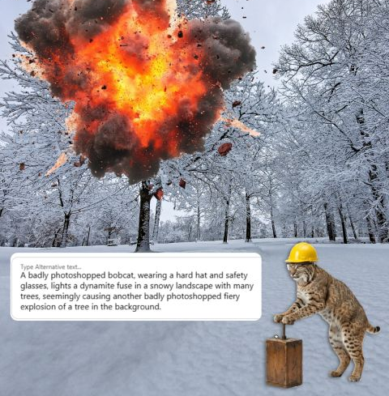
What “Accessible” Actually Means: Alt Text
Example 2:
Images need brief alternative text so all users can get the same information.

Slide 7
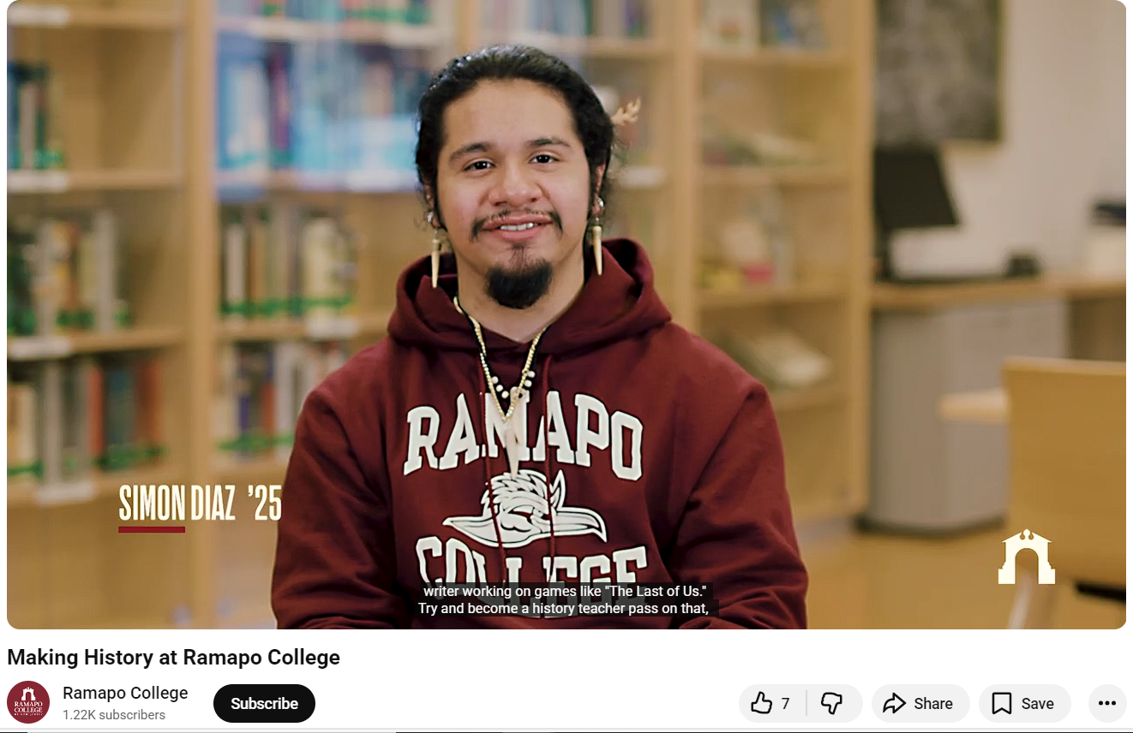
What “Accessible” Actually Means: Captions

Slide 8
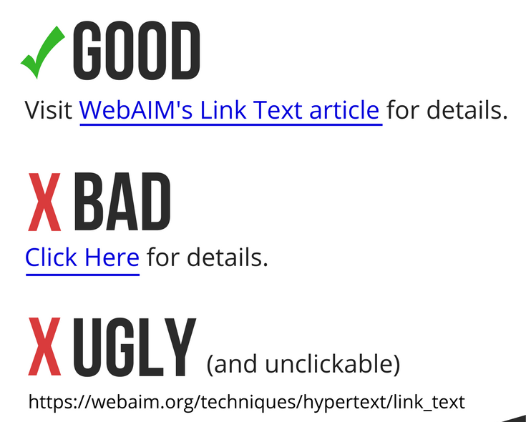
What “Accessible” Actually Means: Descriptive Links
Example 4:
Hyperlinks that are good for both usability and accessibility use descriptive text and retain the standard underline style.

Slide 9
Faculty Role & Expectations
Build accessibility into new materials and to prioritize high-use content first for revision. You don’t need to reformat everything overnight.
If you have not already done so, make it a consistent practice to use accessibility tools and built-in checkers (Canvas, Word, Powerpoint, etc.).
Accessibility is not about perfection. It's about a sustained, good-faith effort.

Slide 10
Support, Training, and Resources
ARC ADA Accessible Syllabus Template
Recorded workshop [link day of] from the IDC from 2/25/25
2nd IDC Workshop: Thursday, March 5 @ 11 AM
Digital Accessibility Guide for Course Materials from the IDC
Digital Accessibility Open Office Hours, IDC Lab (LC201) and via Meet, Tues, Wed, Thurs: 12-2 PM, March 3-April 27 (except Spring Break)

Slide 11
Support, Training, and Resources
Webpages: AudioEye
Canvas: New Accessibility Checker (course-level accessibility check) expected to go live this Spring
Word, Powerpoint, PDF, Google Docs and Slides have built-in accessibility checkers
In discussion with the Provost’s Office about securing a document remediation platform for quickly checking Word, PPT, PDF, etc.
Where to get help: ITS, IDC, OSS
What’s coming next: RCNJ Digital Accessibility Policy

Slide 12
Next Steps:
Website Audit: please remove old or unnecessary digital content ASAP.
Digital Content Remediation: pick with one course and one document type (Word, PowerPoint, PDF) and build from there.
Visit the RCNJ Digital Accessibility Website

Slide 13

Conclusion
Accessibility is the law, and it’s part of effective teaching.
When our materials work for everyone, students spend less time overcoming barriers and more time engaged in learning.

