Slide 1
GE Revision Process: Update
January 21, 2026

Slide 2
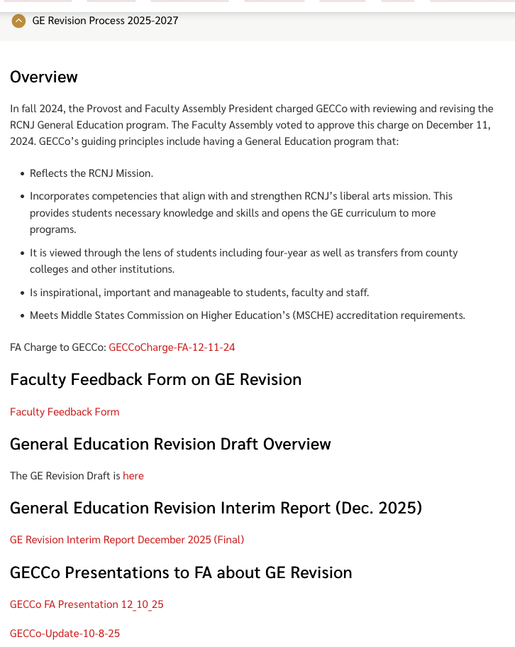
Updated GECCo Website
https://www.ramapo.edu/fa/gecco/

Slide 3
Gathering Feedback
Feedback Form available via GECCo website:
GE Revision Process 2025-2027 tab
https://www.ramapo.edu/fa/gecco/
GE Discussion at UC meetings:
ASB - 1/28
CA - 1/28
HGS - 2/18
Library - 1/28
SSHS - 2/18
TAS - 1/28
Faculty Forum: February 25
Faculty Development Week: March 11
GECCo Office Hours: TBA

