Slide 1
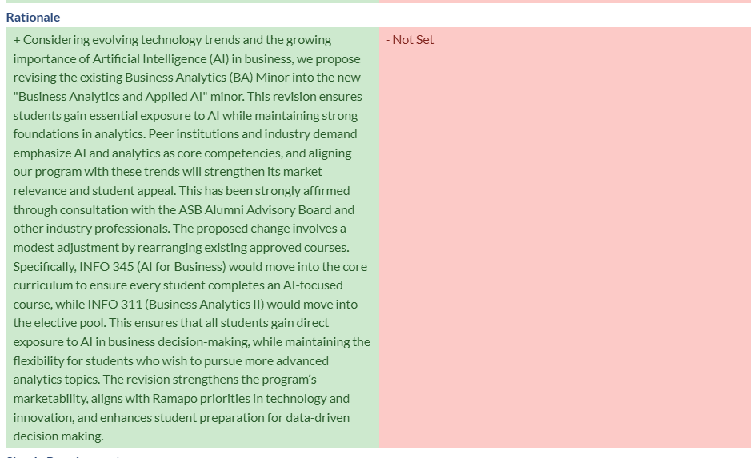
Program Name & Course Description Change for BA Minor: FROM “Business Analytics”
TO “Business Analytics and Applied AI”

