Slide 1

CourseDog @ Ramapo Keeping the Roadrunner Curriculum on Track

Slide 2
What is CourseDog?
CourseDog is RCNJ’s online platform for:
Catalog
Curriculum (forms and system)

Slide 3
Why did we move to CourseDog?
Modern design and improved user-experience for Catalog
Catalog-Curriculum automation and integration
  Elimination of emailed PDF forms
  Elimination of manual updates of the catalog
  Transparency
  Automation
  Easier Archival Process
Notes:
Transparency, accuracy and automation with curricular review process that pushes to the Catalog.
Accessible and ADA compliant
Modern design, easy navigation and searches that encapsulate all relevant student information
Design and flexibility speaks to internal/external audiences

Slide 4
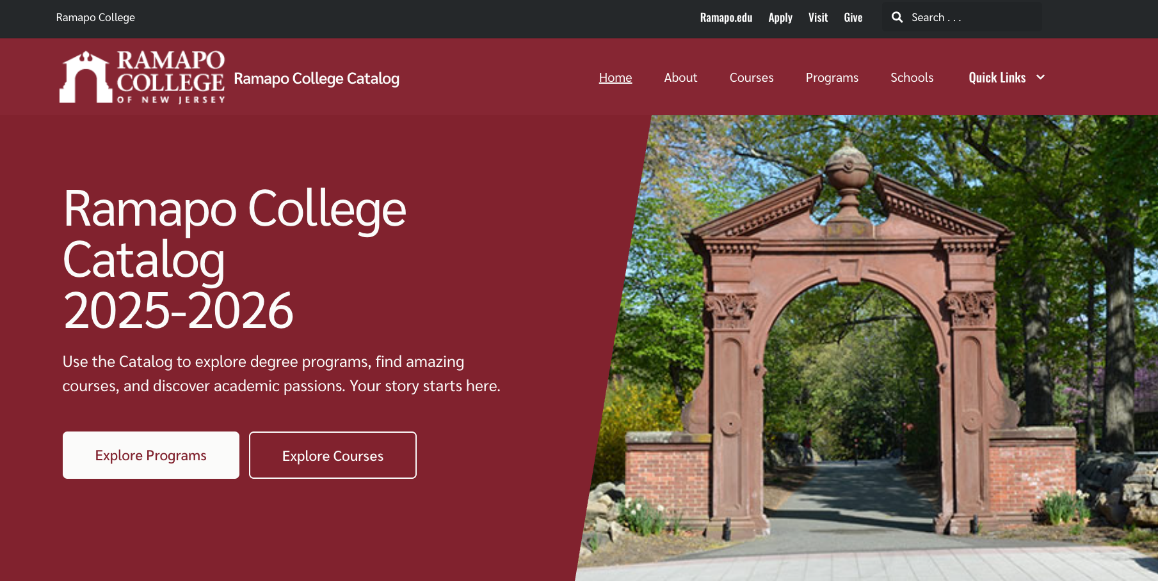
CourseDog Catalog
Landing Page

Slide 5
How did we transition to the CourseDog Catalog?
Reviewed design elements and key content of Ramapo Catalog
Considered best practices from other CourseDog schools
2024-25 degree requirements were imported or manually built and validated against previous catalog
  24-25 changes submitted prior to February were included
July soft-launch
Cataloghelp@ramapo.edu email open to receive feedback
Adjustments to programs and faculty are on-going

Slide 6
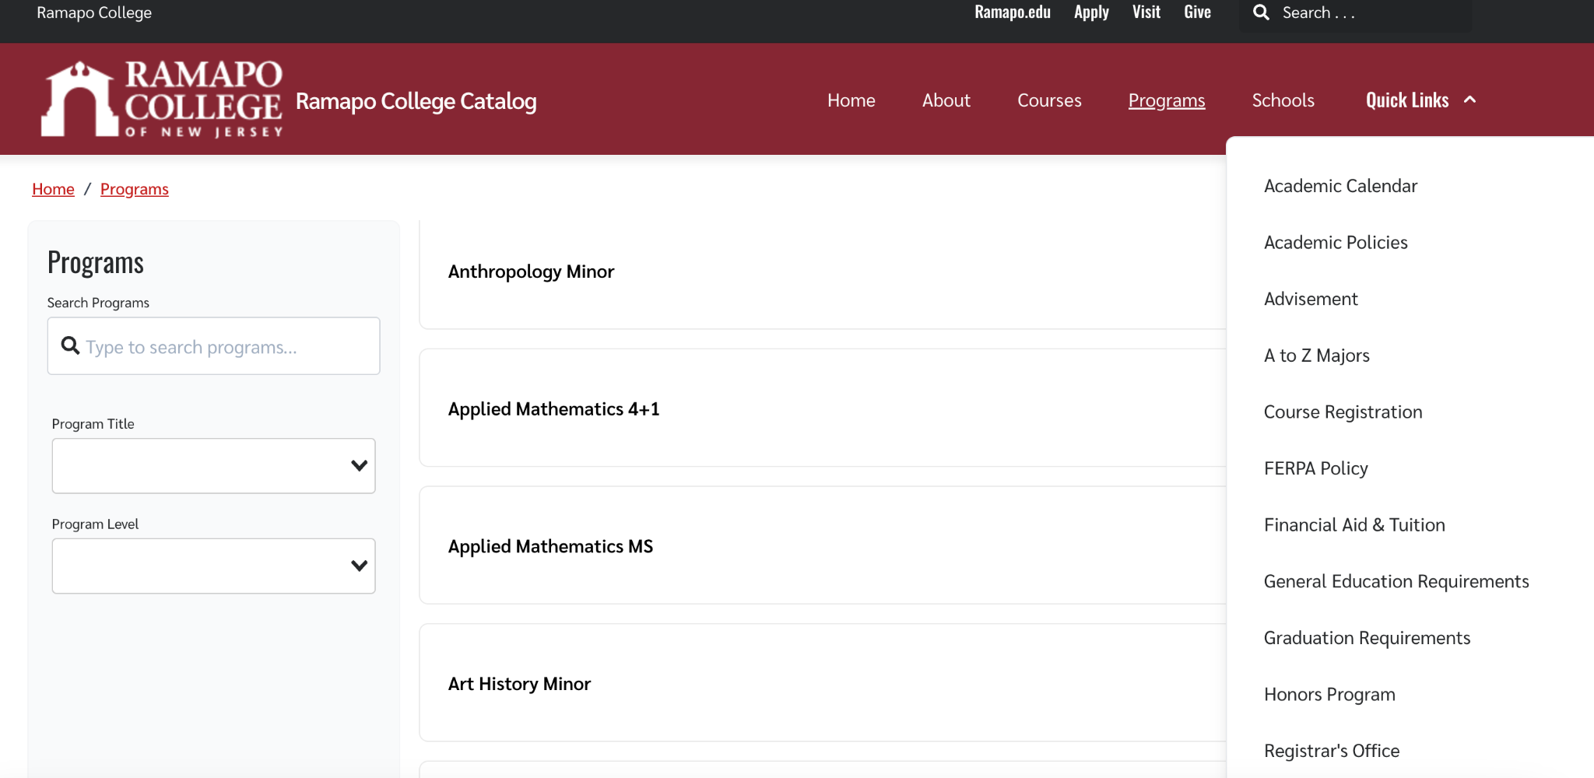
Key features of the 2025-26 Catalog
Static URL https://catalog.ramapo.edu/
Enhanced search by program or course
Quick links
Academic policies now integrated

Slide 7
What’s next for CourseDog Catalog?
Mid-year update will be published in December
Conversations with Convening groups and Deans about curricular clean up
Planned enhancements
  Graduation Plans
  Pre-requisites
Integrate community feedback for 2026-27 Catalog

Slide 8
How did we prepare for the transition to CourseDog for Curriculum?
Reviewed design elements and key content of Ramapo curriculum forms
Forms and workflows were built and tested in Spring 2024
Testing and updates with faculty and Deans
Curriculum, users and roles are loaded in the system

Slide 9
What’s next for Curriculum?
Training & Support
Faculty Training Sessions
  Tues 9/9 @ 3:30 - 5pm (In Person) - IDC Lab LC 201
  Fri 9/12 @ 10:30 - 12:00pm (Webex)
  Weds 9/17 @ 1-2:30pm (In Person) - IDC LC 201
Drop-in Hours for proposal support
Proposal Submissions
  Complete a curriculum cycle in CourseDog
Feedback
  Collect feedback from user groups
  Update the forms and workflows to improve the process for ‘26-27

Slide 10
Connect with us
Cataloghelp@ramapo.edu
Faculty Training Sessions
  Tues 9/9 @ 3:30 - 5pm (In Person) - IDC Lab LC 201
  Fri 9/12 @ 10:30 - 12:00pm (Webex)
  Weds 9/17 @ 1-2:30pm (In Person) - IDC LC 201

