Slide 1
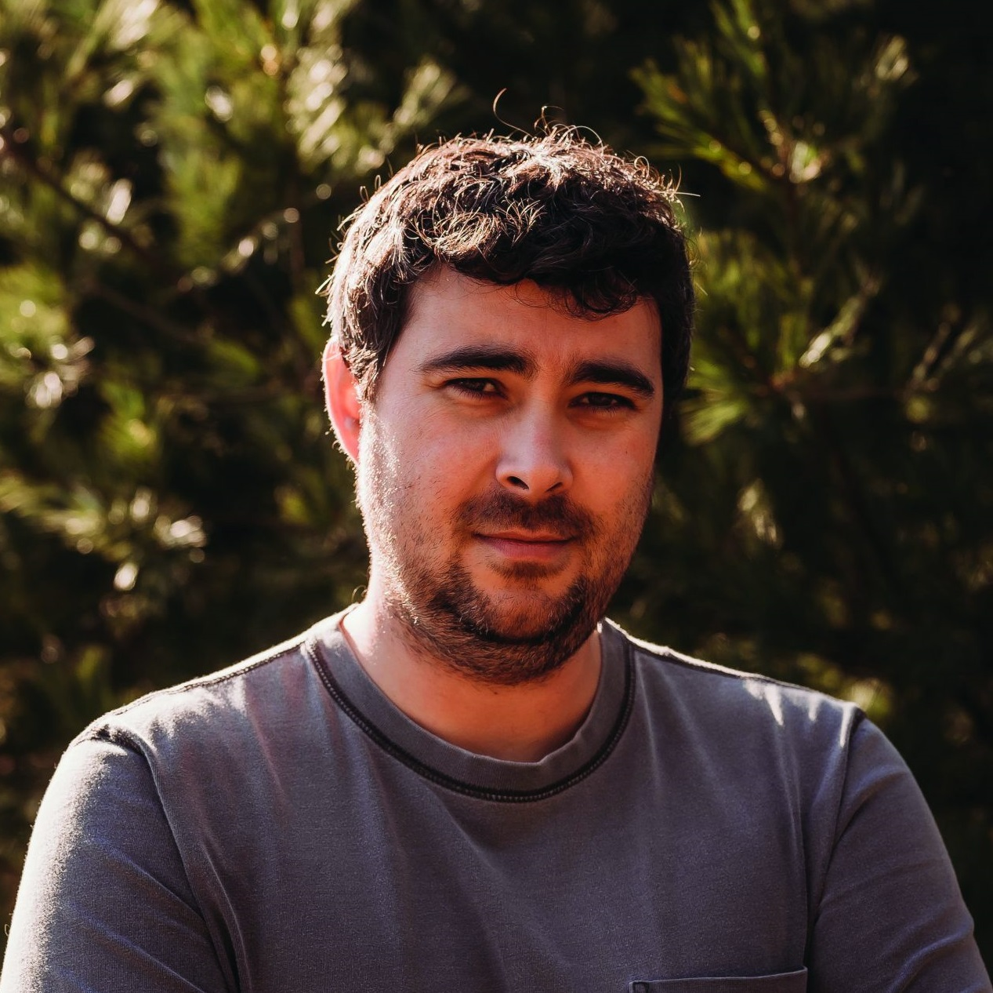
Summer Reading 2025
Author Morgan Talty, a citizen of the Penobscot Indian Nation, is a National Book Foundation 5 under 35 Honoree. Fire Exit is a finalist for the 2024 Joyce Carol Oates Prize.
Please join us for Opening Convocation
Tuesday August 26 @1:30pm Bradley Center
All are welcome!

