Slide 1
GE Town Hall
April 2, 2025

Slide 2

Prompt: “ramapo college general education town hall event”
“A visually appealing illustration of a Ramapo College general education town hall event, depicting a diverse group of students and faculty engaged in lively discussion, with a bright and airy atmosphere in a spacious hall, rendered in a photorealistic style with warm lighting and natural color tones.”

Slide 3
Faculty GE Survey Summary: Preliminary Findings
Survey distributed by email and promoted in Unit Councils
48 responses as of April 1
  24% of 198 Faculty based on Fall 2023
Q1: Do you think [the] description accurately reflects the current GE program at RCNJ? Why or why not?
  41 Responses (85% of the sample)
    Yes: 11
    Mixed: 11
    No: 19
Q2: What are the strengths of the current GE program?
  40 Responses (83% of the sample)
Q3: What are the strengths of the current GE program?
  48 Responses (100% of the sample)

Slide 4
Faculty GE Survey: Key Takeaways
Widespread support for GE changes
Respondents see the GE program as too big in terms of required number of credits and course offerings, too complicated, lacking coherent vision while still missing particular elements (e.g., civic engagement, sustainability, financial literacy…)
Respondents like variety of courses / interdisciplinary nature, coverage of different disciplines
Respondents perceive students have difficulty understanding and navigating the GE program, and some question whether its useful for student.
Respondents noted need for more GE program oversight, assessment data sharing and management

Slide 5
(Some) Comments about GE program from SGA
Broadening GE course offerings:
  ASL
  Financial literacy
  Home economics/general life skills
Testing out of GE courses
Students expressed concerns about transferring GE credits into RCNJ

Slide 6
Next Steps
Gathering information from stakeholders through meetings
  Office of Student Success, Registrar, Transfer office
  CAP, Academic Structures, etc…
Additional survey
  Adjunct faculty & Staff
GECCo summer retreat & planning
Making survey responses and findings public

Slide 7
Discussion Question
Given the feedback we received, and your own perception of the Gen Ed, what elements would you like to keep, and which elements would you like to change?

Slide 8
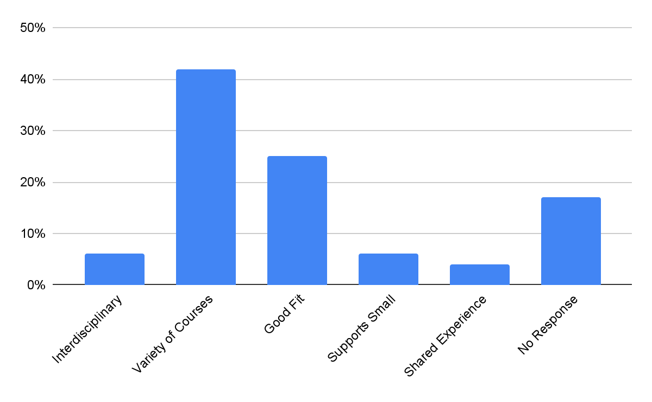
Q2: Strengths

Slide 9
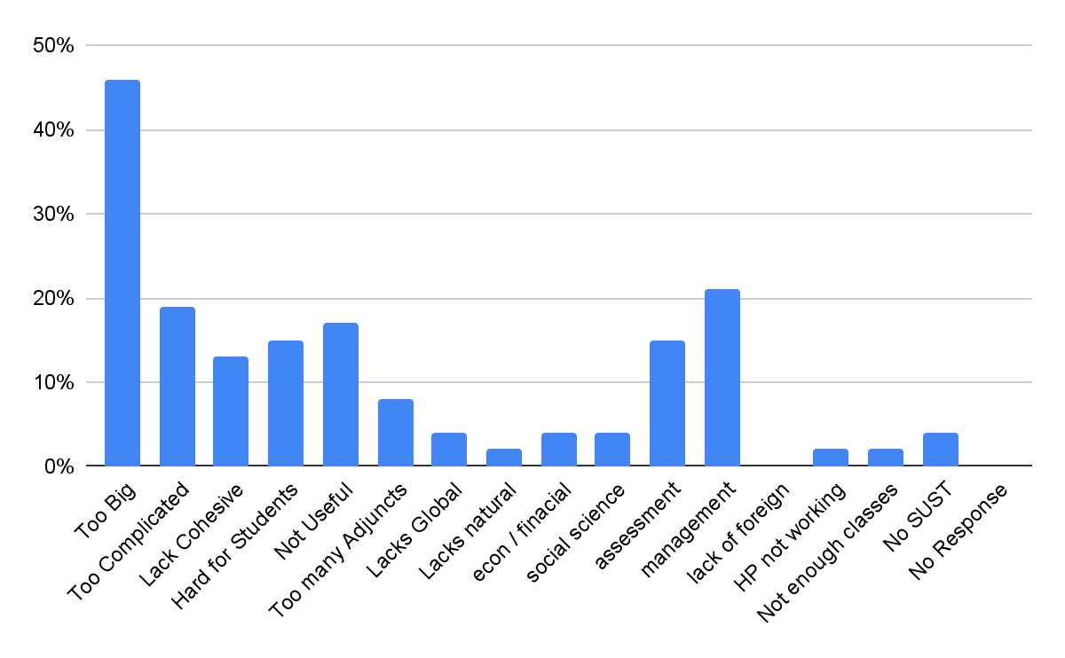
Q3: Weaknesses

