Slide 1
DegreeWorks and CourseDog
Student focused and faculty friendly!

Slide 2
Why are we moving from UAchieve to DegreeWorks?
Improved functionality for building degree audits
More modern design with improved accuracy
More robust search features to support advising needs
Clearer progress indicators for students and advisors

Slide 3
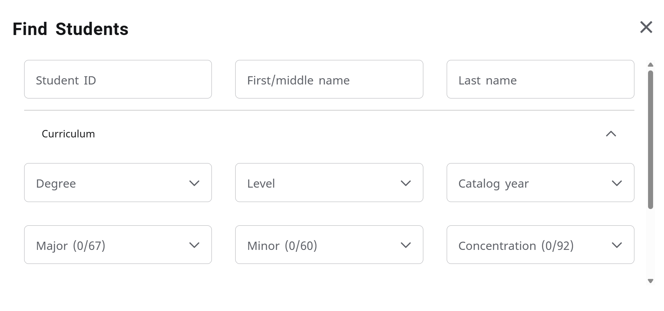
DegreeWorks - Advanced Search
Multiple search filters to help you narrow to a specific population.

Slide 4
DegreeWorks - Key information header
Key information/dates will be posted right here on the student audit.

Slide 5
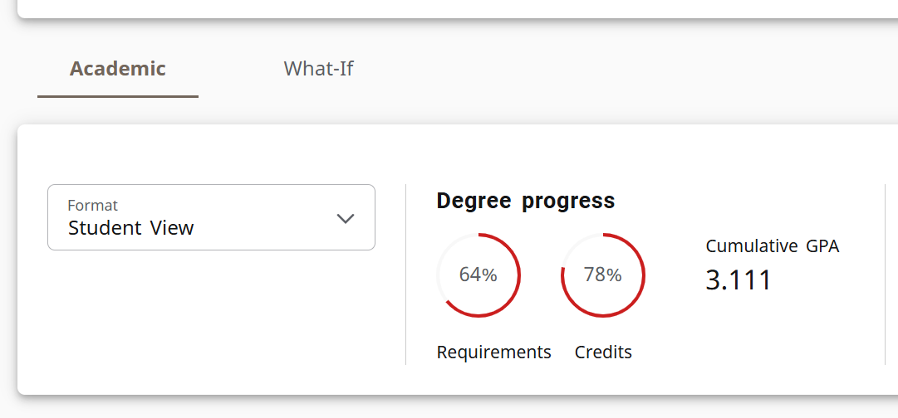
DegreeWorks - Student Progress Indicators

Slide 6
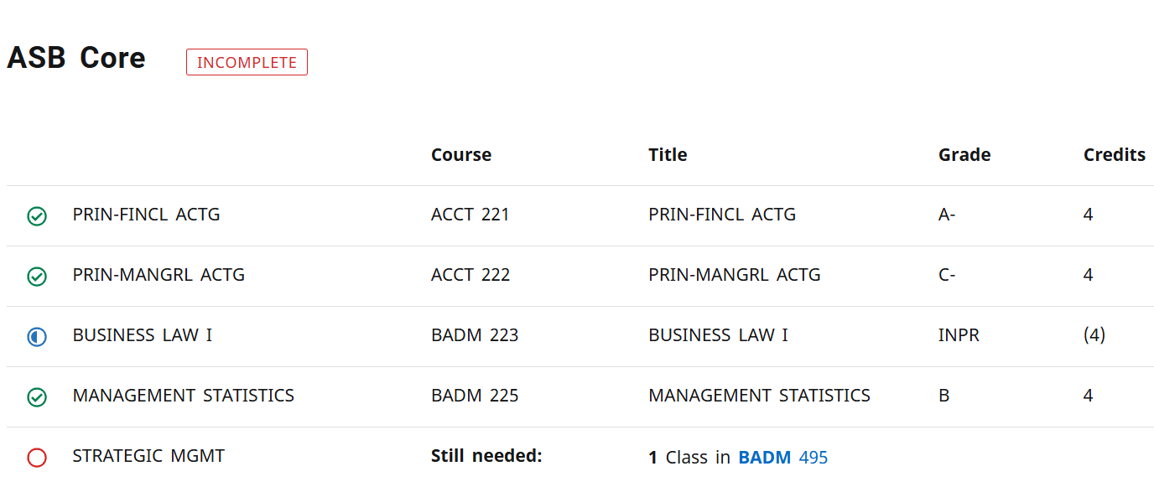
DegreeWorks - Student Progress Indicators

Slide 7
DegreeWorks Training and Implementation
Faculty
March-April 2025: Presented to Deans/Faculty
May-June 2025: Graduate Program Directors and Dean Training
Fall 2025: Faculty training at Unit Councils
Fall-Winter 2025: Individual support
Students
Incoming First Year students for 2025-2026

Slide 8
Why are we moving from website-based Catalog to CourseDog?
Current catalog is series of webpages that are manually updated and not ADA compliant.
Curriculum process is email, pdfs and spreadsheets
CourseDog will serve as our College Catalog and Curriculum tool
Transparency, accuracy and automation with curricular review process that pushes to the Catalog.
Accessible and ADA compliant
Modern design, easy navigation and searches that encapsulate all relevant student information
Design and flexibility speaks to internal/external audiences

Slide 9
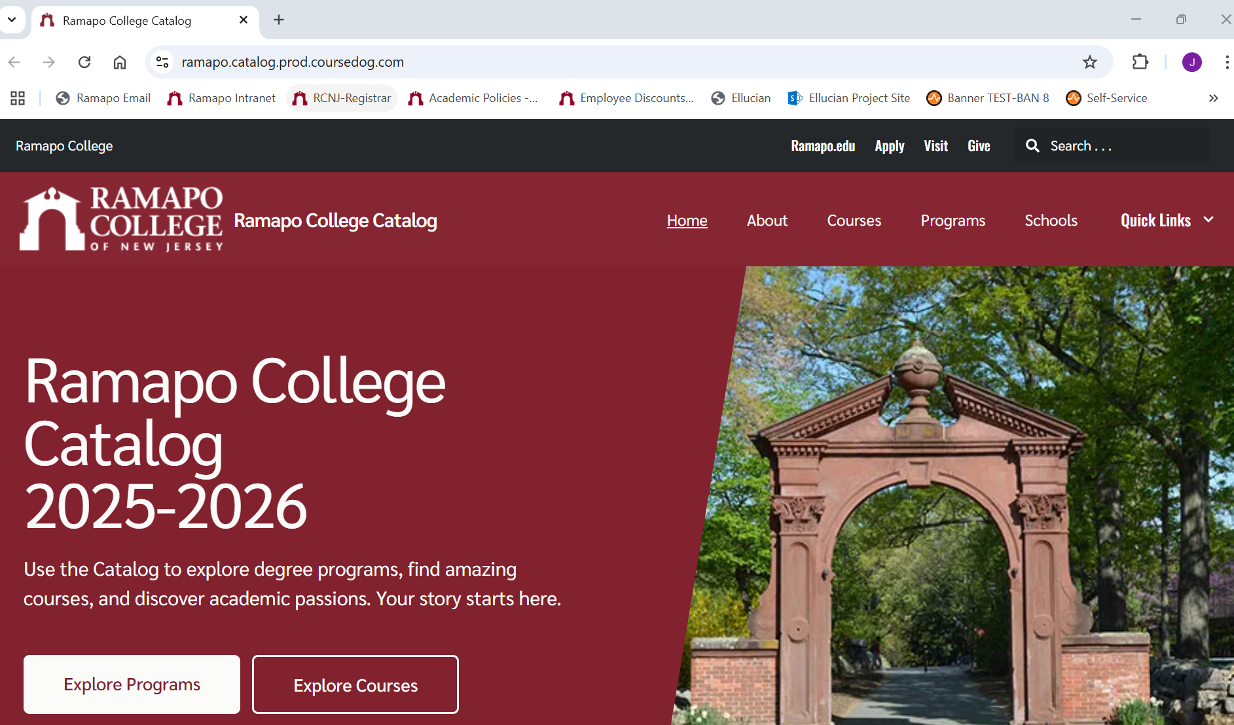
CourseDog Landing Page

Slide 10
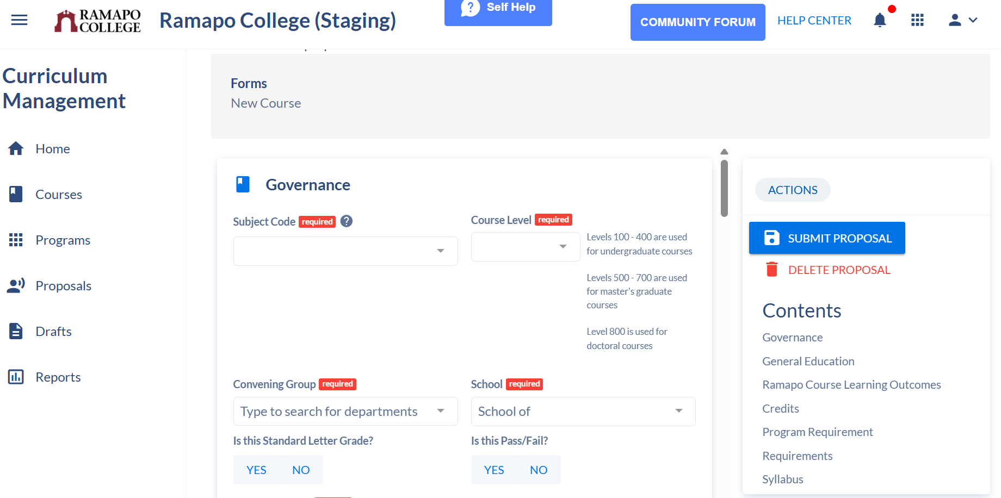
CourseDog Digital Curriculum Form

Slide 11
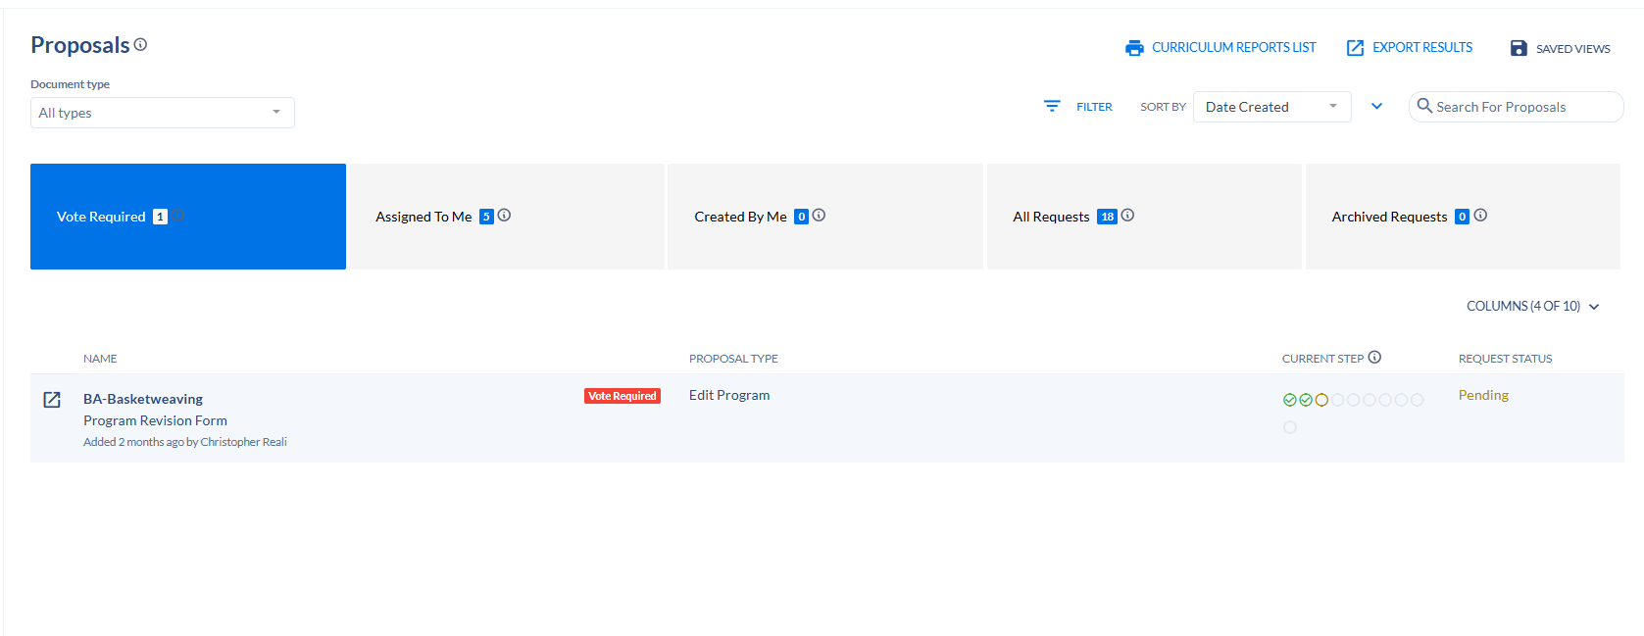
CourseDog Proposal Dashboard

Slide 12
CourseDog Training and Implementation
May – June 2025: AY 2025-2026 College Catalog will go live on the new platform
Fall 2025: Faculty Training for Curriculum
Late-Fall 2025: Use of CourseDog Curriculum Modules

Slide 13
MORE TO COME…

