Slide 1
Teaching Writing Across the Curriculum
All effective writing is indivisible from other essential skills: people who write well can also think logically, read critically, and communicate meaningfully in a range of contexts. This “Teaching Writing Across the Curriculum” resource page includes many brief handouts as well as links to relevant, professional storehouses; here, faculty can find support for their work as teachers of writing. Explore assignments, research, and lesson plan ideas developed by scholars in a range of fields. You’ll also find accessible resources for students in your courses to better support their development as writers:
https://ramapo.instructure.com/enroll/A7D3FK

Slide 2
Homepage

Slide 3
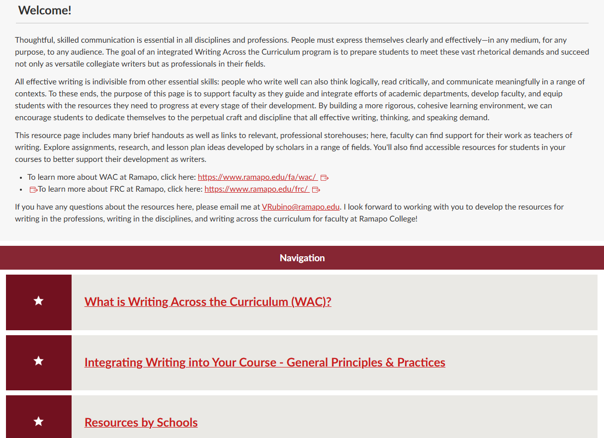

Slide 4
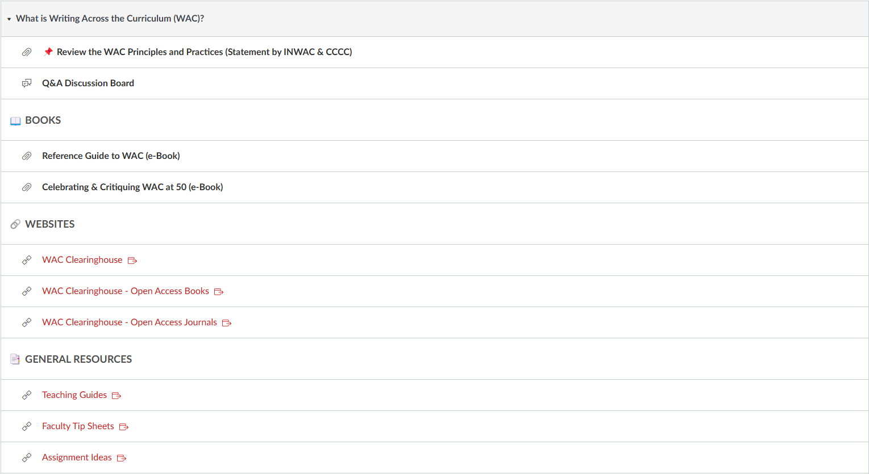
Module 1
Integrated discussion boards – ask questions!

Slide 5
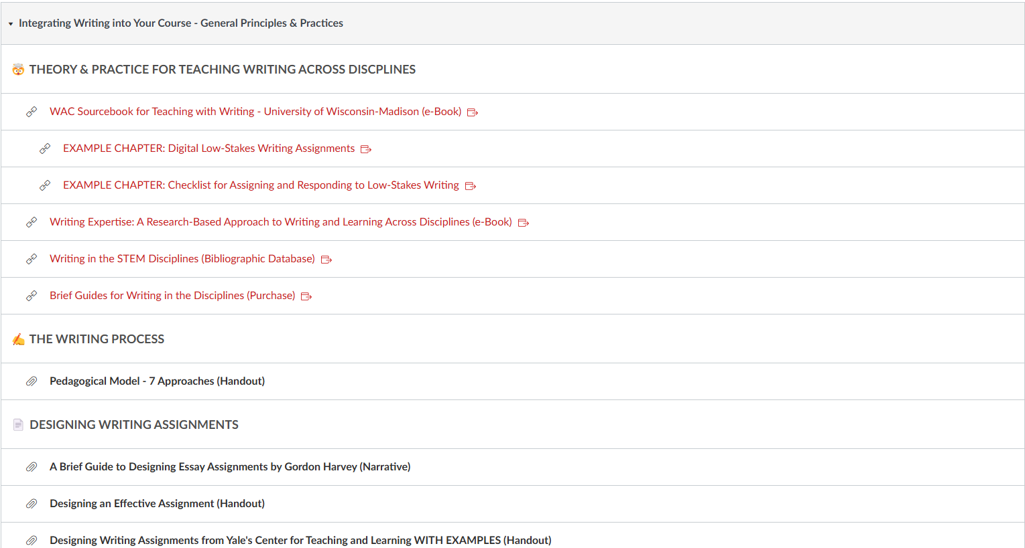
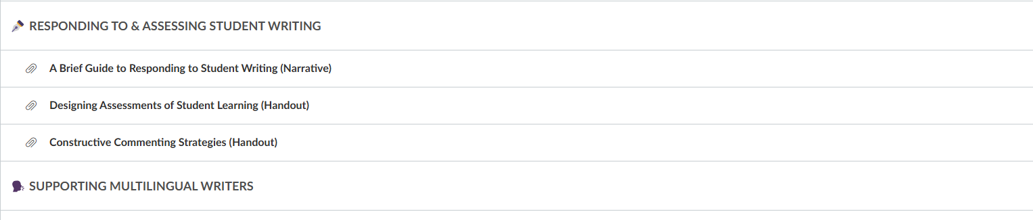
Module 2
Combination of PDF, web link, and handout, and narrative resources

Slide 6
Overview of other headings in Module 2
Module 3
Get involved!

